Slide 1
Numerically modelling matter-wave solitons in Bose-Einstein condensates
Lois Flower

Slide 2
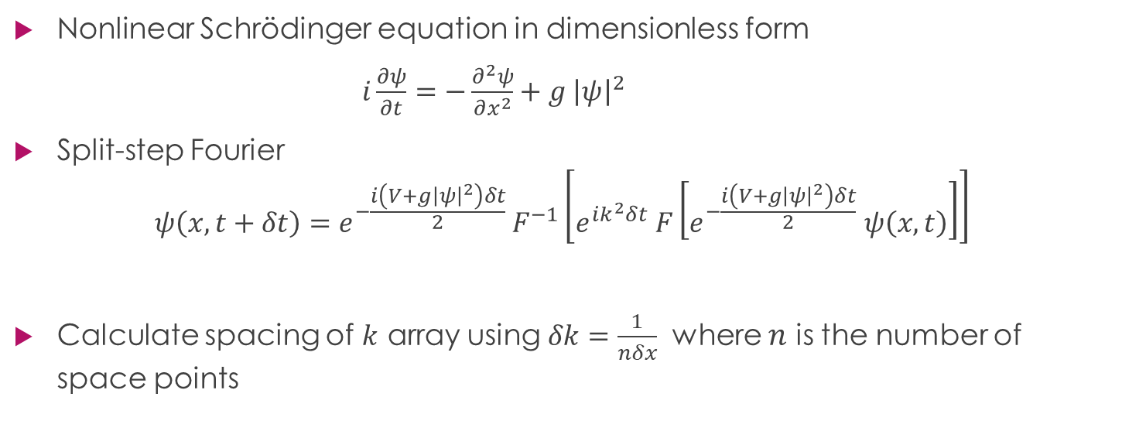
Method
Nonlinear Schrödinger equation in dimensionless form
$i\frac{∂ψ}{∂t}=−\frac{∂^{2}ψ}{∂x^{2}}+g {\left|ψ\right|}^{2}$
Split-step Fourier
$$ψ\left(x, t+δt\right)=e^{−\frac{i\left(V+g{\left|ψ\right|}^{2}\right)δt}{2} }F^{−1}\left[e^{ik^{2}δt} F\left[e^{−\frac{i\left(V+g{\left|ψ\right|}^{2}\right)δt}{2}} ψ\left(x,t\right)\right]\right]$$
Calculate spacing of $k$ array using $δk=\frac{1}{nδx}$ where $n$ is the number of space points

Slide 3
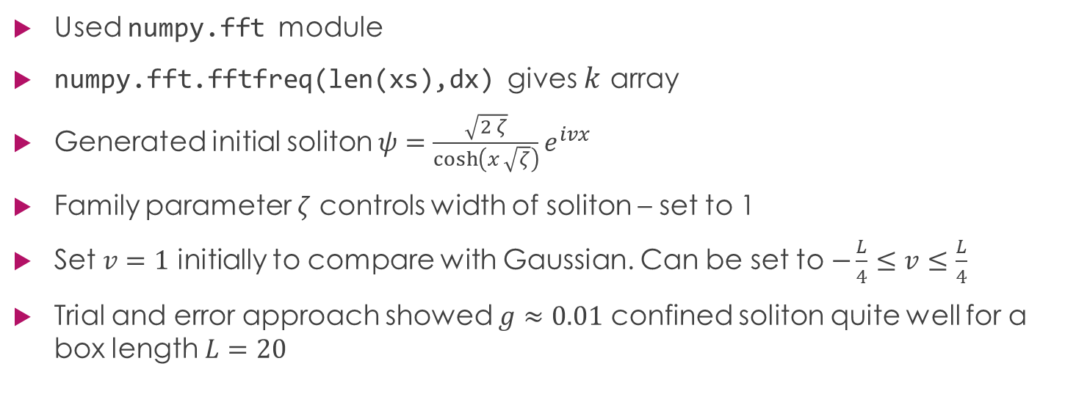
Programming
Used numpy.fft module
numpy.fft.fftfreq(len(xs),dx) gives $k$ array
Generated initial soliton $ψ=\frac{\sqrt{2 ζ}}{\cosh\left(x \sqrt{ζ}\right)}e^{ivx}$
Family parameter $ζ$ controls width of soliton – set to 1
Set $v=1$ initially to compare with Gaussian. Can be set to $−\frac{L}{4}≤v≤\frac{L}{4}$
Trial and error approach showed $g≈0.01$ confined soliton quite well for a box length $L=20$

Slide 4

Finding a value for g
Trial and error produced a value of $g=−0.025$
This is equal to $−\frac{1}{2L}$ when $L=20$is the box length

Slide 5
