Slide 1
There’s No Place Like Home: Matching People to Places Using Survey and Administrative Records
Danielle H. Sandler
Joint work with Linden McBride and Allen Ross
(Part of a larger Administrative Records Census Project led by David Brown)
August 9, 2022
2022 Joint Statistical Meetings
Any opinions and conclusions expressed herein are those of the authors and do not represent the views of the U.S. Census Bureau. All results have been reviewed to ensure that no confidential information is disclosed CBDRB-FY2022-CES019-010.

Slide 2
Administrative Records Census
Goal: To create a count of the 2020 U.S. population from administrative records in parallel to the actual enumeration in order to compare accuracy and speed
This presentation focuses on one piece of the process to build that Adrec Census – the Person-Place model

Slide 3
Person-Place Model
Although many people have only one administrative record address, for those that have more than one, we need a way to assign them to a location
Basic outline of the model:
Use survey address as “truth” address.
Match administrative record addresses for individual to the survey address.
Use characteristics of the administrative address data sources to predict whether a given address matches the survey address
Use these predictions to assign probability of an address being the “true” address in data where we don’t (yet) have the survey address

Slide 4
Census Identifiers: PIK & MAFID
Protected Identity Key (PIK)
Probabilistically assigned person identifier from the Person Verification System
Enhanced PIK (EPIK)
Master Address File ID (MAFID)
Persistent identifier for every address in U.S.

Slide 5
Training Data
2018 American Community Survey
50% Training set (stratified by single address individuals and multiple address individuals)
25% Validation set
Tune hyperparameters
25% Holdout set
Administrative records:
IRS 1040, 1099, 1099R
Housing (HUD/FHA)
USPS National Change of Address
Immigration (CBP/USCIS/IMARS)
Health (IHS/Medicare/MBR)
Bureau of Prisons
Selective Service (SSS)
Commercial (VSGI)
State SNAP/WIC/TANF

Slide 6
Features
Source Indicators and interactions
Dates
Difference between ACS interview date and Adrec source date
Max and min date for address from all records
IRS 1040 Income Variables
Demographics: Age, Race, Hispanic Origin, Sex
Count of total MAFIDs associated with each PIK from Adrecs

Slide 7
Models
Goal: to evaluate a set of models with a variety of decision boundaries and regularization options
Logit regression
Elastic net
Random forest
Boosted tree

Slide 8
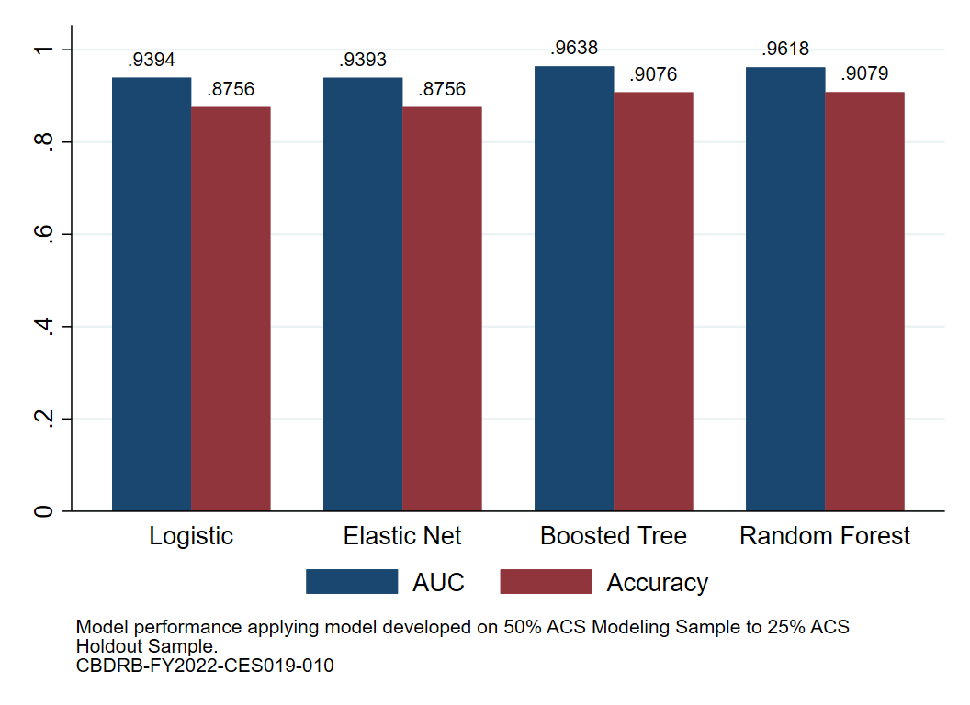
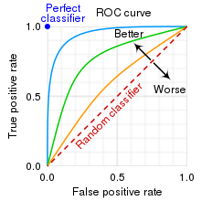
Model Performance - Overall
AUC = Area Under the Curve.
Accuracy = the proportion of times there is a match for a MAFID assigned greater than 50% probability.
Source: Wikipedia. Drawn by CMG Lee based on http://commons.wikimedia.org/wiki/File:roc-draft-xkcd-style.svg

Slide 9
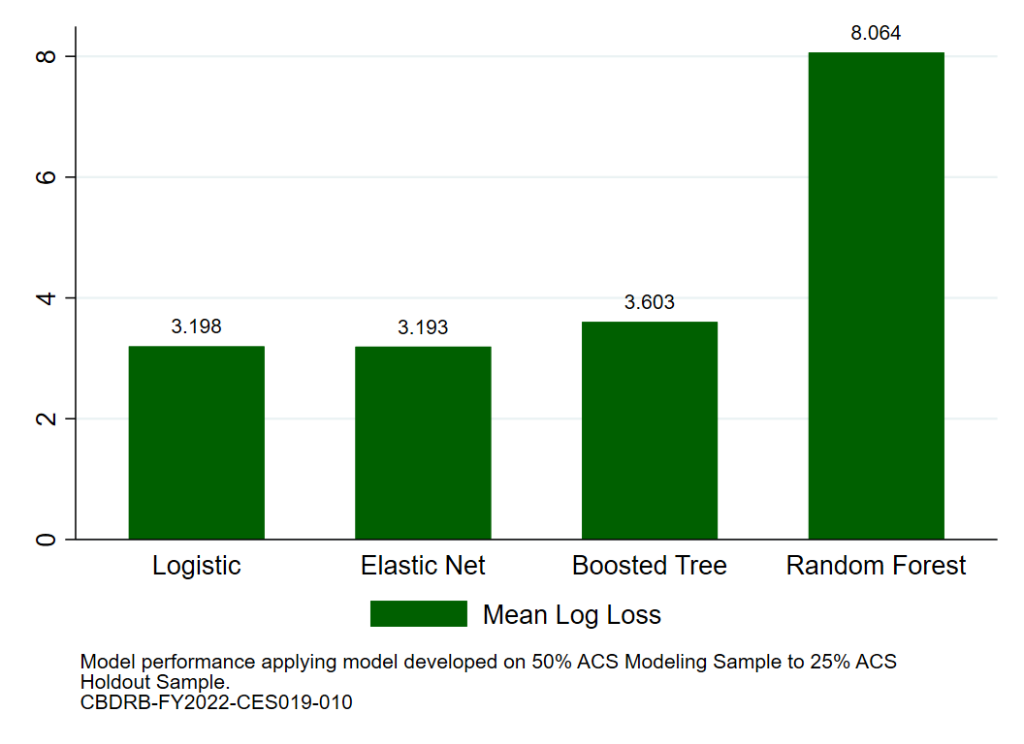
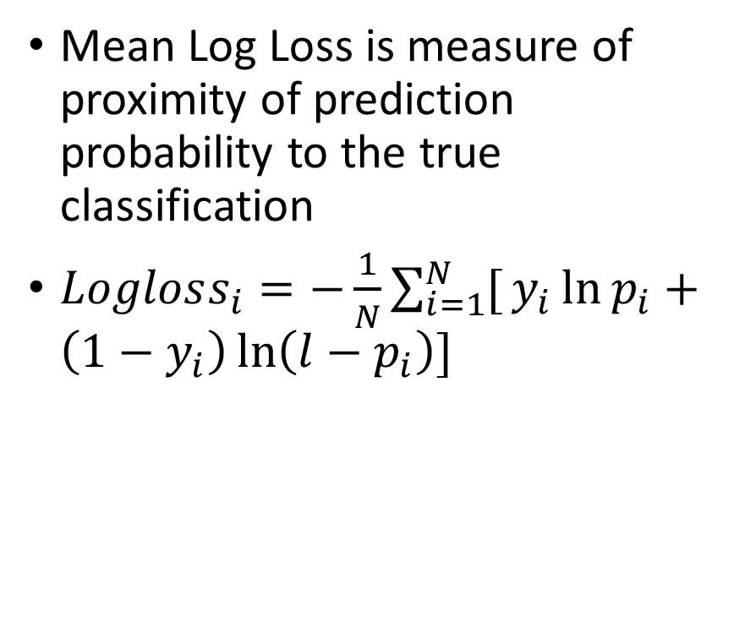
Model Performance - Overall
Mean Log Loss is measure of proximity of prediction probability to the true classification
$Logloss_{i}=−\frac{1}{N}\sum_{i=1}^{N}{[}y_{i}\ln{p_{i}}+\left(1−y_{i}\right)\ln\left(l−p_{i}\right)]$

Slide 10
Address Assignment
Maximum – Select one address from potential administrative addresses per person based on highest predicted probability
Probability – Use all potential administrative addresses, weighted according to the predicted probability
Repeated draw – Randomly draw one potential administrative record address per person based on predicted probability. Repeat N times.

Slide 11
Coverage
One reason the administrative address predicted by the model may not match the survey address is if the survey address doesn’t appear in the administrative records
To assess the model match rates, we abstract from this by only using observations where the survey address is one of the potential addresses
We also exclude individuals with only one address from these match statistics

Slide 12
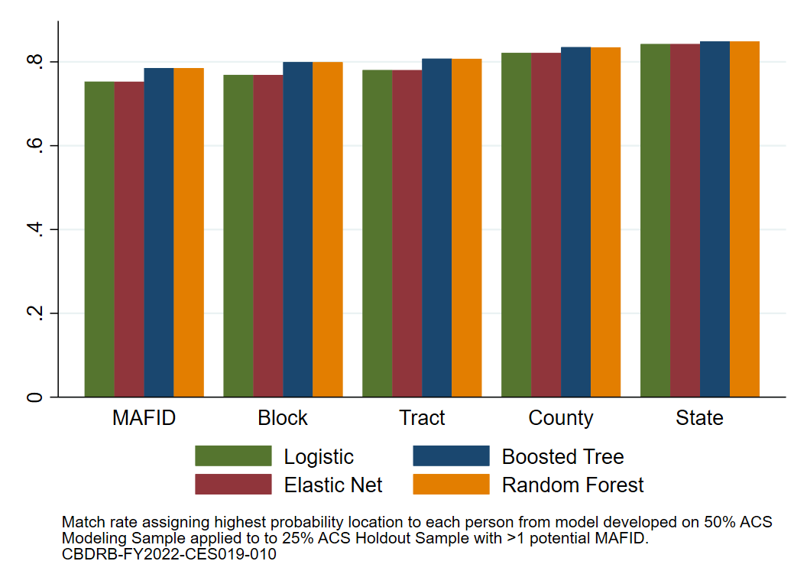
Model Performance By Geographic Aggregation

Slide 13
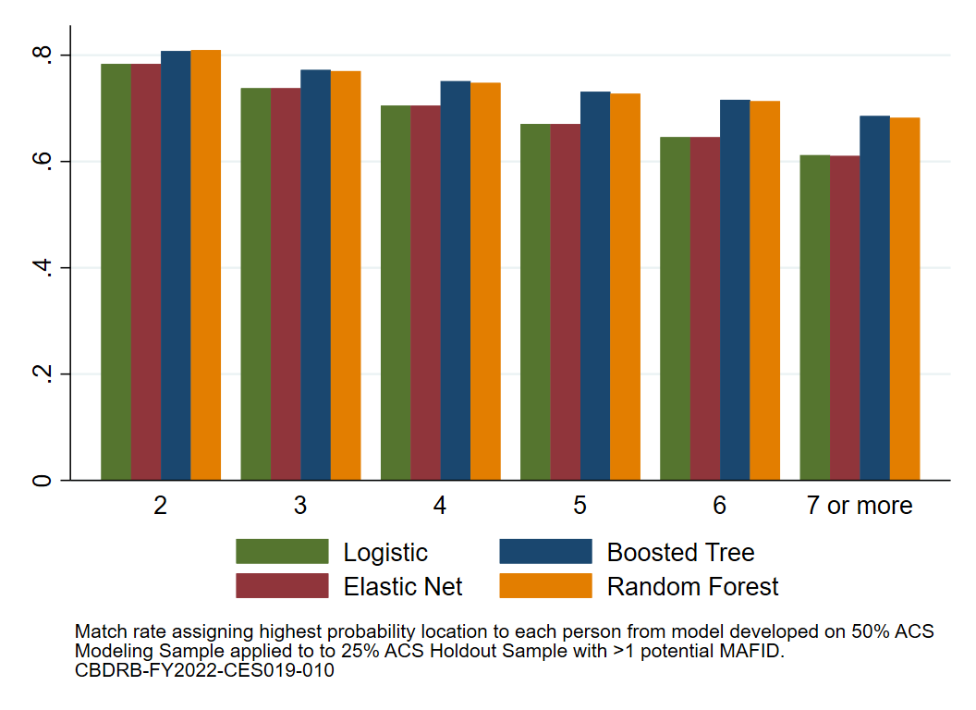
Model Performance By Number of Potential Address Matches

Slide 14
Applying Model to 2020 Administrative Records
Estimate model with full 2018 ACS data
Use trained model to assign predicted probabilities to administrative addresses from 2019 and 2020 administrative data, using April 1, 2020 as reference date
Filter out individuals who, from immigration, birth, and death records, can be determined to not be present on Census day

Slide 15
Summary
To build an administrative records Census, we needed a person-place model to match people to the correct locations, given a set of potential locations
We used survey addresses from the 2018 ACS as our “truth” and matched them to a large set of administrative records
We used four different predictive models: logistic regression, elastic net, random forest, and boosted tree
All four models had strong predictive power and accuracy, given the high quality data used
Moving forward, we use the random forest model on the full 2018 ACS data to estimate predictive probabilities for the 2020 administrative records addresses

