Slide 1
Cursor 101
Definitions, features, MCP & Snowflake — a beginner's guide
Internal training · RYM / Inventory · July 2026

Slide 2
What You Will Learn
Core definitions (prompt, Agent, MCP, Skill, Rule, and more)
How the Cursor window and modes work (Ask, Agent, Plan)
Cursor features: chat, @ mentions, Tab, inline edit, Rules, Skills, Hooks
What the Agent can do — and what you always approve yourself
Three team workflows: daily report, IFP forecast, ask for help
MCP from scratch: local servers (IFP) and remote servers (Snowflake)
Step-by-step MCP setup with diagrams (no coding required for daily use)
By the end, you will know what to type on day one and how MCP fits in.

Slide 3
How This Deck Is Organized
Section | Slides cover…
Part 1 — Basics | What Cursor is, UI layout, glossary
Part 2 — Features | Modes, @ mentions, Agent tools, Rules & Skills
Part 3 — Team workflows | Daily report, IFP, help prompts
Part 4 — MCP | IFP bridge, build your own, Snowflake connection
Part 5 — Reference | Troubleshooting, cheat sheet, shortcuts

Slide 4
What Is Cursor?
Think of it as a smart assistant inside a code editor
Cursor looks like VS Code (a program for working with project files).
The difference: it has a chat box where you type normal English.
You do NOT need to know how to code to use it.
You describe what you want. Cursor can:
• Run scripts that already exist on your computer
• Read and update project files for you
• Explain what a script does when you're stuck
You stay in control — Cursor asks before changing files.

Slide 5
Cursor vs a Generic Chatbot
Why use an editor instead of copy-paste?
Generic chat (e.g. web UI) | Cursor
You paste code in and out | AI reads and edits files in your open folder
You run every command yourself | Agent can run terminal steps for you (with approval)
No project context | Sees structure, config, and @ mentions you attach
General answers | Team Skills teach IFP / report workflows

Slide 6
Why Use Cursor?
Same work, less clicking around
The old way | The Cursor way
Open IFP portal, fill in every field | Type: "Run a forecast for Hulu US, 2 per hour"
Run a Python script yourself in terminal | Type: "Run @dailypublisherscript.py"
Hunt through files to change a setting | Type: "Add Disney Plus to targeting"
Read a long error message alone | Type: "Why did that fail?"
Cursor does not replace your judgment — it helps you move faster.

Slide 7
The Cursor Layout (Wireframe)
Same idea as VS Code + Chat on the side
Explorer
Project files
Editor
Open file / diff view
Chat (Ctrl+I)
Agent · Ask · Plan
Terminal (Ctrl+`) — PowerShell, Python, git
Tip: Pin Chat (Ctrl+I). Most daily work is Explorer + Chat, not manual terminal.

Slide 8
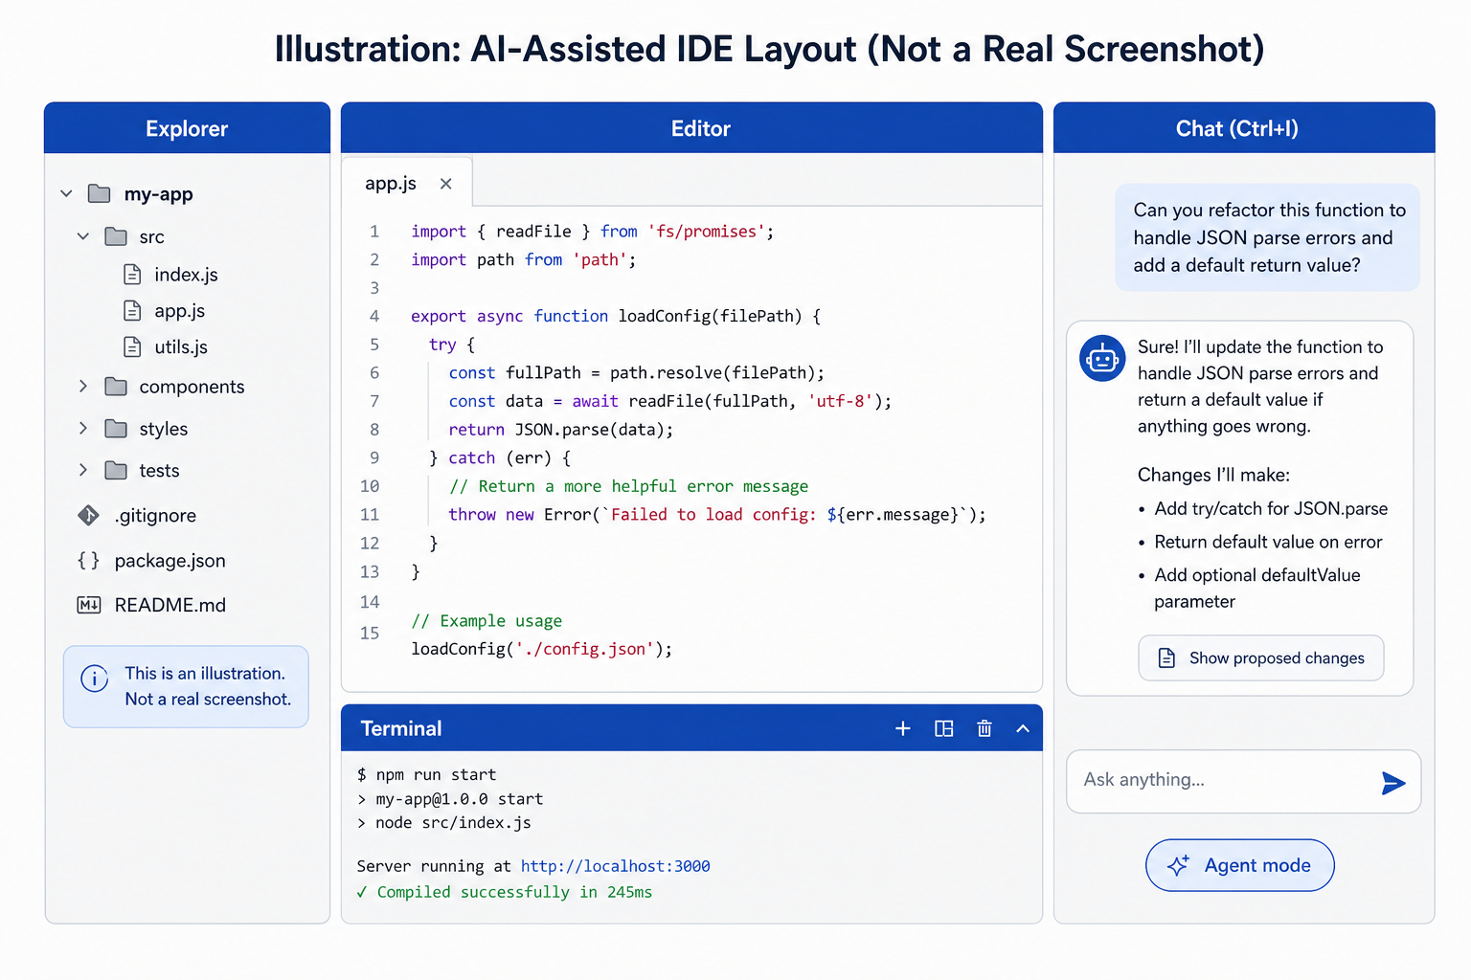
What It Looks Like in Practice
Illustrations included; replace with your own PNGs in docs\images\ when ready
[Screenshot: 03-at-mention.png] Drop PNG in docs\images\ and rebuild deck
Chat + Agent mode (illustration until you add 02-agent-chat.png)
@ file picker
[Screenshot: 01-open-folder.png] Drop PNG in docs\images\ and rebuild deck
File → Open Folder

Slide 9
The Cursor Window — 4 Areas to Know
Area | What it is
Left sidebar | Your project files and folders — like File Explorer
Center | The file you are viewing or editing
Chat (Ctrl+I) | Where you talk to Cursor — this is the main thing you'll use
Terminal (Ctrl+`) | A command window — Cursor can run commands here for you
Most of your time will be in Chat. You rarely need to touch the terminal yourself.

Slide 10
Glossary — Everyday AI Terms
Part 1 of 2
Term | Definition
LLM | Large language model — the AI that reads and writes text
Prompt | What you type in chat; your instruction in plain language
Context | Files, @ mentions, and project info the AI can see this turn
Diff | Side-by-side view: red = removed lines, green = added lines
Token | Chunk of text the model processes; long chats use more context
Hallucination | AI states something wrong confidently — verify numbers & paths

Slide 11
Glossary — Cursor Product Terms
Part 2 of 2
Term | Definition
Agent | Chat mode that can act: edit files, run commands, call MCP tools
Ask | Chat mode that only explains — no file or terminal changes
Plan | Chat mode that drafts a step plan before making larger changes
Composer / Chat | Main AI panel (Ctrl+I) for multi-step tasks
Tab | Inline AI autocomplete as you type in the editor
Inline Edit | Select code → Ctrl+K → describe a small local change
MCP | Model Context Protocol — standard way to plug external tools into Cursor
Skill | SKILL.md file that teaches the Agent a team workflow
Rule | .cursor/rules — standing instructions for every chat in a project
Hook | Script that runs on Cursor events (save, submit prompt, etc.)

Slide 12
A Few Simple Terms
Term | Plain English
Project / folder | A folder on your computer with scripts and config files
Script | A file that runs a task automatically (like the daily report)
Prompt | What you type in chat — your request in normal words
Agent mode | Cursor can take action (run things, edit files)
Ask mode | Cursor only explains — it won't change anything
@ mention | Point Cursor at a specific file, e.g. @dailypublisherscript.py

Slide 13
Cursor Features at a Glance
Feature | What it does for you
Agent chat (Ctrl+I) | Run scripts, edit config, iterate on errors
Ask mode | Explain code, brainstorm prompts, zero file changes
Plan mode | Break big tasks into reviewable steps first
@ mentions | Attach files, folders, docs, terminals, or web to your prompt
Tab completion | Speed up typing in code or config files
Terminal integration | Agent runs py, PowerShell, git — you approve runs
MCP servers | Named tools in chat (IFP forecast, Snowflake SQL, etc.)
Rules & Skills | Encode team standards and repeatable workflows
Background Agent / Cloud | Optional: longer jobs off your laptop (if enabled by IT)

Slide 14
Before You Start
You need two things on your computer:
• The project folders (ask your team for the path)
• Cursor installed (cursor.com)
For IFP forecast work only:
• Connect to Hulu VPN first
You do NOT need to:
• Install Python yourself (Cursor can run it for you)
• Memorize file paths or commands
• Know how the scripts work internally

Slide 15
Your Two Project Folders
Open one at a time
Folder name | What it does
all-publishers-daily-report | Builds the daily Excel report and email draft
ifp-frequency-cap-tests | Runs IFP inventory forecasts and cap tests
How to open: File → Open Folder → pick the folder
Tip: Only open the folder you need for today's task.

Slide 16
The Whole Process in 5 Steps
This is the flow every time
Step 1 — Open the right project folder
Step 2 — Press Ctrl+I to open chat
Step 3 — Make sure Agent mode is selected (not Ask)
Step 4 — Type what you want in plain English
Step 5 — Review what Cursor did, then accept or reject changes
That's it. Every workflow below follows these same 5 steps.

Slide 17
Example: Your First Prompt
1. Open folder: all-publishers-daily-report
2. Press Ctrl+I
3. Select Agent mode
4. Type this:
Run @dailypublisherscript.py
5. Cursor runs the script and tells you what happened.
6. If it edited a file, you'll see a diff — click Accept or Reject.

Slide 18
Agent vs Ask Mode
Pick the right mode before you type
Mode | Use when you want to...
Agent | DO something — run a script, edit a file, fix an error
Ask | LEARN something — explain code, answer a question, no changes
Plan | DESIGN first — outline steps before Agent executes
Default to Agent for daily work.
Switch to Ask when you only want an explanation:
"Explain how dailypublisherscript.py works"

Slide 19
Plan Mode — Think Before Doing
Use Plan when the task touches many files or needs a careful sequence.
Flow:
1. You describe the goal in chat and select Plan mode
2. Cursor proposes steps (no changes yet)
3. You edit or approve the plan
4. Switch to Agent (or continue) to execute step by step
Good for: refactors, new MCP setup, large config changes.
Skip for: one-line prompts like Run @dailypublisherscript.py

Slide 20
What the Agent Can Use
Tools are automatic — you stay in control
Read / edit project files
Search codebase
Run terminal
Call MCP tools
Use @ context (files, docs)
You approve diffs & commands
Cursor asks before risky actions
You will see prompts to approve terminal commands and file edits.
Never paste passwords, PAT tokens, or API keys into chat — use env vars.

Slide 21
Rules, Skills & Hooks
How teams teach Cursor your way of working
Mechanism | Purpose
Rules (.cursor/rules) | Always-on instructions: naming, security, review steps
Skills (SKILL.md) | Playbooks the Agent reads when a task matches (e.g. IFP cap tests)
Hooks (hooks.json) | Automation on events — format on save, lint before commit
User Rules (Settings) | Personal preferences across all projects
Most beginners only need Skills already in the repo — no setup required.

Slide 22
@ Mentions — More Than Files
Type @… | Use when…
File / Folder | Point at dailypublisherscript.py or config/
Code selection | Attach highlighted lines from the editor
Docs | Pull in indexed documentation (if enabled)
Terminals | Share last command output — great for "why did this fail?"
Web | Let Agent fetch a public URL (policy permitting)

Slide 23
The @ Symbol — Point Cursor at a File
Type @ in chat, then start typing a filename.
Cursor shows a list — pick the file you mean.
Why this helps: Cursor knows exactly which file to use.
Examples:
Run @dailypublisherscript.py
Update @config/base-request.json
Explain @dailypublisherscript.py step by step

Slide 24
Three Workflows — Pick One
I want to... | Workflow
Build today's daily report email | Workflow 1 — Daily Report
Run an IFP forecast or cap test | Workflow 2 — IFP Forecast
Ask a question or change a setting | Workflow 3 — Ask for Help
The next slides walk through each one step by step.

Slide 25
Workflow 1: Daily Publishers Report
In one sentence
Cursor downloads today's MicroStrategy files from Outlook,
updates your Excel template, and opens an email draft for you to review.
It does NOT send the email automatically — you review and click Send.
Folder to open: all-publishers-daily-report
The one prompt to use:
Run @dailypublisherscript.py

Slide 26
Workflow 1: What Happens Behind the Scenes
Step 0 — Find today's MSTR email in Outlook and download the Excel attachments
Step 1 — Copy daily data into the master Excel template (~20K rows)
Step 2 — Copy quarterly data into the template (~170K rows)
Step 3 — Refresh pivot tables and formulas
Step 4 — Build summary tables and open an Outlook email draft
You review the draft, make any edits, then send it yourself.

Slide 27
Workflow 1: What You Need First
Before running the daily report, check:
• Outlook is open (or can be opened)
• Today's MicroStrategy email has arrived
• The master Excel template is on your machine
If something fails, tell Cursor the error message:
"The MSTR email wasn't found — what should I check?"
Manual backup (if chat isn't working):
cd C:\Users\syeda012\projects\all-publishers-daily-report
py dailypublisherscript.py

Slide 28
Workflow 2: IFP Forecast
In one sentence
Cursor calls the IFP inventory forecast API and returns numbers for you.
You do NOT need to log into the IFP portal website.
Folder to open: ifp-frequency-cap-tests
Before you start: Connect to Hulu VPN.
Describe the forecast in plain English. Include:
• Date • Publisher (Hulu) • Country (US) • DMA (optional) • Frequency cap

Slide 29
Workflow 2: One Quick Forecast
Type something like:
Run a forecast for 7/10 Hulu US, Baton Rouge, 2 per hour
Cursor returns three numbers:
Capacity — total inventory in the pool
Available — inventory still available after the cap
Ratio — Available ÷ Capacity
Example response:
Capacity: 1,314,840 | Available: 105,187 | Ratio: 8.0%

Slide 30
Workflow 2: Run All Cap Tests at Once
Optional — for testing multiple caps
Instead of one forecast, run every test case in one go.
In chat, type:
Run the frequency cap test matrix
Results are saved to output\results.json.
Ask Cursor to summarize:
"Show available and capacity for all scenarios"
Frequency cap examples:
2 per 1 DAY | 1 per 1 HOUR | 3 per 30 MINUTE | 4 per 30 DAY

Slide 31
Workflow 3: Ask for Help
No script to run — just ask
I want to... | Type this
Understand a script | "Explain @dailypublisherscript.py step by step"
Change targeting | "Add Disney Plus to publisher targeting"
Change dates | "Update dates to July 15–31"
Look up a DMA code | "What's the DMA code for Baton Rouge?"
Fix an error | "Why did the last command fail?"
Learn how to do something | "Walk me through running a frequency cap test"
DMA tip: The IFP portal shows names (Baton Rouge). The API uses numbers (716). Ask Cursor to translate.

Slide 32
When Cursor Edits a File
Always review before accepting
Cursor shows you a diff — red = removed, green = added.
You choose:
• Accept — keep the change
• Reject — undo the change
You are always in control. Cursor never auto-commits or auto-sends email.
If you're not sure about a change, click Reject and ask:
"Explain that change before applying it"

Slide 33
What Is MCP?
Model Context Protocol — a bridge between Cursor and external systems
Definition: MCP is an open standard for connecting AI clients to tools and data.
Simple analogy: MCP is like labeled buttons in chat —
"Run IFP Forecast" or "Run SQL in Snowflake".
An MCP server exposes tools (functions) Cursor can call with your approval.
Examples on our IFP MCP server:
• run_forecast — one forecast with a frequency cap
• run_cap_test_matrix — run all cap test cases
• validate_cap_test_matrix — PASS/FAIL validation
You type in plain English. Cursor picks the tool. MCP runs it.

Slide 34
MCP Vocabulary
Term | Meaning
MCP client | Cursor — discovers tools and sends requests
MCP server | Bridge program (local script or hosted service)
Tool | One callable action, e.g. run_forecast or run_sql
stdio transport | Cursor starts a local process and talks over stdin/stdout
HTTP / SSE transport | Cursor calls a remote URL (Snowflake-managed MCP)
mcp.json | Cursor config listing servers, commands, URLs, and env vars

Slide 35
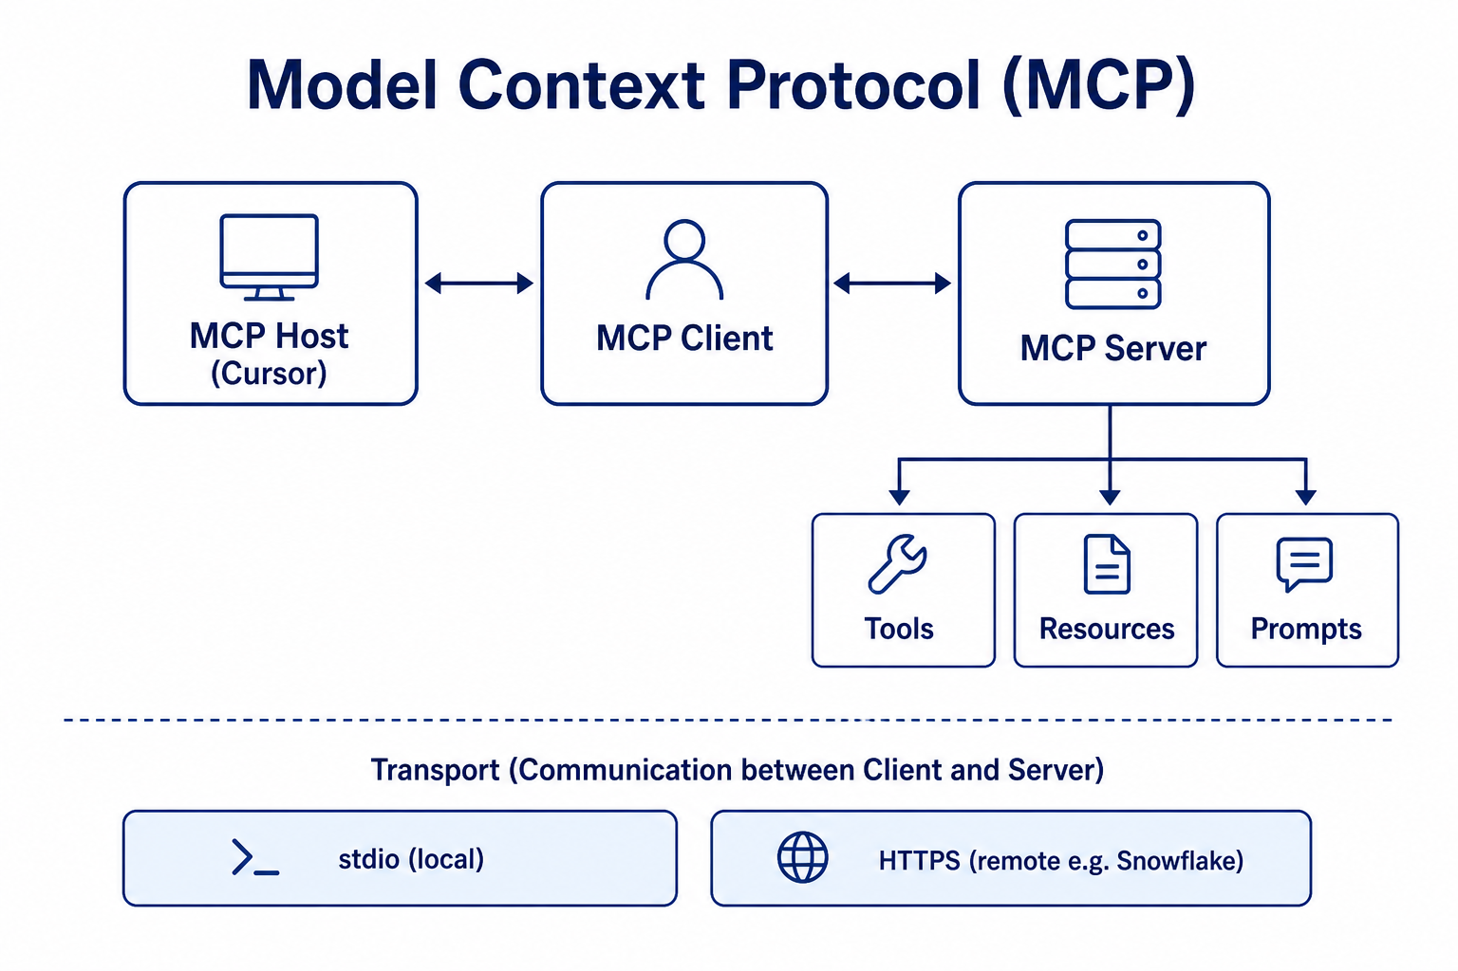
MCP Architecture (Reference Diagram)
Source: generated for training — see modelcontextprotocol.io for spec
Host → Client → Server · tools, resources, transports
For official spec diagrams: modelcontextprotocol.io/docs/learn/architecture

Slide 36
Two Ways to Connect MCP
Local script vs cloud-hosted server
Type A — Local MCP (stdio)
Cursor
Starts process
→
MCP server.py
Runs on your PC
→
Internal API
IFP forecast
Type B — Remote MCP (HTTPS + token)
Cursor
HTTP client
→
Snowflake MCP URL
Hosted by Snowflake
→
Warehouse
SQL / Cortex
IFP uses Type A (Python on your machine). Snowflake uses Type B (HTTPS + PAT in env vars).

Slide 37
How MCP Works — The Pipeline
You
Type in chat
Cursor Agent
Picks the right tool
MCP Server
Small bridge program
IFP API
Returns forecast data
→
→
→
1. You ask in chat: "Run a forecast for Hulu US, 2 per hour"
2. Cursor Agent decides to use the run_forecast MCP tool
3. MCP server builds the API request and calls IFP
4. Results come back to chat — capacity, available, ratio
You never open a terminal or run a script manually.

Slide 38
Without MCP vs With MCP
Without MCP
You
Ask in chat
Cursor
Runs script
Terminal / Script
run-forecasts.ps1
IFP API
Forecast data
→
→
→
With MCP
You
Ask in chat
Cursor
Calls MCP tool
MCP Server
run_forecast
IFP API
Forecast data
→
→
→
Both paths reach the same IFP API. MCP is faster for one-off questions in chat.

Slide 39
MCP Workflow — What You Do as a User
No setup needed if already configured
Step 1 — Connect to Hulu VPN
Step 2 — Open ifp-frequency-cap-tests in Cursor
Step 3 — Press Ctrl+I → Agent mode
Step 4 — Type your request in plain English:
Run a forecast for 7/10 Hulu US, Baton Rouge, 2 per hour
Run the frequency cap test matrix
Validate all cap cases
Step 5 — Read the results in chat. Done.

Slide 40
How to Set Up an MCP Server
One-time setup — usually done by a team lead
1
Create MCP server
Small program with tools — e.g. ifp-mcp-server/server.py
↓
2
Register in mcp.json
Tell Cursor how to start it — ~/.cursor/mcp.json
↓
3
Restart Cursor
Reload so MCP is picked up
↓
4
Ask in chat
e.g. "Run a forecast for Hulu US"
Analogy: mcp.json is like saving a phone number so Cursor knows who to call.

Slide 41
MCP Setup — The Two Pieces
Piece | What it is
MCP server program | ifp-mcp-server/server.py — exposes tools, calls the IFP API
Cursor config file | ~/.cursor/mcp.json — tells Cursor how to start the server
IFP MCP tools exposed to chat:
run_forecast | run_cap_test_matrix | validate_cap_test_matrix
The server reads config from ifp-frequency-cap-tests:
config/base-request.json and reference/cap-ratio-expectations.json

Slide 42
MCP Setup — mcp.json Example
File location: C:\Users\<you>\.cursor\mcp.json
Add an entry under mcpServers:
{
"mcpServers": {
"ifp-forecast": {
"type": "stdio",
"command": "py",
"args": ["C:/.../ifp-mcp-server/server.py"],
"env": {
"IFP_API_URL": "http://inventory-forecasting-prod-dplus...",
"IFP_TESTS_ROOT": "C:/.../ifp-frequency-cap-tests"
}
}
}
}
type: stdio — Cursor talks to the server over a local pipe
command + args — how to start the MCP server program
env — paths and settings (no passwords in this file)
After saving: restart Cursor or reload MCP in Settings → MCP

Slide 43
Build a Custom MCP Server (Outline)
For engineers connecting a new API or database
1. Pick a runtime — Python is common (FastMCP / official MCP SDK)
2. Define tools — each tool = name, description, input schema, handler function
3. Implement handlers — call your API or DB with env-based credentials
4. Test locally — run the server script; use MCP inspector or Cursor Settings
5. Register in ~/.cursor/mcp.json — command, args, env (never commit secrets)
6. Document for users — plain-English prompts that map to each tool
Security: least-privilege creds, validate inputs, no secrets in repo or chat.
# Conceptual tool definition
@mcp.tool()
def run_forecast(publisher: str, cap: str) -> str:
"""Call IFP API; return capacity / available / ratio."""

Slide 44
Snowflake MCP (Third-Party Example)
Remote MCP hosted by Snowflake — not a local script
Snowflake runs the MCP server in your account — Cursor connects over HTTPS.
Typical tools exposed (depends on how your admin configured the server):
• Run SQL against a warehouse
• Cortex Search / Analyst
• Custom UDFs or stored procedures exposed as tools
Auth: Programmatic Access Token (PAT) — treat like a password.
Store PAT and MCP URL in environment variables, not in chat or git.
Docs: docs.snowflake.com → Snowflake Cortex → MCP

Slide 45
Snowflake MCP — Setup Flow
1
Create PAT
Snowsight → Settings → Programmatic Access Token
↓
2
Get MCP URL
account / database / schema / mcp-servers / name
↓
3
Set env vars
SNOWFLAKE_MCP_SERVER_URL, SNOWFLAKE_PAT_TOKEN
↓
4
Register in mcp.json
url + Authorization: Bearer ${...}
↓
5
Restart Cursor
Settings → MCP → green status
Use a role with least privilege — only USAGE on the MCP server and required objects.

Slide 46
Snowflake MCP — mcp.json Pattern
Values come from env vars — never hardcode the PAT
{
"mcpServers": {
"Snowflake": {
"url": "${SNOWFLAKE_MCP_SERVER_URL}",
"headers": {
"Authorization": "Bearer ${SNOWFLAKE_PAT_TOKEN}"
}
}
}
}
SNOWFLAKE_MCP_SERVER_URL example shape:
https://<org>-<account>.snowflakecomputing.com/api/v2/databases/.../mcp-servers/<name>
Set vars in Windows User environment or shell profile → restart Cursor.
In chat: "List tables in schema X" or "Run this SELECT …" (if tools allow).

Slide 47
IFP MCP vs Snowflake MCP
 | IFP (local) | Snowflake (remote)
Who hosts server | Your laptop (server.py) | Snowflake account
Transport | stdio | HTTPS + Bearer PAT
Typical use | Inventory forecasts & cap tests | SQL, Cortex, warehouse data
VPN | Hulu VPN required | Corporate / Snowflake network policy
Config | command + args + IFP_* env | url + PAT env vars

Slide 48
MCP Setup — Cursor Settings UI
Alternative to editing mcp.json by hand
In Cursor:
1. Open Settings (gear icon or Ctrl+,)
2. Search for "MCP"
3. Click "Add new MCP server" or edit mcp.json
4. Save and reload
You should see the server listed as ifp-forecast (shows as user-ifp-forecast in chat).
Status indicators:
• Green / ready — connected, tools available
• Error — check VPN, Python (py), or file paths
First use may prompt you to authenticate — click Allow and retry.

Slide 49
MCP Troubleshooting
Problem | Fix
MCP not listed in Settings | Check ~/.cursor/mcp.json exists and restart Cursor
Server shows error on start | Verify py works and server.py path is correct
Tool call fails / network error | Connect to Hulu VPN first
Authentication prompt | Click Allow when Cursor asks, then retry
Wrong forecast targeting | Be specific in chat: publisher, date, DMA, cap
Most users never touch MCP setup — just ask for a forecast when VPN is on.

Slide 50
When Something Goes Wrong
Problem | What to do
"Python was not found" | Tell Cursor: use py instead of python
Connection / network error | Connect to Hulu VPN (IFP work only)
MSTR email not found | Check Outlook — today's MicroStrategy email may not have arrived yet
Cursor changed the wrong file | Click Reject, then be more specific in your prompt
Don't know what to type | Copy a prompt from the cheat sheet slide
Portal shows DMA name, API wants number | Ask: "What's the DMA code for [city]?"

Slide 51
Copy-Paste Prompt Cheat Sheet
Run @dailypublisherscript.py
Run a forecast for [date] Hulu US, [city], [N] per [hour/day]
Run the frequency cap test matrix
What's the DMA code for [city name]?
Explain @dailypublisherscript.py step by step
Why did the last command fail?

Slide 52
Keyboard Shortcuts
Action | Key
Open chat | Ctrl+I
Inline edit selection | Ctrl+K
Open terminal | Ctrl+`
Open Command Palette | Ctrl+Shift+P
Send message immediately | Ctrl+Enter
Accept Tab suggestion | Tab
Security reminders:
• Never paste passwords or API keys into chat
• Do not share forecast data outside the team
• Review file changes before accepting

Slide 53
Your First 5 Minutes — Try This Now
1. Open Cursor
2. File → Open Folder → all-publishers-daily-report
3. Press Ctrl+I → select Agent mode
4. Type: Explain @dailypublisherscript.py in simple terms
5. Read the answer — no risk, nothing gets changed
When you're ready for real work:
• Daily report → Run @dailypublisherscript.py
• IFP forecast → connect VPN, then describe the forecast you need

Slide 54
You're ready
Open a folder → Ctrl+I → Agent mode → type what you need
Cursor handles the rest. You review and approve.

