Slide 1

Linux Day 2017
How to analyze [M|B]illions of events in NRT
Notes:
‹#›

Slide 2

Speaker
DAVIDE VERGARI
Profilo
ESPERIENZA IN AMBITO ENTERPRISE in:
DataWarehouse & Data Mining
Amministrazione di sistemi *nix
Gestione di infrastrutture complesse
Progettazione ed implementazione di sistemi cloud e di virtualizzazione
QUATTRO ANNI DI ESPERIENZA in:
Implementazione progetti BIG DATA
BIG DATA & IOT
Progettazione Sistemi Big Data in ambito EDW
CERTIFICAZIONI su HDP 2.x e CDH 5.x
DOCENTE della HORTONWORKS UNIVERSITY.
Big Data Tech Manager di Exage S.p.A., architetto soluzioni Hadoop certificato HDP 2.x
www.exage.com
davide.vergari@exage.com
it.linkedin.com/in/davide-vergari-59339054
@DavideVergari
Notes:
‹#›

Slide 3

Speaker
DAVIDE ISOARDI
Profilo
ESPERIENZA IN AMBITO ENTERPRISE in:
Amministrazione di sistemi *nix
Gestione di infrastrutture public e privat cloud
Progettazione ed implementazione di sistemi di real time analysis
DUE ANNI DI ESPERIENZA in:
Implementazione progetti BIG DATA
Intergrazione sistemi NoSQL e SQL
Progettazione sistemi di ingestion in streaming
CERTIFICAZIONI su HDP 2.x e CDH 5.x
DOCENTE della HORTONWORKS UNIVERSITY.
Big Data System Architect
di Exage S.p.A., architetto soluzioni Hadoop certificato HDP 2.x
www.exage.com
davide.isoardi@exage.com
linkedin.com/in/davide-isoardi-65a0967a
Notes:
‹#›

Slide 4
Data Streaming
Data streaming is the transfer of data at a steady high-speed rate
IoET, social network, industry 4.0, are producing more data than in the past few decades
They have different format, often they’re free text

Slide 5
Data Streaming
Collect data from different social networks and ecommerce sites to do a sentiment analysis on some products
Real-time network threat detection
Anticipate hardware failure and avoid it
Legacy systems are not enough to store and analyze this kind of data:
They are too many
They are too fast
They are too “strange”

Slide 6
Stream Data & Big Data
Big data can be easily definited by using the «3v» definition:
Volume
Velocity
Variety
Stream data are big data!

Slide 7
Why Hadoop?
HADOOP:
Is a collection of open source software frameworks for the distributed storing and processing of large sets of data
Is scalable and fault tolerant
Works with commodity hardware
Processes all types of Big Data
Structured, semi-structured, unstructured
HADOOP DESIGN GOALS:
Use inexpensive, enterprise-grade hardware to create very large clusters
Achieve massive scalability through distributed storage and processing

Slide 8
Hadoop: Distributed File System + Scheduler
Yet Another Resource Negotiator (YARN)
Hadoop Distributed File System (HDFS)
storage
storage
CPU
RAM
storage
storage
Notes:
Storicamente il dwh enterprise è stato un componente fondamentale di ogni enterprise
L’aumento della quantità di dati rende poco efficienti le soluzioni attuali
‹#›

Slide 9
Hortonworks – 100% Opensource for Hadoop
150%
Fondata nel 2011
Dollar-based
Net expansion rate
(media ultimi quadrimestri)
1.100
100%
1°
HADOOP
dipendenti
Provider pubblico
65%
16
Open Source
Apache Hadoop
data platform
IPO 4Q14 (NASDAQ: HDP)
Support Subscription
Operating billings growth (anno su anno nel 2Q16)
paesi
Notes:
‹#›
Tra le grandi distribuzioni di Hadoop l’unica 100% opensource
Fondata da ingegneri di yahoo e quotata in borsa
Numero di subscription in crescita
Presente in 16 paesi con più di 1000 dipendenti

Slide 10
Why open?
Economic benefits
DATA
VARIETY
HORTONWORKS
OPEN SOURCE
Support for "low cost" data centers and cloud-based architectures
Guaranteed integration
Speed up the adoption of technologies that rely on the ODPi stack.
PROPRIETARY
HADOOP
ECONOMICS
EDW
RDBVS
Notes:
Nuove fonti di dati, come ad esempio i social network e l’IOT permettono alle aziende di effettuare analisi di mercato sempre più approfondite e trasformare l’experience BI in predictive BI
Queste fonti sono tuttavia difficili da integrare nelle soluzioni esistenti e il volume dei dati non strutturati o semi strutturati è in aumento. Raccoglierli è importante ma deve essere economicamente vantaggioso
‹#›

Slide 11
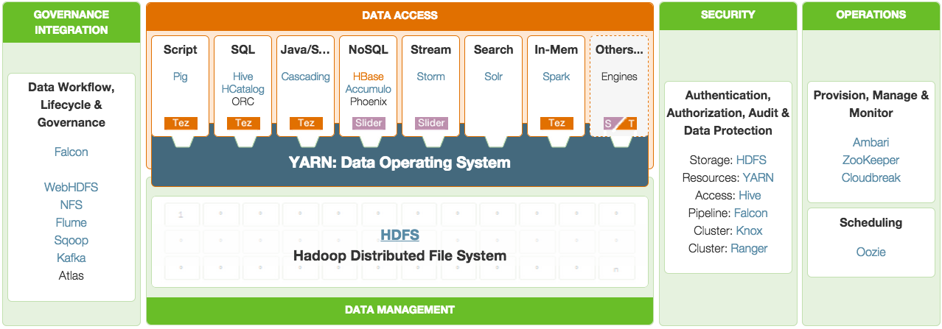
HDP Stack
Notes:
‹#›

Slide 12
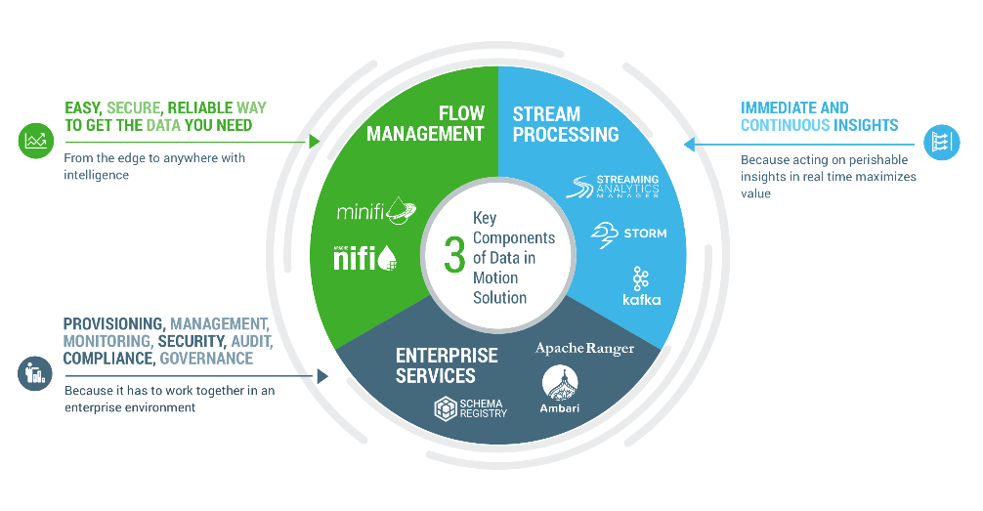
HDF – Hortonworks Data Flow
Hortonworks DataFlow (HDF) provides the only end-to-end platform that collects, curates, analyzes and acts on data in real-time, on-premises or in the cloud, with a drag-and-drop visual interface. HDF is an integrated solution with Apache Nifi/MiNifi, Apache Kafka, Apache Storm and Druid.
The HDF streaming real-time data analytics platform includes Data Flow Management Systems, Stream Processing, and Enterprise Services.
Notes:
‹#›

Slide 13
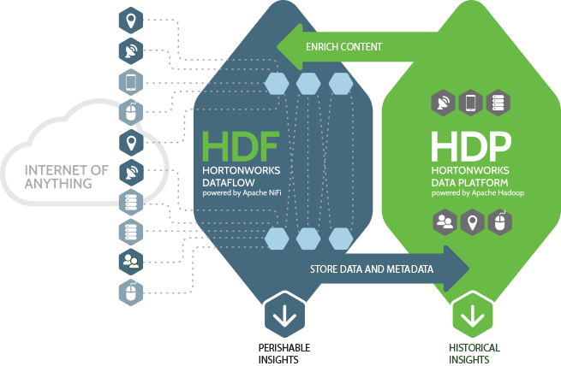
HDF and HDP Integration
HDF dinamically connects HDP to data at the edge
HDF secures and encrypts the movement of data into HDP
HDF includes mature IoAT data protocols that improve device extensibility
HDF offers traceability of data with lineage and audit trails
Notes:
Lo scenario attuale consiste nell’elaborazione di dati provenienti da sistemi diversi che attraverso job di data preparation e ingestion possono essere presentati ad utenti e applicazioni.
Lo scenario si basa sulle tre fasi di RACCOLTA – GESTIONE e ANALISI
‹#›

Slide 14
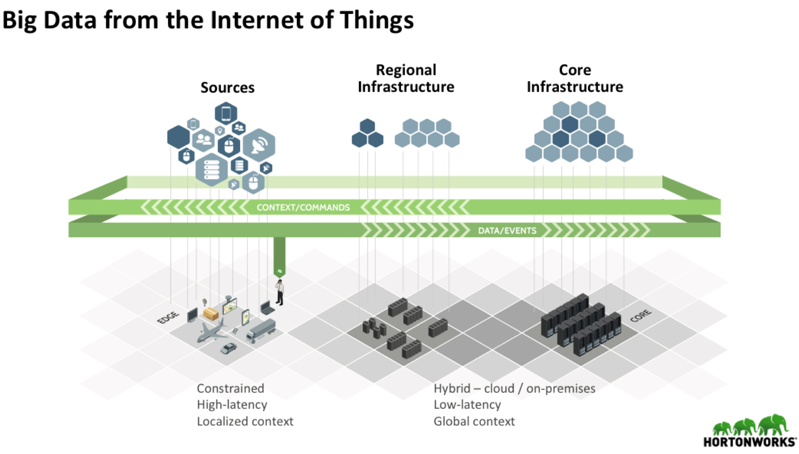
Global Architecture
Data from the edge are sent to the regional HDF infrastructure where they can be stored and analyzed
They can also be replicated to a central, core infrastructure with HDF and HDP where they can be enriched with data from other regional clusters
Notes:
Il concetto è quello di evolvere il DWH attuale in modo da raggiungere un elevato livello di efficienza economica e la possibilità di integrare, gestire e analizzare dati da fonti eterogenee
‹#›

Slide 15
DEMO

Slide 16

Apache NiFi – https://nifi.apache.org
An easy to use, powerful, and reliable system to process and distribute data
Apache NiFi supports powerful and scalable directed graphs of data routing, transformation, and system mediation logic
Web-based user interface
Highly configurable
Loss tolerant vs guaranteed delivery
Low latency vs high throughput
Dynamic prioritization
Flow can be modified at runtime
Back pressure

Slide 17
Apache NiFi – https://nifi.apache.org
MiNiFi—a subproject of Apache NiFi—is a complementary data collection approach that supplements the core tenets of NiFi in dataflow management, focusing on the collection of data at the source of its creation
Specific goals for the initial thrust of the MiNiFi effort comprise:
Small size and low resource consumption
Central management of agents
Generation of data provenance (full chain of custody of information)
Integration with NiFi for follow-on dataflow management
Perspectives of the role of MiNiFi should be from the perspective of the agent acting immediately at, or directly adjacent to, source sensors, systems, or servers.

Slide 18
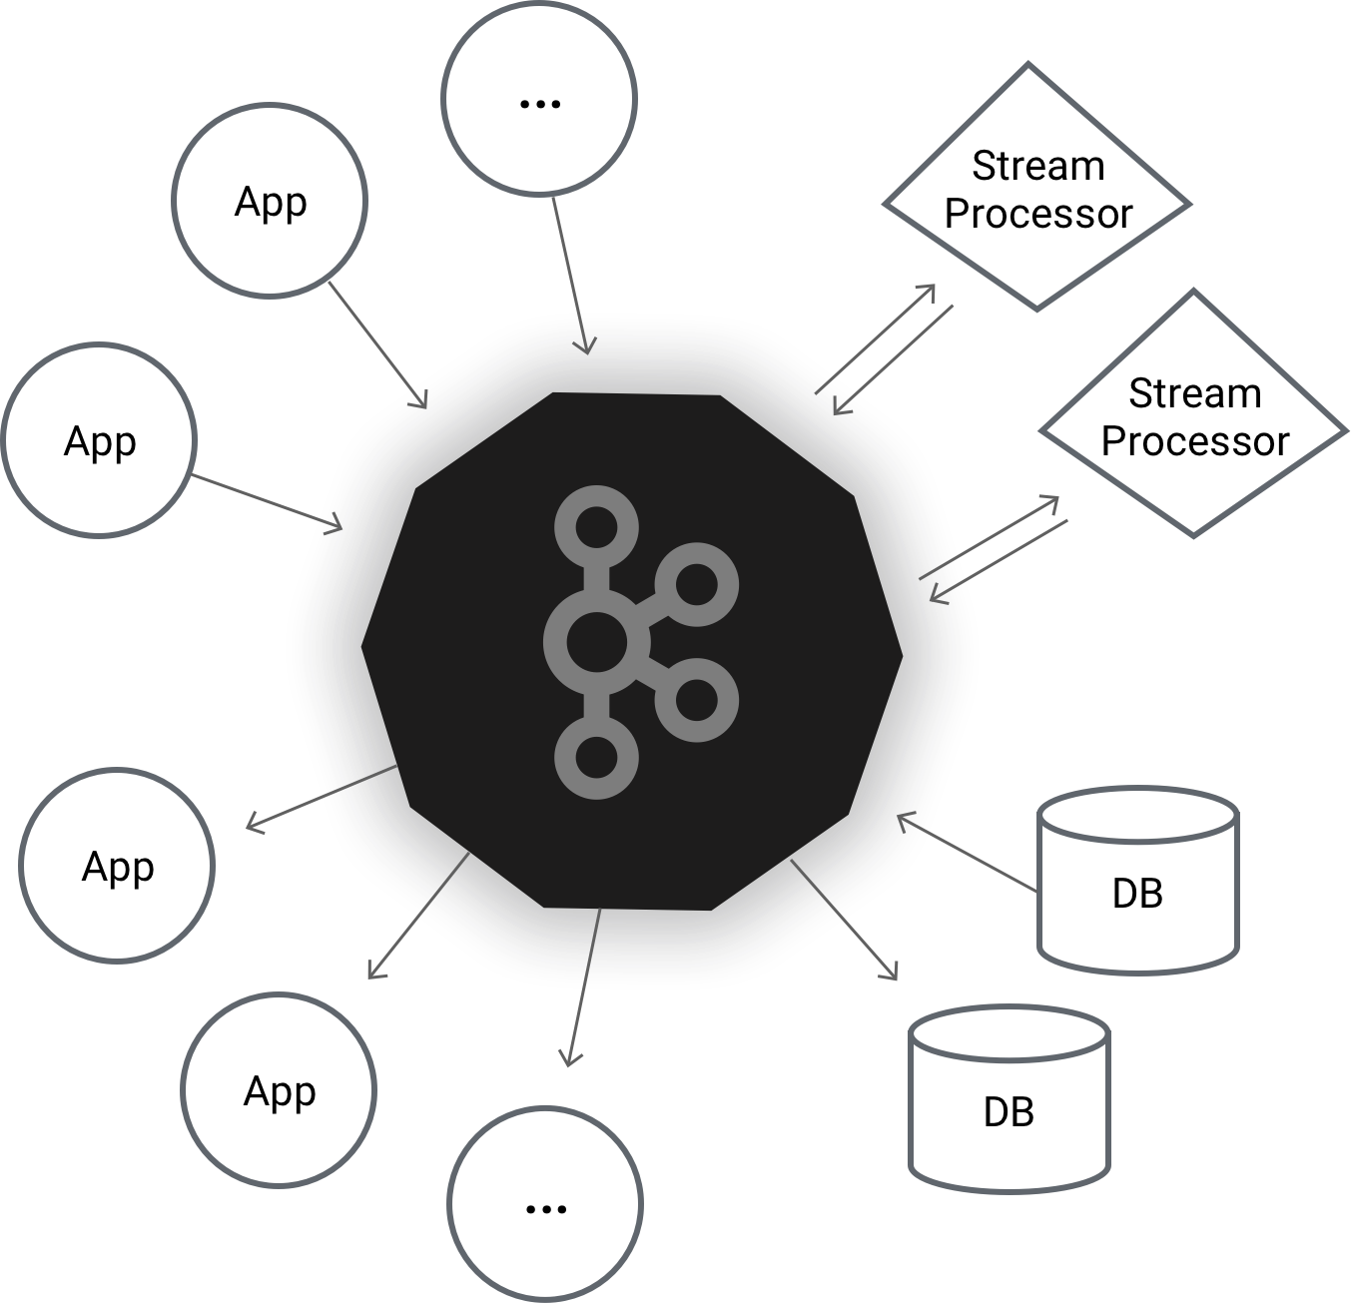
Apache Kafka – https://kafka.apache.org
Kafka is used for building real-time data pipelines and streaming apps. It is horizontally scalable, fault-tolerant, wicked fast, and runs in production in thousands of companies
It consists in 3 main parts:
Producers
Brokers
Consumers
Messages sent to Kafka are splitted in topics and partitions
A topic is a category or feed name to which records are published. Topics in Kafka are always multi-subscriber; that is, a topic can have zero, one, or many consumers that subscribe to the data written to it.
Each partition is an ordered, immutable sequence of records that is continually appended to a structured commit log. The records in the partitions are each assigned a sequential id number called the offset that uniquely identifies each record within the partition

Slide 19
Apache Kafka – https://kafka.apache.org
Producers
Producers publish data to the topics of their choice. The producer is responsible for choosing which record to assign to which partition within the topic. This can be done in a round-robin fashion simply to balance load or it can be done according to some semantic partition function (say based on some key in the record)
Consumers
Consumers label themselves with a consumer group name, and each record published to a topic is delivered to one consumer instance within each subscribing consumer group. Consumer instances can be in separate processes or on separate machines
If all the consumer instances have the same consumer group, then the records will effectively be load balanced over the consumer instances
If all the consumer instances have different consumer groups, then each record will be broadcast to all the consumer processes

Slide 20
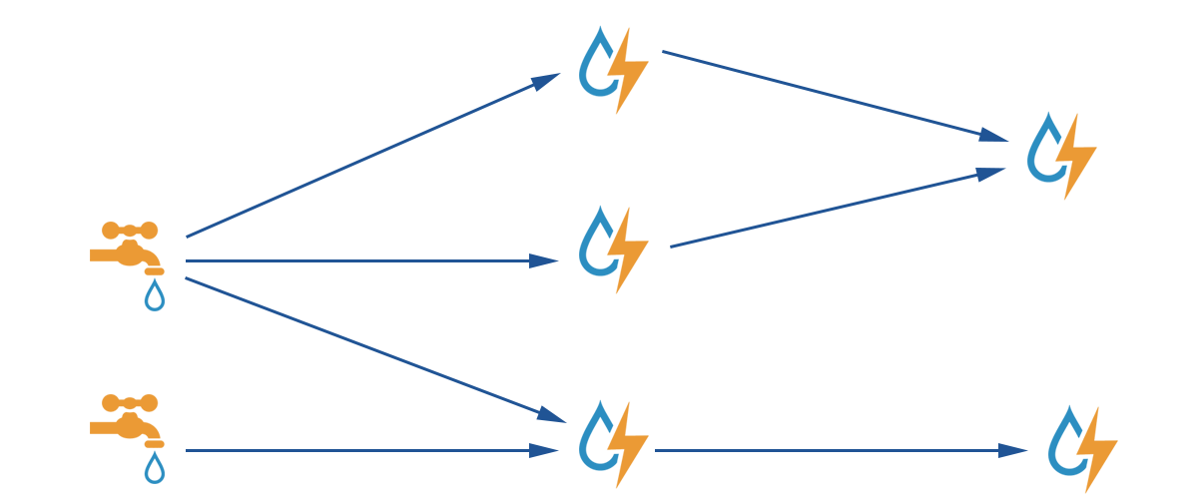

Apache Storm – http://storm.apache.org
Apache Storm is a free and open source distributed realtime computation system. Storm makes it easy to reliably process unbounded streams of data, doing for realtime processing what Hadoop did for batch processing. Storm is simple and can be used with any programming language
Storm has many use cases: realtime analytics, online machine learning, continuous computation, distributed RPC, ETL, and more
Storm is fast: a benchmark clocked it at over a million tuples processed per second per node

Slide 21
Apache Storm – http://storm.apache.org
Integrates
Storm integrates with any queueing system and any database system. Storm's spout abstraction makes it easy to integrate a new queuing system
Simple API
Storm has a simple and easy to use API with three abstraction: Spout, Bolt and Topologies
A spout is a source of streams in a computation. Typically a spout reads from a queueing broker such as Kestrel, RabbitMQ, or Kafka, but a spout can also generate its own stream or read from somewhere like the Twitter streaming API
A bolt processes any number of input streams and produces any number of new output streams. Most of the logic of a computation goes into bolts, such as functions, filters, streaming joins, streaming aggregations, talking to databases, and so on
A topology is a network of spouts and bolts, with each edge in the network representing a bolt subscribing to the output stream of some other spout or bolt. A topology is an arbitrarily complex multi-stage stream computation. Topologies run indefinitely when deployed
Scalable
Storm topologies are inherently parallel and run across a cluster of machines. Different parts of the topology can be scaled individually by tweaking their parallelism
Fault Tolerant
Storm is fault-tolerant: when workers die, Storm will automatically restart them. If a node dies, the worker will be restarted on another node
Guarantees data processing
Storm guarantees every tuple will be fully processed. One of Storm's core mechanisms is the ability to track the lineage of a tuple as it makes its way through the topology in an extremely efficient way

Slide 22

Druid – http://druid.io
Druid is a high-performance, column-oriented, distributed data store.
It is an open source data store designed for OLAP queries on event data
Interactive Queries
Issue sub-second ad-hoc queries to group, filter, and aggregate data.
Real Time Streams
Ingest data in streams or batches to unify real-time and historical views
Horizzontaly Scalable
Existing Druid clusters have scaled to petabytes of data and trillions of events, ingesting millions of events every second

Slide 23
GRAZIE PER L’ATTENZIONE

