Slide 1







UNCLASSIFIED
DISRUPT
ARMY
Our Sponsors

Slide 2
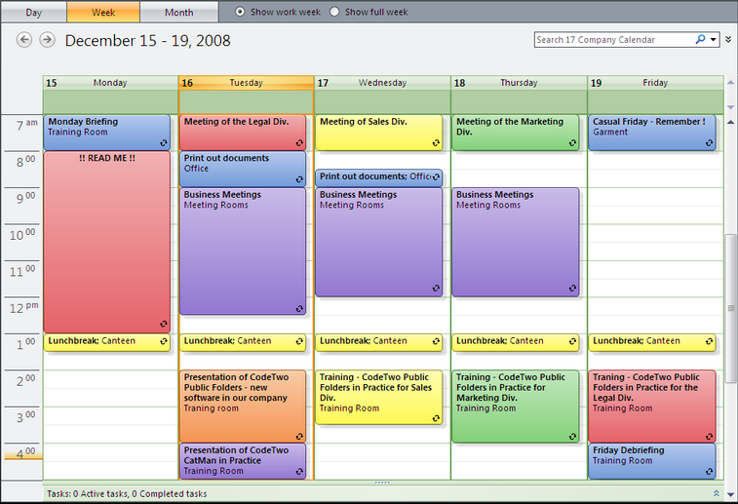
7 Personal Calendars
Executive Engagement Calendar
CG
DCG-N
DCG-S
DCG-NG
DCG-AR
COS
G3

Slide 3
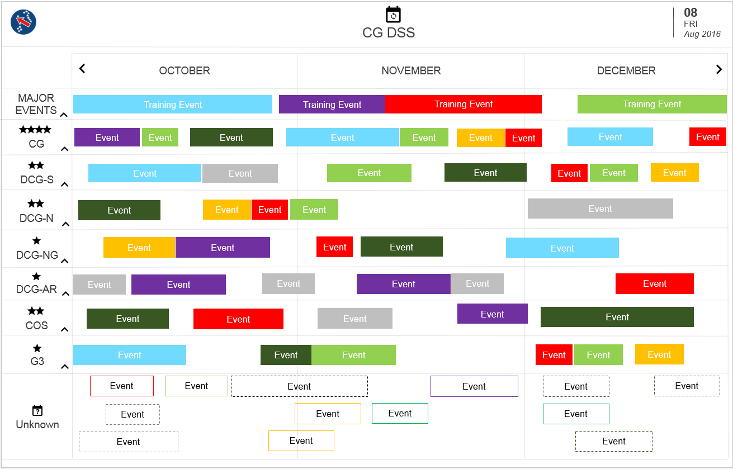

Slide 4
Executive Engagement Calendar
Instant Insights

Slide 5
That’s Where We need You and Your Team!

Slide 6
High Level Requirement
Dashboard using data available from calendar events that will help the 4-star General make informed decisions for next quarter.

Slide 7
Timeline
Tonight
5:00PM: Meet & Greet
5:30PM: Event Presentation
6:00PM: Dinner & Hack
9:00PM: Final Questions
Tomorrow
8:00am: Breakfast
10:00am: Project Submission
11:00am: Top 3 teams pitch
11:30am: Winners Announced
12:00pm: Event Closeout

Slide 8


Slide 9
Resources
Visit our github repo /disruptArmy/30 SEP 2016 for mock data and requirements list.
I will be around for questions/concerns

Slide 10



@disruptArmy
#disruptArmy
/disruptArmy
@disruptArmy
#disruptArmy

