Slide 1







UNCLASSIFIED
DISRUPT
ARMY
Our Sponsors

Slide 2



@disruptArmy
#disruptArmy
/disruptArmy
@disruptArmy
#disruptArmy

Slide 3
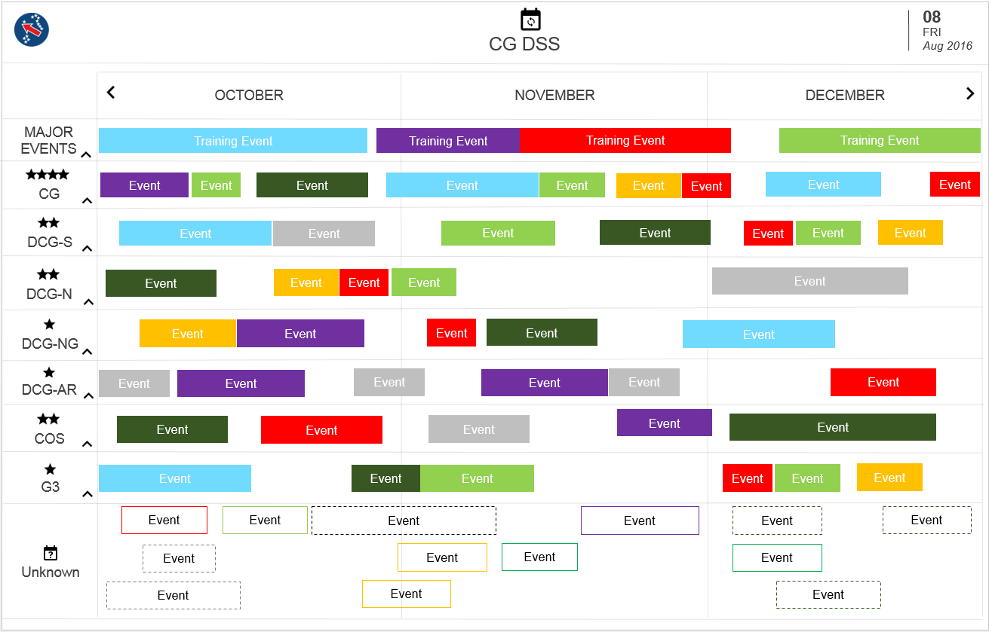
Executive Engagement Calendar
Instant Insights

Slide 4
8:00am: Breakfast
10:30am: Project Submission
11:00am: Top 3 teams pitch
11:30am: Winners Announced
12:00pm: Event Closeout

Slide 5
Teams
Submissions
Participants
12
10
36

Slide 6
FEEDBACK FOR NEXT EVENT

