Slide 1
Verified Circles: High-Trust Connections for Relocators
Tackling the Reliability Gap in Social Matching
Final Project

Slide 2
The Reliability Gap: Why matching isn't enough
• The Stats: 78% of relocators fail to build a core social circle within 12 months (Survey N=45).
• The Pain: It's not about finding people. It's about the high failure rate of meetings.
• Quote: "I have 500 matches, but I stopped trying because everyone flakes." (Interview P3)
• Core Issue: Low commitment mechanisms lead to a "Market for Lemons" (Low trust).

Slide 3
Methods + Evidence Map
Method | N / Source | What it answers | Key Limitation
Market Analysis | Cognitive Research (2024) | "Is this a real business?" | Macro data excludes niche apps.
Competitor Analysis | Product Teardown | "Why do users leave?" | Functional analysis only.
Synthetic Interviews | 6 AI Personas (GPT-4) | Hypothesis Generator | Simulation only. Requires validation.
User Survey | N=45 (Real Users - CSV) | Validation of Isolation | Biased to online distribution.
Scientific Theory | Signaling Theory | "Why will verification work?" | Theoretical application.
Process Note: Synthetic interviews = hypothesis generator; validation = surveys + behavioral test.

Slide 4
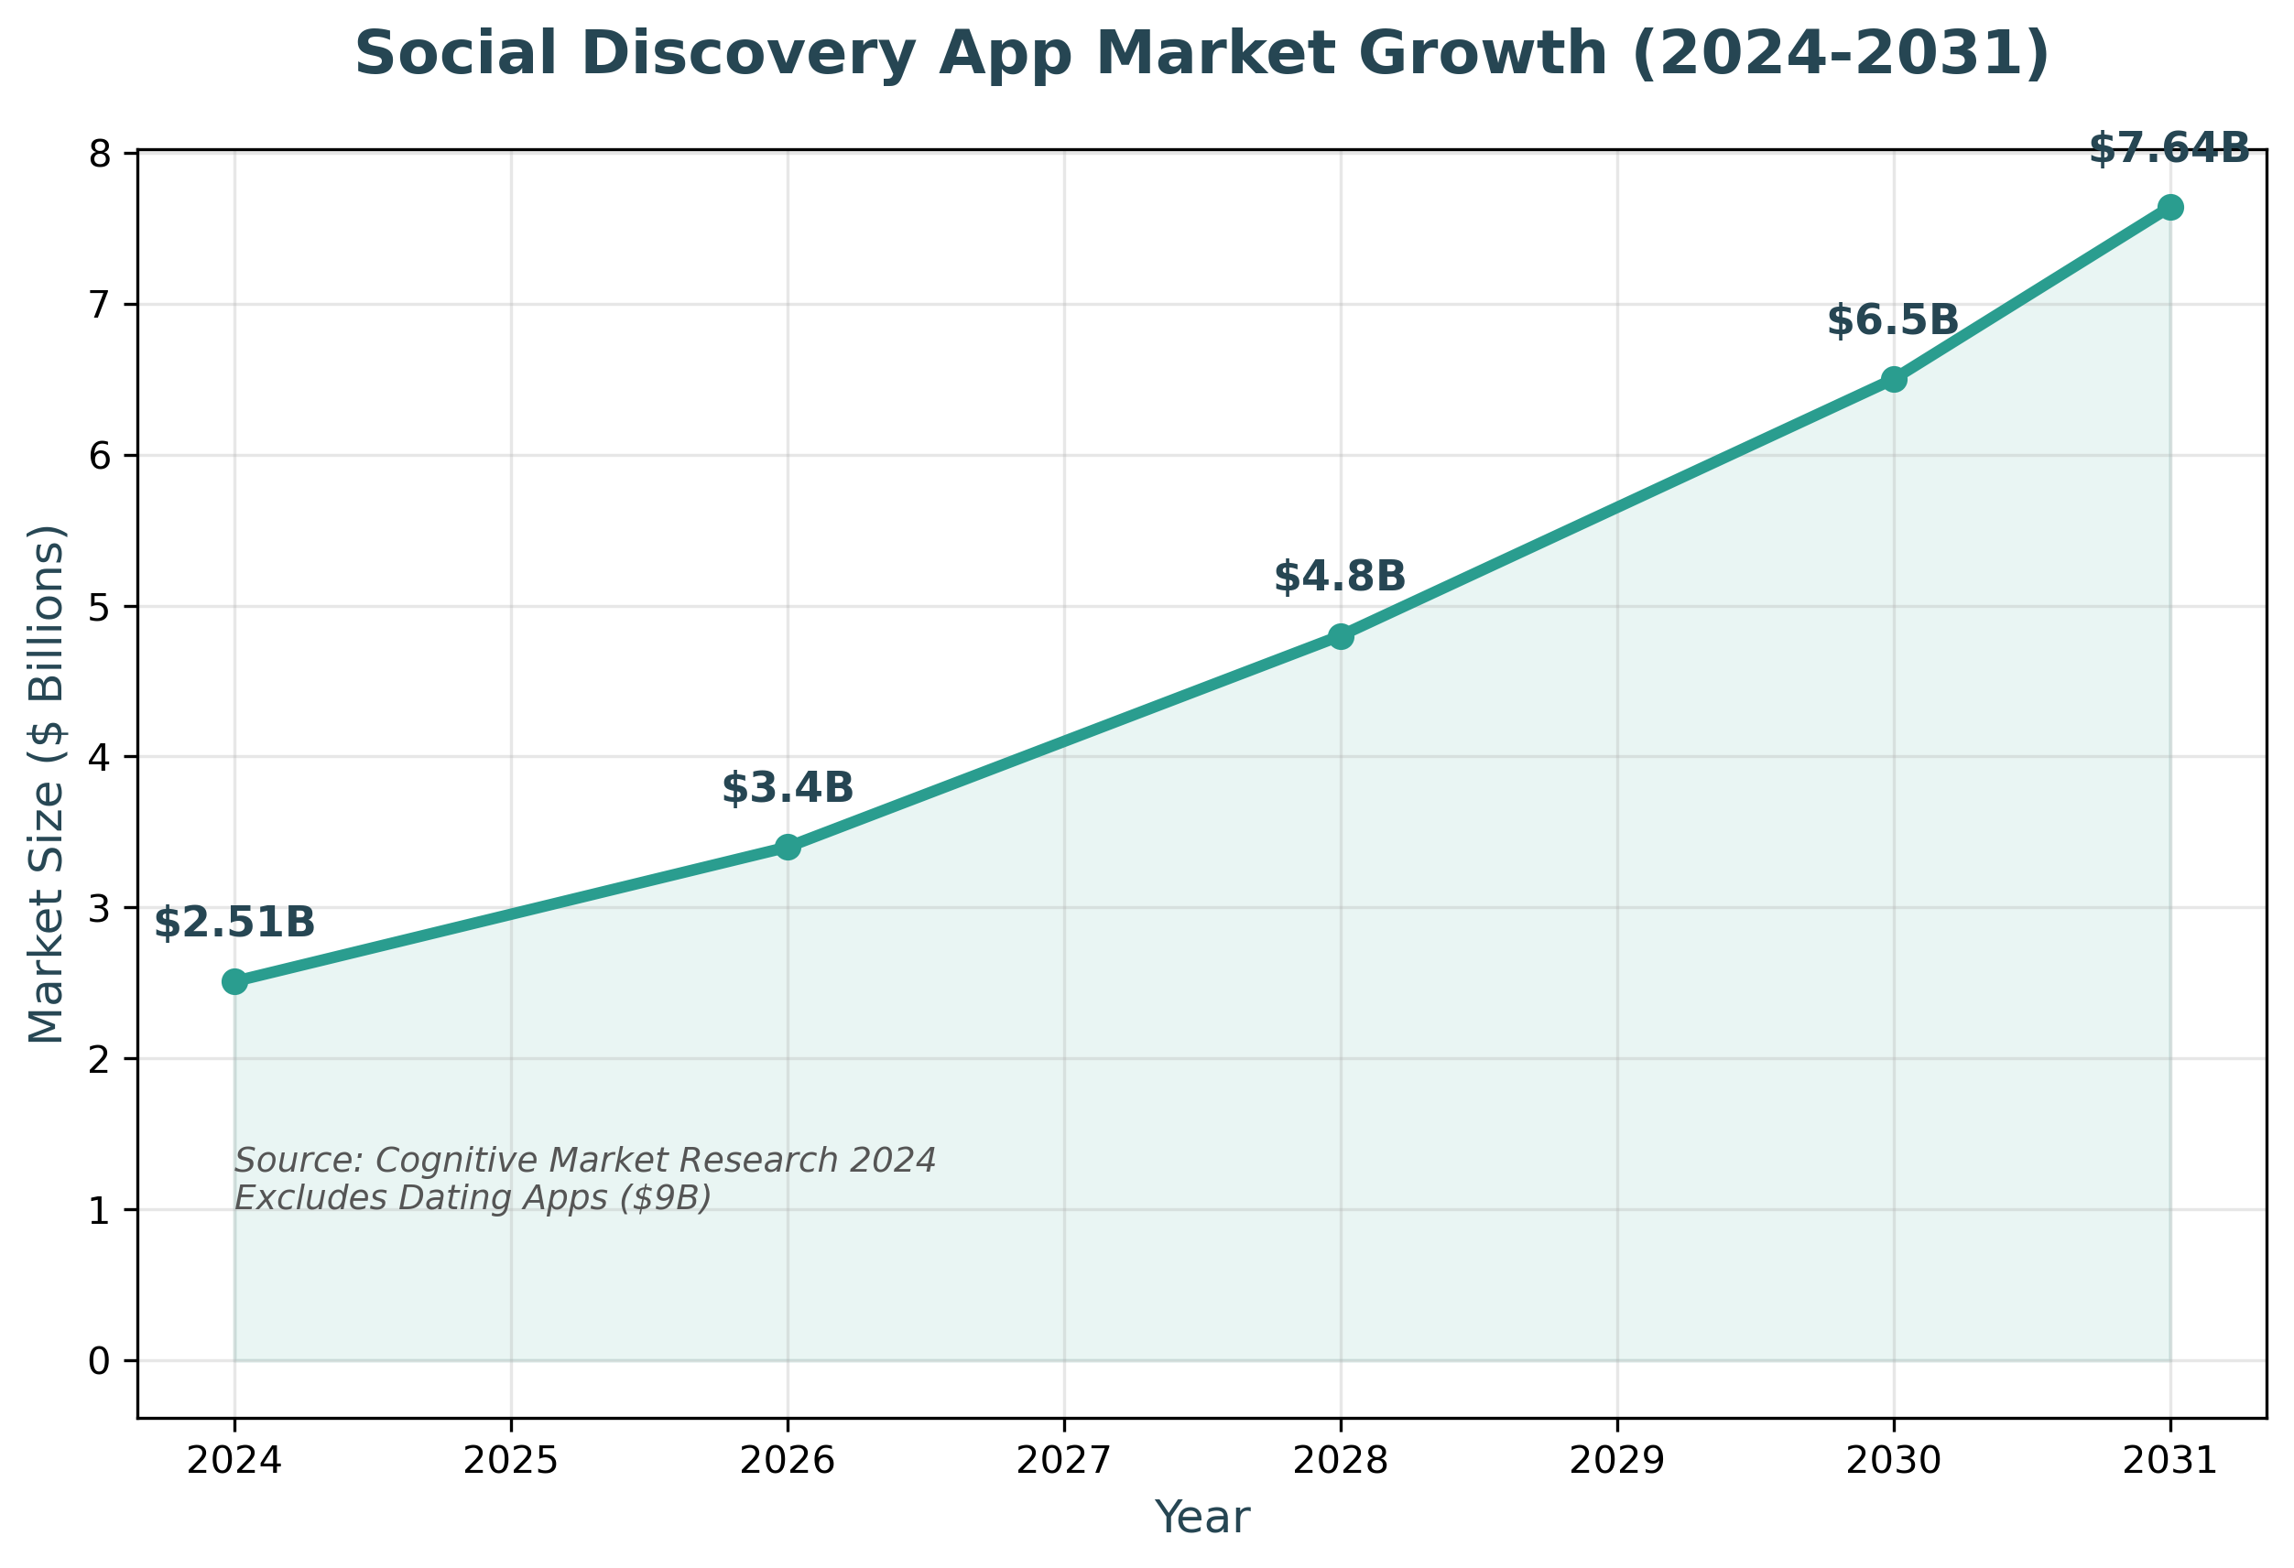
The 'Social Discovery' Market is Growing vs Dating
• Social Discovery Market: ~$2.5 Billion (2024) -> Proj. $7.6B by 2031 (CAGR 17%).
• The Gap: Dating Apps earn $9B/year (Optimization).
• The Opportunity: Users pay for Access to a high-reliability network.

Slide 5
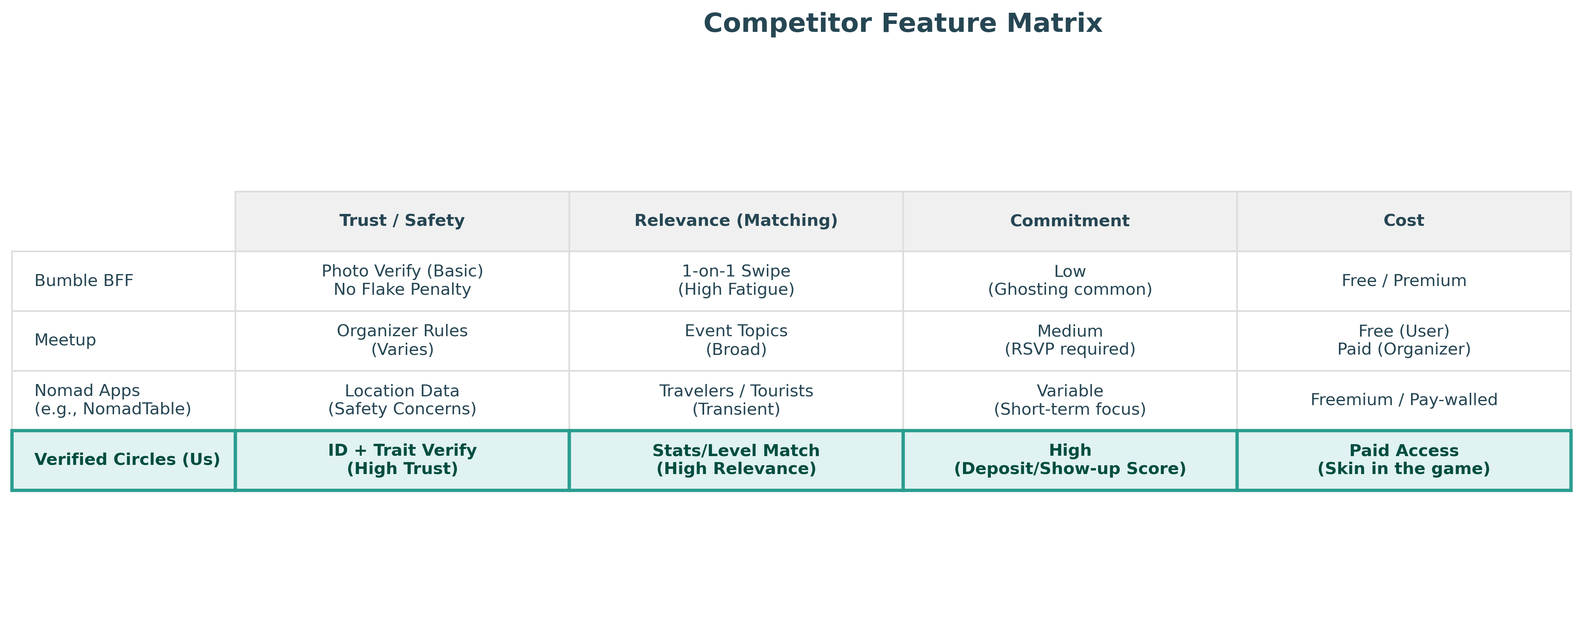
Competitor Analysis (The Trust & Commitment Gap)
• Bumble BFF: Optimizes for Visuals. Result: Dating fatigue.
• Meetup: Optimizes for Topics. Result: High noise.
• Nomad Apps: Optimizes for travelers. Result: High transience & Safety gaps.
• Verified Circles: Optimizes for Trust & Commitment.

Slide 6
Scientific Validation: Signaling Theory
1. Costly Signals: Trust is built when someone invests effort (Cost) that is hard to fake.
- Selfie = Cheap Signal (Low Trust)
- Career/Sport History = Costly Signal (High Trust)
2. Homophily: We bond with those who share verified traits.
3. Result: Verification acts as 'Social Collateral'.

Slide 7
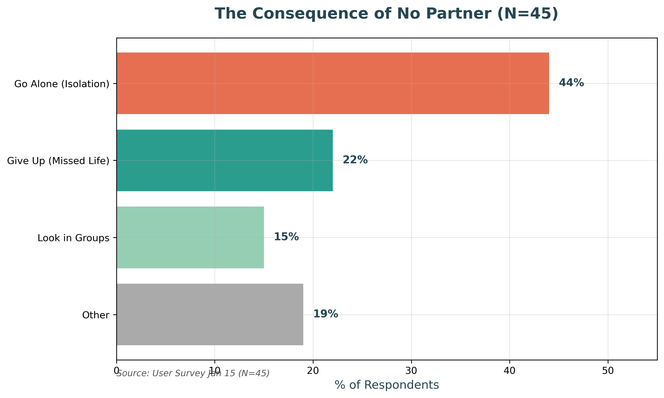
User Insights (Validation)
• The Reliability Gap: 'People says maybe and vanish.' (Users crave structure).
• The Trust Filter: Users currently stalk manually. We automate it.
• Survey Validation (N=45): 44% 'Go Alone' when no partner found.

Slide 8
Persona: 'The Time-Constrained Professional'
• Name: Omer, 32 (Senior Dev, Relocated to NYC)
• Pain: 'I have limited free time. I can't afford to waste an evening on a meetup where I don't click.'
• Current Solution: Does nothing. (Risk of wasted time > Reward)
• Needs: Efficiency, Reliability, Shared Context.

Slide 9
Solution: The '3-Layer Trust' System
Pivot: From 'Open Access' (Noise) to 'Verified Access' (Signal).
1. Trust Layer: Identity Verification + Social Collateral. (Safety)
2. Relevance Layer: Level-based Matching (e.g. Tennis 4.0). (Boredom)
3. Commitment Layer: Reputation System + Event Deposit. (Flakiness)

Slide 10
Product Snapshot & UVP
• UVP: 'The Reliability of a Club. The Convenience of an App.'
• Tagline: 'No Flakes. No Fakes. Just Friends.'
• Differentiation:
- Erasure of 'Swiping' -> Connect on Context.
- Erasure of 'Open Groups' -> Verified Peers.
• Success Metrics:
- Primary: Show-up Rate (>85%)
- Secondary: Repeat Meet Rate

Slide 11
Quantitative Validation Proposal (Next Steps)
• Behavioral Test (Smoke Test)
• Landing Page: 'NYC Tech Runners - Verified Members Only.'
• Metric: Conversion rate of visitors willing to link Strava.
• Success Criteria: >15% conversion.
- Justification: Survey 2 showed 60% willingness so 15% is conservative.

Slide 12
Conclusion
• The Problem: Loneliness is driven by Activity Isolation (44% go alone) and Flakiness.
• The Solution: Verified Circles reduces no-show rates via Costly Signals.
• Next Steps: Launch Smoke Test to validate conversion.

