Slide 1


Annotating Named Entities in TEI
Virtual Training School on NER
COST Action CA 16204 « Distant reading »
23rd of March 2021

Slide 2
PRESENTATION PLAN
What are the TEI tags for named entities?
How to use the tags – from a simple to a more elaborated annotation
Converting csv files into TEI/XML files

Slide 3
TEI about Names, Dates, People, Places
2 sections:
- Section 3.5 « Names, Numbers, Dates, Abbreviations, and Addresses » within chapter 3 « Elements available in all TEI documents »
Chapter 13: more in-depth encoding of « Names, Dates, People and Places »
Most of the above are « referring strings », that can be annotated with « referencing strings », aka <rs>

Slide 4
TEI simple annotation
<rs type=‘PERS’>Harry Potter</rs>
<rs type=‘ROLE’>Her Majesty</rs>
<rs type=‘ROLEMISC’>his cousin</rs>
<rs type=‘ORG’>the Ministry of Magic</rs>
<rs type=‘PLACE’>Hogwarth</rs>
<rs type=‘WORK’>The Tales of Beedle the bard</rs>
<rs type=‘EVENT’>the Yule Ball</rs>
<rs type=‘FAC’>Astronomy tower</rs>
<rs type=‘MISC’>Monday</rs>
<rs type=‘DEMO’>the Griffindors</rs>

Slide 5
TEI simple annotation
Do we keep the values of @type identical to those used in BRAT? (typography, expressivity, alignment with other taxonomies)
<rs> is not the only tag recommended by TEI
How do we link entities pointing to the same referent?

Slide 6
TEI annotation: types of NE
Competing classifications (see NER campaigns)
Values of @type are not constrained in TEI > you can define your own when customizing the schema
NER on literary texts: problem of the purely fictitious/ mixed characters, places, events, roles, etc.
<rs type=‘PERS’>Harry</rs> stopped under the big statue of <rs type=‘PERS’>Queen Victoria</rs>.
<rs type=‘litchar’>Harry</rs> stopped under the big statue of <rs type=‘histchar’>Queen Victoria</rs>.
<rs type=‘PERS’>Harry</rs> stopped under <rs type=‘WORK’>the big statue of <rs type=‘ROLE’>Queen</rs> <rs type=‘PERS’>Victoria</rs></rs>.

Slide 7
TEI annotation: types of NE
Whatever the choice, the values of @type should be documented in the header
<tagUsage gi=‘rs’>This element is used for marking up all named entities in the text. The type attribute on on this element takes one or more of the following values:
<list type="gloss">
<label>PERS</label>
<item>Proper names of people including first names, last names, individual or family names, fictional names and unique nicknames. This applies also to gods. Generational markers (Jr., VIII), and royal titles (Queen, Sir are included). Honorific titles (Mr., Mrs., Miss, Ms, Dr, Prof) are included when they occur followed by the proper name. Category to be used for named animals too. </item>
<label>ORG</label>
<item>Names of companies, political parties, educational institutions, sport teams, hospitals, museums, libraries etc. Especially, hotels, museums, hospitals, libraries, churches and temples, commercial facilities, ... </item>
Etc.
</list>

Slide 8
TEI alternatives
Eltec BRAT annotation values | TEI potential « translations »
PERS (person names) | <name>, <persName> or <rs type=‘person’>
ROLE (profession, nobility, office) | <roleName> or <rs type=‘role’>
ROLEMISC (family, epithet) | <rs type=‘family’>for the first, <roleName> for the second
ORG (organizations, political parties, companies…) | <orgName>, <name type=‘organisation’> or <rs type=‘organisation’>
PLACE (all types of locations) | <placeName>, <geogName>, <name type=‘place’> or <rs type=‘place’>
WORK (titles of art works) | <title> or <rs type=‘title’>
EVENT | <rs type=‘event’> (not <event>!!!)
FAC (infrastructure, superstructure, transportation) | <rs type=‘facility’>
MISC (dates, times, measures) | <date>, <time>
DEMO (names of kinds of people) | <rs type=‘demonym’>

Slide 9
TEI alternatives: person names
Harry Potter
<persName>
<forename>Harry</surname>
<surname>Potter</surname>
</persName>
Tom Riddle, Lord Voldemort
<persName>
<forename>Tom</forename>
<surname>Riddle</surname>
<addName>lord Voldemort</addName>
</persName>
Or
<persName>
<forename>Tom</forename>
<surname>Riddle</surname>
<roleName>lord</addName>
<addName>Voldemort</addName>
</persName>

Slide 10
TEI alternatives: roles
Barnabas the Barmy
BRAT: <PERS>Barnabas</PERS> <ROLEMISC>the Barmy</ROLEMISC>
TEI: <persName> <forename>Barnabas</forename> <roleName>the Barmy</roleName> </persName>
his mother Lily
BRAT: <ROLEMISC>his mother</ROLEMISC> <PERS>Lily</PERS>
TEI: <rs type=‘family’>his mother</rs> <name>Lily</name>
Or
<rs type=‘family’>his mother</rs> <persName><forename>Lily</foreName></persName>

Slide 11
TEI alternatives: place names
Little Whinging, Surrey
<placeName>
<settlement>Little Whinging</settlement>
<region>Surrey</region>
</placeName>
12, Grimauld Place, Islington, London
<address>
<addrLine>12, Grimauld Place</addrLine>
<addrLine>Islington</addrLine>
<addrLine>London</addrLine>
</address>

Slide 12
TEI alternatives: place names
A playground 200 m far from Little Whinging
<rs>a playground</rs> <placeName>
<measure>200 m</measure>
<offset>far from</offset>
<settlement>Little Whinging</settlement>
</placeName>
the Portkey placed at the top of Stoatshead Hill
The Portkey placed <placeName>
<offsett>at the top of</offset>
<geogName>
<name>Stoatshead</name> <geogFeat>Hill</geogFeat>
</geogName>
</placeName>

Slide 13
TEI alternatives: events
He wanted to invite Cho Chang to the Yule ball
He wanted to invite <name>Cho Chang</name> to <rs type=‘event’>the Yule ball</rs>
⚠️ Not <event> (alas!)
« An <event> element is usually used to record information about a place, or a person; for this reason the element usually appears as content of a <place> or <person>. However, it is also possible to describe events independently of either a person or a place. This may be useful in such applications as chronologies, lists of significant events such as battles, legislation, etc. » (TEI Guidelines, 13.3.4.3)

Slide 14
TEI alternatives: dates, time, measures
BRAT: value MISC for all
TEI
<date>: « contains a date in any format »
unsure however about:
<date>That Monday</date> he waked up full of determination.
<time>: « contains a phrase defining a time of day in any format »
<time when="08:48:00">8:48</time>
<date when="2001-09-11T12:48:00">Sept 11th, 12 minutes before 9 am</date>
<time when="1999-01-04T20:42:00-05:00">4 janvier 1999 à 8h de l'après-midi.</time>
<measure>
<measure><num>2</num> <unit>galleons</unit></measure>

Slide 15
TEI alternatives: works of art
<title>: works fine for texts, sometimes music and paintings, but it seems more of a tag abuse for statues and other works
Last year, we read <title>Le Rouge et le Noir</title>.
*He was seated under <title>Molière’s bust</title>.
He was seated under <rs type=‘work’>Molière’s bust</title>

Slide 16
Enriching the TEI annotation
Referencing strings pointing to the same entity
@key
<rs type=‘litchar’ key=‘HP’>Harry</rs> stopped. Snape was watching him. <rs type=‘litchar’ key=‘HP’>Potter</rs>, he said, …
Problem is to remain consistent about the @key values, since they are not linked to an xml:id
One can also use a standard reference, documented using a <taxonomy> element in the TEI header
Referencing strings pointing to the same entity, defined elsewhere on the web
@ref
<rs type=‘litchar’ ref=‘https://en.wikipedia.org/wiki/Harry_Potter_(character)’>Harry</rs> stopped. <rs type=‘litchar’ ref=‘https://en.wikipedia.org/wiki/Severus_Snape’>Snape</rs> was watching him.

Slide 17
Enriching the TEI annotation
How named entities are named?
Single NE/ group NE

Slide 18
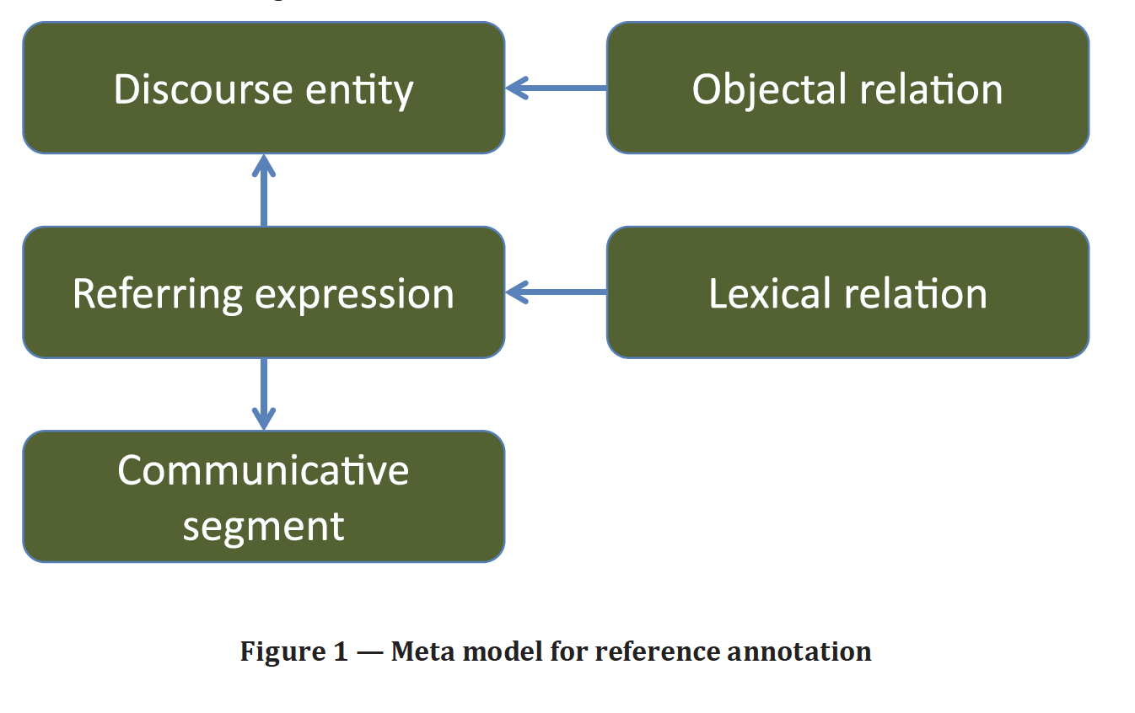
Enriching the TEI annotation
ISO/FDIS 24617-9 Language resource management — Semantic annotation framework — Part 9: Reference annotation framework (RAF)

Slide 19
Enriching the TEI annotation
<listAnnotation type="referringExpressions">
<annotationBlock target="#u-12-d1e24564">
<span xml:id="m1" target="#w2 #w3" type="referringExpression"> <!-- el hombre -></span>
<span xml:id="m2" target="#w8" type="referringExpression"> <!-- sus --></span>
</annotationBlock>
</listAnnotation>
<listAnnotation type="discourseEntities">
<interp xml:id="e1" inst="#m1" type="discourseEntity"/>
<interp xml:id="e2" inst="#m2" type="discourseEntity"/>
</listAnnotation>
<listAnnotation type="objectalRelations">
<link xml:id="link1" ana="#fs1" target="#e2 #e1” type="objectalRelation"/>
<fs xml:id="fs1">
<f name="objectalRelation"><symbol value="objectalIdentity"/></f>
</fs>
</listAnnotation>

Slide 20
Enriching the TEI annotation: relations between the discourse entities
<p>‘<rs key=‘SJ’>Girl number twenty</rs>’, said Mr. Gradgrind, squarely pointing with his square forefinger, ‘I don’t know <rs key=‘SJ’>that girl</rs>. Who is <rs key=‘SJ’>that girl</rs>?’</p>
<p>‘<rs key=‘SJ’>Sissy Jupe</rs>, sir,’ explained <rs key=‘SJ’>number twenty</rs>, blushing, standing up, and curtseying.</p>
<p>‘Sissy is not a name,’ said Mr. Gradgrind. ‘Don’t call yourself <rs key=‘SJ’>Sissy</rs>. Call yourself <rs key=‘SJ’>Cecilia</rs>.’</p>
<p>‘It’s father as calls me <rs key=‘SJ’>Sissy</rs>, sir,’ returned <rs key=‘SJ’>the young girl</rs> in a trembling voice, and with another curtsey.</p>

Slide 21
Enriching the TEI annotation: relations between the discourse entities
<p>‘<rs key=‘SJ’ ana=‘hyperonym identifier’>Girl number twenty</rs>’, said Mr. Gradgrind, squarely pointing with his square forefinger, ‘I don’t know <rs key=‘SJ’ ana=‘hyperonym’>that girl</rs>. Who is <rs key=‘SJ’ ana=‘hyperonym’>that girl</rs>?’</p>
<p>‘<rs key=‘SJ’ ana=‘fullName’>Sissy Jupe</rs>, sir,’ explained <rs key=‘SJ’ ana=‘identifier’>number twenty</rs>, blushing, standing up, and curtseying.</p>
<p>‘Sissy is not a name,’ said Mr. Gradgrind. ‘Don’t call yourself <rs key=‘SJ’ ana=‘forename’>Sissy</rs>. Call yourself <rs key=‘SJ’ ana=‘altname’>Cecilia</rs>.’</p>
<p>‘It’s father as calls me <rs key=‘SJ’ ana=‘forename’>Sissy</rs>, sir,’ returned <rs key=‘SJ’ ana=‘hyperonym’>the young girl</rs> in a trembling voice, and with another curtsey.</p>

Slide 22
Enriching the TEI: objectal relations
<p>There were <rs key="Gradgrinds" ana="name" corresp="#LG #TG" type="partial_corresp">five young Gradgrinds</rs>, and they were models every one. [...]</p>
<p>A space of stunted grass and dry rubbish being between him and the young rabble, he took his eyeglass out of his waistcoat to look for <rs key="child" ana="hyperonym" corresp="#LG #TG" type="partial_corresp">any child he knew by name, and might order off</rs>. Phenomenon almost incredible though distinctly seen, what did he then behold but <rs key="LG" ana="name qualifier" corresp="#LG" type="identity">his own metallurgical Louisa</rs>, peeping with all her might through a hole in a deal board, and <rs key="TG" ana="name qualifier" corresp="#TG" type="identity">his own mathematical Thomas</rs> abasing himself on the ground to catch but a hoof of the graceful equestrian Tyrolean flower-act!</p>

Slide 23
Enriching the TEI: objectal relations
<profileDesc> <particDesc> <listPerson> <person xml:id="LG"> <name>Louisa Gradgrind</name> </person> <person xml:id="TG"> <name>Thomas Gradgrind</name> </person> </listPerson> </particDesc> </profileDesc>
See chapter 16 of the Guidelines, « Linking, Segmentation and Alignment »: <title>, <name>, <seg> in the body + <linkGrp> in the back (or other document)

Slide 24
Automatising NE annotation
Various existing tools: SEM (sémantiseur-étiqueteur markovien), Stanford NER, SpaCy (Python library)
Not all languages covered by each tool
Two of the tools available at http://nerbeyond.jerteh.rs/

Slide 25
Exercise workflow
TXT file
Simple XML/TEI
NER with SpaCy or StanfordNER
Enrich XML output
(manual annotation)

