Slide 1
UNITEX for NER
Cvetana Krstev, JeRTeH & University of Belgrade
Denis Maurel, Université de Tours, Lifat

Slide 2
Outline of this presentation
Why Unitex for NER?
Why using dictionaries?
Why using graphs?
What can graphs in Unitex do?
Why using cascades?

Slide 3
Why using Unitex for NER?
Because it enables production of lexicon-based and rule-based systems;
It enables writing rules that rely on information from dictionaries
These rules are in the form of finite-state transducers (even ATN);
Sometimes called „local grammars“ or „shallow parser“;
Advantages:
These rules are not „black boxes“;
Lexicon-based and rule-based systems are unavoidable for preparation of training sets for machine-learning systems.

Slide 4
What is in dictionaries that can help NER?
Jeanne d'Arc,N+PR+Anthroponyme+Individuel+Celebrite
a noun (N)
a proper name (PR)
an anthroponyme, a proper name of a human being (Anthroponyme)
an individual proper name (Individuel)
a famous person (Celebrite)
Jovanka Orleanka,N+NProp+Hum+Name+Cel+DOM=Hist
a noun (N)
a proper name (NProp)
a human being (Hum)
a name given to a human being (Name)
a famous person (Cel)
a historical person (DOM=Hist)

Slide 5
What is in dictionaries that can help NER?
Bab el=Mandeb,N+PR+Toponyme+Hydronyme
a noun (N)
a proper name (PR)
a toponym (Toponyme)
a hydronym (Hydronyme)
Bab-el-Mandeb,N+NProp+Top+Hyd+Strait+Cel
a noun (N)
a proper name (NProp)
a toponym (Top)
a hydronym (Hyd)
a strait (Strait)

Slide 6
What is in dictionaries that can help NER?
Banque centrale européenne,N+PR+Anthroponyme+Collectif+Groupement+Organisation
a noun (N)
a proper name (PR)
an anthroponyme, a proper name of a human being (Anthroponyme)
a collective name (Collectif)
a group (Groupement)
an organisation (Organisation)
Evropska centralna banka,N+NProp+Org+DOM=Fin+ACR=ECB
a noun (N)
a proper name (NProp)
an organisation (Org)
in a domain of finances (DOM=Fin)
its acronym is ECB (ACR=ECB)

Slide 7
What is in dictionaries that can help NER? proper names that are not related to one individual
Eric,N+Prenom:ms
Éric,N+Prenom:ms
a noun (N)
a first name (Prenome)
masculine (m)
singular (s)
Marko,N+NProp+Hum+First
Vitas,N+NProp+Hum+Last
a noun (N)
a proper name (NProp)
a human (Hum)
a first name (First)
a surname (Last)

Slide 8
What is in dictionaries that can help NER? common nouns for titles, professions, positions
professeur,N+z1+Profession
directeur,N+z1+Profession
roi,N+z1+Profession
a profession (Profession)
profesor,N+Hum+Prof
direktor,N+Position
kralj,N+Hum+Ttl
a noun (N)
a human (Hum)
a profession (Prof)
a position (Position)
a title (Ttl)

Slide 9
What is in dictionaries that can help NER? and other common nouns
mai,N+z1
dimanche,N+z1
après,PREP+z1
quotidiennement,ADV+z1
maj,N
nedelja,N
posle,PREP
svakodnevno,ADV
a noun (N)
an adverb (ADV)
a preposition (PREP)

Slide 10
Can a NER system rely on dictionaries only?
Would lexical masks like these be enough to recognize NEs in a text with high recall and precision?
French | Serbian | NE type
<N+PR+Toponyme+Hydronyme> | <N+NProp+Hum+Hyd> | hydronym
<N+Groupement+Organisation> | <N+NProp+Org> | organization
<N+Prenom> <N+Prenom> | <N+First> <N+Last> | person’s full name

Slide 11
Dictionaries are not enough, why?
Dictionaries can never cover all named entities (names of people, toponyms, organization names, etc.). (recall drops)
This is especially true for temporal expressions that can be written in various formats and numerical expressions (measures, money...) that use numerals written with digits, words and ther combination.
Moreover, word forms are ambiguous that may lead to false recognitions. (precision drops)

Slide 12
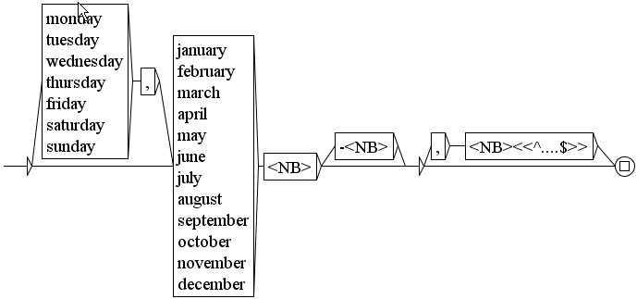
A date graph, can that be described by a dictionary?
number
4-digits number

Slide 13
Examples of ambiguity
some names are used to designate several things: Balkan – a mountain and a superregion; Congo (Kongo) – a river and a country
geographic names: Aden – a city and a personal name; Amazon – a river, an ethnonym, an organization
geographic names: Una – a river and a feminine name, Sava – a river and a masculine name and a feminine name; Jelica – a mountain and a feminine name
personal names: Miloš – a first name and a surname;
common nouns: Višnja – a feminine first name and a common noun (sour cherry), Ali – a masculine first name but aslo; a conjunction (but);

Slide 14
The ambiguity of forms
 | Ivan (masculine) | Ivana (feminine)
nominative | Ivan | Ivana
genitive | Ivana | Ivane
dative | Ivanu | Ivani
accusative | Ivana | Ivanu
vocative | Ivane | Ivana
instrumental | Ivanom | Ivanom
locative | Ivanu | Ivani

Slide 15
Graphs can help to solve many of these problems, how?
1:
They can descibe different forms a certain NE can appear in;
For example, a full name of a person as it appears in a text can consists of:
First name
Last name
Additional last name
Middle name or initial
Nick name
Title
Various orders of components; some components are optional
The recognized information is an output, e.g. the text is modified;

Slide 16

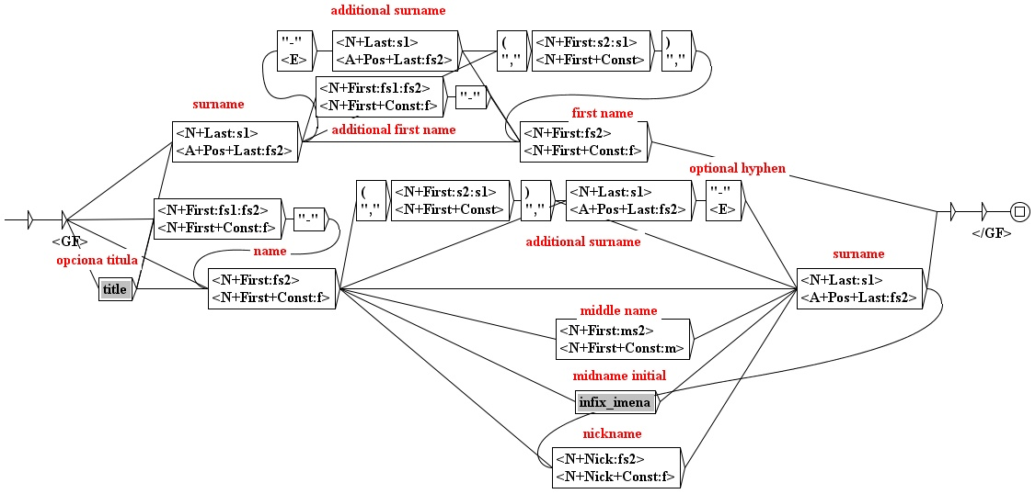
Feminine personal names in the genitive case (Serbian)
output
output
first+last

Slide 17
Names that would be recognized by some of these graphs (m/f; nominative, genitive...)
dr Milan Jovanović Batut – title, first, last, nick (m/nom);
Bojana Petrović-Popović – first, last,hyphen,last (f/nom);
Milan Gale Muškatirević – first, nick, last (m/nom);
Mahtija Ahtisarija – first, last (m/gen);
Mirjana R. Milenković – first, initial, last (f/nom);
prof. dr Dragan Radovanović – title, title, first, last (m/nom);
Aleksandar-Kristijan Golubović – first, hyphen, first, last (m/nom);
Prof. Jovana Hadži-Đokića – title, first, link, hyphen, last (m/gen);
Tešić Zoran – last, first (m/nom).

Slide 18
2: How can graphs help with false recognitions?
Some lexical masks can be restricted if there is an unwanted ambiguity;
Some concordance lines obtained with the lexical mask <N+NProp+Hyd> on a Serbian text:
There are false recognitions because
Oko is a form of Oka, a river in Russia and also a preposition oko and a form of a noun (eye);
Po is a river in Italy, and a preposition po.
povećanje vodostaja na | Nišavi | , ali i na planinskim
DOSTIGAO JE JUČE | OKO | PODNE VRH NAKON ČEGA
ali i plastenike. | Po | rečima mnogobrojnih
zbog izlivanja | Rasine | , te Zapadne i Južne

Slide 19
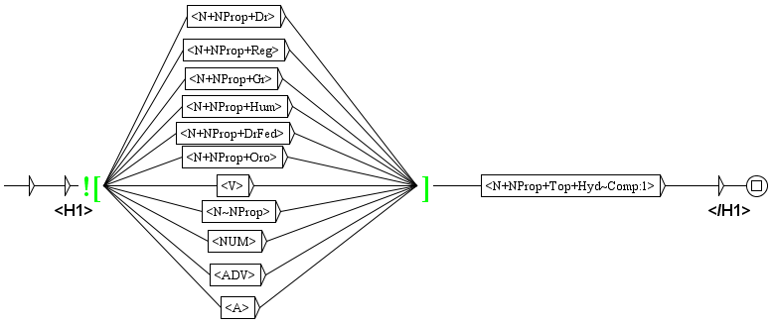
Rejecting false recognitions
lexical mask that recognizes hydronyms
but only if it is not some other proper name or other POS

Slide 20
The „right context“
Green brackets introduce so called „right context“;
The context can be „positive“ if you want the pattern inside the bracket to match the analysed text at the current position, or „negative“ otherwise;
Suprisingly, the „right context“ can appear at the beging of the graph (as in our example), in which case it proceeds only if at the current position the pattern inside brackets is matched (positive) or not (negative).

Slide 21
This can be rather restrictive and reject many true positives
This graph would reject all ocurrences of the river Sava because it is ambiguous with the first name
It will reject all ocurrences of the river Kolubara because kolubara is an ergonym, e.g. a trade name of a coal.
It will reject all ocurrences of the river Gradac because it is also the name of numerous villages in Serbia, Croatia, Bosna and Hercegovina, Montenegro, Slovenia, ... and a diminutive of grad (city)
Can this be mended?

Slide 22
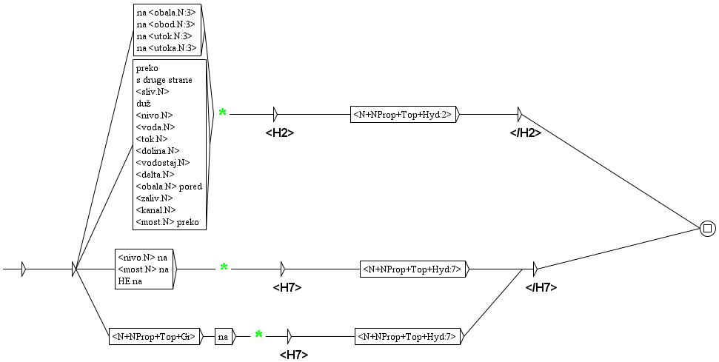
3. Recovering false rejections
lexical masks that recognize hydronyms
but only if preceded with the specified context

Slide 23
What would be recognized and tagged by this graph?
triggers
hydronyms
On the other side of the Drina
a bridge over the Danube
on the border along the Danube
raft in Belgrade on the Sava
on the banks of the Danube
s druge strane | <h2> | Drine | </h2> | da se „dignu“
za most preko | <h2> | Dunava | </h2> | , u prostorijama
na granici duž | <h2> | Dunava | </h2> | rešiće se
splav u Beogradu na | <h7> | Savi | </h7> | odakle je krenuo
Na obali | <h2> | Dunava | </h2> | pojali su
inserted tags
inserted tags

Slide 24
The „left context“
The green asterix indicates the end of the „left context“ of the expression we want to match;
Graphs can be written without this special feature, but than the left context is a part of a recognized section (and appears, for example, in concordances);
Note: output in the „left context“ is ignored.

Slide 25
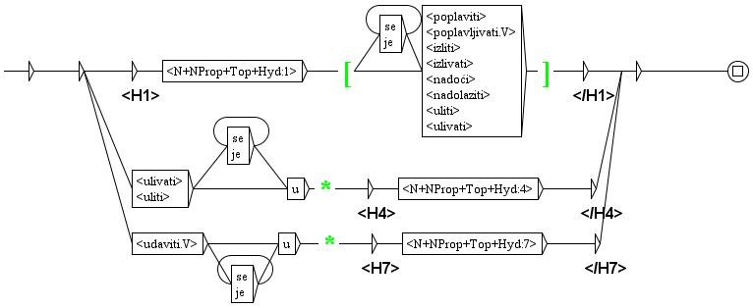
3. Recovering false rejections
verbs in the right context
hidronym
verbs in the left context
hidronym

Slide 26
What would be recognized and tagged by this graph?
the river Tamnava overflowed in the region
Timok flooded 300 houses
she drowned in the Sava
She jumped into the Sava.
hydronyms
triggers
dok se reka | <h1> | Tamnava | </h1> | izlila u rejonu
 | <h1> | Timok | </h1> | poplavio 300 kuća
udavila se u | <h7> | Savi | </h7> | i da je doneta u
i skoči u | <h4> | Savu | </h4> | .
triggers
inserted tags
inserted tags

Slide 27
4. Normalization of recognized entities
Sometimes it is useful to normalize the recognized values, and pass that value to the output;
This can be done for several purposes:
a numerical value in an entity (measures, money, percents, etc.) can be normalized;
a recognized date or time expression can be put in a normalized form, according to the standard;
for a recognized entity for person, place etc. a lemma can be output.

Slide 28
Normalization of numerals
171,1 milion evra | <money val="171100000EUR"/>
18 milijardi i 800 miliona dolara | <money val="180800000000USD"/>
160 kilometara na čas | <measure val="160kmh"/>
milijardu kubnih metara | <measure val="1000000000m3"/>
7,2 posto | <percent val="7.2%"/>
tri i po odsto | <percent val="3.5%"/>
Special type of graphs, called dictionary graphs, were
developed for Serbian that are used in the phase of
the application of dictionaries.
They assigne to each numeral its „normalized“ value.
The normalized value is also assigned to all currencies and measurement units in the Serbian dictionaries.

Slide 29
Normalization of temporal expressions
1991. godine avgusta meseca | <TIMEX3 type=“DATE“ val=“1991-08“/>
početkom maja 1992. godine | <TIMEX3 type=“DATE“ val=“1992-05“ mod=“START“/>
dva sata i 15 minuta popodne | <TIMEX3 type=“TIME“ val=“T14:15“/>
tokom meseca aprila 2011. godine | <TIMEX3 type=“DURATION“ val=“2011-04“/>
poslednjih sto godina | <TIMEX3 type=“DURATION“ val=“P100Y“/>
triput nedeljno | <TIMEX3 type=“SET“ val=“P1W“ freq=“3X“/>
Values are assigned to the attributes of TIMEX3 tag according to the standard TimeML

Slide 30
Normalization of proper named entities
Prof. Jovana Hadži-Đokića | <PERS val=„Prof. Jovan Hadži-Đokić"/>
Mahtija Ahtisarija | <PERS val=„Mahti Ahtisari"/>
udavila se u Savi | udavila se u <LOC val=„Sava"/>
Jadranskog mora | <LOC val=„Jadransko more"/>
Beogradskih elektrana | <ORG val=„Beogradske elektrane"/>
MMF | <ORG val=„Međunarodni monetarni fond"/>
Transducers that perform this normalization rely on the content of dictionaries
For instance, the entry for „Međunarodni monetarni fond“ (International Monetary Fund) has to have a marker saying that MMF is its acronym.
They also use a special „morphological mode“ and dictionary entry variables.

Slide 31
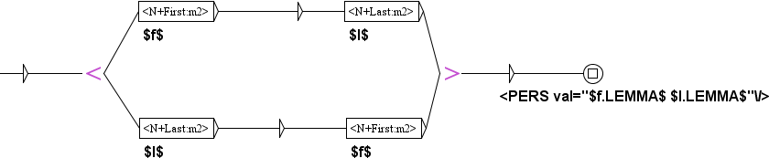
Dictionary entry variables and the morphological mode
morphological mode
morphological mode
f.LEMMA is a lemma part of a dictionary entry
dictionary entry variables -
f is set to a dictionary entry
that matches the pattern
<N+First:m2>

Slide 32
Cascades of graphs for NER

Slide 33
What are cascades of transducers?
Transducers are graphs that produce output (as we saw before)
the output can be merged with the text, or;
it can replace the recognized sequence.
A cascade of transducers applies a sequence of transducers one after another;
Each of these trandusers produces output that can be used by transducers that follow;
In a cascade, all types of transducers acn be used that can be used;
only the use of the left context is of no use;

Slide 34
What can be the output of a cascade?
It can be whatever one finds suitable for solving one’s problem;
For producing a NER system it is useful if transducers produce output that is in the form of a lexical tag?
A lexical tag is one type of a token in Unitex
For instance, {aujourd’hui,.ADV} is a lexical tag in a French text that is introduced during preprocessing;
In this way, there are no more three separate tokens: aujourd - ’ - hui, two of them being nonexistant words in French.

Slide 35
How it works?
Look at the sequence: Bank of England
A transducer reognizes England as an administrative location and replaces it with a lexical tag:
Bank of {England,.entity+loc+adm}
A subsequent transducer looks for names of organization and one of patterns it looks for is: <bank.N> of <entity+loc>
It recognizes that patterns and replaces the whole sequence with the new lexical tag:
{Bank of {England,.entity+loc+adm},.entity+org+ent}

Slide 36
Embedded named entities are recognized
---les
<org>
usines
<orgName>
du
<persName>
<roleName type="nobility">marquis</roleName>
<nameLink>de la</nameLink>
<surname>Lande</surname>
</persName>
</orgName>
</org>
factories of marquis de la Lande

Slide 37
Embedded named entities are recognized
<pers>
<persName_full>Aleksandra Miloševića</persName_full>,
<role>učitelja</role>
<org_gen>OŠ „
<persName_full>Velizar Stanković Korčagin</persName_full>"
iz
<top_gr>Velikog Šiljegovca</top_gr>
</org_gen>
</pers>
Aleksandar Milošević, teacher of the EC „Velizar Stanković Korčagin“
from Veliki Šiljegovac (in genitive)

Slide 38
Why are embbeded entities important?
Because they connect recognized entities;
What do we know about Aleksandar Milošević?
He is a teacher;
Where does he teach?
At the elementary school „Velizar Stanković Korčagin“
Where is that elementary school?
In Veliki Šiljegovac.

Slide 39
What is specific for the use of transducers in a Unitex cascade?
For each transducer in a cascade one has to specify whether it is used in a merge or a replace mode;
For instance:
Merge mode: enclosing recognized sequence in XML tags:
...+381 60 1234567... ⇒ <tel>+381 60 1234567</tel>
Replace mode: replace recognized sequence with a new text:
...+381 60 1234567... ⇒ <tel-number/>
(anonimization)

Slide 40
Repetition of the use of a transducer
A transducer in a cascade can be used repeteadly until reaching a fixed point, that is, the point in which it cannot modify the text anymore.
One has to be careful with the use of such transducers in order not to enter an endless loop (like in programming).
Example:
Text uses a tag <em> for emphasizing a sequence, and an attribute type to say how, with values: i for italic, b for bold, and s for small caps. These tags can be embbeded.
We want to replace the tag <em> with tags <i>, <b> or <s> according to the value of the attribute type.

Slide 41
Example:
Text:
...<em type="i">aaa bbb <em type="b">ccc ddd <em type="s">eee fff</em> ggg hhh</em> iii jjj</em>...
Transducer:
Recognizes tags <em type="$x"> and </em> and text between them that consists of [a-j]+ and tags <i>, </i>, <b>, </b>, <s>, </s> (but not <em> and </em>)
and replaces tags <em> and </em> with <$x> and </$x>.

Slide 42
How does the transducer work in the iteration mode?
Text:
...<em type="i">aaa bbb <em type="b">ccc ddd <em type="s">eee fff</em> ggg hhh</em> iii jjj</em>...
First run recognizes <em type="s">eee fff</em>
Resulting text: ...<em type="i">aaa bbb <em type="b">ccc ddd <s>eee fff</s> ggg hhh</em> iii jjj</em>...
Second run recognizes: <em type="b">ccc ddd <s>eee fff</s> ggg hhh</em>
Resulting text: ...<em type="i">aaa bbb <b>ccc ddd <s>eee fff</s> ggg hhh</b> iii jjj</em>...
Third run recognizes: <em type="i">aaa bbb <b>ccc ddd <s>eee fff</s> ggg hhh</b> iii jjj</em>
Resulting text: ...<i>aaa bbb <b>ccc ddd <s>eee fff</s> ggg hhh</b> iii jjj</i>...
Forth run: fixed point, transducer cannot recognize anything.

Slide 43
Rules applied to transducers in a Unitex cascade
Priority is always given to the longest match.
Regularly (outside a cascade) all matches by a local grammar are indexed, which means that they are listed also in concordances. Since a transducer in a cascade modifies text, it has to choose between several possibilities, and it chooses the leftmost match.
Weights can be given to paths that match the same sequence:
when producing concordances, only line with the highest weight is listed;
in a cascade, since a transducer has to produce an output, one path among those that match the same sequence is randomly chosen, unless the wights are assigned to these paths.

Slide 44
Example of the use of weights
Priority is always given to the longest match.
Regularly (outside a cascade) all matches by a local grammar are index, which means that they are listed also in concordances. Since a transducer in a cascade modifies text, it has to choose between several possibilities, and it chooses the leftmost match.
Weights can be given to paths that match the same sequence:
when producing concordances, only line with the highest latest weight is listed;
in a cascade, since a transducer has to produce an output, one path among those that match the same sequence is randomly chosen, unless the wights are assigned to these paths.

Slide 45
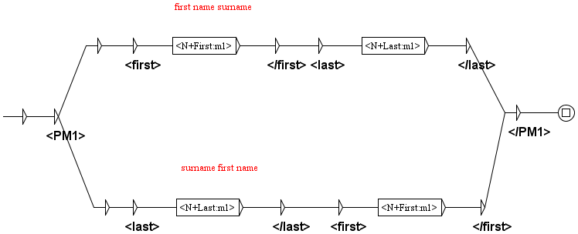
A transducer without weights
Recognizes masculine names in the nominative case writen in one of two forms:
first name followed by a surname (a path above)
a surname followed by a first name (a path below)
In the case both pats are matched, e.g. Novak Milić, one path would be randomly chosen.

Slide 46
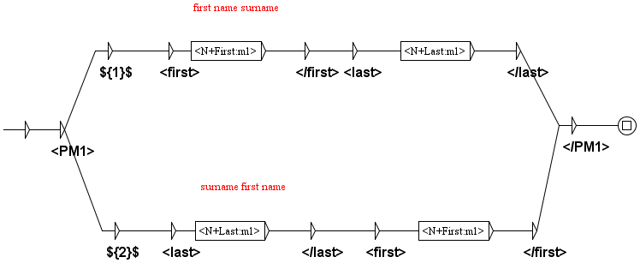
A transducer with weights
Weight 1 is given to the: first name followed by a surname (a path above)
Because it is the usual (more frequently used) order of a first name and a surname
Novak Milić, would be tagged as <PM1><first>Novak</first> <last>Milić</last></PM1>
weight 1
weight 2

Slide 47
Tagging generalization graphs
A special kind of graphs to be used in cascades, and useful for NER;
Sometimes we recognize something in a text due to triggers; e.g. in ...reka Sava... reka is a trigger that enables tagging Sava (which is ambiguous) as a hydronym.
But Sava can appear in the same text without any trigger in her context.
Then generalization graphs can be used that have empty boxes that the program itself fills with forms automatically extracted from a list of tokens of a text that were previously tagged in a given way.

Slide 48
The example of a generalization graph
At a certain point of the application of a cascade a list of tokens of a text contains the following:
{Sava,.NE+hyd+river:ms1q}
{Savi,.NE+hyd+river:ms3q:ms8q}
{Savu,.NE+hyd+river:ms4q}
In a text there are still forms Sava, Savi, Savu... that were not tagged

Slide 49


A generalization graph
Avoids tagging what has already been tagged
A generalization graph after processing

Slide 50
Why else are cascades interesting for NER?
With cascades recognition (analyse) is separated from tagging (synthese).
One cascade is used for the recognition and the other for the tagging.
That means that different taggings can be used for different purposes, not changing anything in the recognition process:
With or without embbeding
Skipping tags for some recognized entities, etc.

Slide 51
An example of the analysis and synthesis – a text FRA02001 from the French sub-collection
D-reading NER tag set
<p>- Le gouvernement français, messieurs, avait été pressenti par l'<ORG>Aéro-Club</ORG> au sujet de cette course au Pôle, le <ORG>Conseil des ministres</ORG> m'a chargé de vous dire qu'il ajoute cent mille francs aux trois cent mille dont on vient de vous parler !</p>
<p>Le <PERS>marquis de la Lande</PERS> agita le bras pour demander la parole puis il annonça :</p>
<p>- Je donne deux cent mille francs ! Ne voulant pas demeurer en reste avec le richissime marquis, ami de tous les sports, les gros instructeurs d'automobiles, les <ROLE>industriels</ROLE> qui se trouvaient là s'empressèrent de s'engager pour de fortes sommes...</p>
<p>Si bien que le <ROLE>président</ROLE>, lorsque le tumulte fut un peu calmé, put annoncer :</p>
<p>- Messieurs, le prix du voyage au Pôle sera de un million six cent mille francs !</p>

Slide 52
An example of the analysis and synthesis – a text FRA02001 from the French sub-collection
TEI NER annotation
<p><s>- Le gouvernement français, messieurs, avait été pressenti par l'<orgName>Aéro-Club</orgName> au sujet de cette course au Pôle, le <orgName>Conseil des ministres</orgName> m'a chargé de vous dire qu'il ajoute <measure type="currency" quantity="cent mille" unit="francs">cent mille francs</measure> aux trois cent mille dont on vient de vous parler !</s></s></p>
<p><s>Le <persName><roleName type="nobility">marquis</roleName> <nameLink>de la</nameLink> <surname>Lande</surname></persName> agita le bras pour demander la parole puis il annonça :</s></s></p>
<p><s>- Je donne <measure type="currency" quantity="deux cent mille" unit="francs">deux cent mille francs</measure> !</s> <s>Ne voulant pas demeurer en reste avec le richissime marquis, ami de tous les sports, les gros instructeurs d'automobiles, les <roleName type="office">industriels</roleName> qui se trouvaient là s'empressèrent de s'engager pour de fortes sommes...</s></s></p>
<p><s>Si bien que le <roleName type="office">président</roleName>, lorsque le tumulte fut un peu calmé, put annoncer :</s></s></p>
<p><s>- Messieurs, le prix du voyage au Pôle sera de <measure type="currency" quantity="un million six cent mille" unit="francs">un million six cent mille francs</measure> !</s></s></p>

Slide 53
How can cascades be used?
They can be used in the Unitex environment;
Preferable mode for developers – it is easy to try and correct;
Unitex commands used in the Unitex environment can be translated into a script, which subsequently can be used in the command line of the operating sequence.
The script can be applied to a single file or to a collection of files in a folder.
Preferable mode for end users.
That is how French NER system (CasEN) was used to annotated the whole French collection.

Slide 54
Is this all that can be said about Unitex?
Certainly not.
There is much more that can be said about graphs, transducers, cascades etc.
For instance, we have not mentioned various sort of variables and how they can help in solving probles.
Fortunately, there is a comprehensive manual that can be downloaded from the Unitex official site
https://unitexgramlab.org/releases/3.1/man/Unitex-GramLab-3.1-usermanual-en.pdf

Slide 55
You can also read some articles:
Krstev, Cvetana, Ivan Obradović, Miloš Utvić, and Duško Vitas. "A system for named entity recognition based on local grammars." Journal of Logic and Computation 24, no. 2 (2014): 473-489.
Jaćimović, Jelena. "Recognition and normalization of temporal expressions in Serbian medical narratives." Infotheca-Journal for Digital Humanities 19, no. 2 (2019): 26-60.
Jaćimović, Jelena, Cvetana Krstev, and Drago Jelovac. "A rule-based system for automatic de-identification of medical narrative texts." Informatica 39, no. 1 (2015).
Friburger, Nathalie, and Denis Maurel. "Finite-state transducer cascades to extract named entities in texts." Theoretical Computer Science 313, no. 1 (2004): 93-104.
Maurel, Denis, Enza Morale, Nicolas Thouvenin, Patrice Ringot, and Angel Turri. "ISTEX: A database of twenty million scientific papers with a mining tool which uses named entities." Information 10, no. 5 (2019): 178.

