Slide 1
Unitex for NER - exercises
Cvetana Krstev, JeRTeH & University of Belgrade
Denis Maurel, Université de Tours, Lifat

Slide 2
Starting
Start Unitex
Choose English as the working language
Choose text (Menu Text →Open): ENG18900_Doyle_noHeader_xml.txt
It is a text from English ELTeC sub-collection (Arthur Conan Doyle’s novel „The sign of four“); header was removed for easier manipullation (for exercises)
XML tgs are there, but the suffix .xml was replaced by .txt

Slide 3
Processing the text
Answer „yes“ to the question „Do you want to preprecess the text“
Uncheck the boxes „Applay graph in a MERGE mode“ and „Applay graph in a REPLACE mode“
Press „GO“ button

Slide 4
Applying dictionaries
Open Text→Apply Lexical Resources
Check if three dictionaries are set by default: dela-en-public, CasENAmbiguites-, CasEnIstexDico (they have to be „gray“);
If not:
select dictionaries that are not (Ctrl+click)
Press „Set default“
Then press „Apply“
If yes:
everything is OK, exit

Slide 5
Apply lexical mask <N+FirstName>
Open Text→Locate Pattern
Type in „Regular expression“ field: <N+FirstName>
In „Search limitation“ choose „Index all occurrences in text“
Press „Search“ button
You should obtain 391 matchs
Press „OK“, then press „Build concordance“

Slide 6
What can be seen in concordances?
There are positive matches: Abdullah, Abel, Jonathan, etc.
There are also false matches: London, India, An, Even, etc.
More precise querries are neccesary
We will make a graph that uses the marker „FirstName“ and the context
Open new graph with FSGraph→New

Slide 7
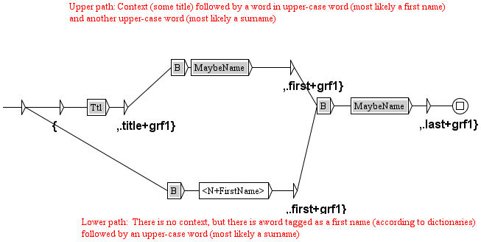
Make this simple graph

Slide 8
The use of subgraphs
In order to invoke a subgraph you have to type in a box a colon and then the name of a subgraph
:B
:Ttl
:MaybeName
This boxes are red until you save your graph in the same folder in which this sub-graphs are stored
This you will do when you finish with your graph, then the boxes will turn gray.

Slide 9
The output of a graph
You want to make a lexical tag out of the recognized sequences.
The begining of a tag is an open curl bracket: <E>/{
then comes the recognized sequence
the end of a lexical tag is its type, and the closing curl bracket: <E>/,.first+grf1}
Beside a type we can add the name of the graph, it is good for the contol, to know which graph has tagged what

Slide 10
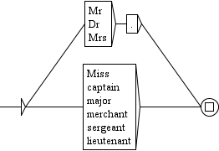

What the sub-graphs do? Alt+click to open a subgraph
MaybeName.grf
title.grf
B.grf

Slide 11
Have you produced the graph?
Save it with some name (xxx.grf)
FSGraph→Save as...
Now you can use it:
Text → Locate Pattern
Use this graph for search
Produce concordances with Grammar outputs not taken into consideration (by default), you will obtain 96 lines (some are OK, some are not)
Produce now cocordances in the Merge mode, you obtain again 96 lines of concordances, but recognized sequences have the form of lexical tags:
{Abdullah,.first+grf1} {Khan,.last+grf1}

Slide 12
What else?
We proceed with graphs that try to recognize as many names as possible (as correctly as possible)
This graphs are already prepared, we will just use them
How to see them? We will open an already prepared cascade:
Text→ApplyCassys cascade
select cascade TS_analysis.csc
press button Edit
We will look at next graphs, one by one (you can see each of graphs by selecting one and pressing a button View)

Slide 13

2. Gen_first
If something was recognized as a first name in a broader contex (graph T_First_Upperfirst), we assume it is correct and we tag all occurrences of that as a first name as well.

Slide 14
Apply the cascade
Now we can apply the cascade that performs the analysis, that is, recognizes and tags names (intermediary tagging);
We will now apply this cascade:
Text→ApplyCassys cascade
select cascade TS_analysis.csc
press button Launch

Slide 15
How can we see what this graph has done?
Open in Unitex the intermidiary file:
Text→ENG18900_Doyle_noHeader_xml_csc→ ENG18900_Doyle_noHeader_xml_1_0.snt (it is the result of the first graph in the cascade)
search for the pattern <first> (Text→Locate Pattern) – you will obtain 41 mathes
Now open file ENG18900_Doyle_noHeader_xml_2_0.snt (it is the result of the second graph in the cascade)
Again search with the pattern <first> – you will obtain 96 results
The second grpah has „generalized“!
We will continue to analyze braphs in this cascade.

Slide 16

3. Gen_last
It has the same function as the previous graph but for the „last“ name
We can check what it has done in the same way as for the previous graph, only we look in the next intermediary file.

Slide 17
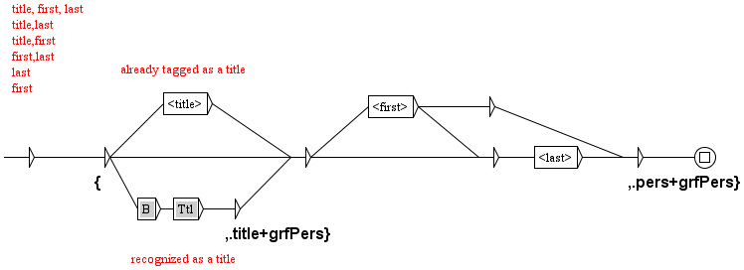
4. Pers
We tag a „person“ everything we had recognized so far

Slide 18
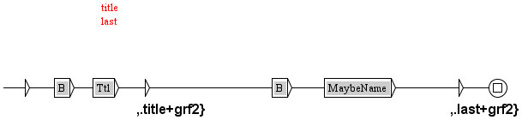
5. T_Last
We try to recognized what is left – title followed by something written in the first upper-case (probably a surname)

Slide 19
The end of the cascade
The last two graphs were already used:
You can use the same graph several times in the same cascade if that suits your purpose
Gen_last generalizes the newly recovered surnames
Pers groups all elements belonging to a person named entity

Slide 20
What has been achieved?
Open the results of the cascade:
Text→Open→ENG18900_Doyle_noHeader_xml_csc.raw
(you have to go back to the Corpus folder)
„Do you want to preprocess the text“, you answer „No“
This version of the result uses lexical tags that you may use for the search
Text→Locate Pattern→Regular expression: <pers>
You will obtain 600 matches, you can produce concordnces to see what is there.

Slide 21
How can you obtain XML version of results?
This was a cascade for the recognition (the analysis phase)
Now you have to open another version of the result of the first cascade:
Text→Open→ENG18900_Doyle_noHeader_xml_csc.txt
It is in the Corpus folder and again you do not want a preprocessing
We will open an already prepared cascade:
Text→ApplyCassys cascade
select cascade TS_synthesis.csc
press button Launch

Slide 22
What have we got?
You can open now the newly prduced file ENG18900_Doyle_noHeader_xml_csc_csc.txt (from the catalog Corpus) in Notepad++
You will see at the beginning:
<pers><first>Sherlock</first> <last>Holmes</last></pers>
and later on:
<pers><title>Miss</title> <first>Mary</first> <last>Morstan</last></pers>

Slide 23
What about false recognitions?
Many of them can be avoided, how?
First, dictionaries have to be improved to contain more proper names with more refined markers.
Even without that much can be done.
You can notice that there are lot of „urban places“ mentioned in this novel. Using appropriate triggers (street, square, etc.) and the most appropraite order of graphs can remove many ambiguities.
The same goes for toponyms (island, isles, etc.)

Slide 24
Conclusion
This exercise session was prepared to give you the impression how things are done and what can be achieved.
There is a comprehesive manual to help
There is a forum to answer your questions
We are also available in order you need help

