Slide 1
Welcome to reactive programming in Spring
Can you answer to the followings,
What does reactive programming means?
What are the draw backs in current thread programming model?
What is the name of the project available in spring eco-system to provide reactive programming?
What are the two main publisher contacts available in spring eco system?
What is Rsocket?

Slide 2
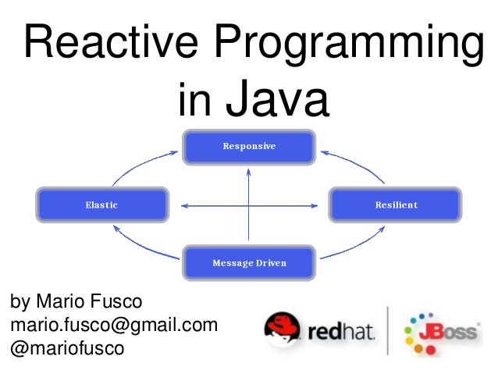

Slide 3
What does term reactive mean?
The term, “reactive,” refers to programming models that are built around reacting to change — network components reacting to I/O events, UI controllers reacting to mouse events, and others. In that sense, non-blocking is reactive, because, instead of being blocked, we are now in the mode of reacting to notifications as operations complete or data becomes available.

Slide 4
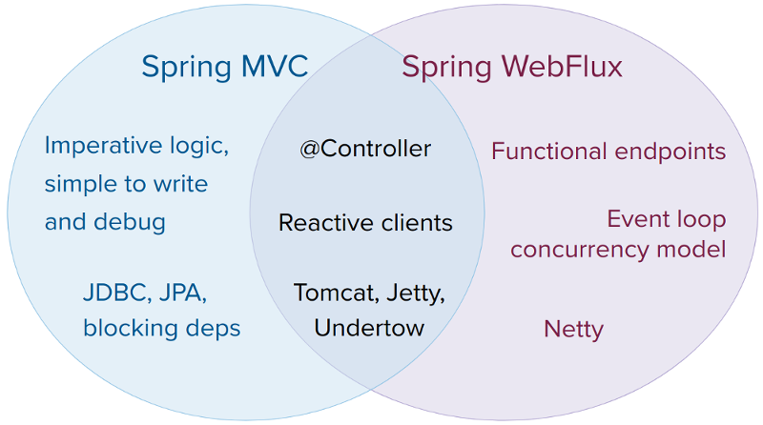
Spring WebFlux

Slide 5

Spring WebFlux Key Features
Spring WebFlux is supported on Tomcat, Jetty, Servlet 3.1+ containers, as well as on non-Servlet runtimes such as Netty and Undertow. All servers are adapted to a low-level, common API so that higher-level programming models can be supported across servers.
Reactive and non-blocking generally do not make applications run faster there for the main focus to handle many requests with small number of resources(Threads and Memory)
In Spring WebFlux (and non-blocking servers in general), it is assumed that applications do not block, and, therefore, non-blocking servers use a small, fixed-size thread pool (event loop workers) to handle requests.

Slide 6
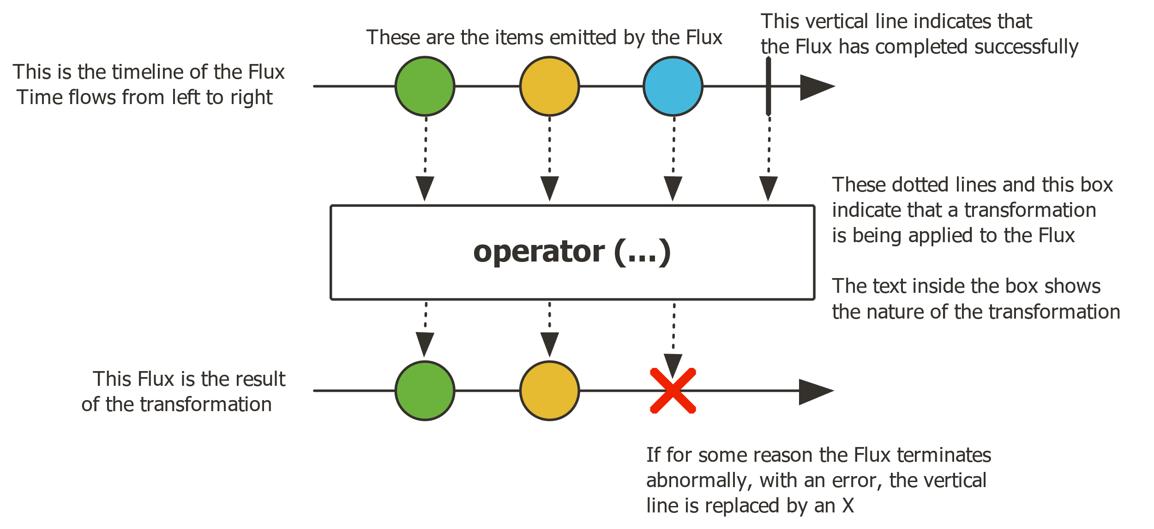
Two Main APIS in Spring WebFlux
Flux is the reactive time publisher that can emits zero or more elements.

Slide 7
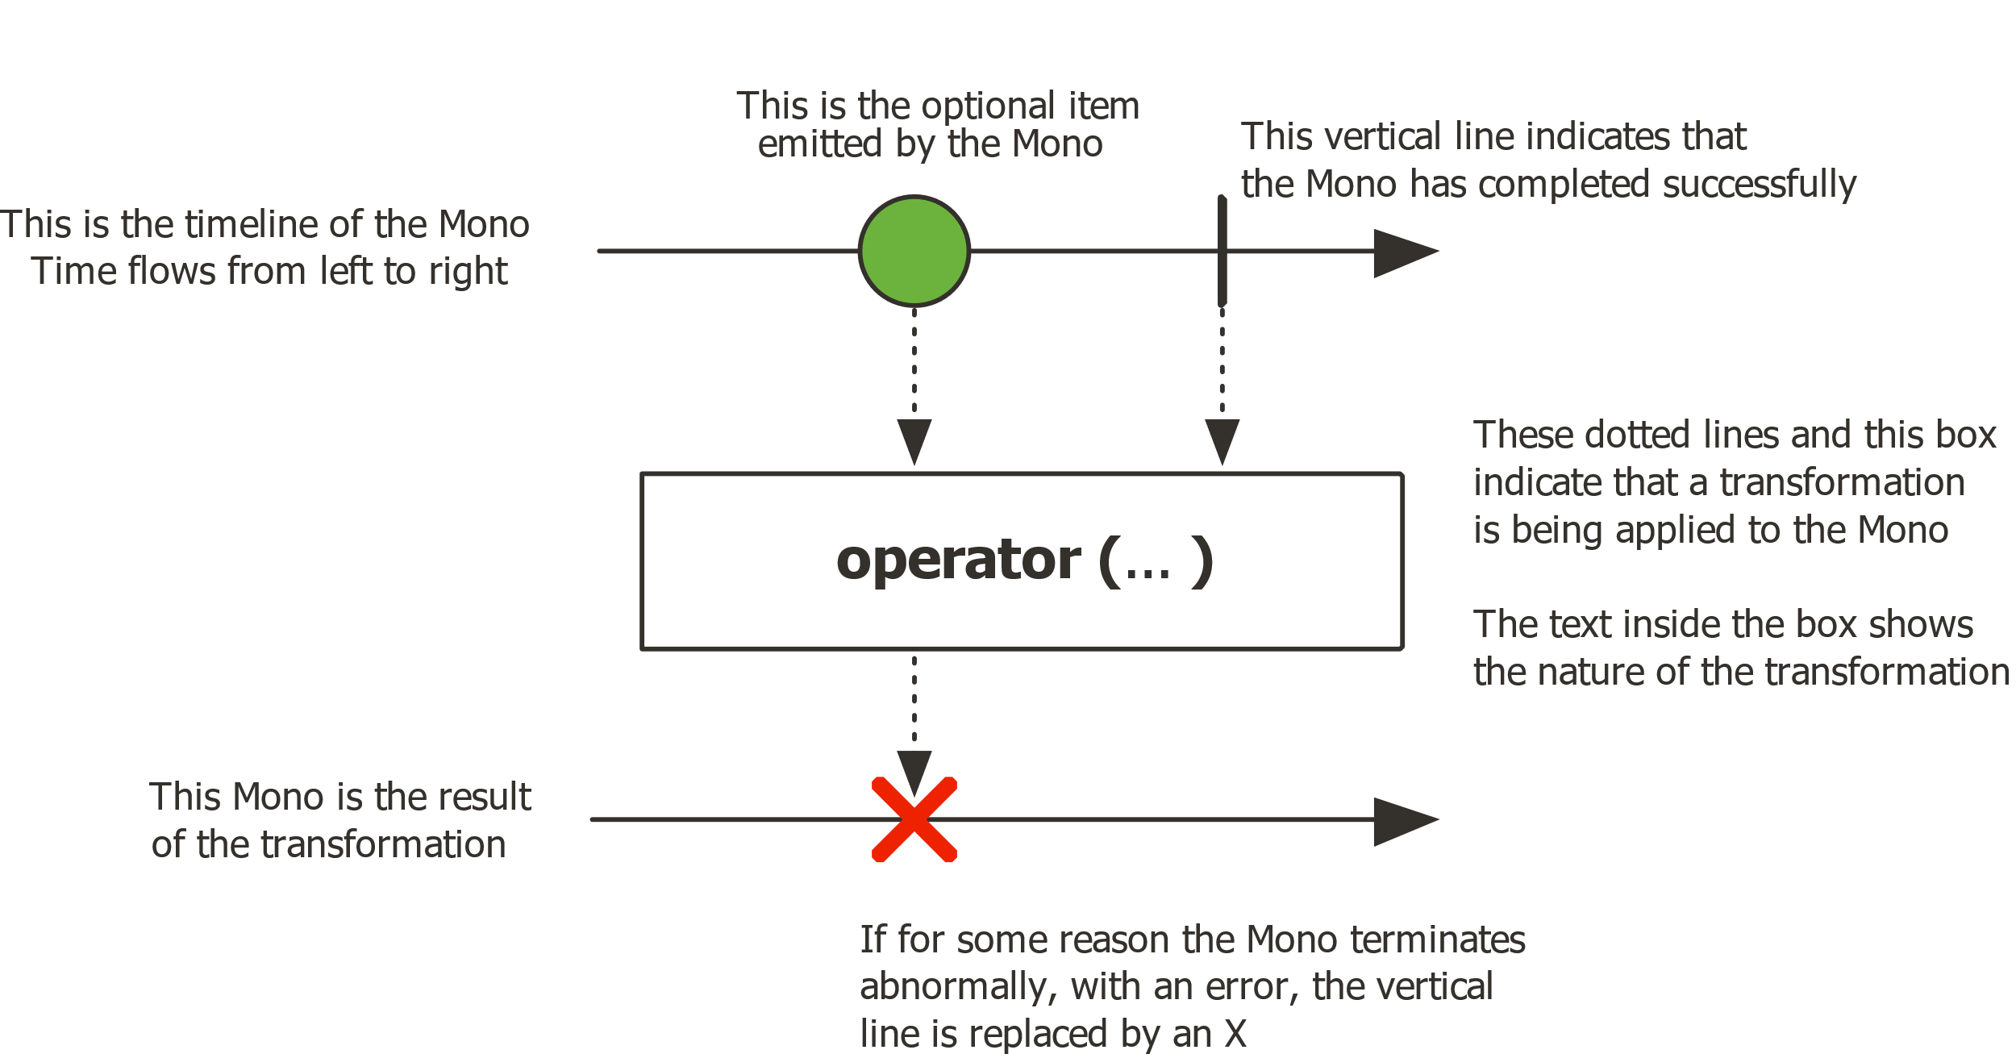
Two Main APIS in Spring WebFlux
Mono is the reactive time publisher that can emits zero or one elements.

Slide 8
Rsocket
RSocket is the future of communication in microservice and cloud-native architectures and it is an application layer protocol initially developed by Netflix and adopted by facebook .
There are four symantics in Rsocket protocol named as,
RequestResponse
RequestStream
FireAndForget
RequestChannel

Slide 9
Useful Resources
https://docs.spring.io/spring/docs/current/spring-framework-reference/web-reactive.html
https://projectreactor.io/docs/core/release/api/reactor/core/publisher/Flux.html
https://projectreactor.io/docs/core/release/api/reactor/core/publisher/Mono.html

Slide 10
Questions?

