Slide 1

Team
ynman
Notes:
EJ

Slide 2
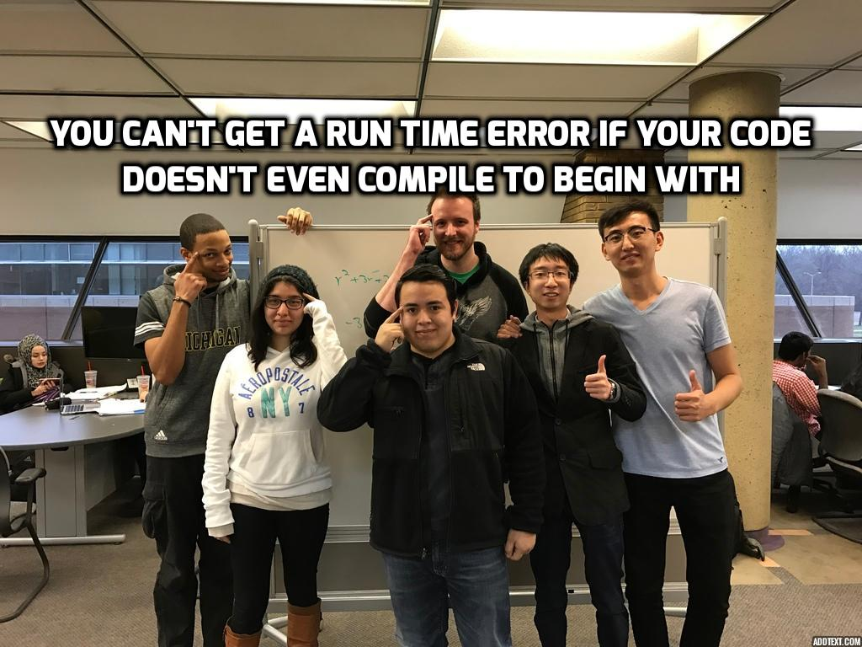
Notes:
EJ
Name from left to right
Durwin Johnson, Cindy Samano, Alex Pope, Erik Johnson, Wenhao Zhang, Reggie Jirigesu

Slide 3
Introduction to Team: Individual Skillsets
Erik Johnson
Language of choice: C++
Other languages: VBScript, BASH, Windows Batch, JavaScript, C#
Strengths: Project management experience, CS research experience, detail-oriented.
Durwin Johnson
Language of choice: C++
Other languages: lesser degrees of c#, visual basic, and Java
Strengths: Detail-oriented, planning, problem solver.
Alex Pope
Language of choice: C++
Other languages:
Strengths: Organization.
Cindy Samano
Language of choice: C++
Other languages:
Strengths: Communication, methodical, goal-oriented.
Notes:
EJ

Slide 4
Introduction to Team: Individual Skillsets: Project Managers
Reggie Jirigesu
Programming experience in C++, Java and proficient with LINUX
Experienced with web development and proficient with PHP, SQL and HTML
Strong background in algorithms, data structures and mathematics
Wenhao Zhang
• Programming Languages: JavaScript, C++ , Python, Java
Currently does web development
Notes:
EJ

Slide 5
Introduction to Team : Team Skillsets
Strengths:
Know C++ programming language
Communicative
Team dynamic ( personalities do not clash)
Positive attitudes
Thorough investigation of customer requirements
Weaknesses:
Time management
Inexperience
Notes:
CS
Weaknesses:
Time Management: Overconfidence in achieving goals and deadlines
Inexperience: We have never done a project of this scale.

Slide 6
Introduction to Team: Roles and Responsibilities
Team Members | Role | Responsibility
Erik Johnson | Team Lead | Coordinating development team’s tasks Transcribing meeting minutes Submitting Progress report to customer and Project Managers Team signoffs on artifacts
Durwin Johnson | Developer | Producing artifacts related to the project Communicating with the Project Managers Presenting finalized copy of the project Completing tasks assigned by team lead
Alex Pope | Developer
Cindy Samano | Developer
Reggie Jirigesu | Project Manager | Review and sign off on SPMP artifacts Sign off on progress reports Provide guidance and recommendations with all aspects of project
Wenhao Zhang | Project Manager
Notes:
CS
SPMP Task(s)
Erik
1.4 Performance/Behavior Constraints
2.1 Historical Data Used for Estimates
2.2.1 SPMP Completion Estimate
2.2.2.1 Lines-of-Code Estimate
2.2.2.2 Function Estimate
5.0 Staff Organization (all)
Meeting Minutes
Tool Management
Durwin
2.2.2.3 Tasks Estimate
2.2.2.4 Total Overall Project Time Estimate
2.5 Project Resource
4.1 Project Task Set
4.2 Task Network Diagram
4.3 Timeline Chart (Milestones)
Alex
1.2 Project Scope (all)
1.5 Management and Technical Constraints (all)
3.0 Risk Management (all)
2.3 Estimation Techniques Applied Results (all)
2.4 Reconciled Estimate
Cindy
Communication plan
Exception calendar
Availability sheet
1.1 Problem Statement
1.3 Major Software Functions
6.0 (all)
SPMP Reformatting
SPMP Compilation
Presentation Tasks

Slide 7
Additional functionality
Team Functionality
Dynamic item reorder quantity adjustment (AccuStock)
Individual Functionality
Company-wide sales discount (per-item) – Alex Pope
Coupled items - Erik Johnson
Customer refill eligibility –Cindy Samano
Customer coupons – Durwin Johnson
Notes:
CS
Dynamic item reorder quantity adjustment (AccuStock): If we run out of stock of an item frequently, have system order more than the default upon reorder, and if we never run out of stock by X units, have system order less than the default. This will be based on an item threshold that has been increased/decreased.
Company-wide sales (per-item): Wide sale on a particular item: when item X gets rung up a discount is applied
Coupled items: If a customer purchases item X and item X and Y are coupled, a message asking if the customer would like to add item Y to their order is displayed so the cashier can ask
Customer refill eligibility: Based off the refill date of the customer's last order, check all of their prescriptions and see if any are eligible for refill, and if so, display a message to indicate to the cashier to ask the customer if they want that prescription refilled
Customer Coupons: Customer coupons that provide a percent discount across the entire order

Slide 8
Technology We Plan to Use
Programming language: C++
Compiler: Visual Studio 2015
Program Interface: Command line
Offline data storage: Flat Files
Notes:
CS
Programming Language: The team is most familiar with C++.
Since we will be building with visual studio the program will be limited to machines that are compatible with visual studio
Program Interface: The program will use a text-driven menu system reading and writing from the command line as its input/output source due to our skill set limitations as well.
Offline Data Storage: The program will use flat files to store data offline, due to only two members having experience with databases, and nobody having experience integrating databases into C++.

Slide 9
Technology We Plan to Use Tools Used
Communication tools:
Slack
Google Docs and Google Calendar
Organization tools:
Wrike
Microsoft Project
GitHub
Time Tracking tool:
Toggl
Notes:
ej
Communication tools:
Slack: Main method of communication between team members.
Google Docs and Google Calendar
Organization tools:
Wrike Project Management: Used to assign tasks to both team members and Project Managers.
Microsoft project: Used to create the network diagram and timeline chart.
GitHub: Used for versioning of documents.
Time Tracking tool:
Toggl: Used to keep track of time on tasks and meetings.

Slide 10
Technology We Plan to Use Why these tools?
Slack
Wrike
Toggl
GitHub
Microsoft Project
Notes:
EJ
Since these are the tools we will be using throughout the entirety of the project we felt as though we need to justify them:
Slack: Free, previous experience, intuitive, better organization than a group text, log all conversation, mobile app
Wrike: Free, previous experience, easy to assign tasks, keeps you notified, mobile app
Toggl: Free, previous experience, mobile app, reports(team functionality depends on this), time collection for team.
GitHub: Free, ubiquitous, mature, retention of historical versions of artifacts.
Microsoft Project: Most accessible way to build task network diagram.

Slide 11
Estimates Part 1 Estimate
SPMP completion Estimate: 60 Hours
Notes:
EJ
SPMP Completion: Based on previous experience with similar but smaller templates from past Computer Science classes, we Estimate the SPMP will take approximately 60 Hours to complete.

Slide 12
Estimates Overall Project Initial Estimate
Overall Project initial
Lines of code: 5000 lines of code, 102 Hours
Function Estimate: 18 functions
Task Estimate: 46 Hours per person, 184 Hours total
SPMP completion Estimate: 60 Hours
Total Overall Project time Estimate: 162 Hours
Notes:
EJ
Initial project Estimates:
As a basis for our Estimates we drew upon on Erik’s current work experience, a lines of code per hour formula, and sampling of previous projects. Sampling previous projects allowed us to determine which projects are significant enough to be included in the lines of code per hour formula. Erik’s current work experience will give us insight into how much time and effort it will actually take to complete the project. A lines of code per hour formula was applied to major programming projects from CIS 200 and up for each team member.
Lines of code: Based on prior experience with previous computer science projects, we Estimate this project to require 5000 lines of code. 5000 total lines divided by the team average of 49 lines of code per hour giving us102 hours
Function Estimate: We counted the functions present in 1.3, the Major Software Functions, and used them for the function point estimation. The lowest-level functionality in 1.3 is counted and added up. Totaling 18 functions
Task Estimate: Breaking down the project into high level tasks and estimating the time in which we believed it would take to complete each task. 46hours/person , total 184 hours
SPMP Completion: Based on previous experience with similar but smaller templates from past Computer Science classes, we estimate the SPMP will take approximately 60 Hours to complete.

Slide 13
Estimates Actual Part 1 Time Spent
Person-Hours spent so far: 116 Hours
Notes:
EJ
Based on time-tracking in Toggl, and rounding any ‘partial hours’ up to full hours.

Slide 14
Estimates Part 2 Estimate
New Estimation Method: Tasks
Part 2 Estimate (Tasks): 238 Hours
Why switch?
Notes:
EJ
Why switch? Switch to tasks estimate and tweak it based on findings and calculations based on findings from task one.
Original selection was strange heuristic based on average hours spent per day based on person-hours up until today
(vs FPE) Closest estimate to actual (function point seems way off)
(vs LOC) Able to estimate based on task difficulty vs. just an hours-per-day average, better estimates for individual pieces of project
(vs Both) Tasks more adjustable based on new information

Slide 15
Estimates New Overall Project Estimate
Overall Estimate (LOC): 116 Hours (no change)
Overall Estimate (FPE): 808 Hours
Overall Estimate (Tasks): 538 Hours
Notes:
EJ
LOC – No real changes, still based on function decomposition diagram
FPE – Changes based on knowledge gleaned from use case summary & specs and more in-depth thought about program functionality
Tasks – Changes based on knowledge gleaned from completion of phase 1 & use case

Slide 16
SPMP What was easiest?
1.2 Project Scope
1.4 Performance/Behavior Constraints
1.5 Management and Technical Constraints
2.1 Historical Data for Estimates
4.1 Project Task Set
Notes:
CS
Tasks that were easy will be tasks that took the less amount of time to complete based on reports from toggl:
1.2 Project Scope: Laying out the team skillsets helped to identify exclusions such as using a flat-file system vs a database; INCLUSIONS AND EXCLUSIONS.
1.4 Performance/Behavior Constraints: Thinking about reasonable expectations of functionality
1.5 Management and Technical Constraints:
Management constraints: Constraints are based on individual schedules and exceptions to team members availability.
Compared to the technical constaints
Technical constraints: Knowing the kinds of language we will be programming in and based on team skillset.
2.1 Historical Data for Estimates: Deciding what sources to use as historical data i.e Erik’s current job, programs that are from CIS 200 and up (excluding labs b/c we did not feel they were very representative of an individuals work)
4.1 Project task set: A communication plan was already in action by the time the SPMP was assigned making it easier to decide what the next steps of action would be.

Slide 17
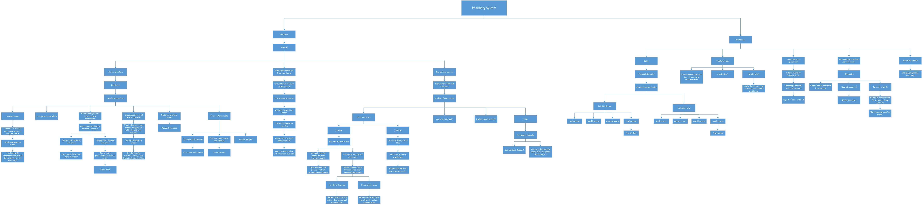
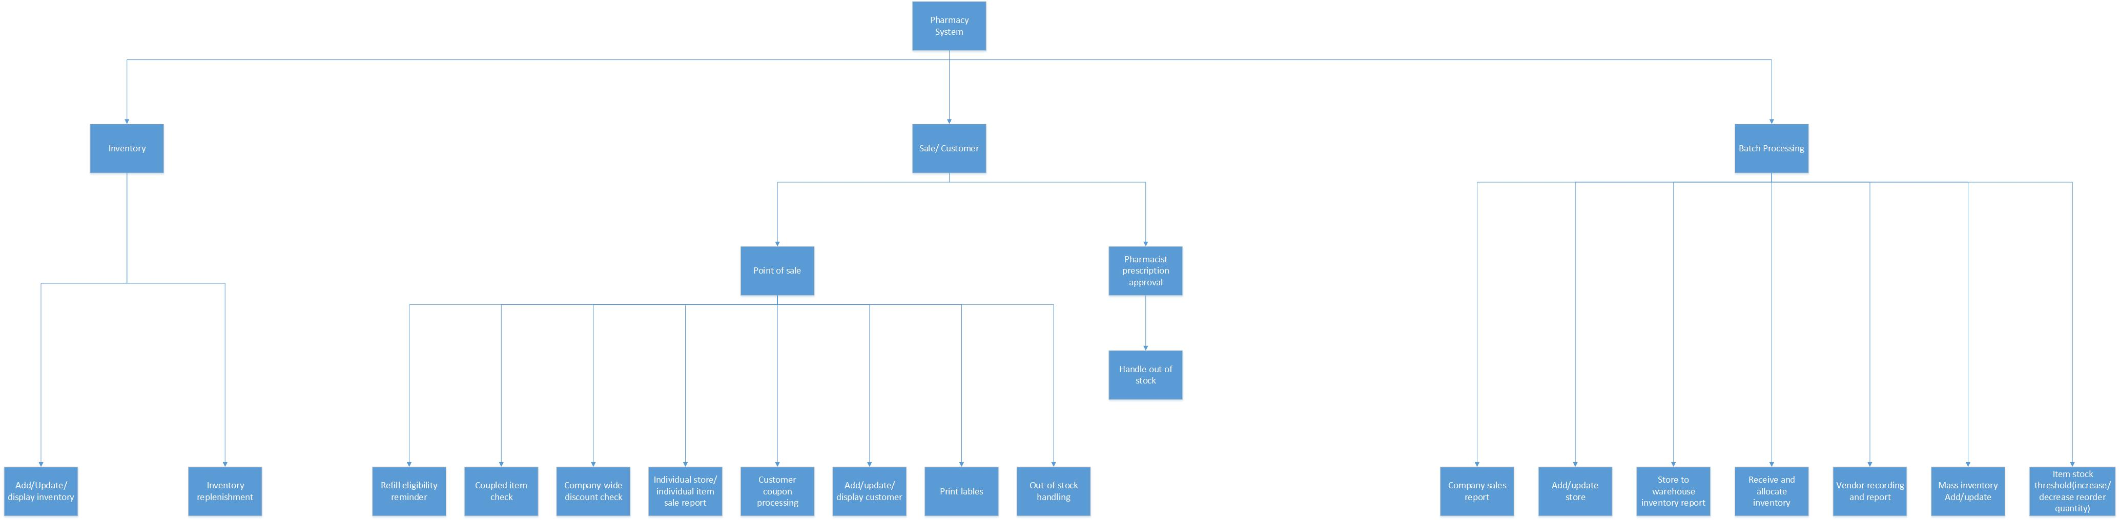
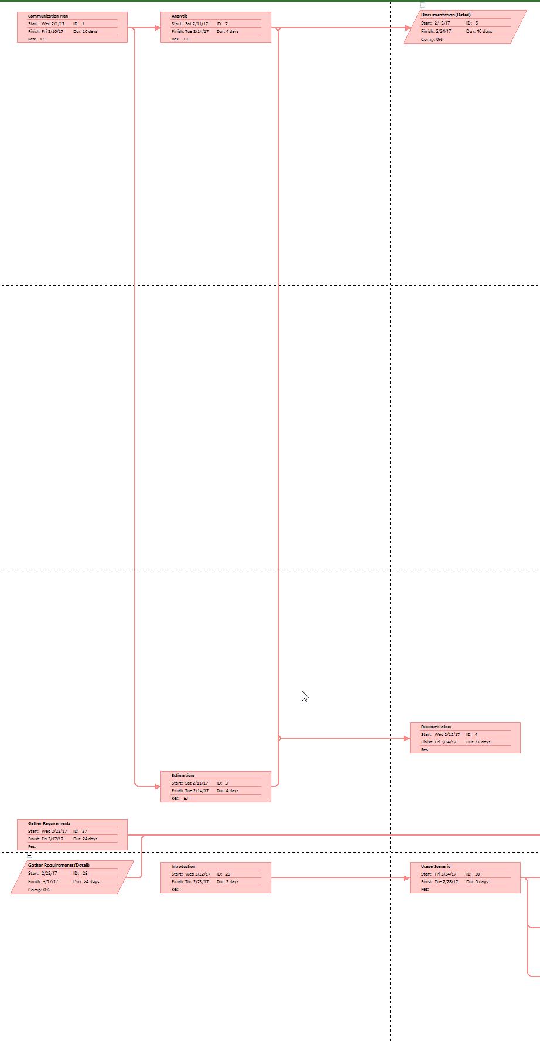
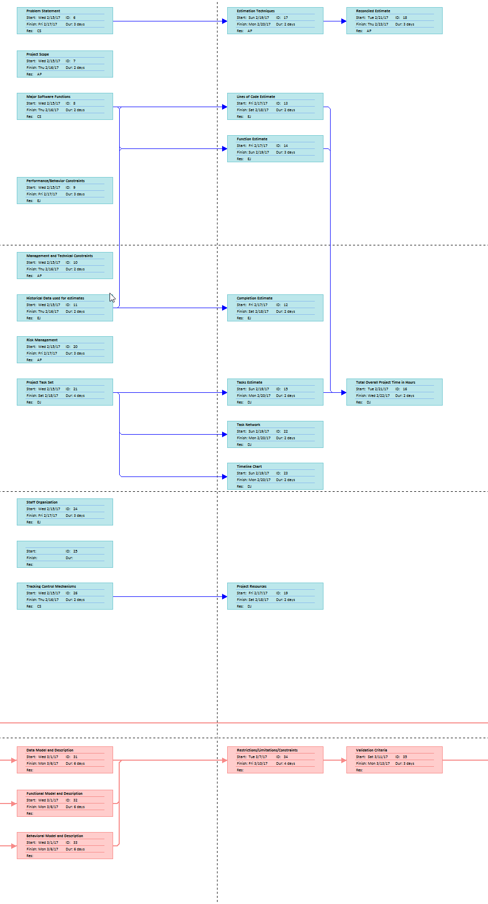
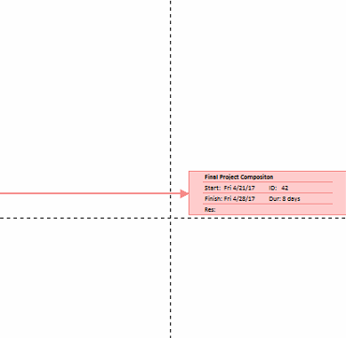
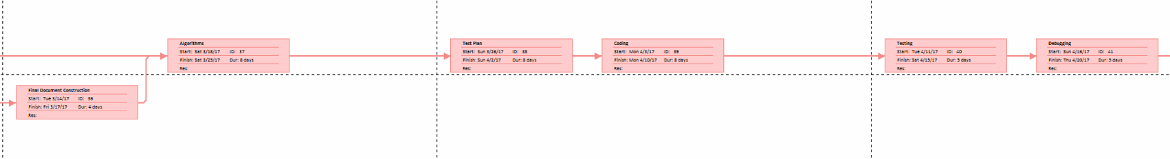
SPMP What was hardest?
1.3 Functional Decomposition (multiple iterations)
2.3 Estimation Techniques Applied and Results
2.4 Reconciled Estimate
3.0 Risk Management
4.2 Task Network Diagram
6.1 Quality Assurance and Control
Document merging and formatting
Notes:
CS
Tasks that were hard will be tasks that took the less amount of time to complete based on reports from Toggl:
1.3 Functional Decomposition
Defining the general functionality not the process. Thinking of it at a high enough level that did not discuss implementation details. This took some discussion to be able to grasp that concept. Also involved some emails to Steiner
2.3 Estimation Techniques Applied and Results
Lines of code: Deciding on the methodology. We spent time discussing which individual projects we would include in our individual LOC Estimates. Then how we would get our teams average LOC/hour from that. We determined a way to find estimates for each method but it turned out to be harder than anticipated.
2.4 Reconciled Estimate
Deciding on which estimate (LOC, FP, Task) would be the final estimation for how long we think the project would take. Then deciding not to use any of them because we did not feel they where representative of the time we feel it would take.
3.0 Risk Mitigation
There were items that were not accounted for. Such as weather, mid-terms, and when people are sick.
Discussion of possible risks and how to mitigate those risks took about an 1 hour to come to agreed upon decisions.
4.2 Task Network Diagram
Deciding if wrike would be the best tool to display the TND. Upon further discussion and investigation of wrike it was decided we would assign task to team members through wrike but we will copy that same data into Microsoft Project in order to be able to display the TND and Timeline chart. Doing so was tedious and took a large amount of time. Our PM’s provided us with a Product key in order to get access to Ms Project
6.1 SQA
Because it was the last section of the SPMP, this required a lot of reviewing and cross checking across all other documents to make sure the contents within it were accurate and valid. Traceability.
Document merging and formatting
There was no style template or discussed format of how the final SPMP would look. So everyone end up using different formats, fonts and bullet points making it harder and a waste of time when we had to put all the documents together.

Slide 18
Communication Plan
Checking Slack once per day
Establish meetings
General Availability Doc
Exceptions Calendar
Notes:
CS
Checking Slack once a day:
Requiring Team members to check Slack at least once per day to stay up to date with project discussions.
Establish meeting dates: Recurring in-person meetings on Sundays
Slack channel “meeting_minutes” contained an overview of the discussions from in-person meetings.
General Availability Doc:
Requiring team members to fill in their general availability during the week.
Exceptions Calendar:
If team member had no changes to their general availability but were unavailable on a specific day, they were required to report it to this calendar by Sunday at 7 PM.

Slide 19
SCM Plan
Slack:
Notifications
Meeting_minutes channel
GitHub:
Source code
Other artifacts
Notes:
CS
Slack:
Notification of a change to the repository of either non-source code or source code files must be communicated to the other team members through Slack.
Meeting_minutes channel: Any changes discussed during in person meetings will be transcribed into meeting_minutes and posted onto Slack.
Github:
Source code:
Will require one administrator (Cindy or Erik) review in order to commit to master branch. When uploading new source code files it will be uploaded to a separate protected branch. In this separate branch team members will be able to upload changed files without having to worry about affecting the master branch. The master branch will act as the baseline for all artifacts. Protected branches by default require at least one review before committing to the master.
Other artifacts:
Files that are non-source code can be uploaded directly to the master branch without review during part 1 of SPMP. Files that are still in progress will have an _ in the title. Those without a “_” will be assumed to be 100% complete.
As far as the non-source code part, that method has been working and we did notify each other on slack whenever there was a new file uploaded. There were problems such as the formatting, that were brought to our attention because of this, but the method it’s self is a good starting place

Slide 20
What worked
Early start
Establishing in-person meetings
Selection of time tracking tool: Toggl
Training for tools
Team communication
Risk management
Setting milestones for ourselves
Notes:
CS
Early start:
Before the we chose teams, Durwin and Erik had discussed tools. We also had a small meeting the same day teams were chosen and had meetings since then.
Through these meetings we were able to minimize the time spent deciding on a meeting location and on the methods of communication before the SPMP was assigned.
Establishing in-person meetings:
Setting up required in-person meetings allowed us to discuss tools, skillsets and assign any tasks we knew we could expect on the SPMP
Selection of time tracking tool:
Helped with determining the Estimates. Using the reports generated in Toggl, we were able to see which tasks were taking up the most time and effort and individual times. We were able to assign tasks based on each persons individual time.
Training tools:
Checking out the tools and tracking task time. Since only one team member had prior experience with a majority of the tools, it was necessary that the other team members became acquainted with the tools and understood the terminology that came with each one i.e committing to master on GitHub
Team communication:
All team members were required to sign off on meeting minutes and check slack at least once per day. Whenever a team member had questions or concerns regarding the SPMP, those questions or concerns were always heard and discussed or answered by either another team member, Project Manager or Steiner
Risk Mitigation:
When our primary meeting location (the library ) was not open or closed early. Our risk mitigation plan was put into action and told us to met at our secondary meeting location, biggby. The biggby we chose was the midpoint from where all team members live so it was the obvious choice.
Setting milestones for ourselves
Motivated us to start working but we all started working on assigned task the night before our “self-set” milestone
This last point will transition into the next slide

Slide 21
What did not work
SPMP formatting and style
Artifact review method
Wrike under-utilized
Dependencies not established early
Communication with PMs
Notes:
CS
SPMP Formatting and Style
Not deciding on a format style earlier.
Artifact Review Method
Asking other team members to review things but not knowing which document to review first based on dependencies and priority
Wrike under-utilized
We intended to use Wrike as a replacement tool for Microsoft Project because not all team member were accessible to it. The point of Wrike was to assign tasks to team members. For the first half of the project, that functionality of Wrike was not utilized because instead team members would just check meeting minutes (where assigned tasks were also mentioned because tasks were usually assigned during in-person meetings) Wrike only contained the SPMP tasks but not the little tasks in between such as sending emails, uploading meeting_minutes or progress reports.
Dependencies not established early
Not properly checking the dependency of one task to another, put other people behind and cased a shift in work load for one person.
Communication With Project Managers
We added them onto our groups on Slack, Wrike, and GitHub. We did not add them to the general availability or exception calendar. But we asked them if they would be able to join us for our weekly Sunday meetings and they said that for the most part yes. At the end of Part1 we realized that the communication process was not well defined. We did not assign specific tasks to them and they did not know when or which parts of the SPMP to check first, they also were not told where to leave comments and feedback which in turn could be the reason why we felt we did not received adequate feedback.

Slide 22
Changes for Part 2
Artifact format standards
Establish artifact review method
Use Wrike more
Reorganize repository
Formalize PM communication
Notes:
CS
Artifact format standards
Deciding on a format for documents i.e. what type of bullet points are we going to use, layout of page. (Style guide)
Establish artifact review method
The team has voted on using the “review” functionality on Microsoft Word to provide critiques on documents of other team members. To avoid overwriting the original, team members must make sure to save their document that contains critiques to a different name. If the document has a major dependency then the document should be reviewed first by the successor and the Project Managers.
Use Wrike More
Assign tasks for every task that was assigned during in-person meetings. Add in due dates and approximate time due. Set tasks as completed once they are completed.
Reorganize repository
Moved all documents dealing with Phase 1 into Phase_1 folder
Created a folder "Phase 1" inside Documentation for Phase 1 items
Within Phase 1, moved individual components of the SPMP to Individual_Components and left the SPMP directly inside Phase_1
Created "Work_In_Progress" folder to be used for documentation and source you are presently working on
Created a folder for each team member by their initials inside "Work_In_Progress"
Formalize PM communication
Assign the Project Managers task on Wrike. Sending reminder messages about the tasks they were assigned. Add them to the general availability sheet to be aware of when they are free. Also include them in the Expectation Calendar so they can add in days they know they will not be available.

Slide 23
What would we do differently from Part 1?
Assign tasks more quickly
Establish dependencies earlier
Review artifacts/tasks with PMs earlier
Establish formal communication process with PMs
Formatting
Notes:
CS & EJ
CS - Assign – In part one it took a while to assign tasks, in part 2 up until now we have taken great pains to assign tasks as soon as it is known what will need to be done.
EJ – Dependencies – In part one, because we did not adequately take dependencies into account for documents, some team members were waiting on a single team member in order to get their documents done. Specifically, the estimates section. Pieces of this section were assigned to three different people. This resulted in a situation where we had to do a lot of last minute work
CS – Review Artifacts/Tasks with PMs earlier – This actually bit us already in Part 2. We took a while to generate the Part 2 artifacts, and weren’t able to get them to our PMs until Sunday. On Sunday we determined that we had done everything mostly correct, but there were still some decent changes to make. We also found that one of the diagrams wasn’t nearly what we expected after reviewing with PMs and checking the book (Use Case Diagram from UC Summary). (Use own words?)
EJ – Establish formal communication process with PMs – Presently we have an informal ‘please check Slack once per day’ which works somewhat tenuously. We plan on changing the process so we can have a confirmed once-per-day visit and an acknowledgment that they have received and acknowledged any communications intended for them and understand any tasks they have been assigned or requested information on.
CS – Formatting – Establish style guides, and preliminary code style guides, as well as procedures on how to deal with preexisting templates that have their own style.

