Slide 1
Robust strong form mesh-free method for transport problems
Seminar I
Mitja Jančič
Ljubljana, 06/05/2020

Slide 2
Introduction
Computational modelling of natural phenomenon
Numerical treatment of PDE
Many different methods for numerical analysis of PDEs proposed
Finite Element/Difference/Volume method
Meshless methods

Slide 3
Introduction: meshless methods
Introduced in 1970s with applications in astrophysical problems and fluid dynamics
Many mesh-free methods
Mesh-free approximation simplifies
Domain discretization
Adaptive procedures implementation

Slide 4
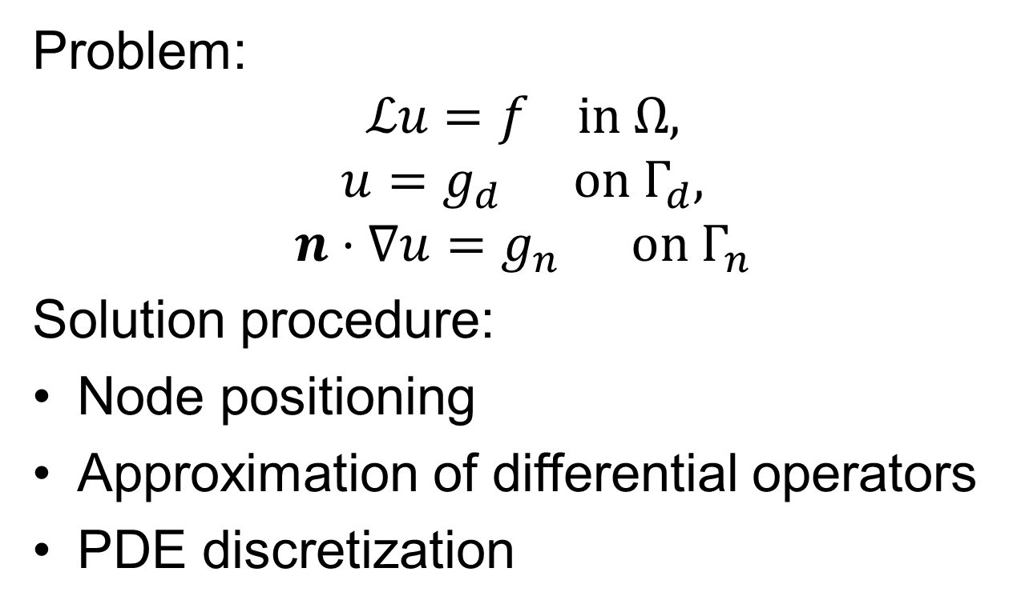
Strong form mesh-free method
Problem:
$$ℒu=f in Ω,$$
$$u=g_{d} on Γ_{d},$$
$$n⋅∇u=g_{n} on Γ_{n}$$
Solution procedure:
Node positioning
Approximation of differential operators
PDE discretization

Slide 5
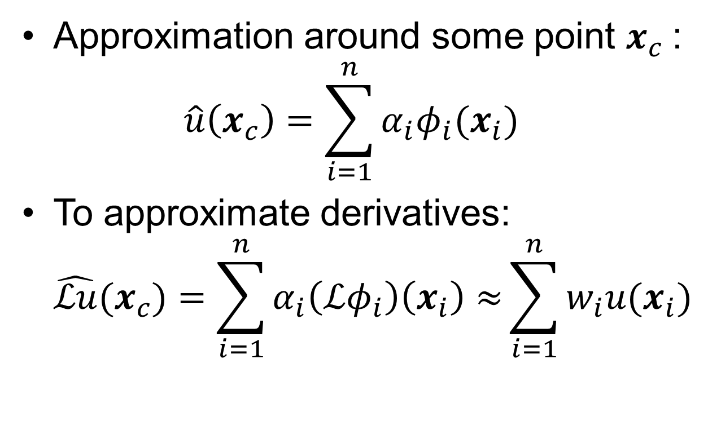
Strong form mesh-free method
Approximation around some point $x_{c}$: $\hat{u}\left(x_{c}\right)=\sum_{i=1}^{n}{α_{i}φ_{i}(x_{i})}$
To approximate derivatives: $\hat{ℒu}(x_{c})=\sum_{i=1}^{n}{α_{i}\left(ℒφ_{i}\right)\left(x_{i}\right)≈}\sum_{i=1}^{n}{w_{i}u(x_{i})}$

Slide 6
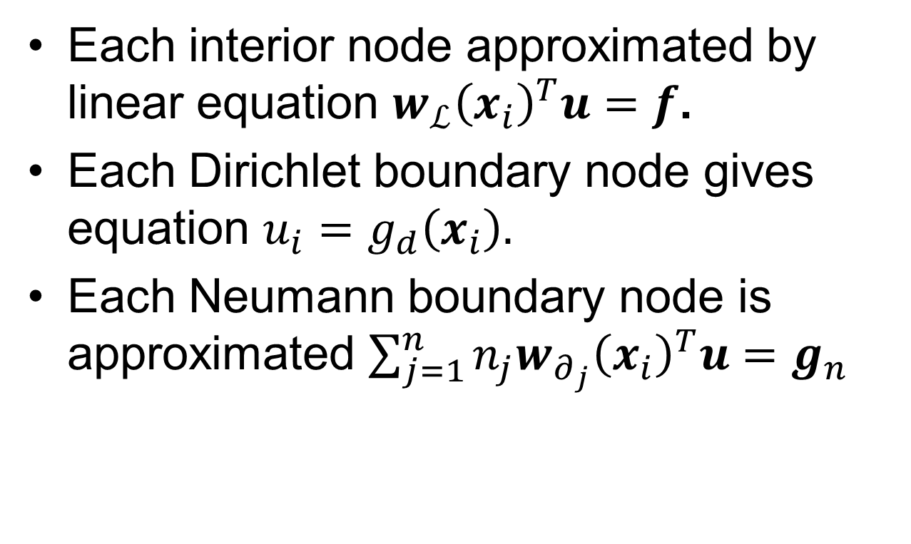
Strong form mesh-free method
Each interior node approximated by linear equation $w_{ℒ}{\left(x_{i}\right)}^{T}u=f$.
Each Dirichlet boundary node gives equation $u_{i}=g_{d}\left(x_{i}\right).$
Each Neumann boundary node is approximated $\sum_{j=1}^{n}{n_{j}w_{∂_{j}}{\left(x_{i}\right)}^{T}u=g_{n}}$

Slide 7
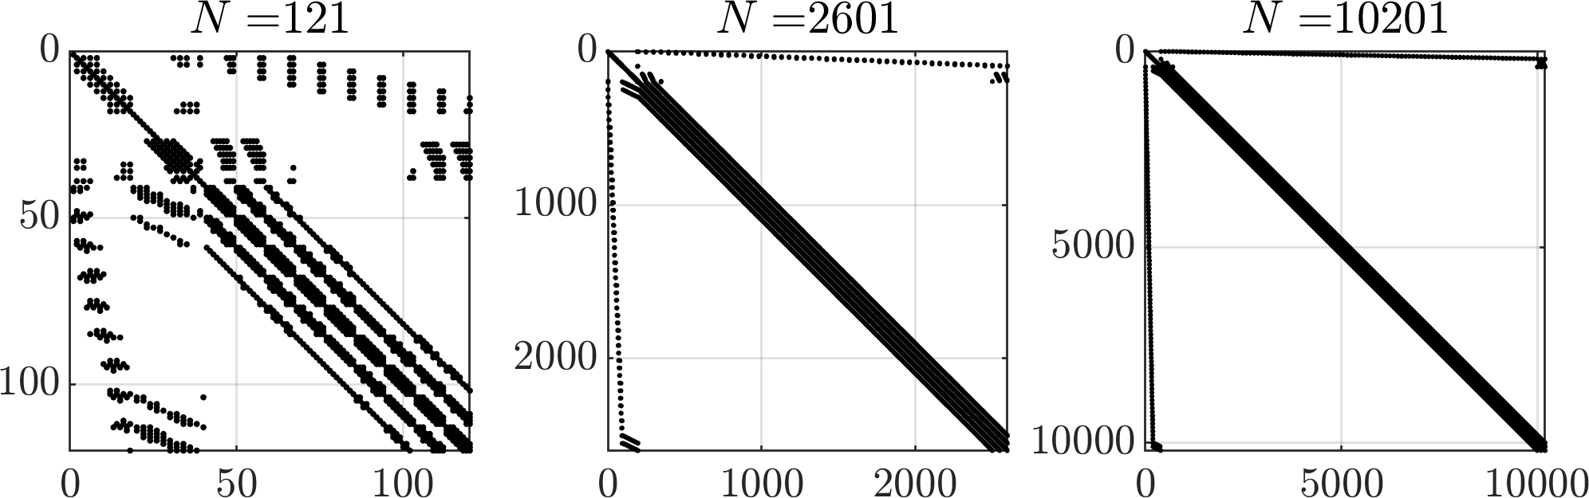
Strong form mesh-free method

Slide 8
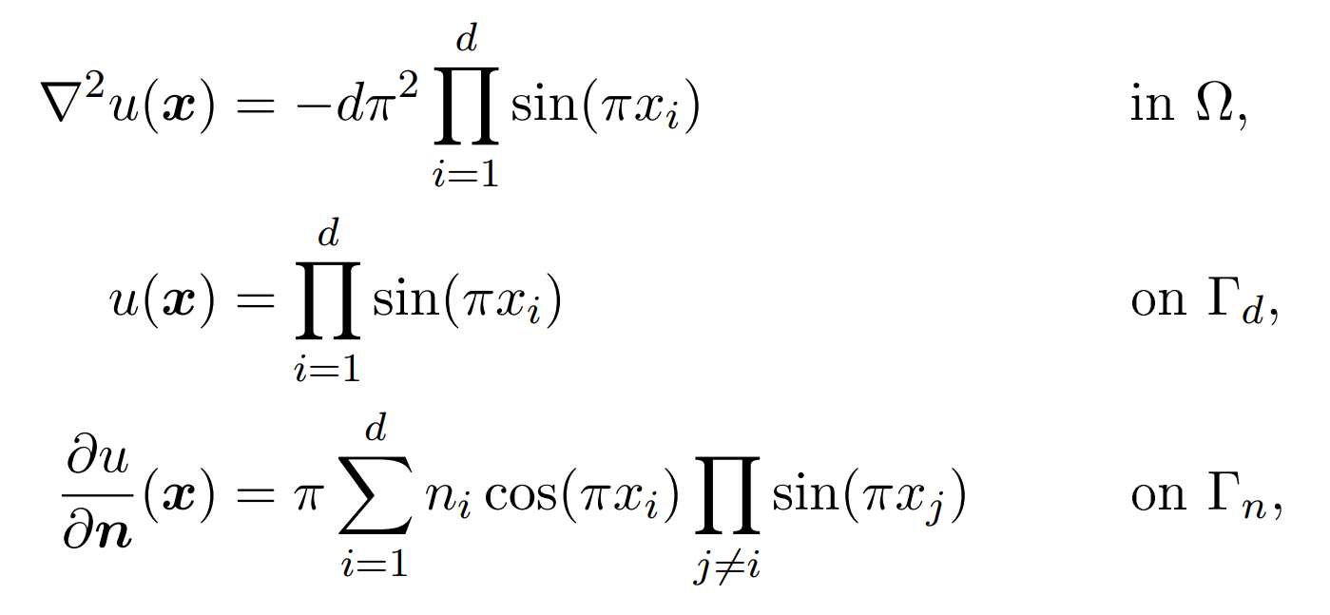
Numerical example
Poisson problem

Slide 9
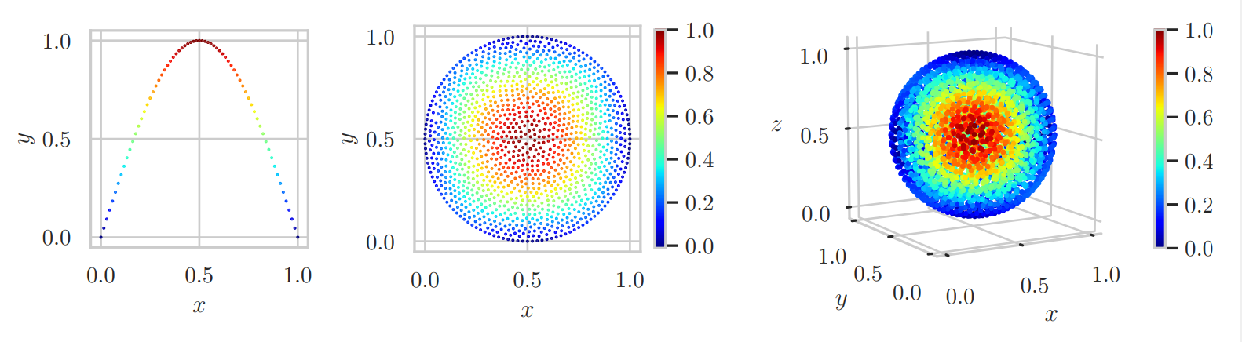
Numerical example

Slide 10
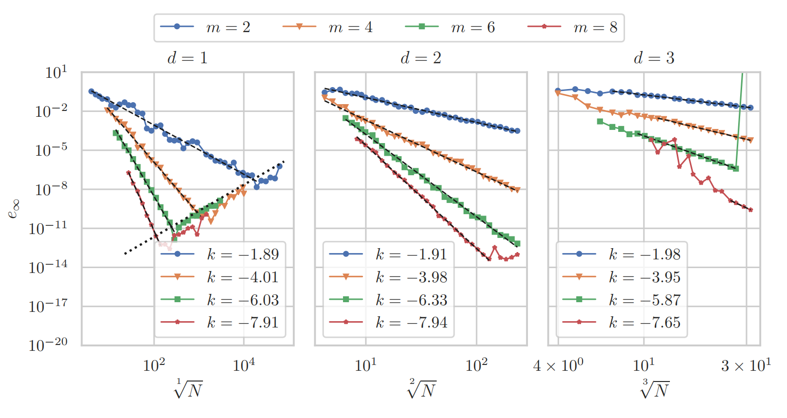
Numerical example

Slide 11
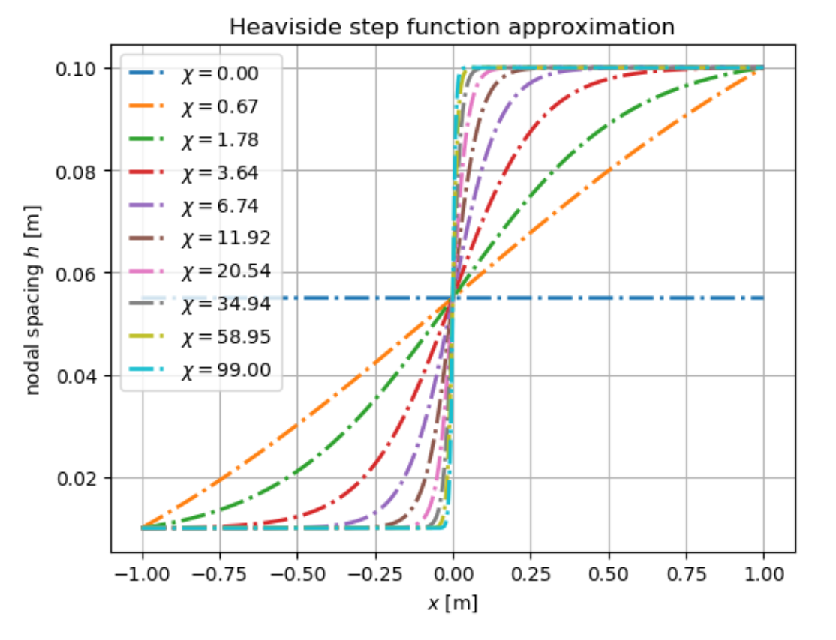
Numerical example - stability

Slide 12
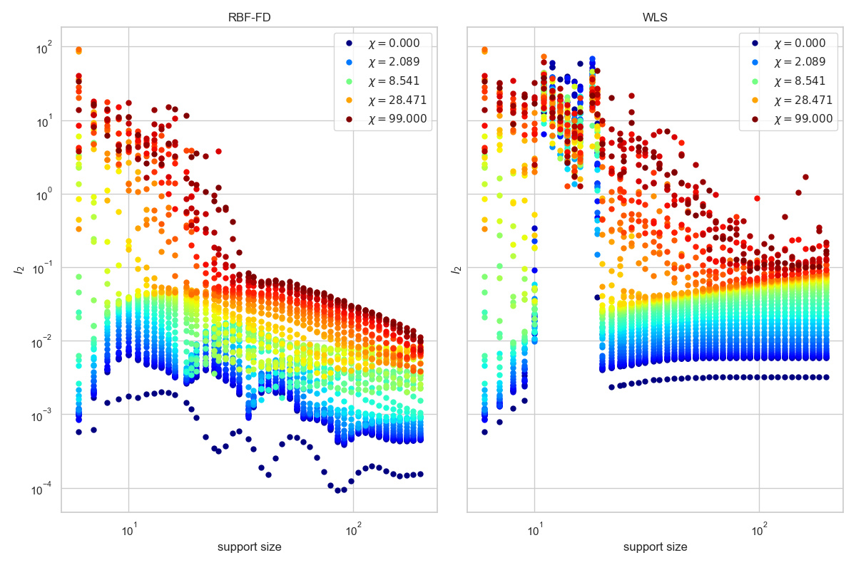
Numerical example - stability

Slide 13
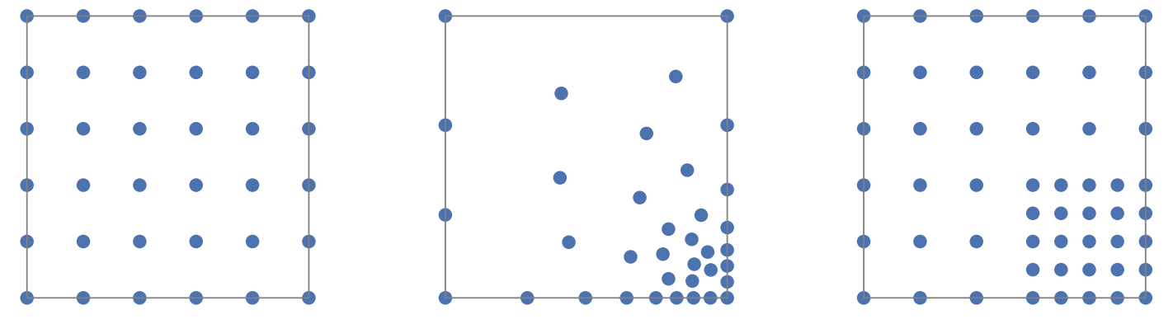
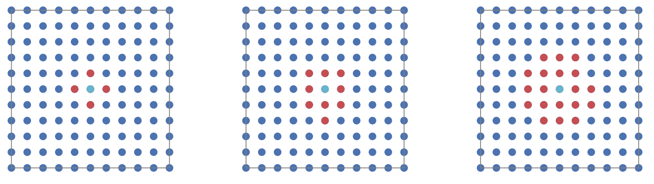
Adaptive procedures
p, h, r adaptive procedures.

Slide 14
Thank you!

