Slide 1

Stability analysis of RBF-FD and WLS based local strong form meshless methods on scattered nodes
Mitja Jančič, Gregor Kosec
Mipro conference, Opatija
Thursday, 5/26/2022

Slide 2

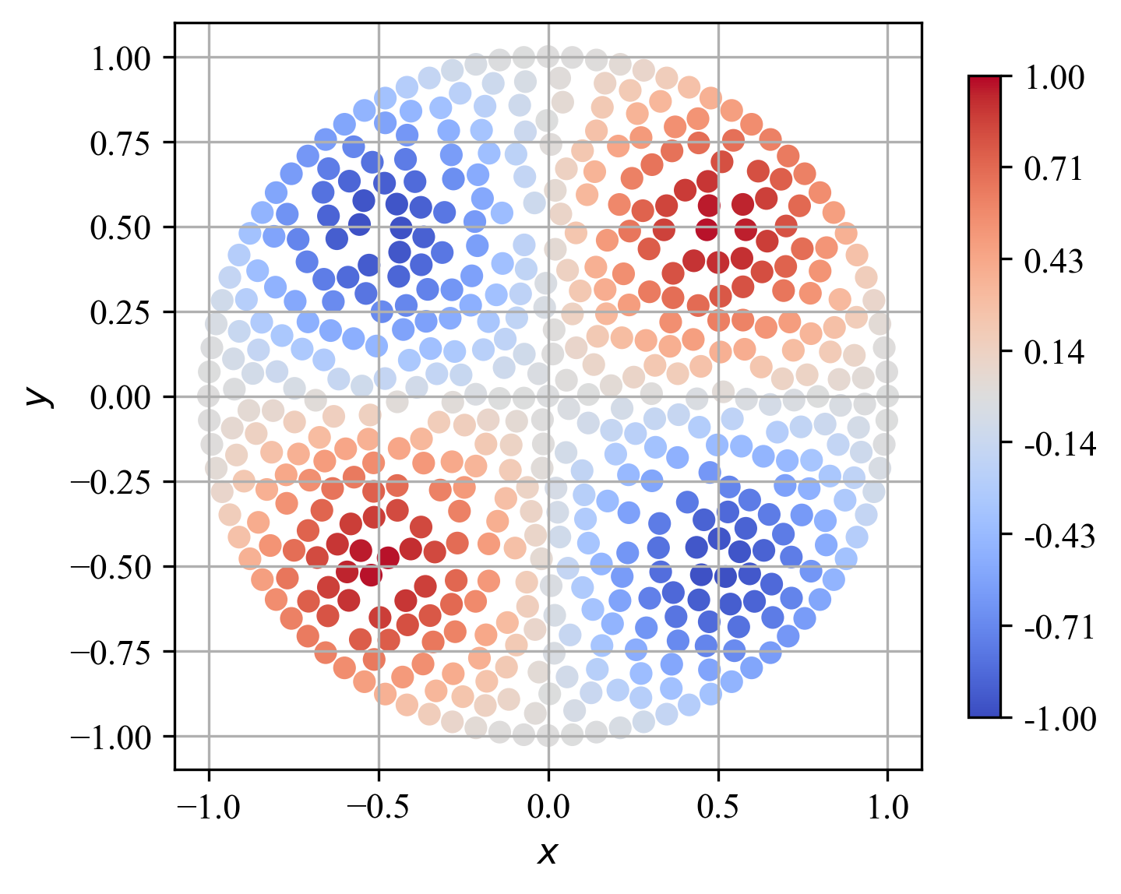
Content
Solution procedure and motivation
Meshless methods
2.1 Radial basis function-generated finite differences (RBF-FD)
2.2 Weighted least squares (WLS)
Problem setup
Results
4.1 Stencil size
4.2 Convergence rates
4.3 Stability estimation

Slide 3
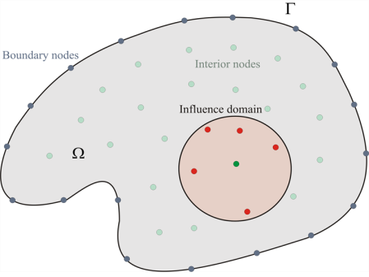
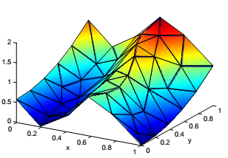
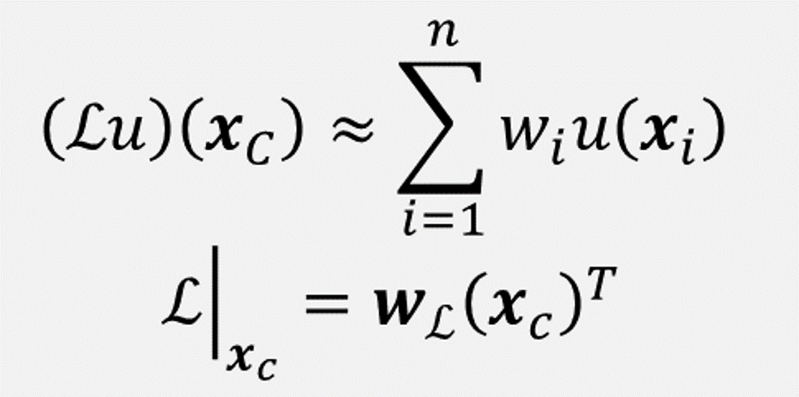
Solution procedure
Normally, PDEs do not have closed form solution
Numerical treatment of partial differential equations:
Domain discretization
Differential operator approximation
PDE discretization
Solve linear system

Slide 4
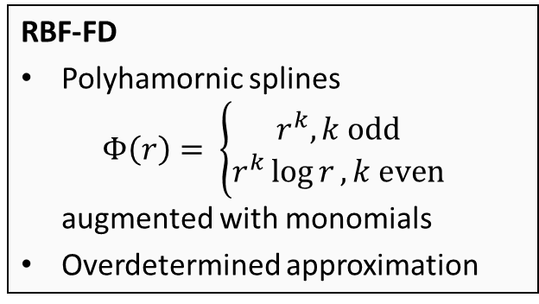
Meshless methods
(Dis)advantages of meshless methods:
+ Do not require mesh to operate.
+ Generalizes to higher dimensions.
+ Direct control over the order of the approximation method.
- Higher complexity: shape computation every time from scratch, support sizes are larger.
RBF-FD
Polyhamornic splines $Φ\left(r\right)= \left\{\begin{aligned}r^{k}, k odd \\ r^{k}\log{r}, k even\end{aligned}\right.$ augmented with monomials
Overdetermined approximation
Local approximation has the same order as the polynomial basis.
WLS
Monomials as basis functions and Gaussian weights.

Slide 5
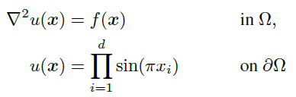


Problem setup
Any conclusions drawn from the analysis should not be specific to any particular domain shape or problem setup.
A simple Poisson problem with Dirichlet boundary conditions on a d-dimensional sphere with a closed form solution.
Closed form solution allows us evaluate the accuracy of the numerical solution
Our aim is to determine which approximation method is more prone to a non-optimal domain discretization.

Slide 6
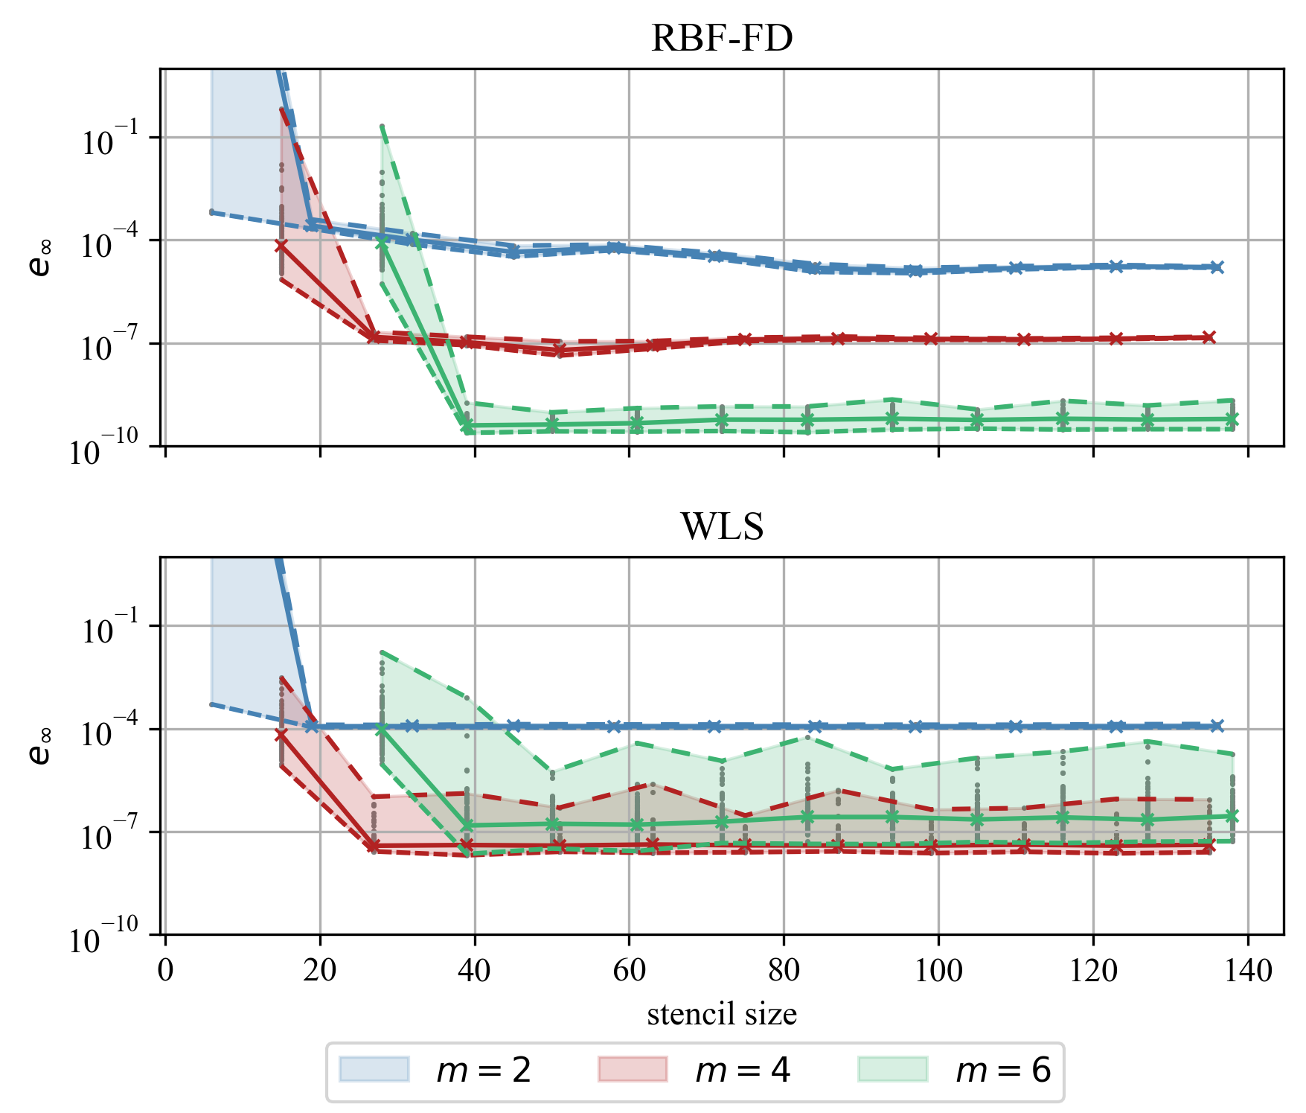
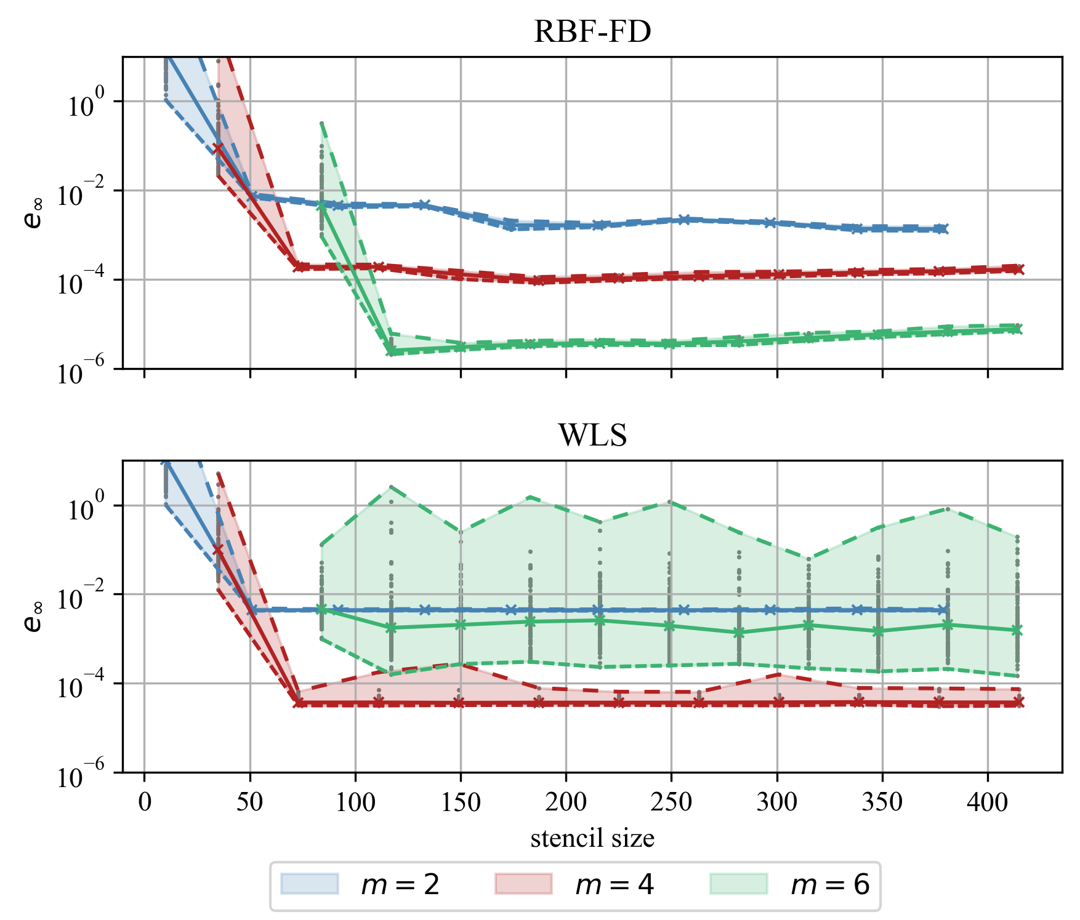

Results: Stencil size
2-dimensional domain (approximately 40600 nodes):
3-dimensional domain (approximately 28100 nodes):
Recommendations by Bayona
$$n=2\left({m+d \atop d}\right)$$

Slide 7
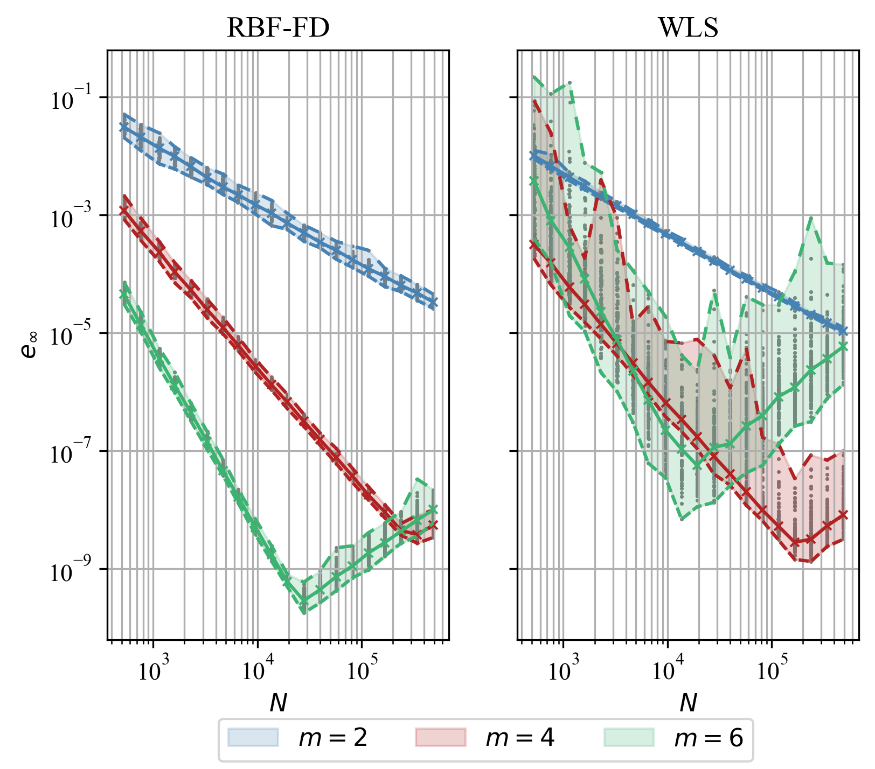
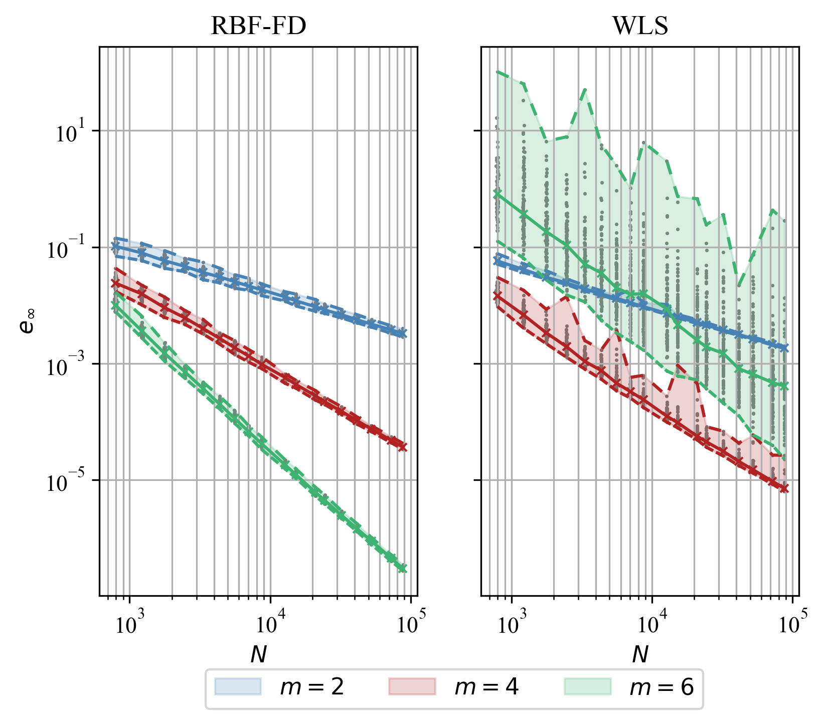
Results: Convergence rates
2-dimensional domain:
3-dimensional domain:

Slide 8
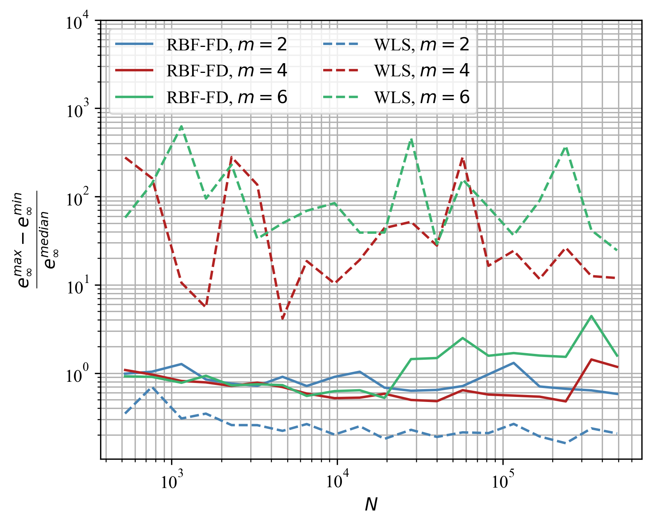
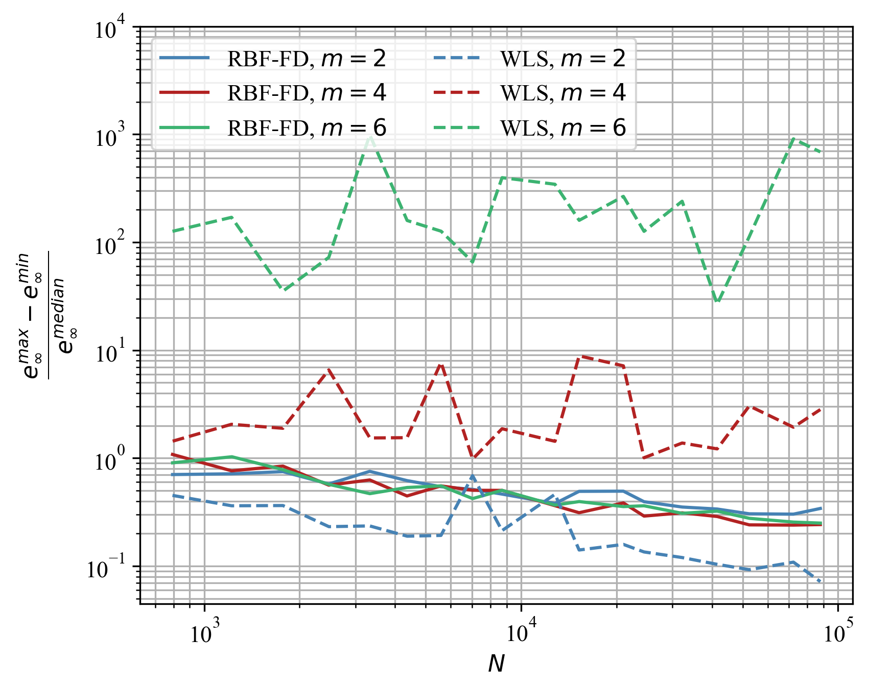
Results: Stability estimation
2-dimensional domain:
3-dimensional domain:

Slide 9
Conclusions
We studied two popular variants of meshless methods: RBF-FD and WLS.
Stencil sizes have a negligible effect on the accuracy of the numerical solution and on the stability.
RBF-FD proved to be more stable, especially for higher order approximations.
For lower order approximations, WLS outperforms RBF-FD.
Future work should include
A detailed study on the effect of stencil size
Study of computational complexity

