Slide 1

A hybrid RBF-FD and WLS mesh-free strong-form approximation method
Mitja Jančič, Gregor Kosec
Splitech conference, Bol
Thursday, 5/26/2022

Slide 2

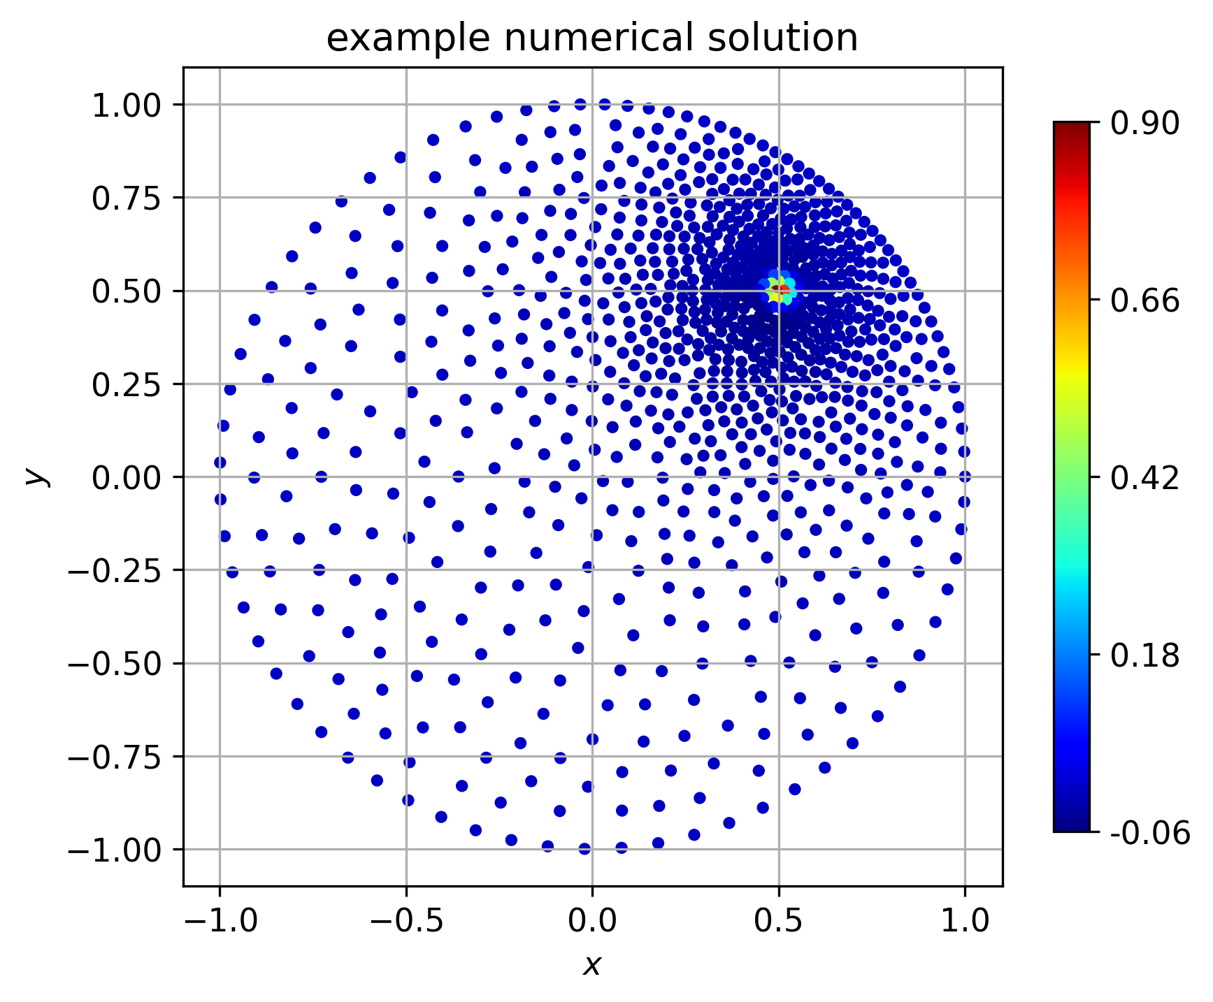
Content
Solution procedure and motivation
Meshless methods
2.1 Radial basis function-generated finite differences (RBF-FD)
2.2 Weighted least squares (WLS)
Problem setup
Results
4.1 Convergence rates
4.2 Stability estimation
4.3 Computational times
4.4 Benchmark problem

Slide 3
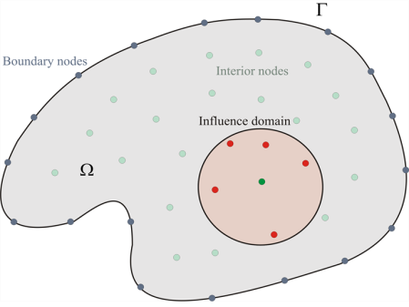
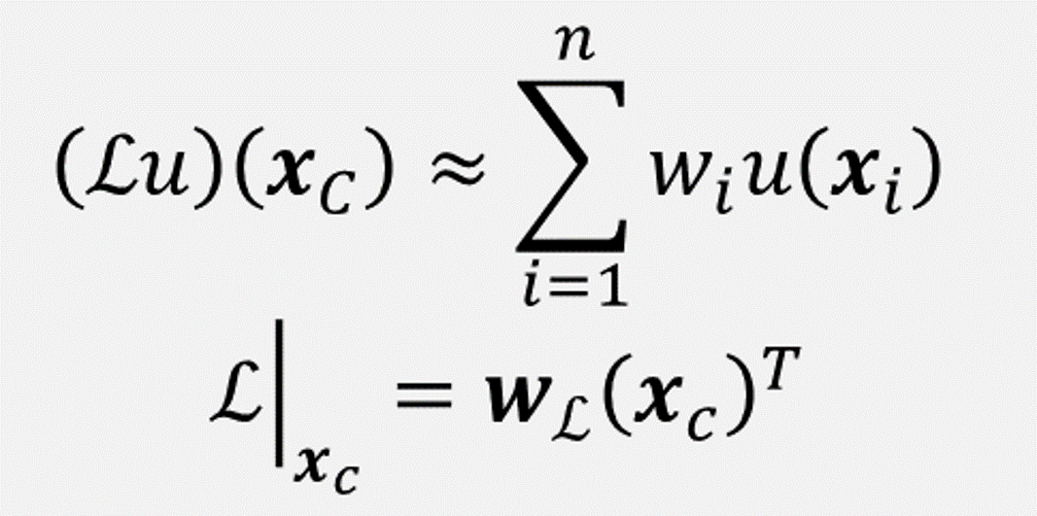
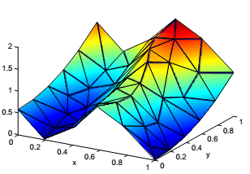
Solution procedure
Normally, PDEs do not have closed form solution
Numerical treatment of partial differential equations:
Domain discretization
Differential operator approximation
PDE discretization
Solve linear system
(Dis)advantages of meshless methods:
+ Do not require mesh to operate.
+ Generalizes to higher dimensions.
+ Direct control over the order of the approximation method.
- Higher complexity: shape computation every time from scratch, support sizes are larger.

Slide 4
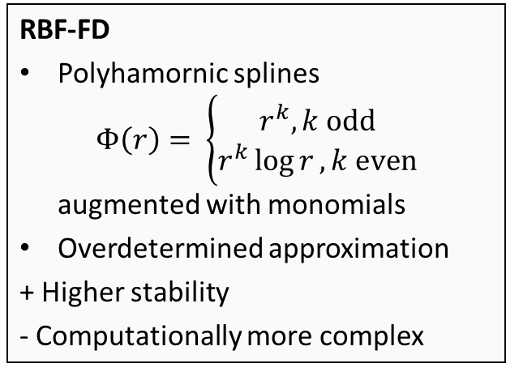
Meshless methods
RBF-FD
Polyhamornic splines $Φ\left(r\right)= \left\{\begin{aligned}r^{k}, k odd \\ r^{k}\log{r}, k even\end{aligned}\right.$ augmented with monomials
Overdetermined approximation
+ Higher stability
- Computationally more complex
WLS
Monomials as basis functions and Gaussian weights.
+ Computationally cheaper
- Sometimes not stable
Local approximation has the same order as the polynomial basis.

Slide 5
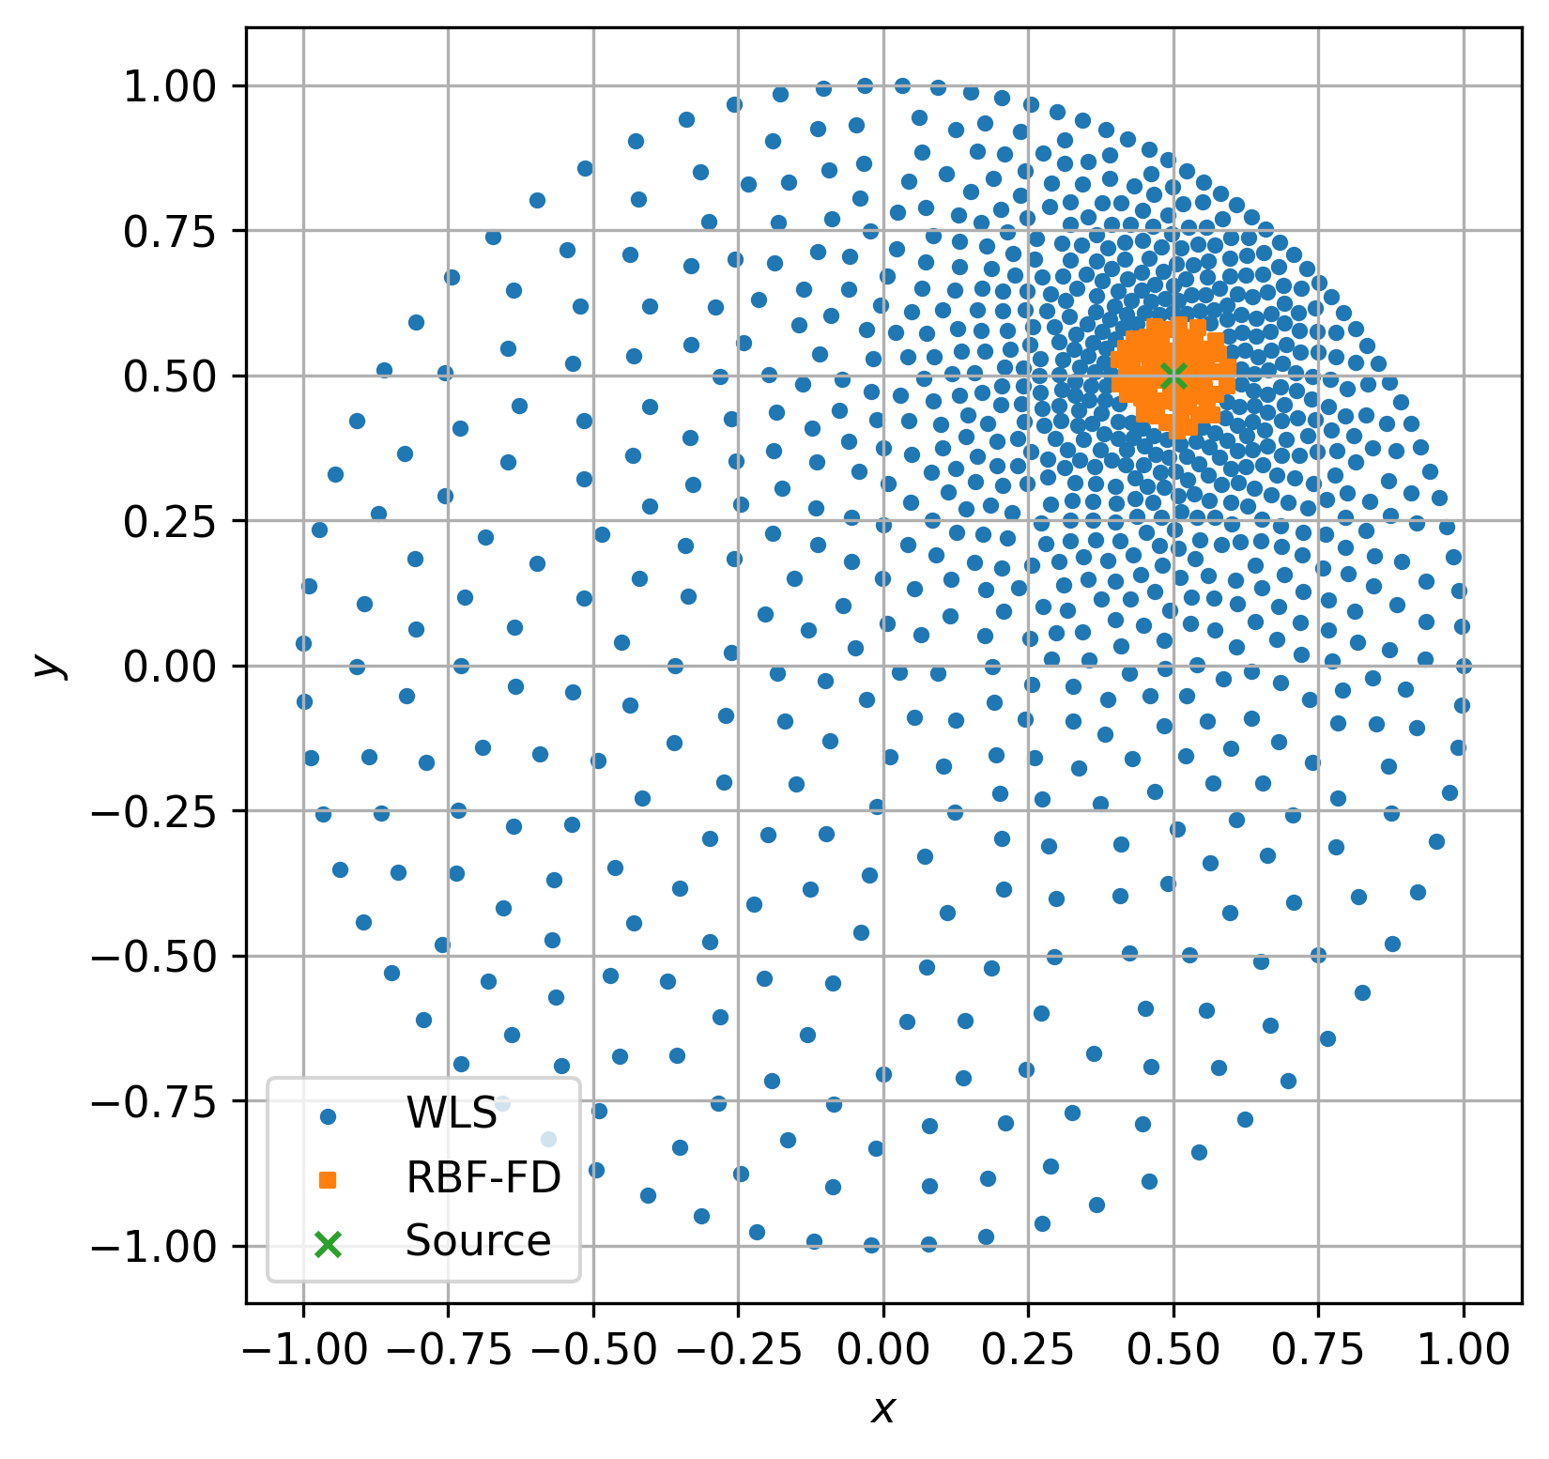
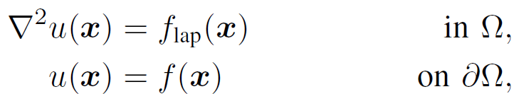


Problem setup
A simple Poisson problem with non-constant Dirichlet boundary conditions on a 2-dimensional sphere with a closed form solution.
Closed form solution allows us evaluate the accuracy of the numerical solution
The division of nodes into RBF-FD and WLS nodes was done apriori, without an error indicator.

Slide 6
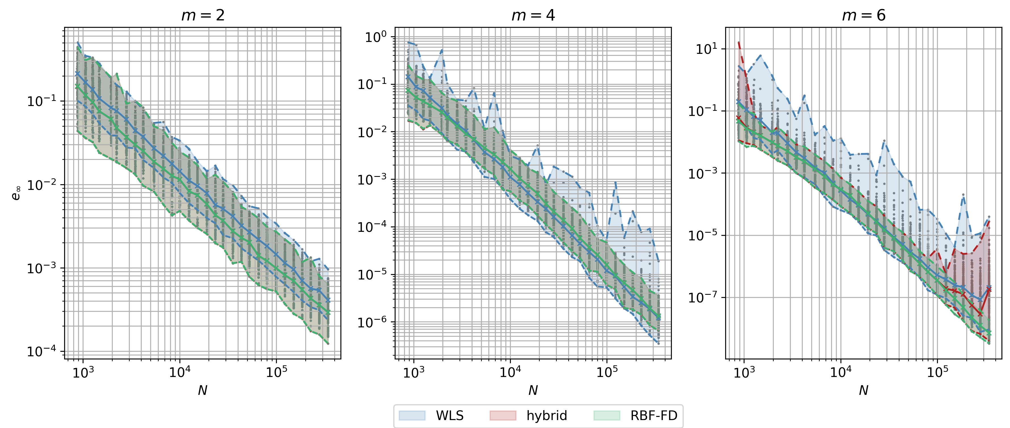
Results: Convergence rates

Slide 7
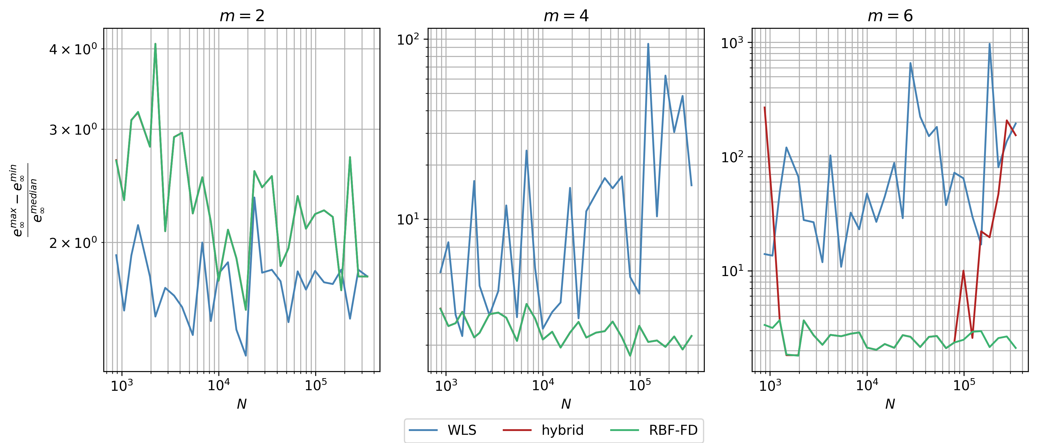
Results: Stability estimation

Slide 8
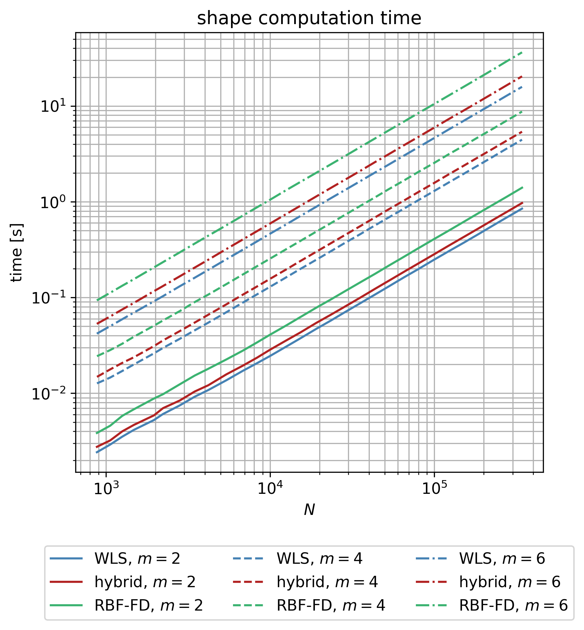
Results: Computational times
RBF-FD is computationally more complex due to larger stencil sizes required for approximation of linear differential operators.

Slide 9
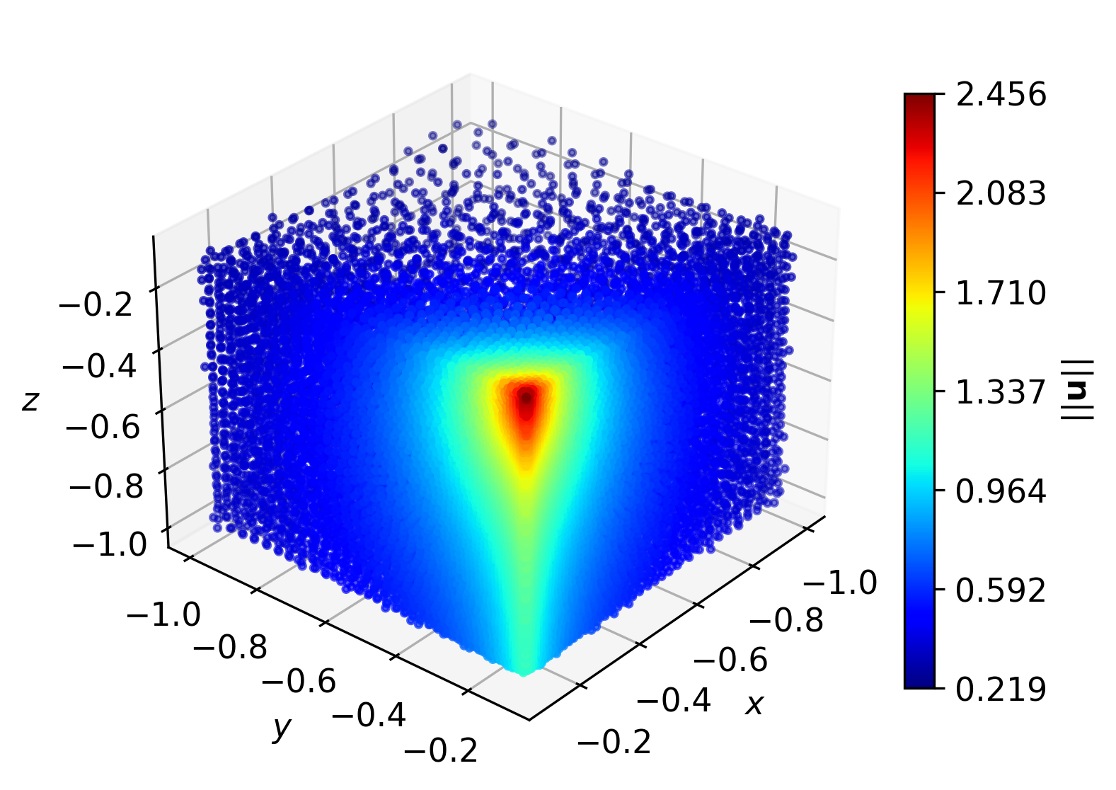

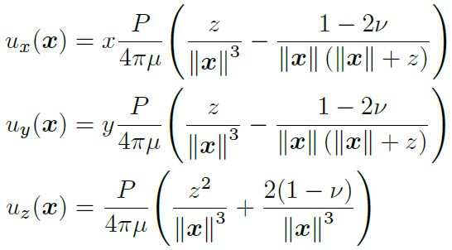
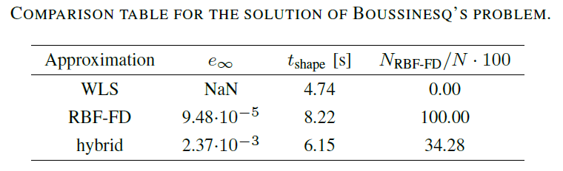
Results: Benchmark problem
Three-dimensional Boussinesq’s problem
with tractable solution

Slide 10
Conclusions
A novel RBF-FD – WLS mesh-free method has been presented.
We observe:
Good convergence behavior of the hybrid method.
Improved stability (compared to pure WLS).
Reduced computational times (compared to pure RBF-FD) – approximately 33 %.
Future work should include
Error indicators to determine the RBF-FD and WLS nodes in a smarter way.

