Slide 1
p-refined RBF-FD solution of a Poisson problem
SpliTech 2021
Mitja Jančič
Bol, 2021

Slide 2
Scope
Introduction
Meshless methods, convergence rate, refined solutions.
Numerical approximation
Domain discretization, differential operator approximation, PDE discretization.
Numerical example
Governing equations, p-refinement, error evaluation.
Results
Convergence rates, computational times.
Future work
hp-adaptivity

Slide 3
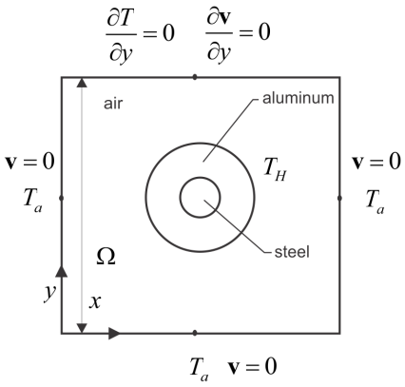


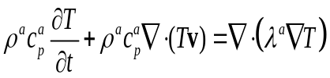

Introduction
Computational modelling.
Numerical analysis of partial differential equations (PDEs) is the backbone of numerous engineering and scientific simulations.
Obtaining the system of PDEs is only one part of the problem.
Tractable solutions to systems of PDEs are rare.

Slide 4
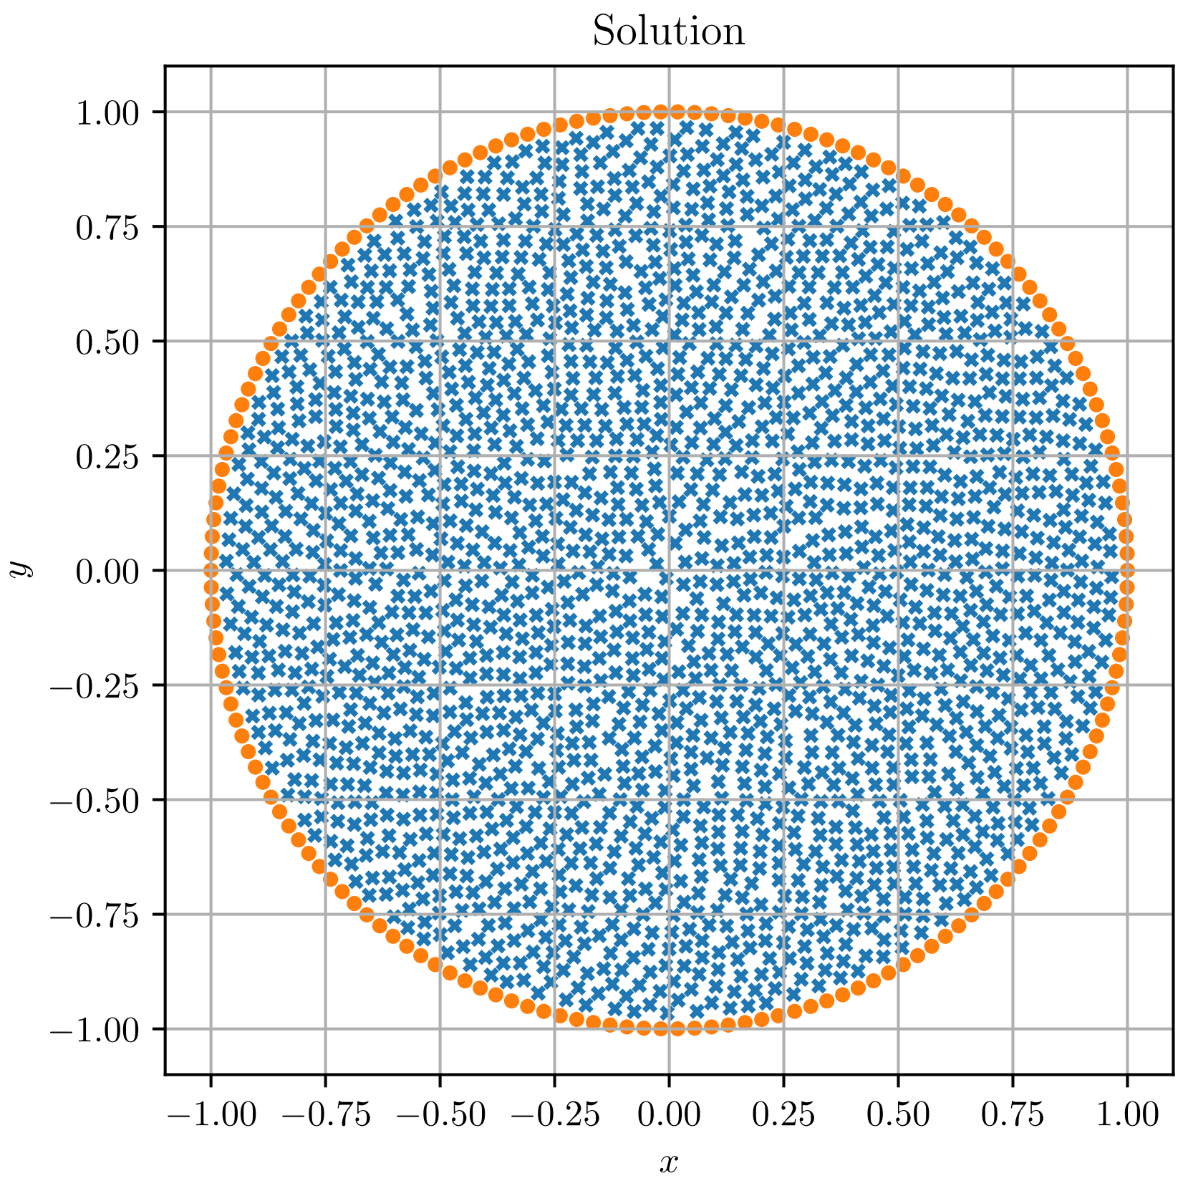
Introduction
Numerical treatment of PDEs.
Popular: FDM, FVM, FEM, …
Gaining popularity: Meshless methods.
(Dis)advantages of meshless methods:
+ Do not require mesh to operate.
+ Generalizes to higher dimensions.
+ Direct control over the order of the approximation method.
- Higher complexity: shape computation every time from scratch, support sizes are larger.

Slide 5
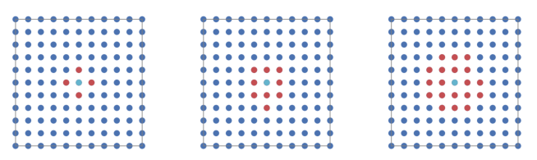
Introduction
Refinement.
Refining methods are indispensable in problems where the solution error varies significantly throughout the computational domain.
Refinement gravely improves accuracy of numerical method.
p-refinement
h-refinement
r-refinement

Slide 6
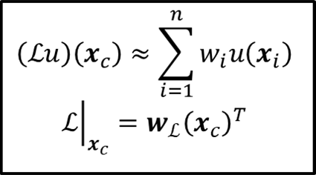
Numerical approximation
Solution procedure.
Domain discretization.
Differential operators approximation.
PDE discretization.
Radial Basis Functions
Augmentation with monomials

Slide 7
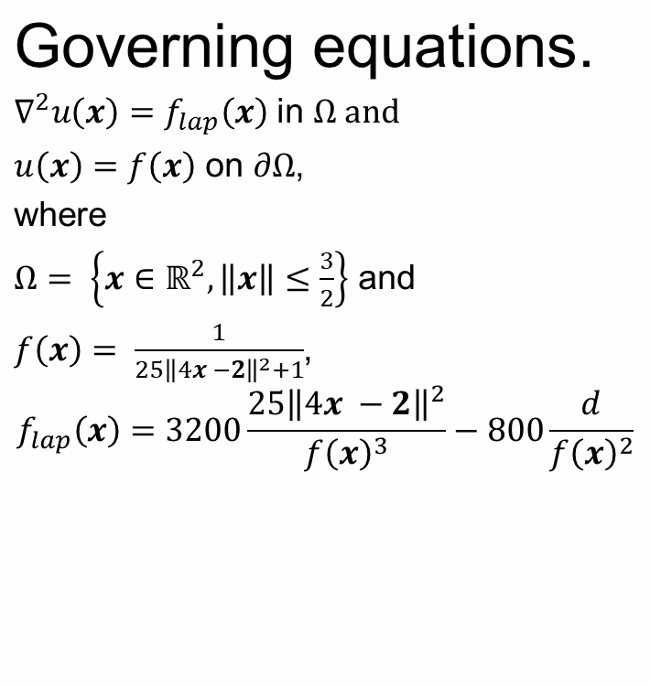
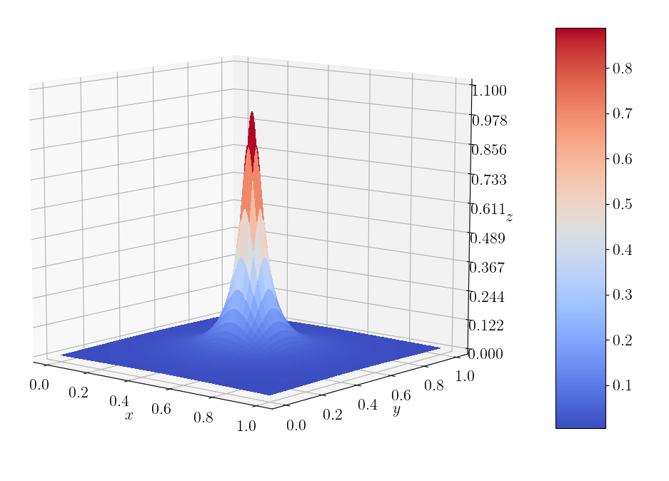
Numerical example

Slide 8
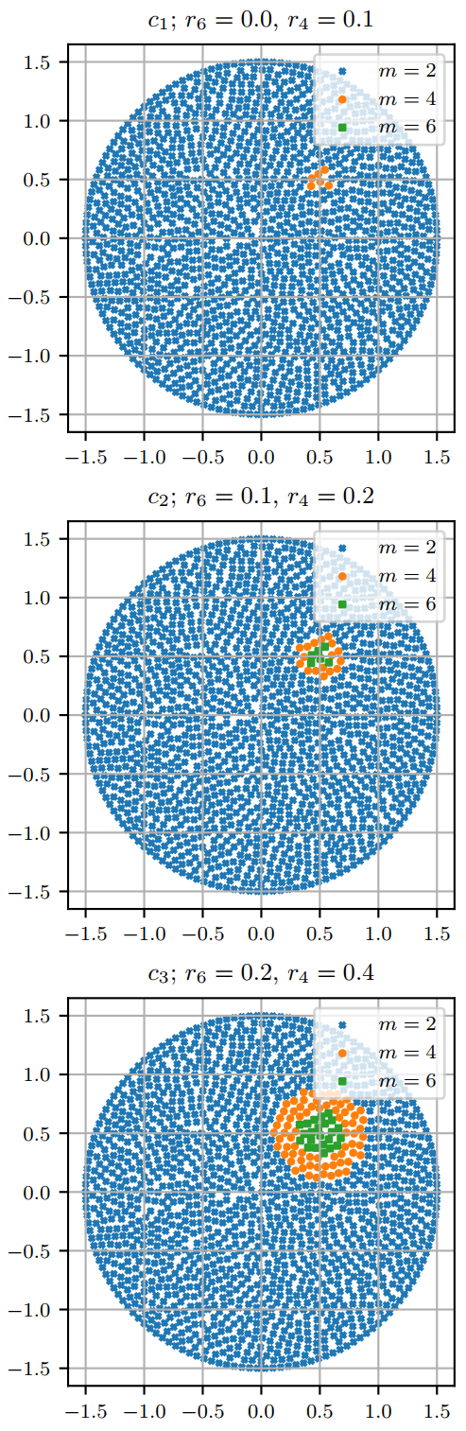
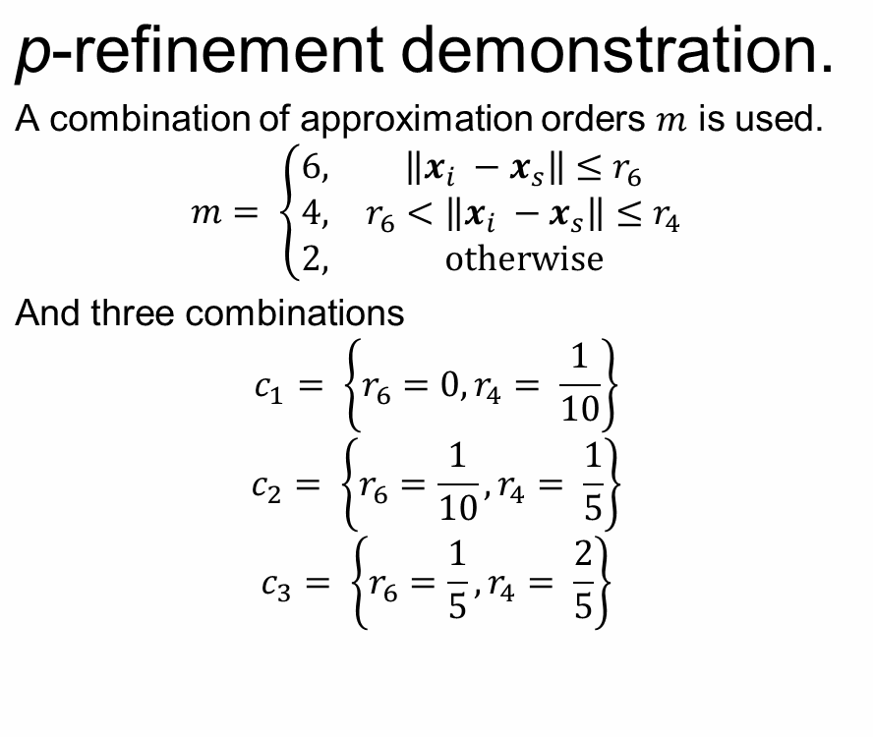
Numerical example

Slide 9
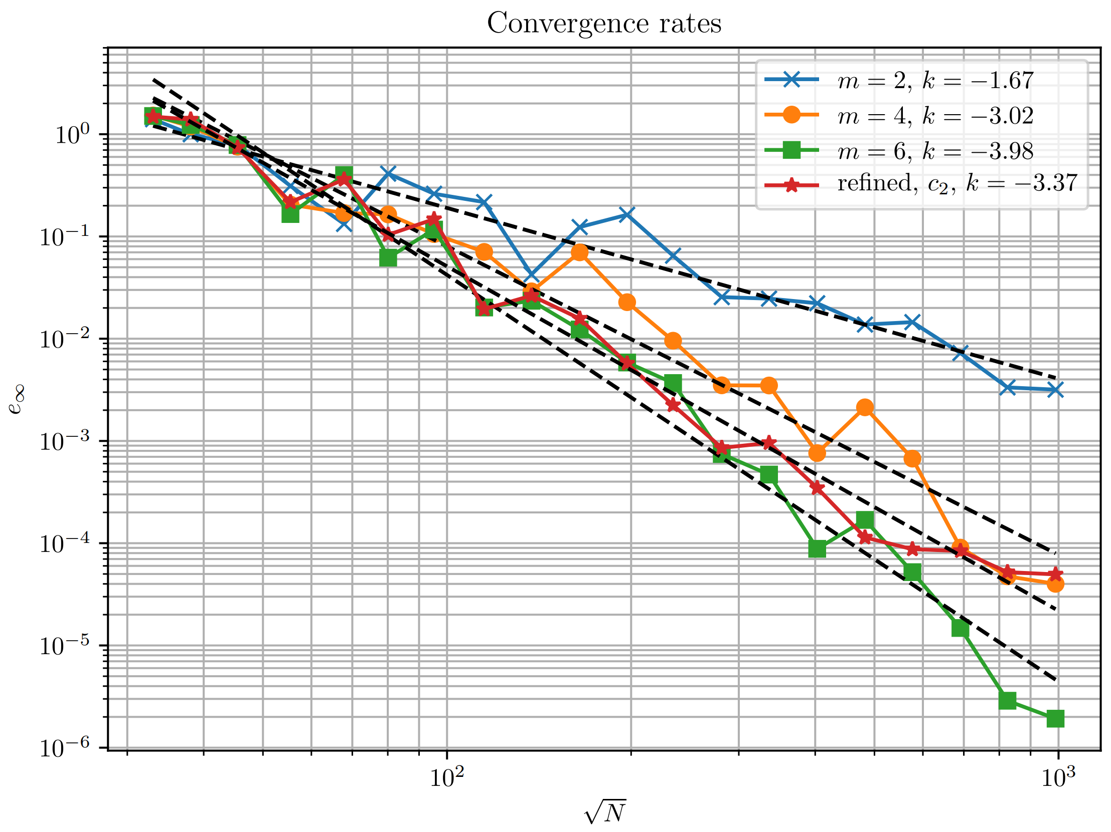
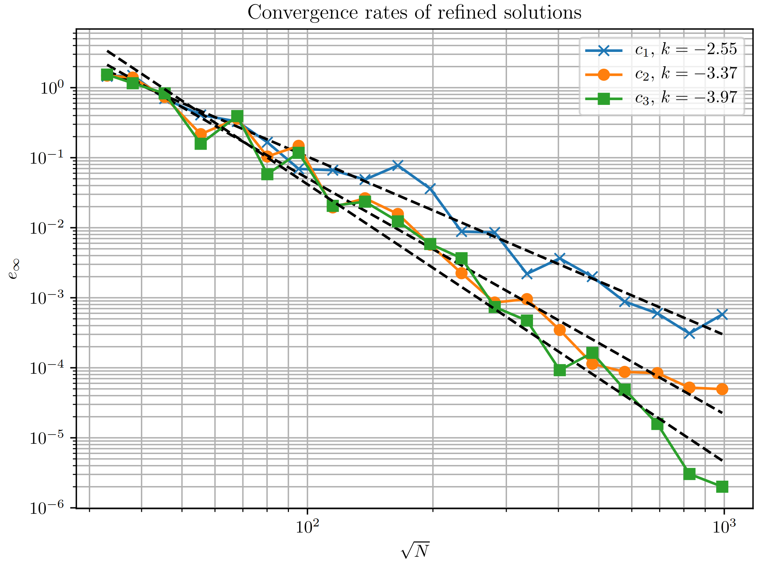
Results
Convergence rates.

Slide 10
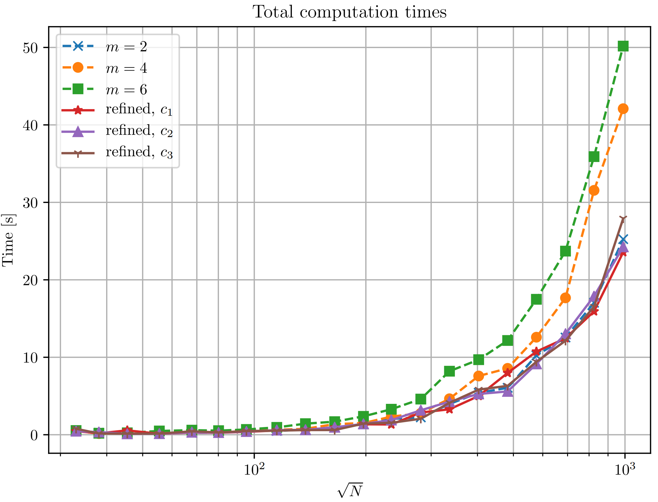
Results
Computation times.

Slide 11
Conclusions
p-refinement procedure, where the order of the local approximation is spatially variable, is presented.
It is shown that p-refinement can improve convergence rates at a very small additional cost to execution time.
Future work.
Improving the local description of considered field by additionally employing h-refinement. A combination of both is also known as hp-refinement.

Slide 12
Thank you.

