Slide 1
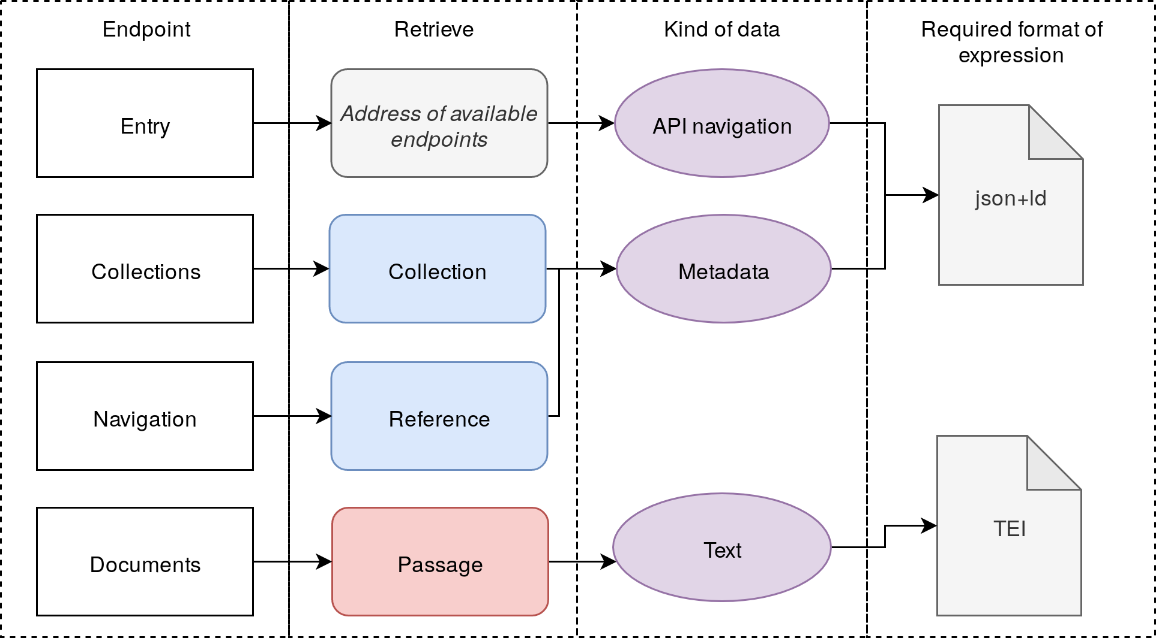
Distributed Text Services (DTS)
A Community-driven Text Interoperability API
Specs: w3id.org/dts
Demo: web + notebooks
FAQ page
Linked Pasts 6, University of London and British Library, December 2-16, 2020
What is DTS?
Endpoints & Operations
Classes of objects in DTS
Goal: enable machine-actionable operations across a wide variety of TEI texts.
As DTS strives for genericity, it does not dictate:
how collections should be organized
type of persistent identifiers to use
what ontologies to use for metadata
how the texts are structured.
Collections endpoint:
List available collections
Support for pagination & virtual collections
Navigate between nested collections
Navigation endpoint:
List available text passages
Documents endpoint:
Retrieve the text of a document
Collections:
Hold metadata
Serve as a catalog
May be:
nested
readable
chunked into citable textual elements
References: hold identifiers & metadata for subsections of documents
Passages: hold textual content
Why DTS?
DTS provides a standard way for clients to interact with collections of TEI documents. A standard API allows users to access many text collections using the same client software. It also allows editors to publish text collections in a usable way that existing clients can use.
DTS Community
46 Members
Communication via Google Group list
Technical exchanges: GH issues
Minutes: meeting notes GH repo
Want to join? Subscribe to the Google Group
DTS-compliant resources
A Generic Text API
APIs
ENC
Alpheios
Perseids
EDH
Beta maṣāḥǝft
Implementations
TEI publisher client/server
Perseids DTS API
Nautilus + MyCapytain
DTS supports:
Multi-level/competing text hierarchies
Any identifier scheme (*)
Non-homogeneous text hierarchies
Notes:
DTS provides simple operations for navigating collections, navigating within a text and retrieving textual content.

