Slide 1
D3
2011302590011 Tang Zhixiong
GIS, RS, WHU, 2011

Slide 2
How To Implement A GIS?
ArcGIS
Grass
Q GIS
.etc

Slide 3
Flex
Flash
.Net
Windows

Slide 4
Chrome
FireFox
Safari
IE
D3
Json
HTML5
JavaScript
+

Slide 5
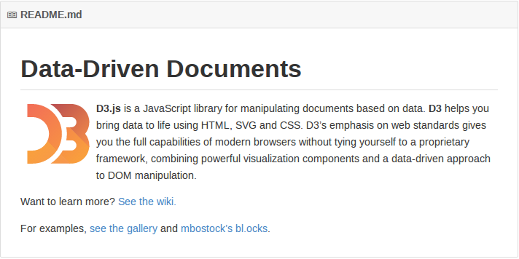

Slide 6
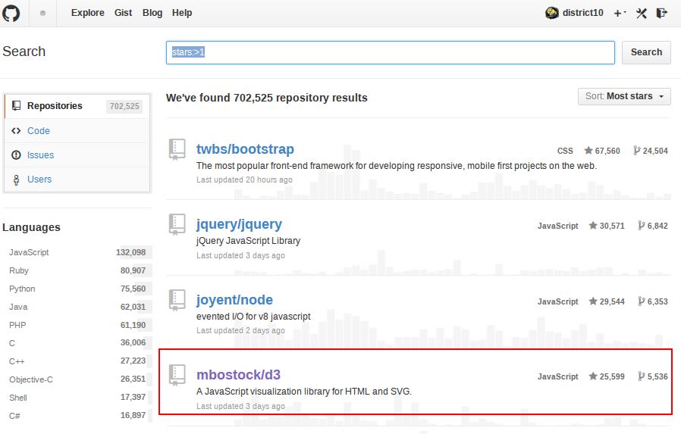

Slide 7


Slide 8
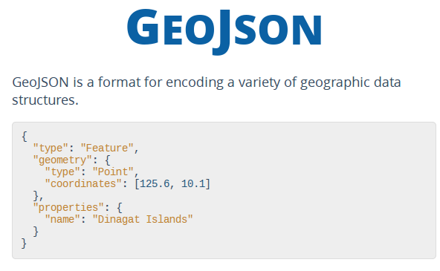

Slide 9
GeoJSON + D3

Slide 10
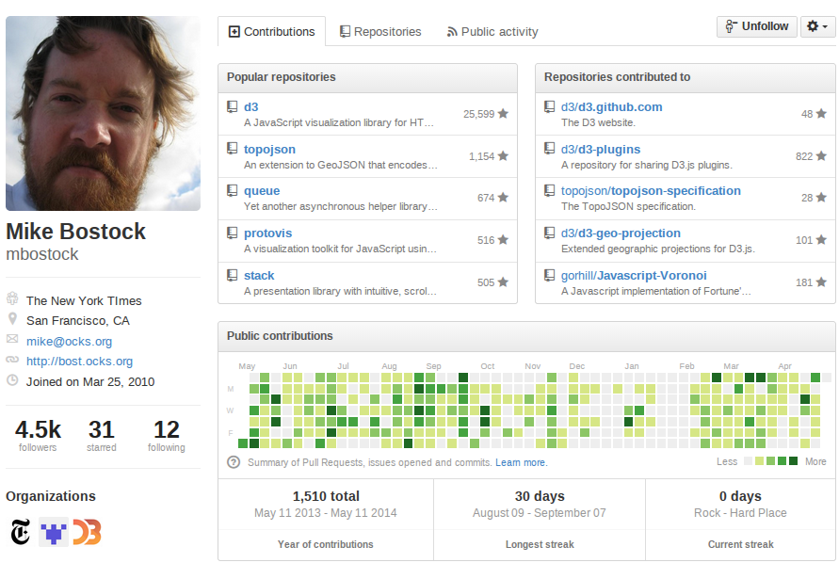

Slide 11
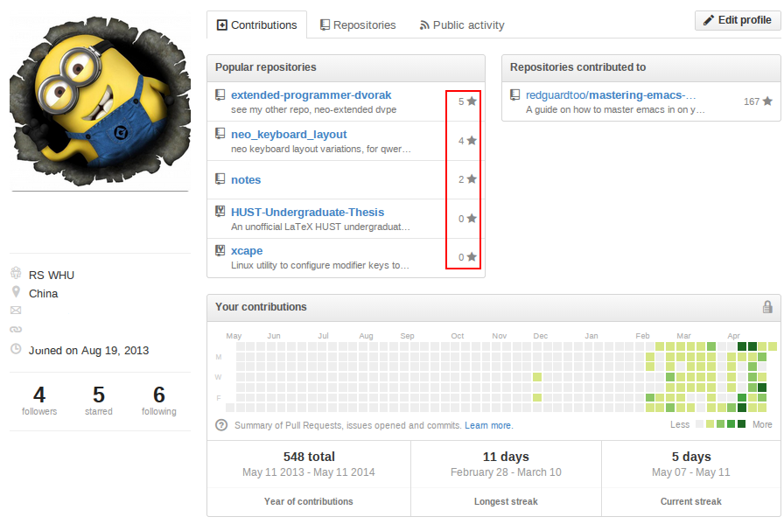
https://github.com/district10

Slide 12
完

