Slide 1
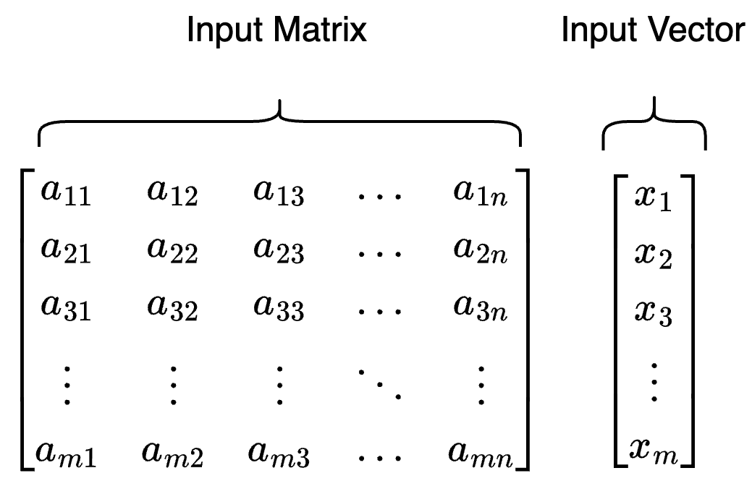
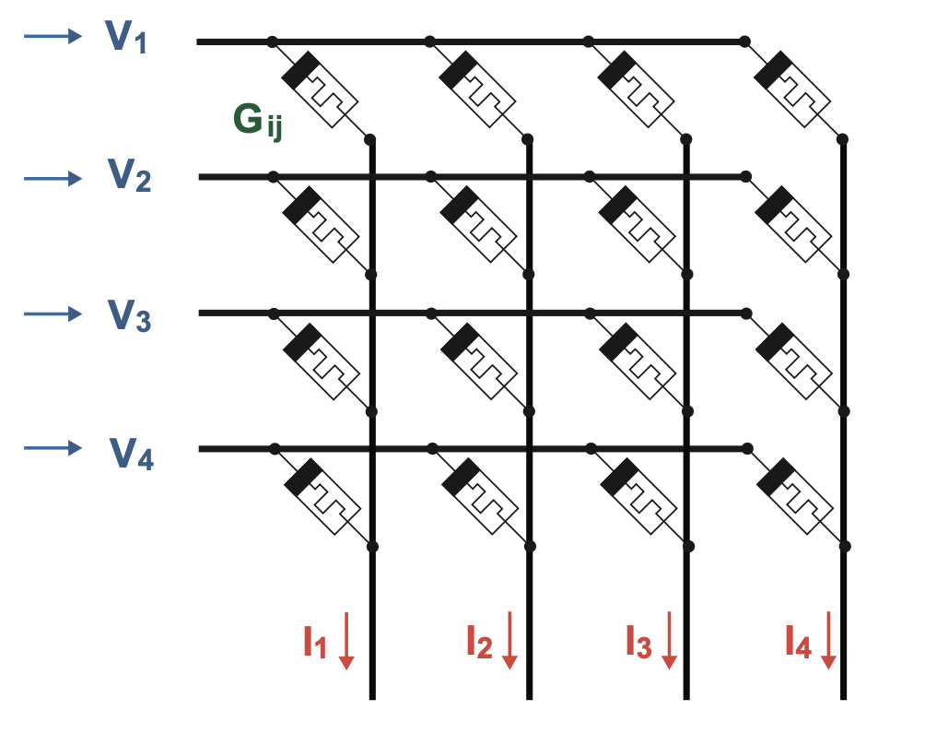
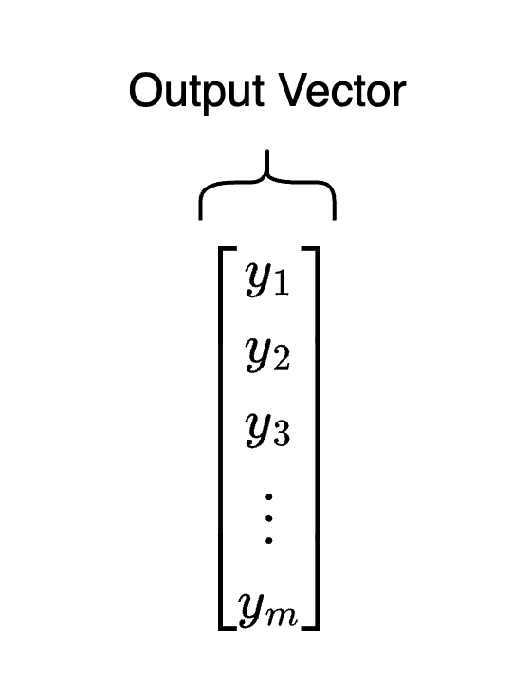
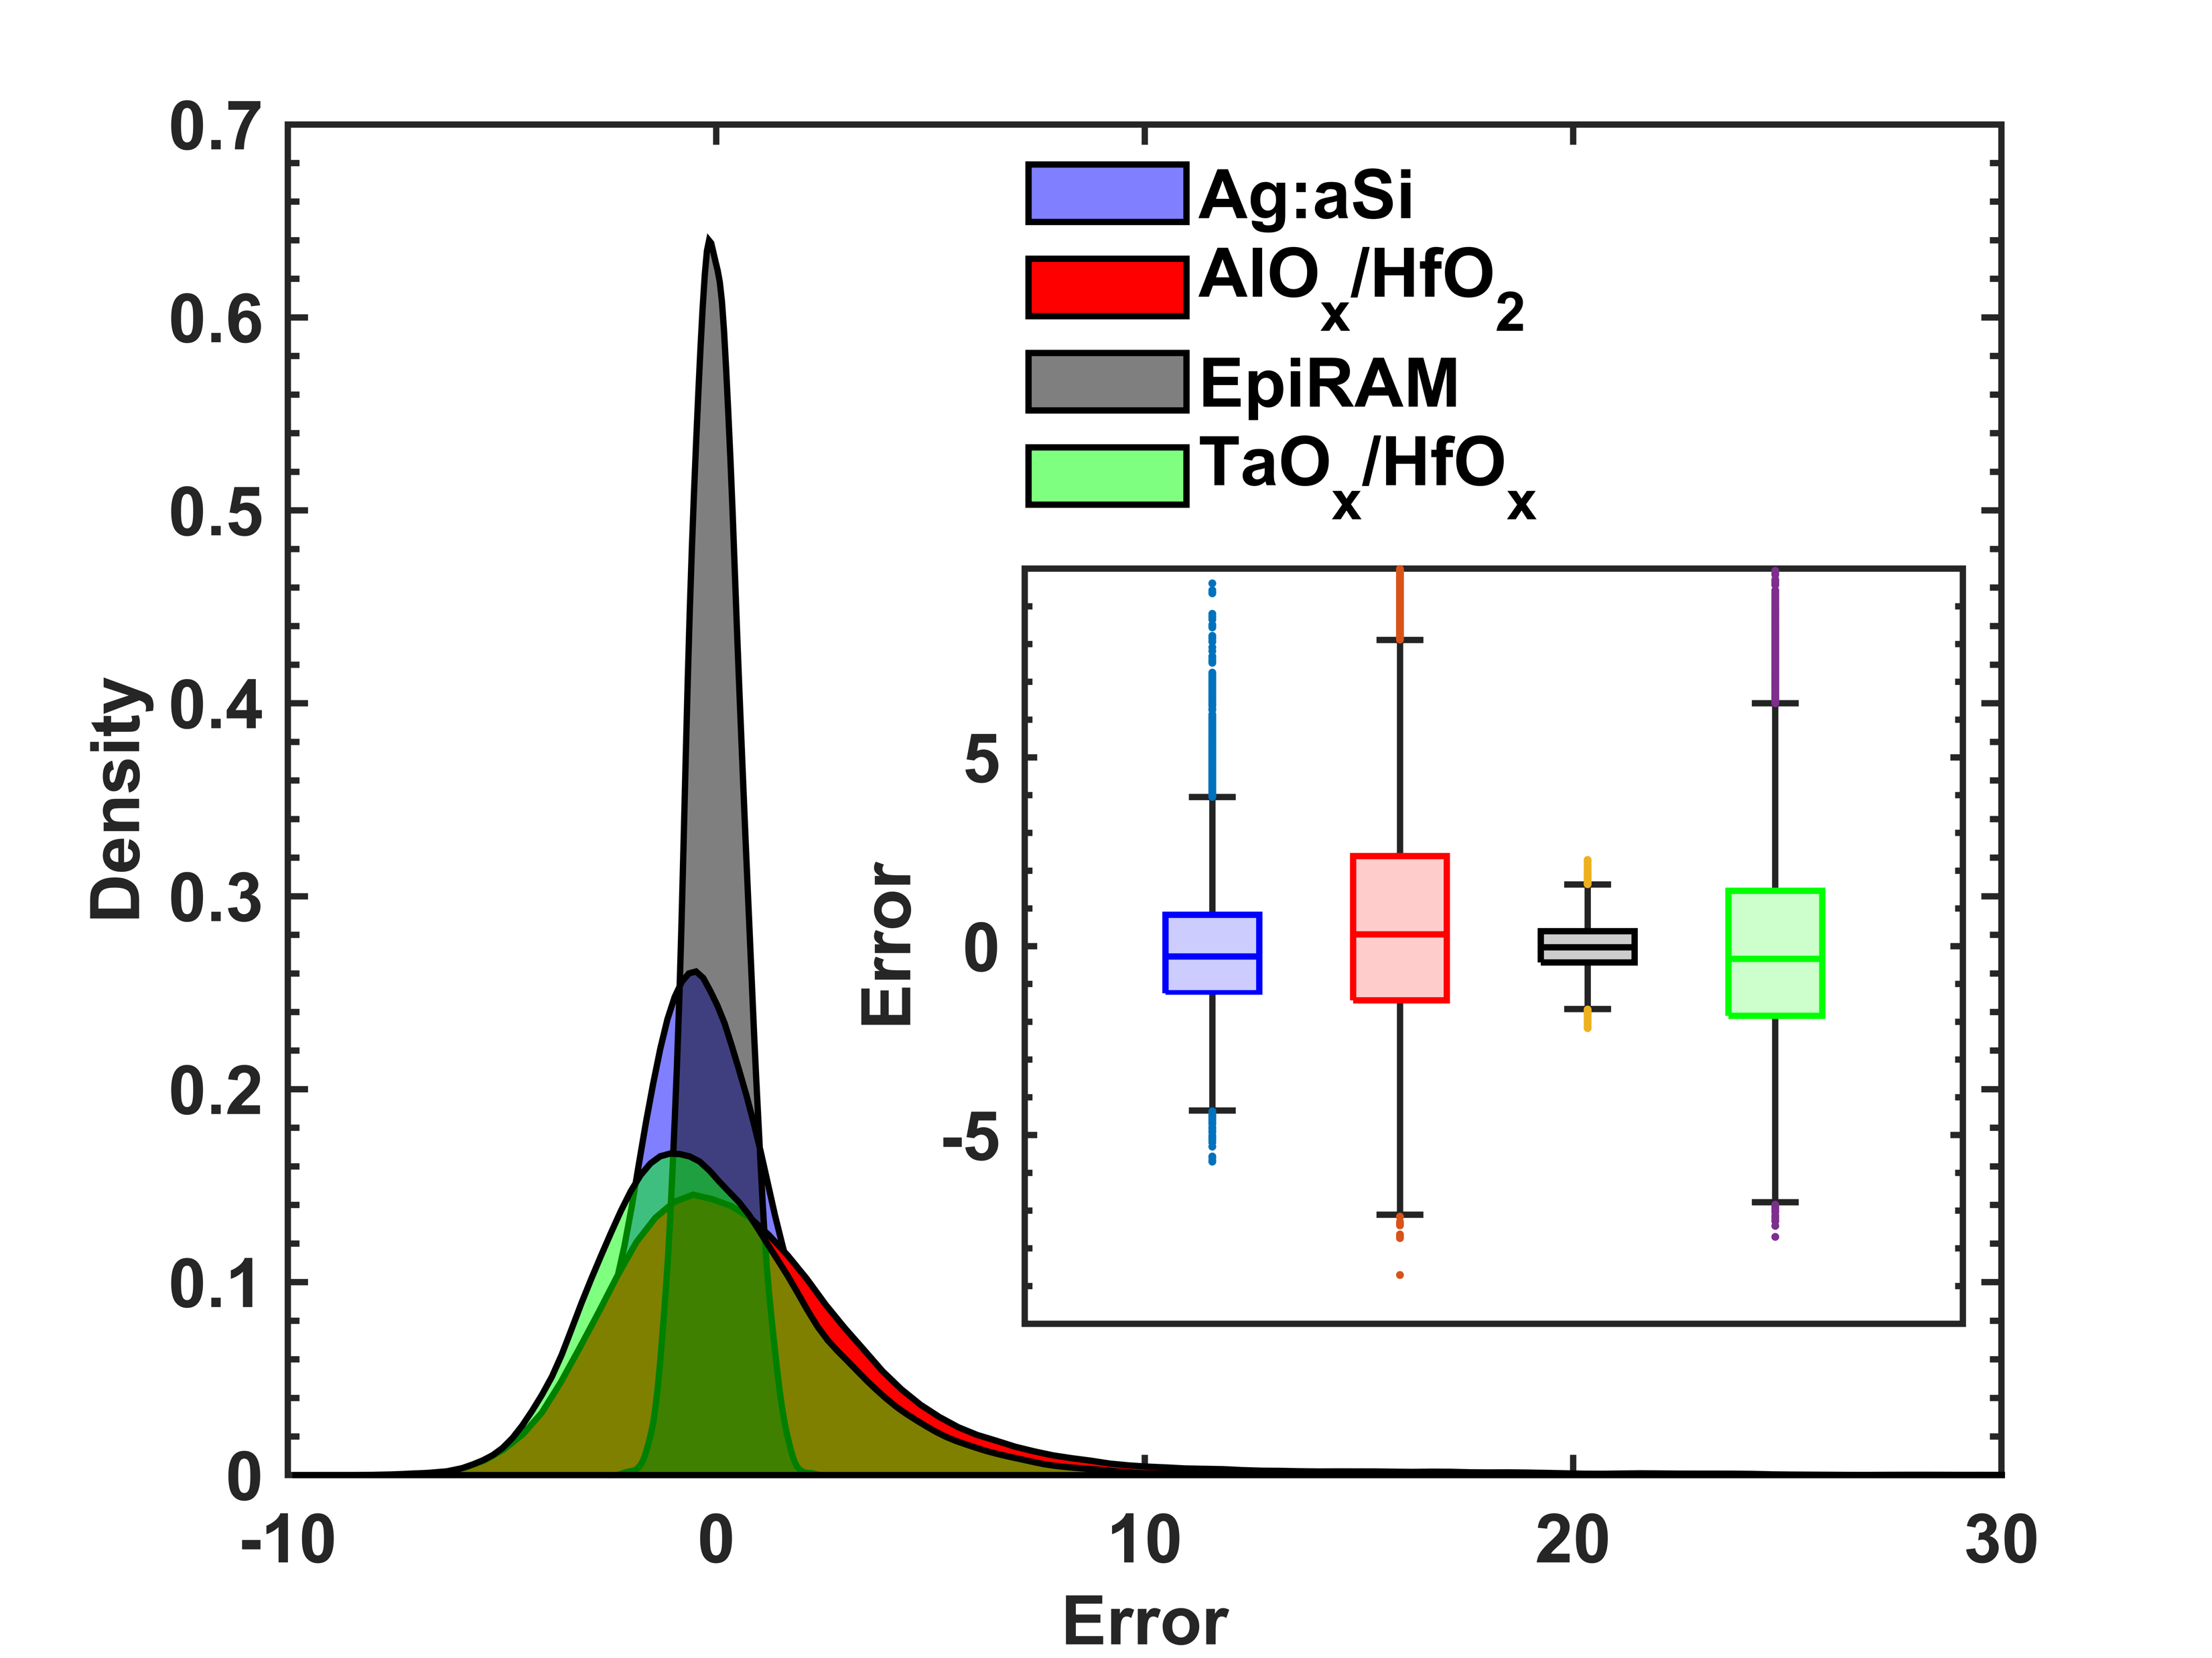
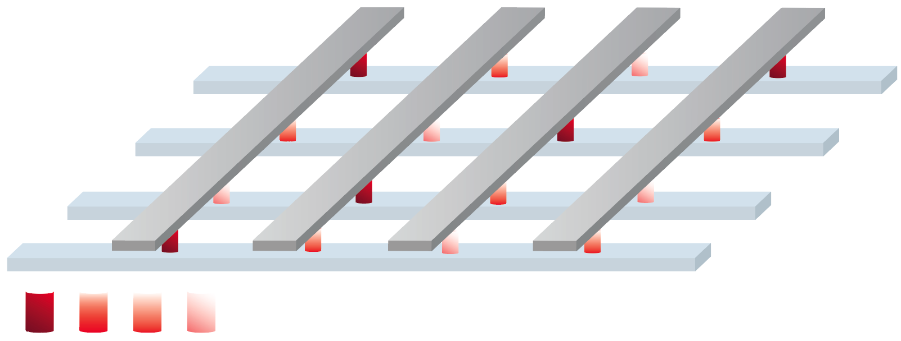
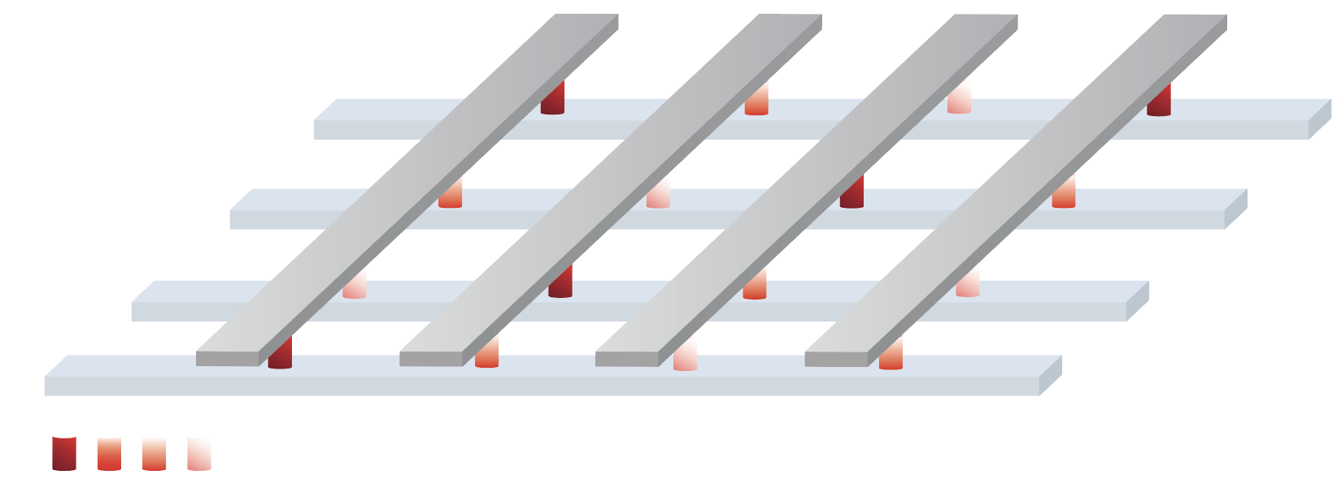
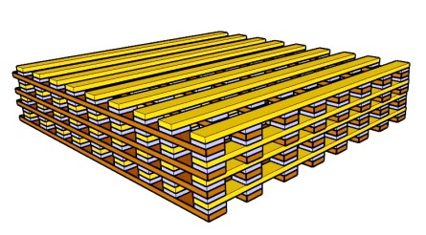
Python
C++
Simulation
MelisoPy
Cython (Python Wrapper)
MLP+ NeuroSim
Specify Device Type
Fix Crossbar Dimensions
Encode Tolerances
Encode Matrices and Vectors
Turn On/Off Scaling & Hardware
Initialize Matrix as Weights
Preprocess Device Parameter
Encode Parameters
Map Parameters to Hardware
Forward Pass
RRAM Crossbar Array
MelisoPy
Cython (Python Wrapper)
MLP+ NeuroSim
Get Final Results
Collect Statistics
Preprocess Output Product
Scale NeuroSim Output
Transform Output Product
Generate Performance Information
Conductance Levels (G_{ij})
Backward Pass

Slide 2
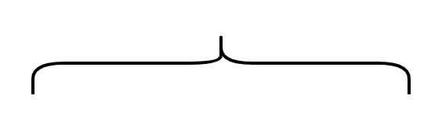






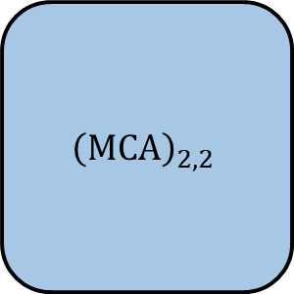






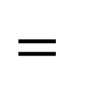


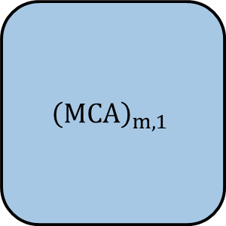



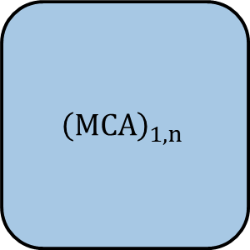



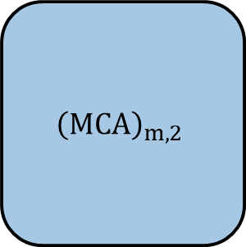







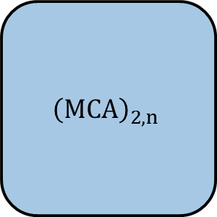

$$A$$
$$x$$
$$y$$
$${\left(MCA\right)}_{1,1}$$
$${\left(MCA\right)}_{1,2}$$
$${\left(MCA\right)}_{1,n}$$
…
$$x_{1}$$
$$y_{1}$$
$${\left(MCA\right)}_{2,1}$$
$${\left(MCA\right)}_{2,2}$$
$${\left(MCA\right)}_{2,n}$$
…
$$=$$
$$y_{2}$$
$$x_{2}$$
…
…
…
…
…
$${\left(MCA\right)}_{m,1}$$
$${\left(MCA\right)}_{m,2}$$
$${\left(MCA\right)}_{m,1}$$
…
$$y_{m}$$
$$x_{m}$$
…
$$G_{1,1}$$
$$G_{1,2}$$
…
$$G_{1,q−1}$$
$$G_{1,q}$$
$$G_{2,1}$$
$$G_{2,2}$$
$$G_{2,q−1}$$
$$G_{2,q}$$
…
…
…
…
$$G_{p,1}$$
$$G_{p,2}$$
$$G_{p,q−1}$$
$$G_{p,q}$$
…

Slide 3
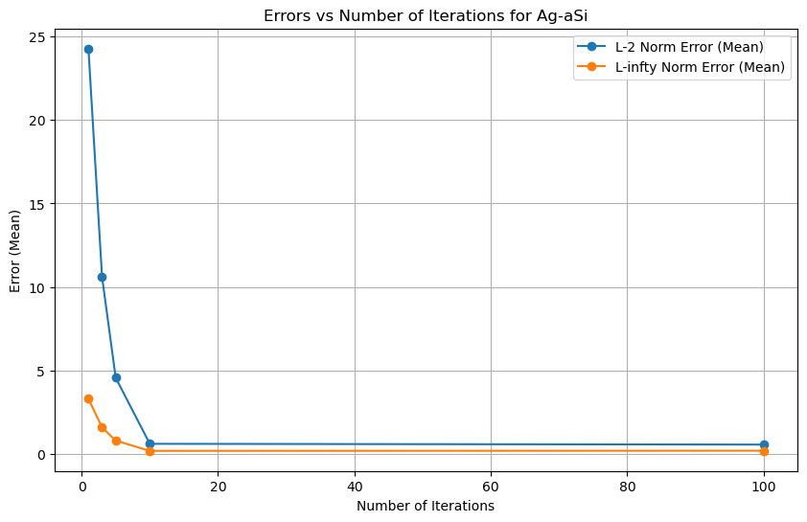
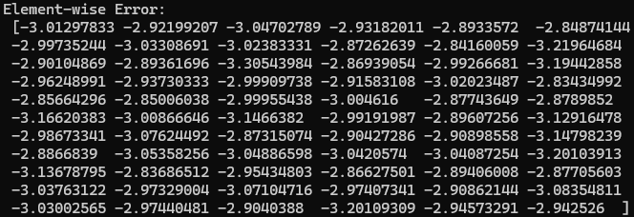
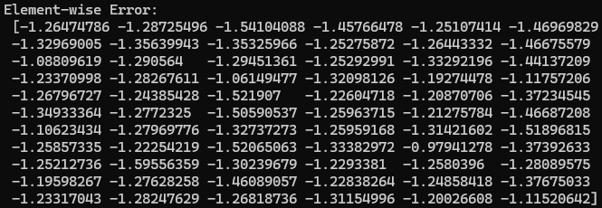
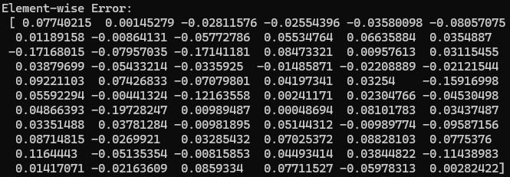
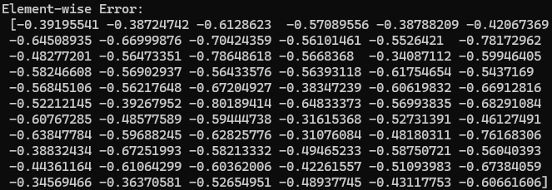
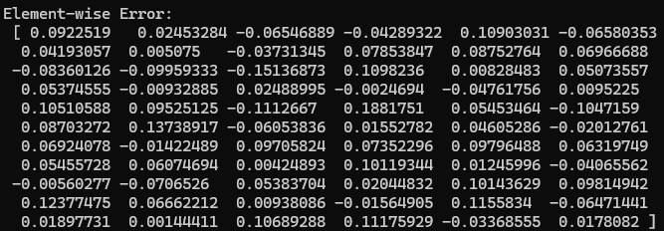

Slide 4
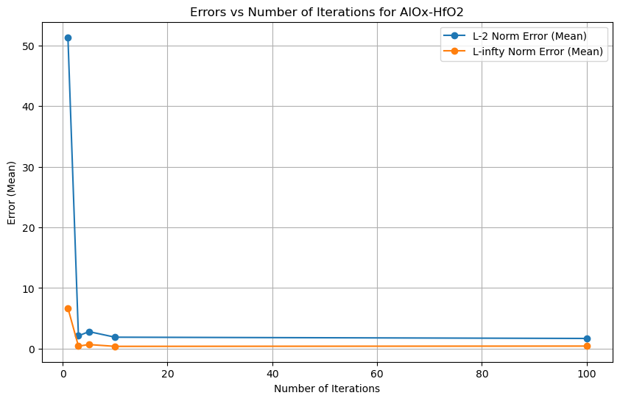
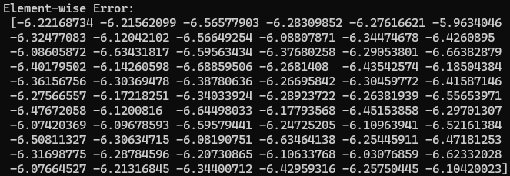
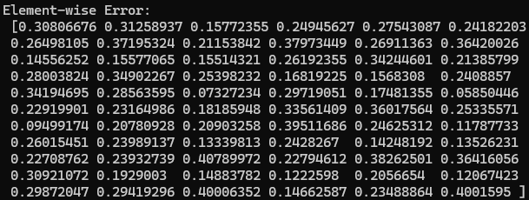
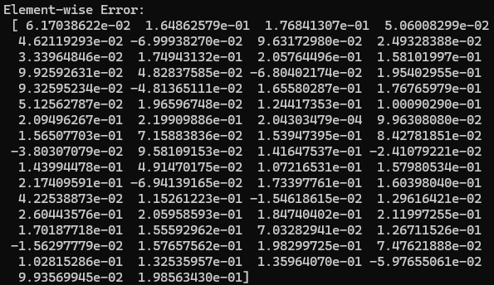
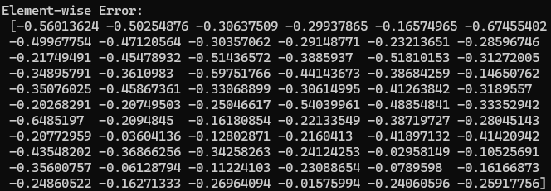
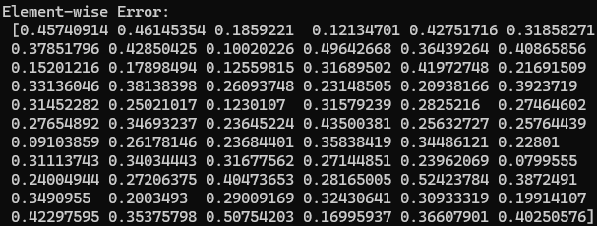

Slide 5
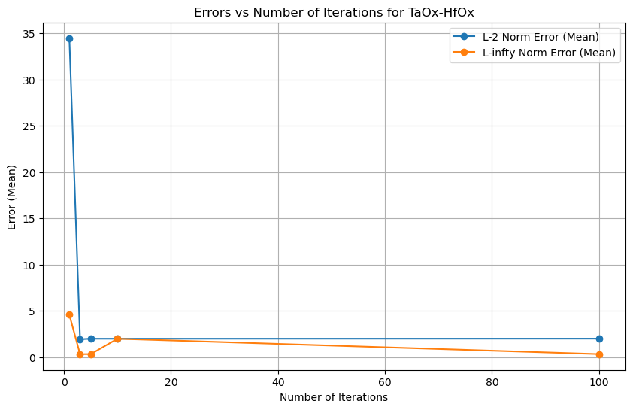
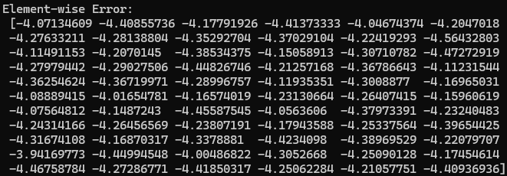
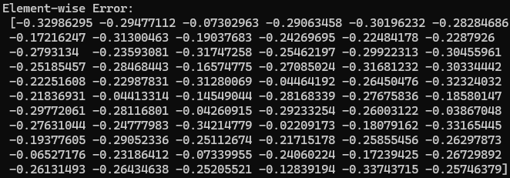
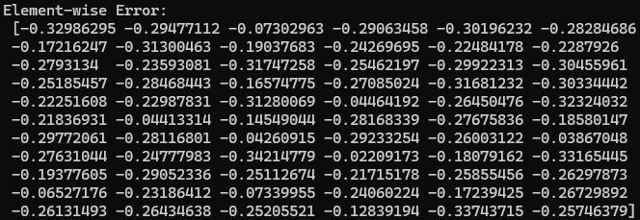
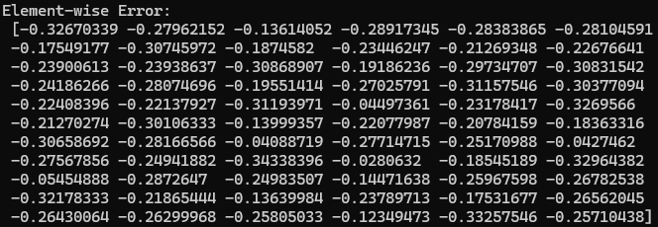
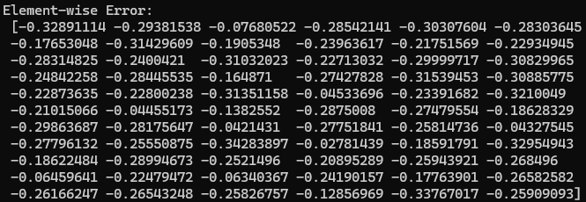

Slide 6
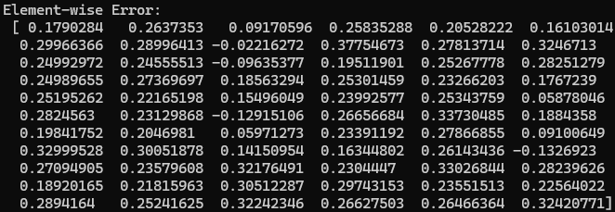
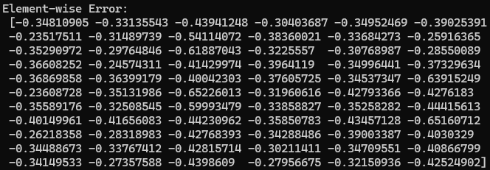
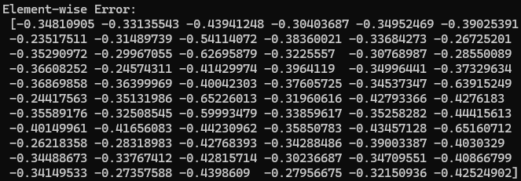
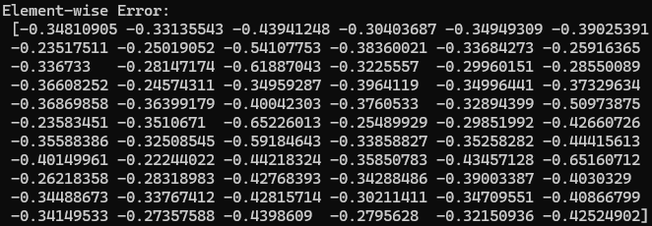
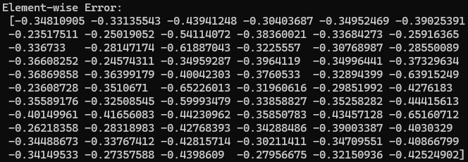
EpiRAM

