Slide 1
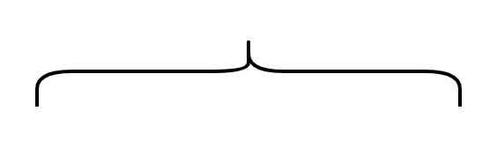
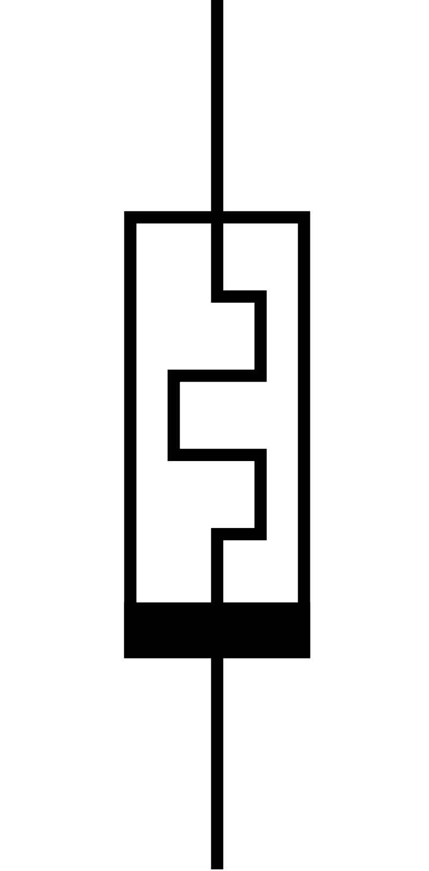





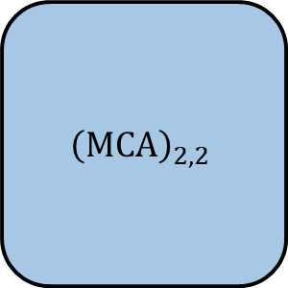






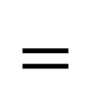


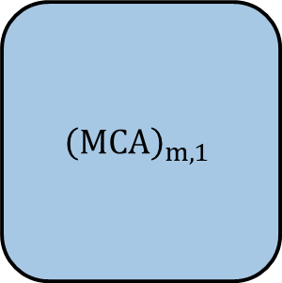



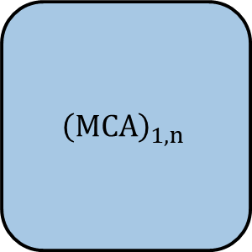



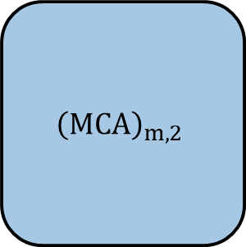







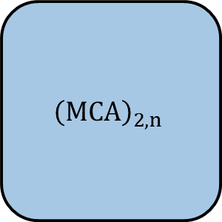

$$A$$
$$x$$
$$y$$
$${\left(MCA\right)}_{1,1}$$
$${\left(MCA\right)}_{1,2}$$
…
$${\left(MCA\right)}_{1,n}$$
$$x_{1}$$
$$y_{1}$$
$${\left(MCA\right)}_{2,1}$$
$${\left(MCA\right)}_{2,2}$$
…
$${\left(MCA\right)}_{2,n}$$
$$=$$
$$y_{2}$$
$$x_{2}$$
…
…
…
…
…
$${\left(MCA\right)}_{m,1}$$
$${\left(MCA\right)}_{m,2}$$
…
$${\left(MCA\right)}_{m,1}$$
$$y_{m}$$
$$x_{m}$$
$$G_{1,1}$$
$$G_{1,2}$$
…
$$G_{1,q−1}$$
$$G_{1,q}$$
$$G_{2,1}$$
$$G_{2,2}$$
…
$$G_{2,q−1}$$
$$G_{2,q}$$
…
…
…
$$G_{p,1}$$
$$G_{p,2}$$
…
$$G_{p,q−1}$$
$$G_{p,q}$$
…

Slide 2
