Slide 1

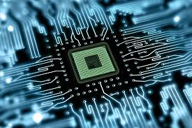
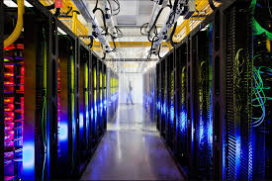
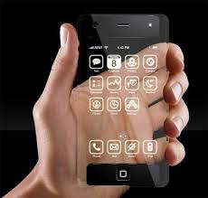
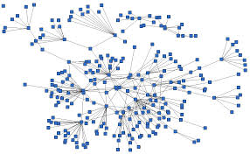
Reliability
Cyber
Physical
Safety
Real-Time
Cyber-Physical
System (CPS)
Computing resources
Terminals & devices
Interoperability
Composability
Networks
Cybersecurity
1

Slide 2
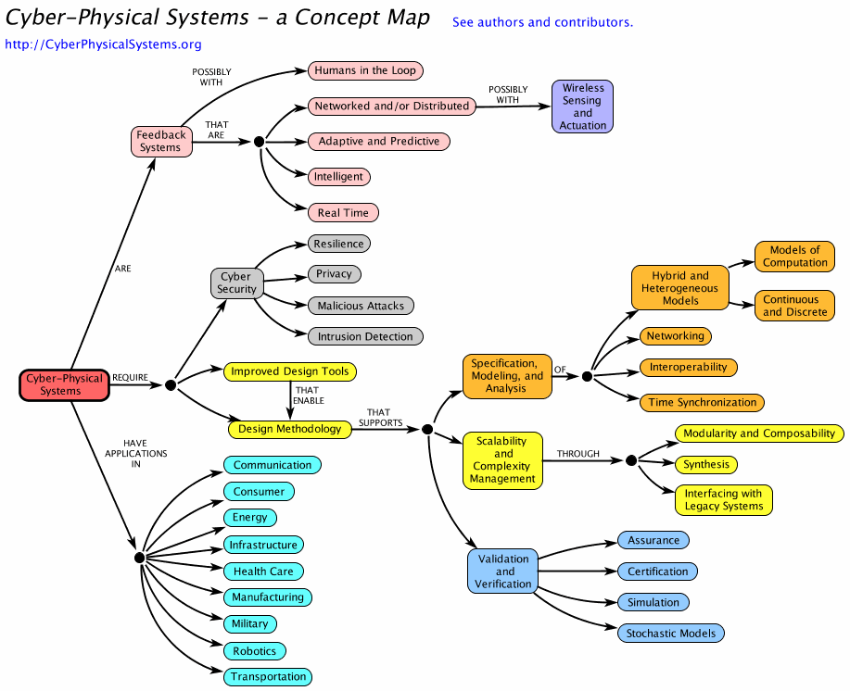
CPS Concept Map

