Slide 1

Michigan Tech
Cyber-Physical System Research
Professor Shiyan Hu
Director, Michigan Tech ICC CPS Research Center

Slide 2
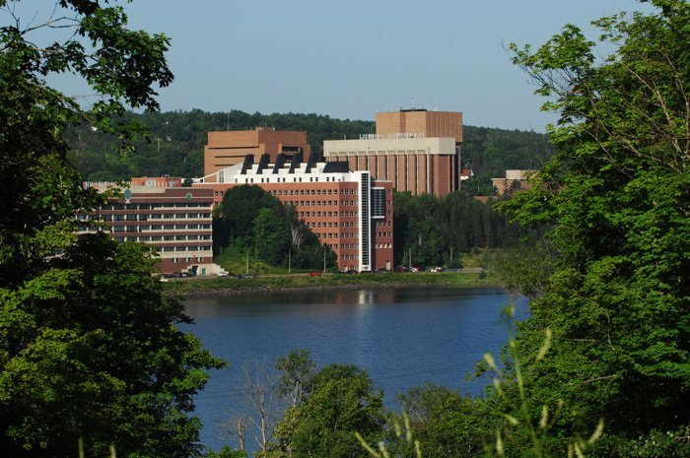
Activities
Part of IEEE Technical Committee on CPS
Publish significantly in CPS
Establish a new CPS course
Submit some CPS related proposals
2

Slide 3
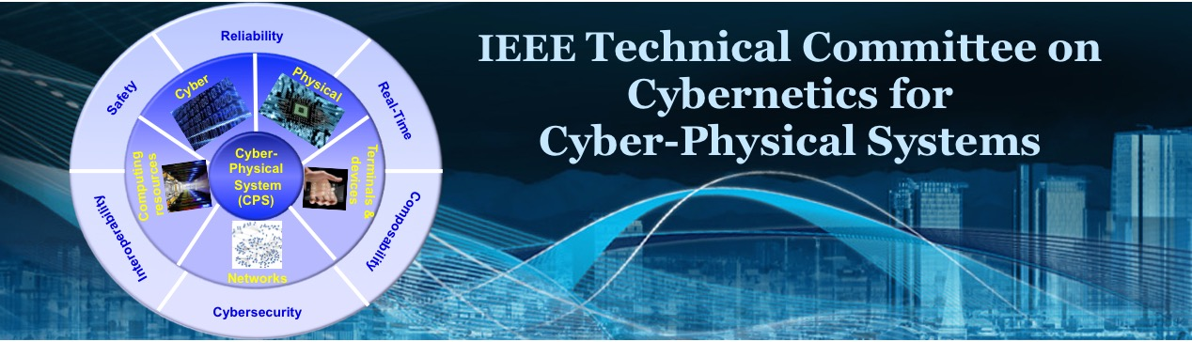
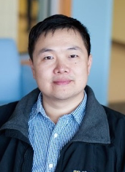








3

Slide 4








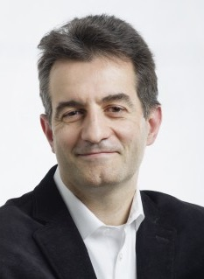

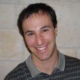

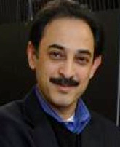

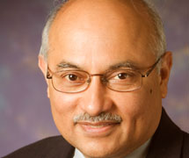

Editor-In-Chiefs
4

Slide 5
Activities in Journals/Conferences/Workshops
INFOCOM-2016 Workshop on CPS
IEEE Transactions on CAD, special issue on CAD for Cyber-Physical System
IEEE Transactions on Computers, special issue on Smart City Computing
IEEE Transactions on Multi-Scale Computing Systems, special issue on Hardware Software Crosslayer Technologies for Trustworthy and Secure Computing
ACM Transactions on Cyber-Physical Systems, special issue on Smart Homes, Buildings and Infrastructure
ICCAD-2015 special session on The Landscape of Smart Buildings: Modeling, Management and Infrastructure
ICCD-2015 special session on Cyber-Physical Integration and Design Automation for Microfluidic Biochips
DAC-2015 special session on Securing Cyber-Physical Systems: From Surveillance to Transportation and Home
More to come …..

