Slide 1

Logo Proposal for the Department of Informatics & Telecommunications at the University of Peloponnese
Ioannis Kokkalis – Panagiotis Papadopoulos

Slide 2


Slide 3


Symbolism
3.
d i t , the acronym that derives from the department name. Department of Informatics and Telecomunications - DIT.
Circuit Vectors, Symbolising Computer Science
Radio Signal that's being transmitted, symbolyzing Telecommunications Science
The University Logo
4.
2.
1.

Slide 4

Regular, Simple and Inverse Versions
Note: The regular version is recommended to be used as a stand-alone logo, and the other two versions are recommended to be used side-by-side with the university logo (Pelopas), but can also be used by themselves for simplicity.

Slide 5


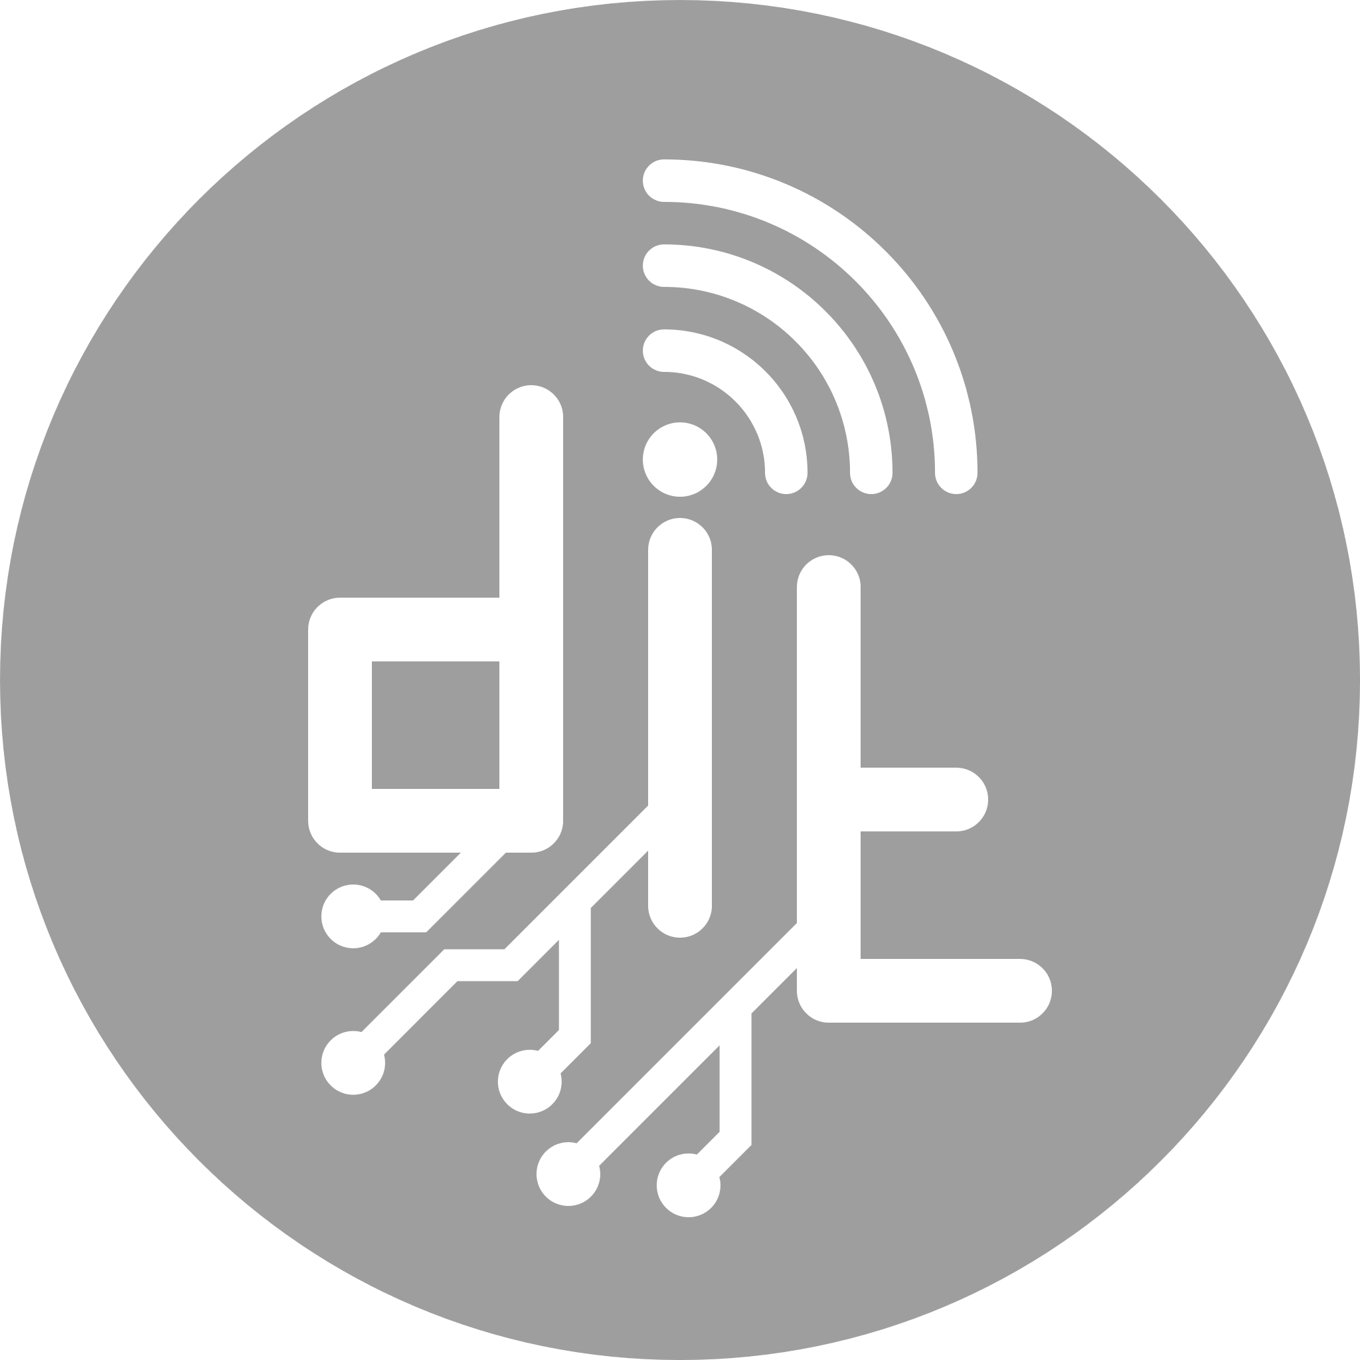
Coloring Customizations
All versions have a template SVG that can be edited so the colors match the needs of the area used.
Ex: For the Regular (shown left) Logo there are three parts that can be colored independently:
main focus of the logo, includes the "dit" and the border
secondary/complimentary are the elements representing the department fields
UoP logo (Pelopas) in the background.
The other versions have similar behavior as well.
1.
2.
3.

Slide 6

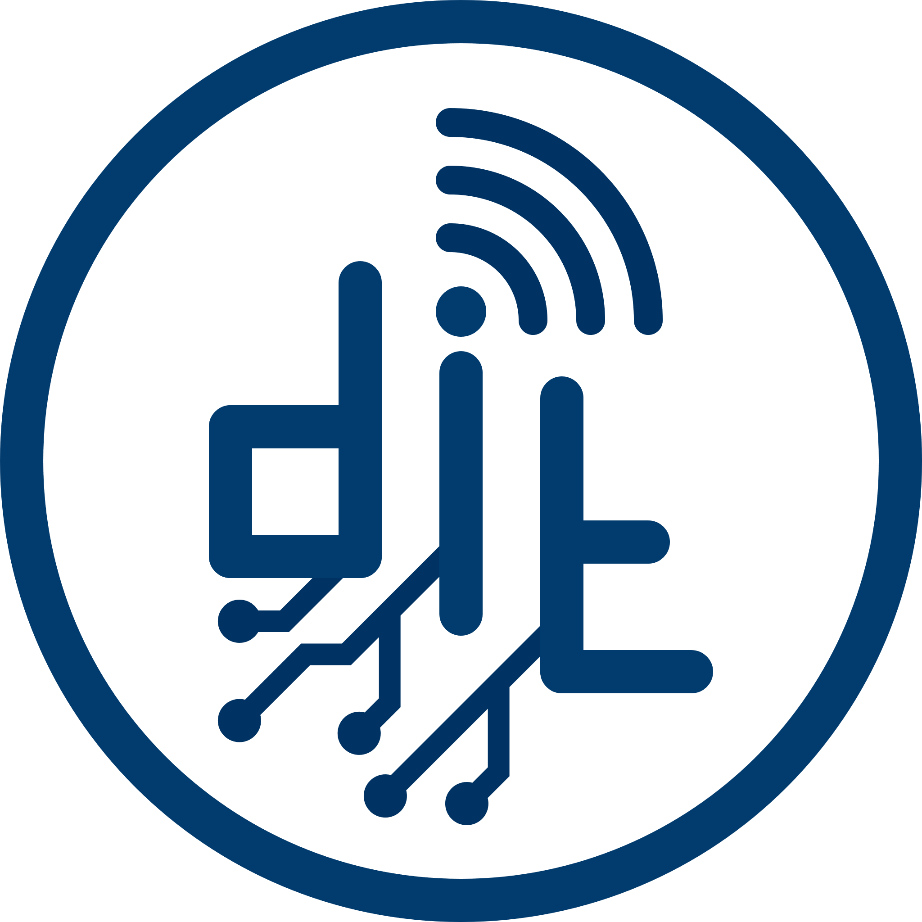

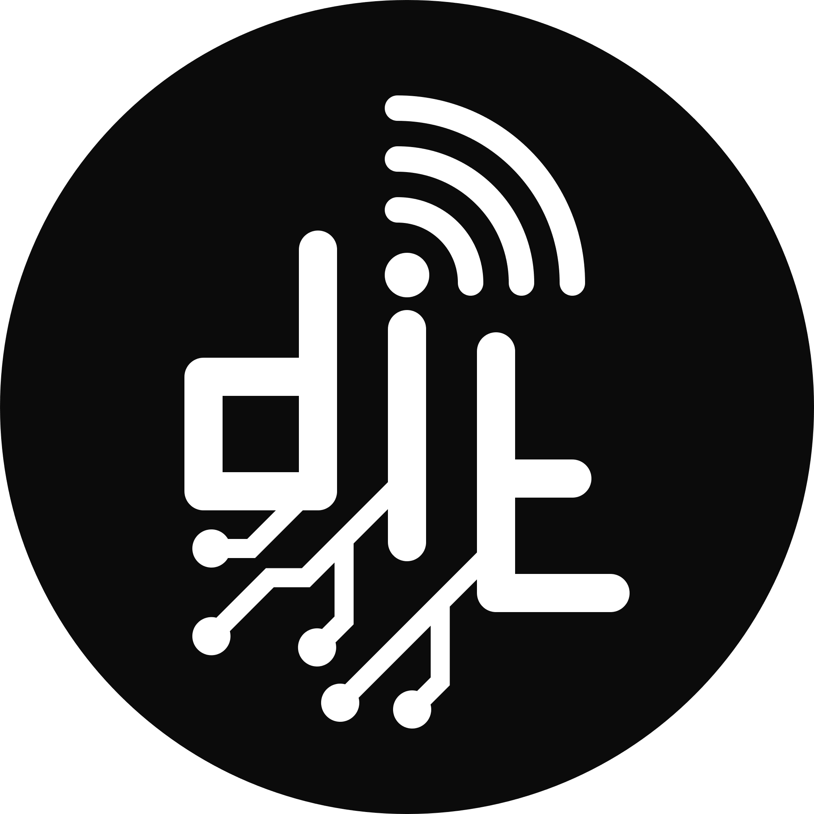
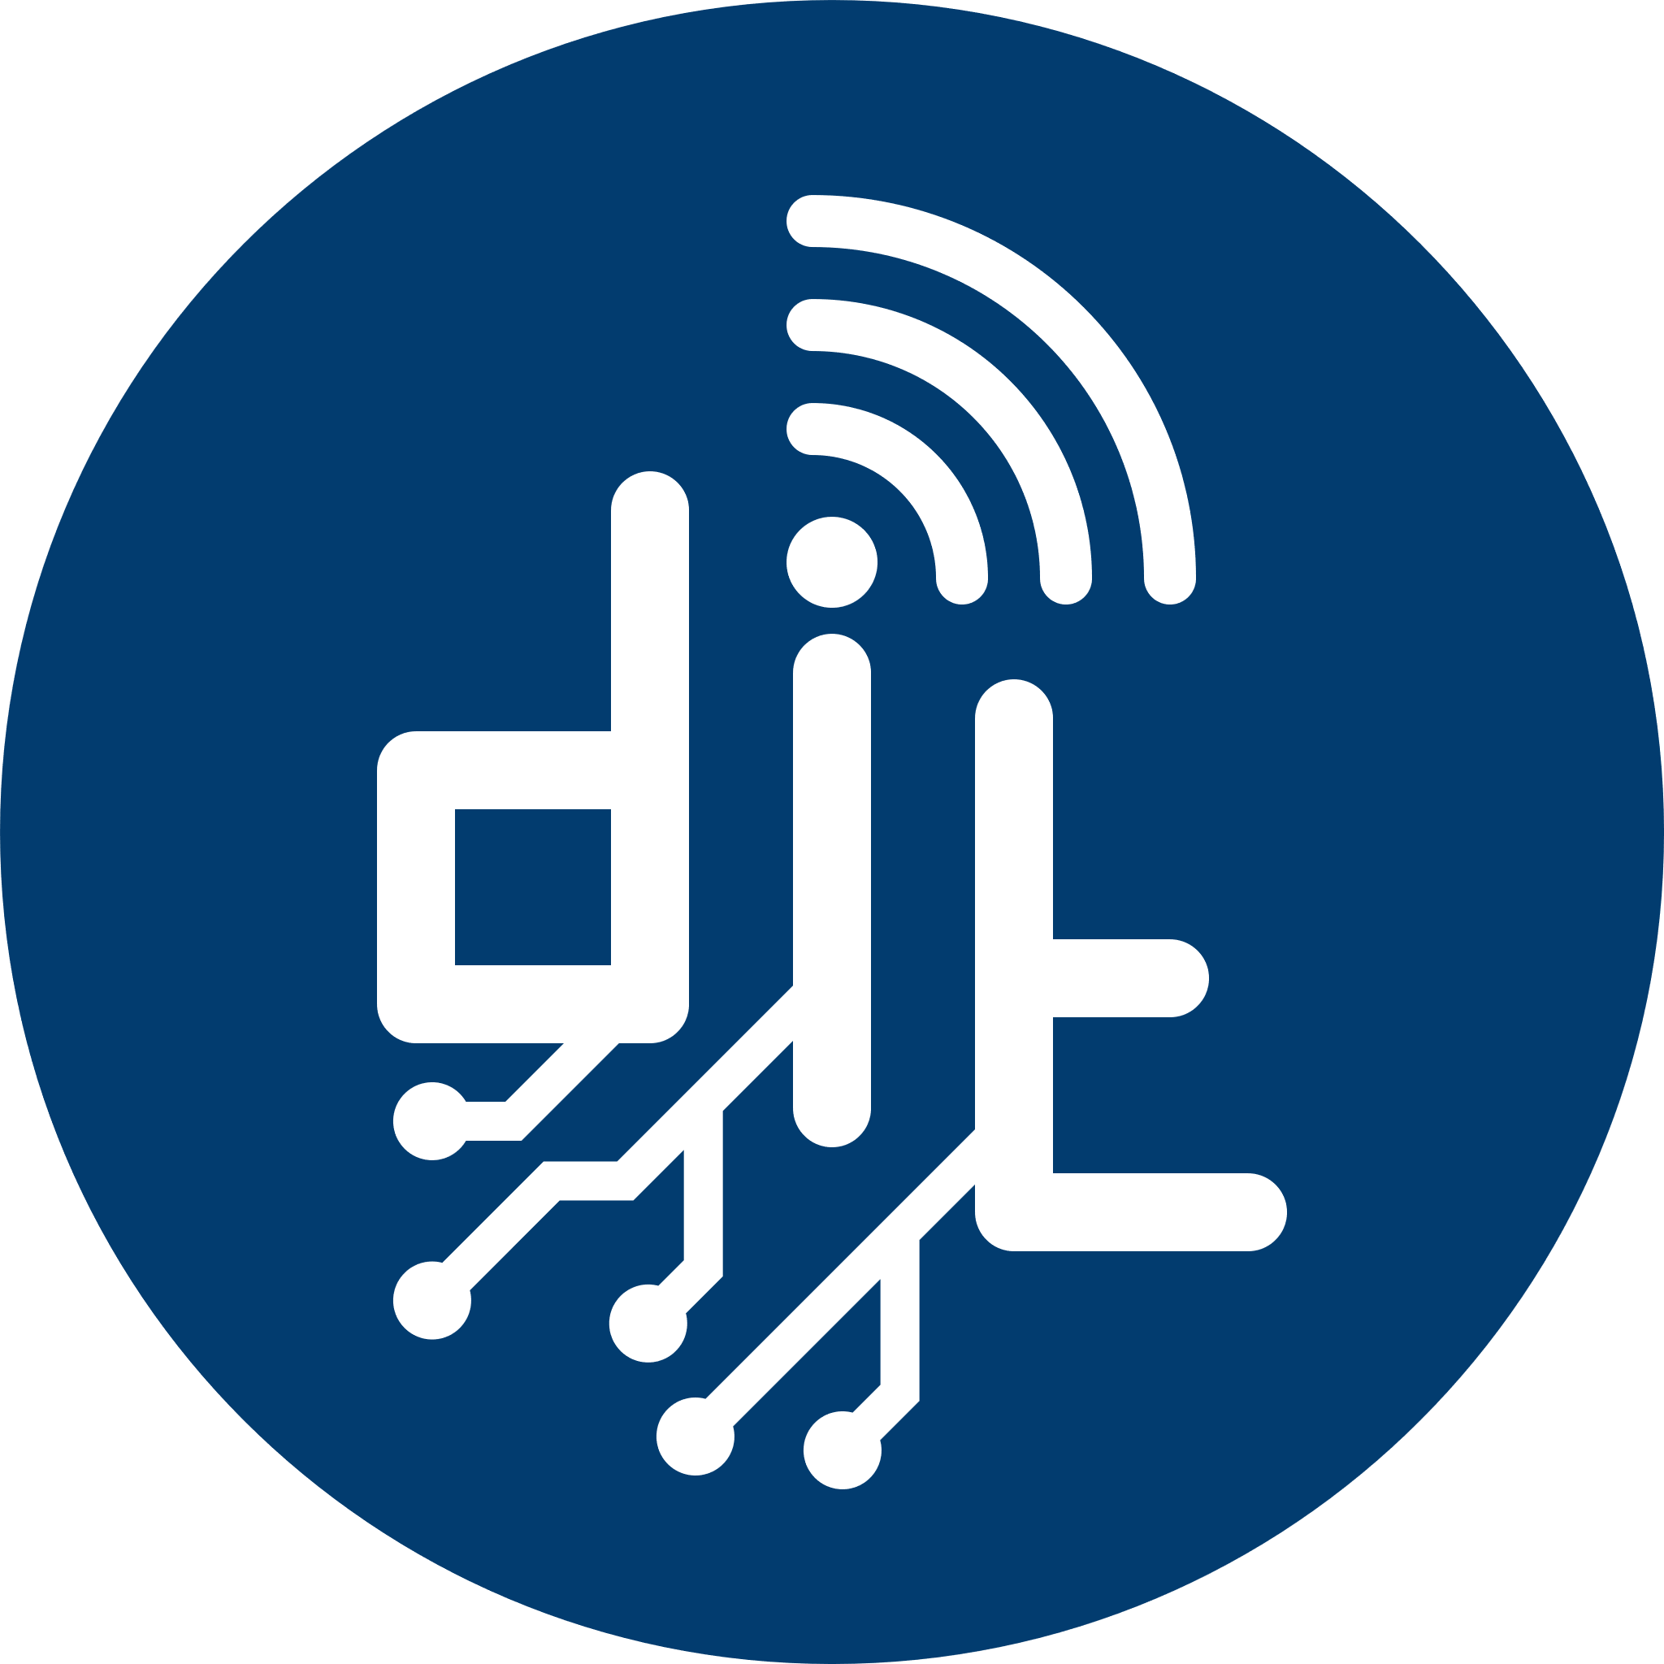
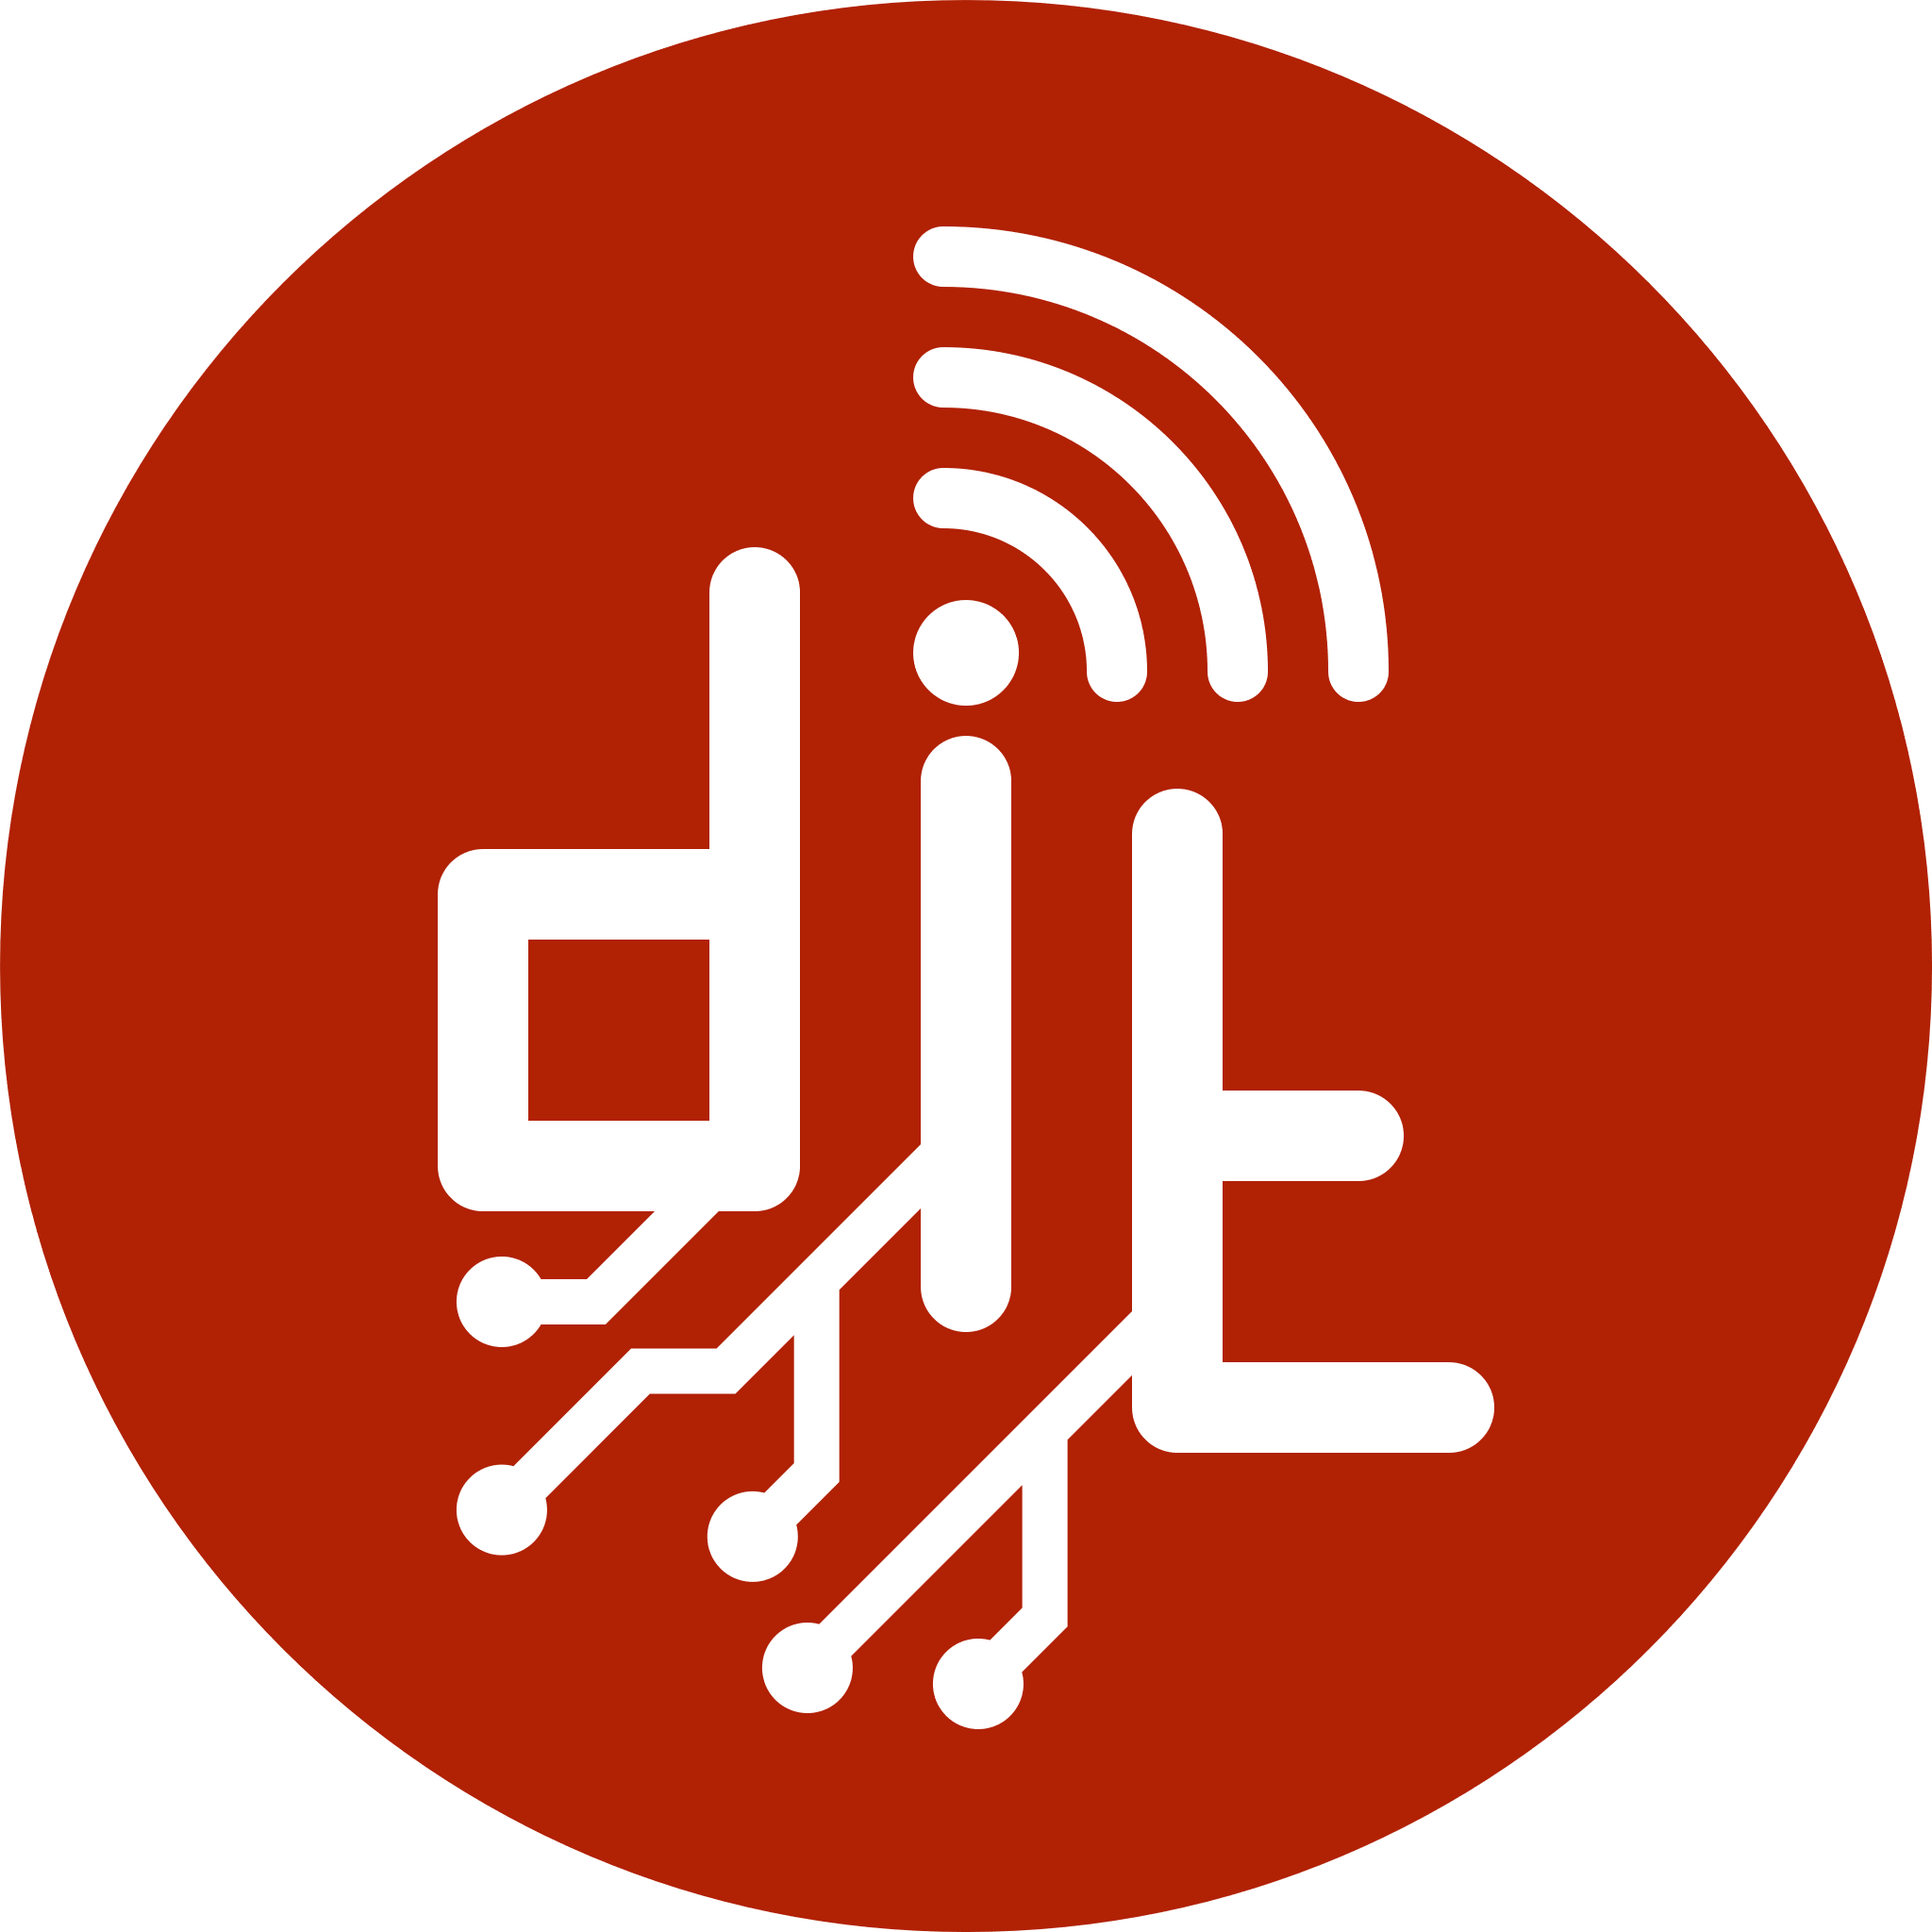


Versions

Slide 7
Uses
In general, the logo can be used wherever representation of our department is needed. More specifically, the logo can be used at:
Websites (related to dit)
Slides
Banners-Posters
Unofficial paperwork etc.

Slide 8
Thank You!
Ioannis Kokkalis
dit19085@go.uop.gr
Panagiotis Papadopoulos
dit19166@go.uop.gr

