Slide 1





CALCULATOR APP
Team Nr. 1
Gundega Alondere
Dita Ābola
Sandra Jēgina

Slide 2
Calculator Web APP
The Task
To create a Web APP calculator that supports healthy lifestyle based on informed choices.
Requirements
User friendly interface with separated calculation options for user input data with explanatory comments on current situation, as well as calorie counting (consumed & burned).
Benefits
“A healthy society is a productive society”

Slide 3
Technologies Used in the Project
IntelliJ IDEA Ultimate 2020
user friendly UI, Spring Boot framework support, SQL support, UML diagrams, IntelliSense
Vaadin 14
possibility to learn a new platform for Web App development, all code can be written in plain Java, prefabricated HTML and CSS files, integrated Spring Boot

Slide 4
Technologies Used in the Project
Lombok
another library to get familiar with, makes code cleaner, less verbosity, easy to use, suggested by a mentor
MySQL Workbench
for project databases, acquiring different views and results according to the functions in the project
Maven, HTML, CSS, Lucidchart (flow diagram design)

Slide 5
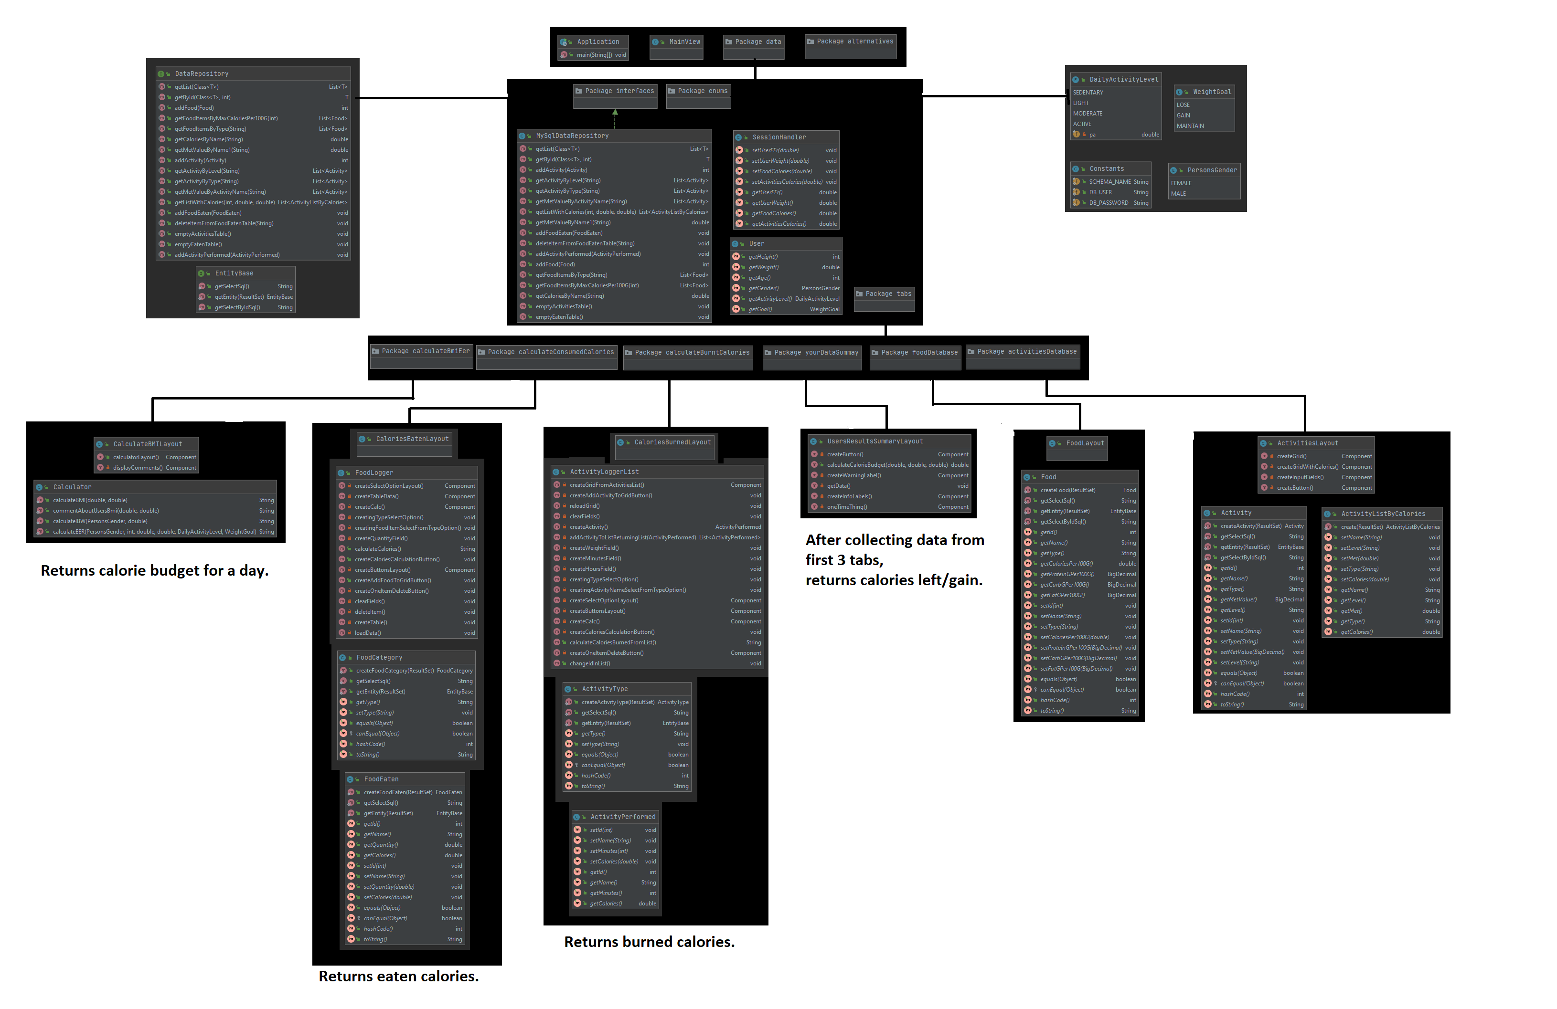


Slide 6
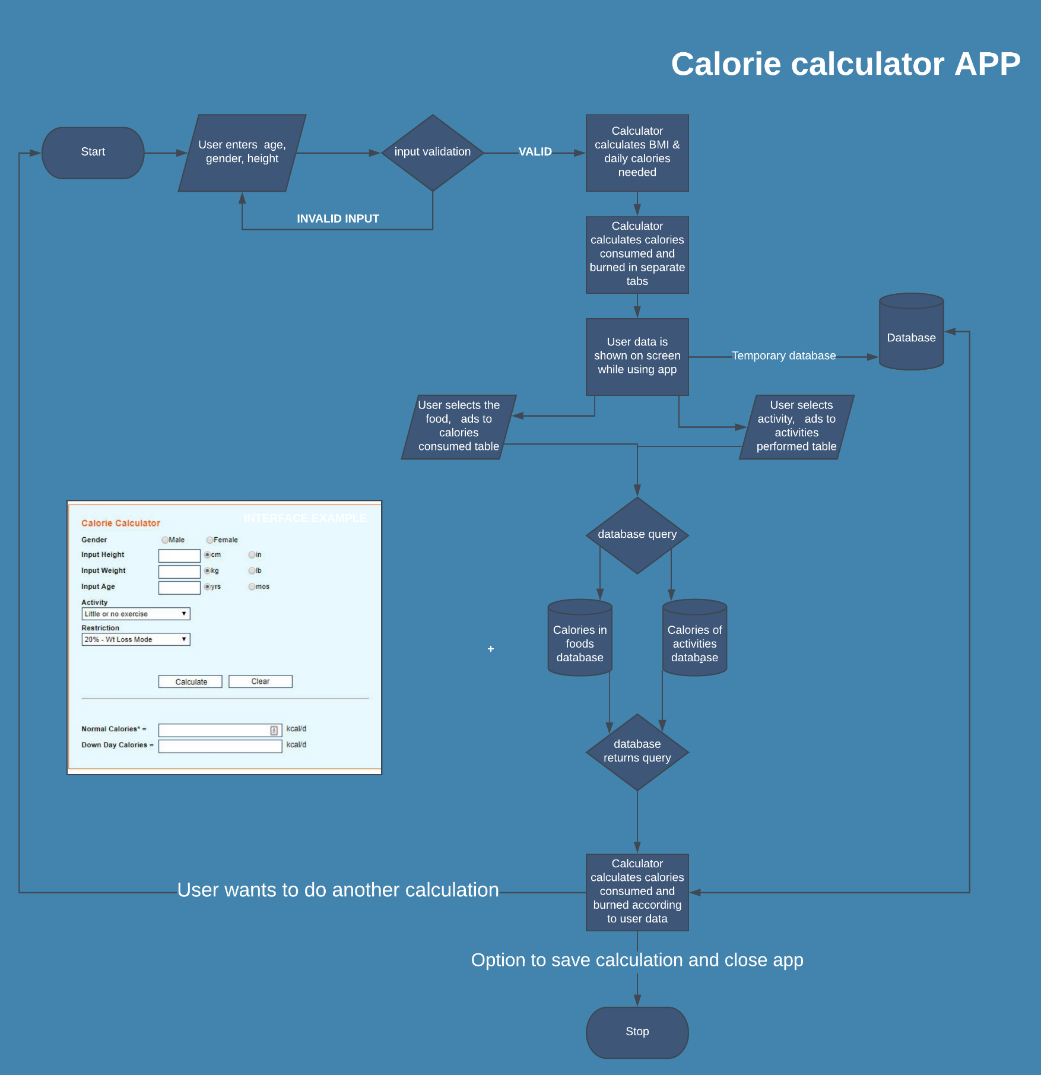


Slide 7
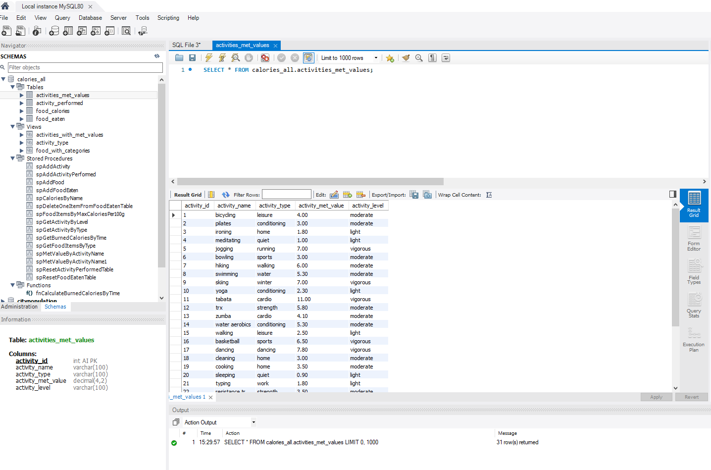


Slide 8
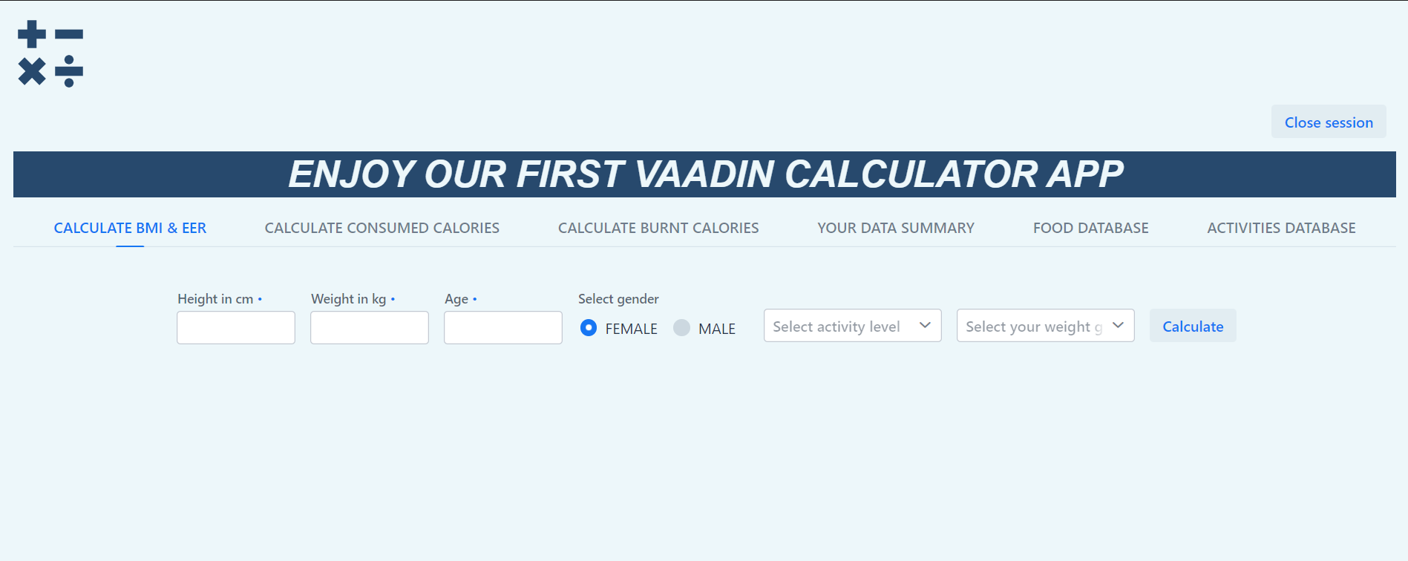
BMI, EER, weight plan calorie calculator

Slide 9
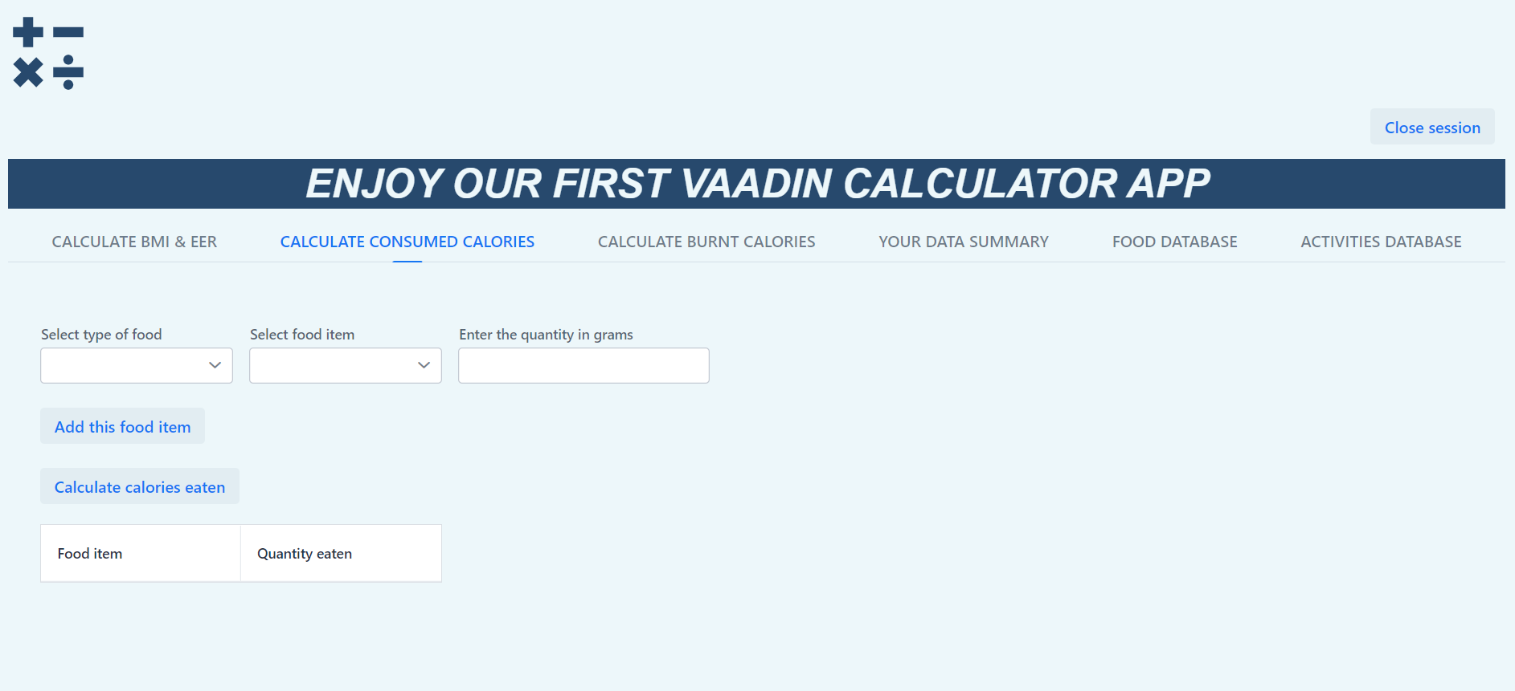
Consumed calorie calculator and the table of added foods

Slide 10
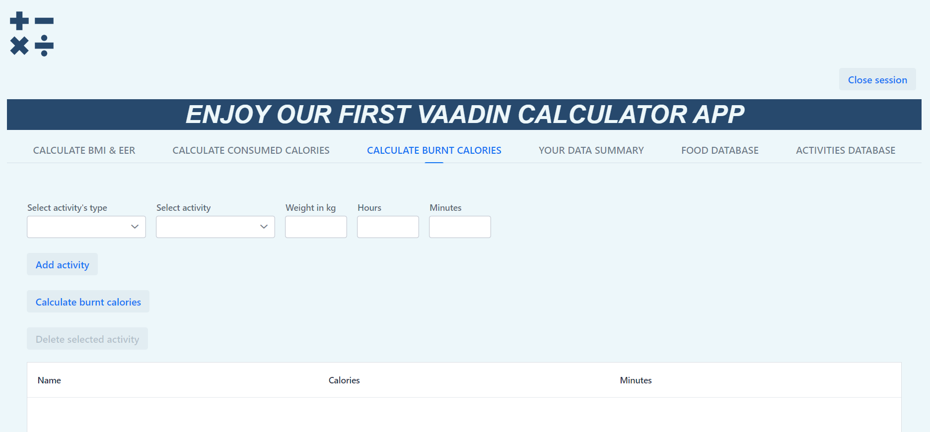
Calories burned calculator and the table of added activities

Slide 11
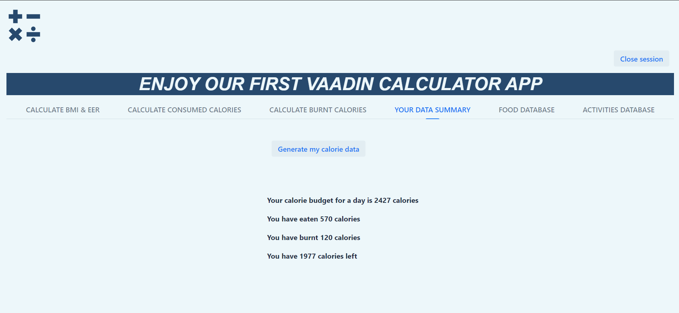
User data summary

Slide 12
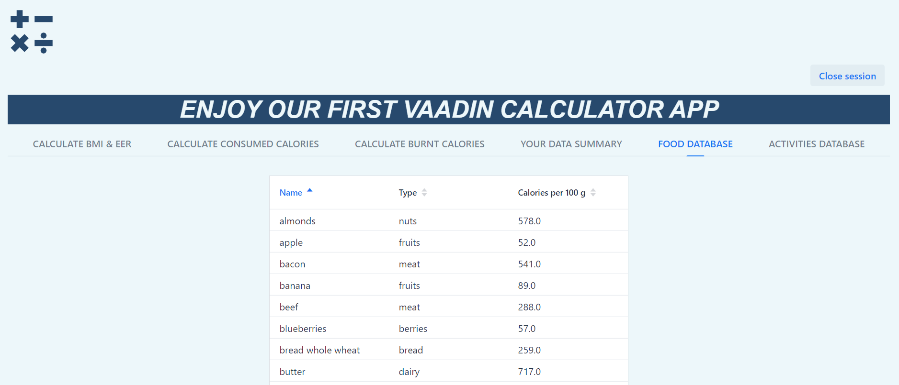
Food database for refference

Slide 13
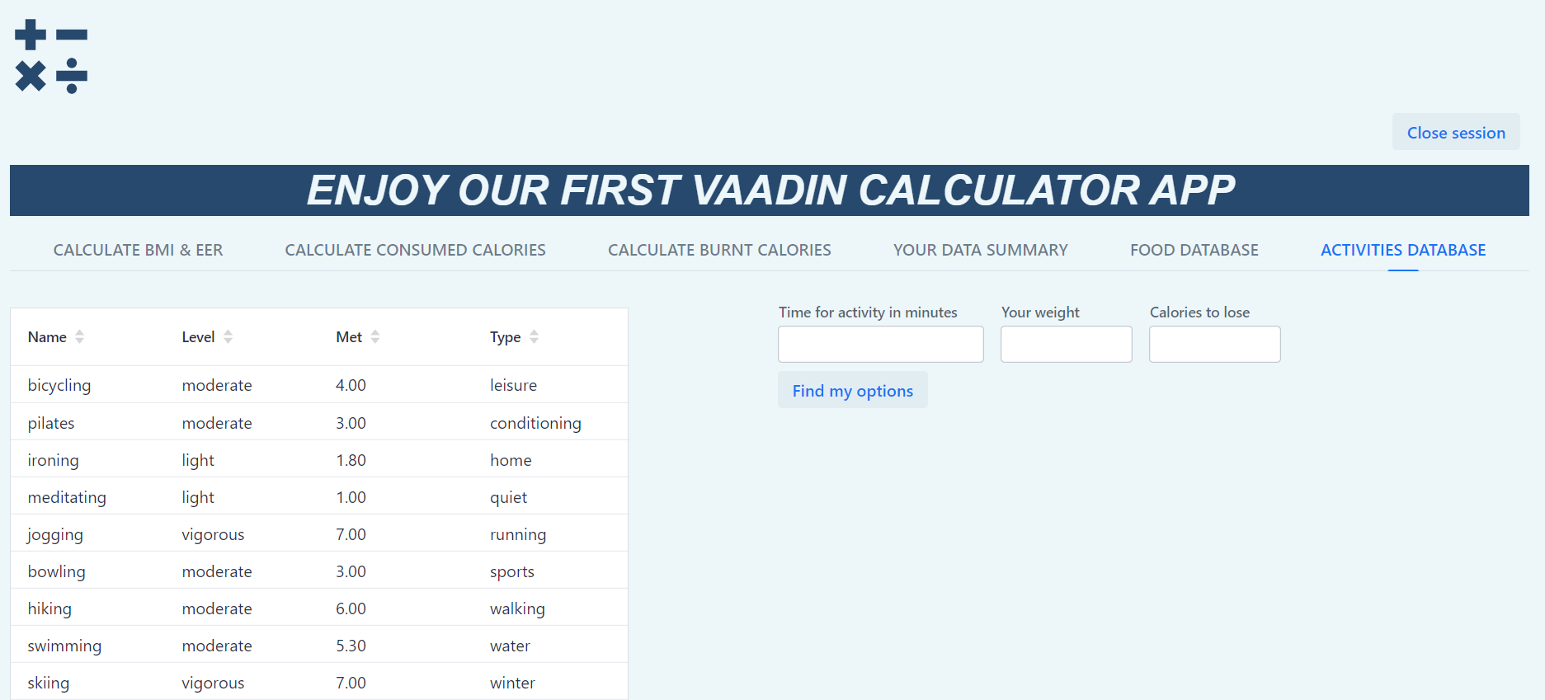
Activities database and option finder for burning certain amount of calories

Slide 14
Major challenges
Lack of experience in project development
- project structuring
- task management between team members
UML diagram
the initial version differs significantly from the result
Shortage of time
- unknown platform (Vaadin)
- code refactoring

Slide 15
Major challenges
Insufficient technical skills
- derivation of an external (“googled”) code snippet to fit it into the project
Trial and error setbacks
- time consuming code testing due to frequent necessity to reload the project to ensure its functionality
Psychological barriers
- imposter syndrome, fluctuating self confidence

Slide 16
Major GAINS
Getting familiar with VAADIN platform
Supportive teammates
Collaboration with mentors
Acknowledgement of gaps
Successful 223 Git commits
Completed project according to the deadline
Acquired experience in project development

Slide 17
THANK YOU!

