Slide 1
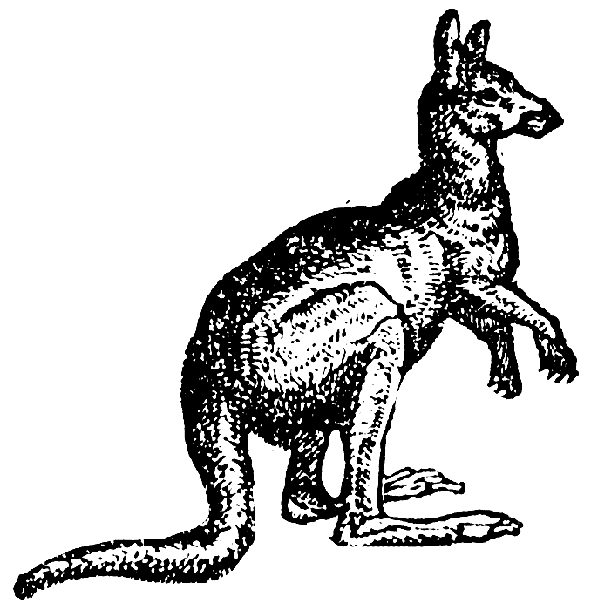
Genome Directory
Define the number of genomes to pick (default = 10) and number of reads to generate per file (default = 100,000)
Execute sim mode
PD on concatenated tree
Determines PD contributions for taxa present in concatentated guide tree in PhyloSift marker directory
Two separate approaches used:
Select a set of taxa that contribute to PD (user input, default = 10)
Same number of taxa are randomly select taxa across PD list
Select Taxa
Generate Simulated Reads
Grinder algorithm randomly generates reads from selected genomes, outputs simulated PE-Illumina and 454 datasets
Mask Simulated Taxa
Workflow plugs into updateDB to mask genomes which have been used to simulate metagenome data.
Cloned Marker Directory
A cloned marker directory is created, where simulated genomes have been removed from marker packages.

