Slide 1
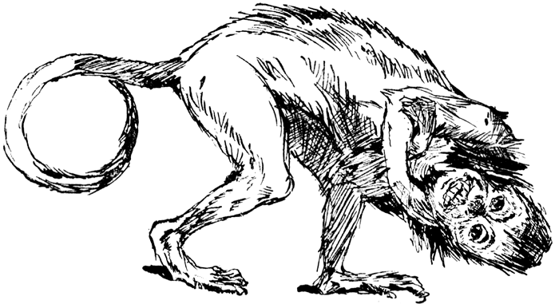

Mapping File
(Accession, NCBI taxon ID)
PD cutoff
Alignment File
(Marker sequences in FASTA format)
NOTE: New marker packages are named according to input filenames (e.g. MarkerAlignment.fasta). Core marker data will be overwritten during new marker builds if input files do not have unique names compared to existing PhyloSift markers.
Execute build_marker mode
HMMbuild
Unalign sequences and create profile HMM out of input data
Generate unique IDs for input sequences
FastTree
Build tree and collapse topology according to a user-specified PD cutoff (e.g. 99%)
HB: Want to mention the dummy pplacer step here but don’t want to go into too much detail (might confuse readers). Is this appropriate?
HB: Creepy monkey (top) or non creepy monkey (below)?? Or both (since they fill out the white space nicely)?
Sequence accessions mapped to phylogeny via a dummy pplacer file
Quantitative metric (minimum hamming distance) used to match edges between NCBI taxon tree and molecular phylogeny
Tree Reconciliation
Reconcile NCBI taxonomy IDs with phylogenetic topology
Clean and package new marker genes
Built Marker Packages
New marker gene packages placed into shared PhyloSift marker directory
Execute index mode
Locally indexed marker packages will not interfere with automatic updates to PhyloSift core markers
Index Marker Database
Indexes the marker databases needed for LAST and Bowtie
Built PhyloSift Marker package
Tree
Hmm profile
Taxon map
Representative sequences
Alignment

