Slide 1

Mineable GemToken
Provably rare digital Collectables
Built on Ethereum
Caleb Ditchfield and Salman Rahim
DappHack

Slide 2
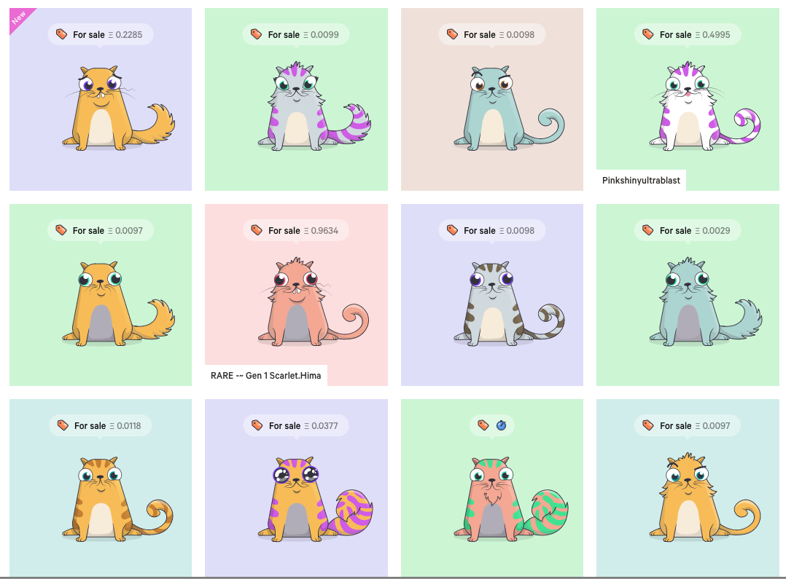
ERC-721
Open standard that describes non-fungible or unique tokens
Defines a minimum interface a smart contract must implement to allow unique tokens to be managed, owned, and traded
Think of them like rare, one-of-a-kind collectables: CryptoKitties

Slide 3

ERC-918
Specification for a standardized Mineable Token that uses a Proof of Work algorithm for distribution
Initially locks tokens and slowly dispenses them with a mint() function which uses a Proof of Work algorithm to control the distribution rate
Token distribution via the ICO model is susceptible to illicit behavior: ICO -> IMO

Slide 4
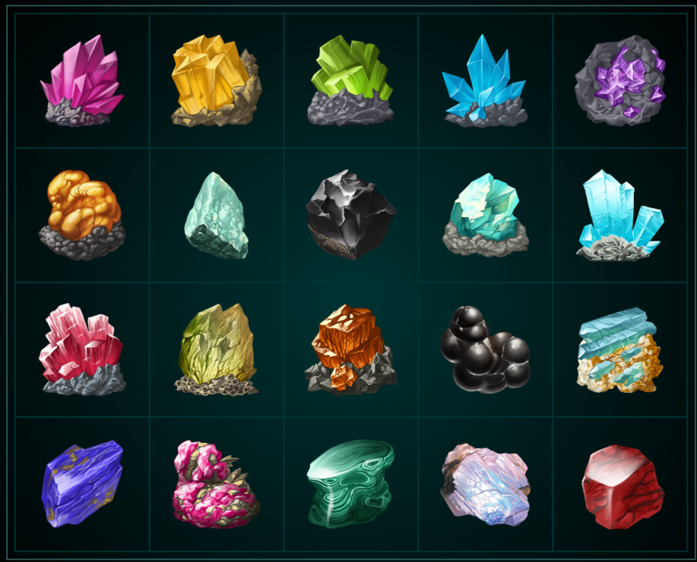
Gem Tokens
The first token to combine ERC-721 and ERC-918 standards
Implements a Proof of Work algorithm that accepts various difficulty levels
Miners who work the hardest get the rarest gems

Slide 5
demo

