Slide 1
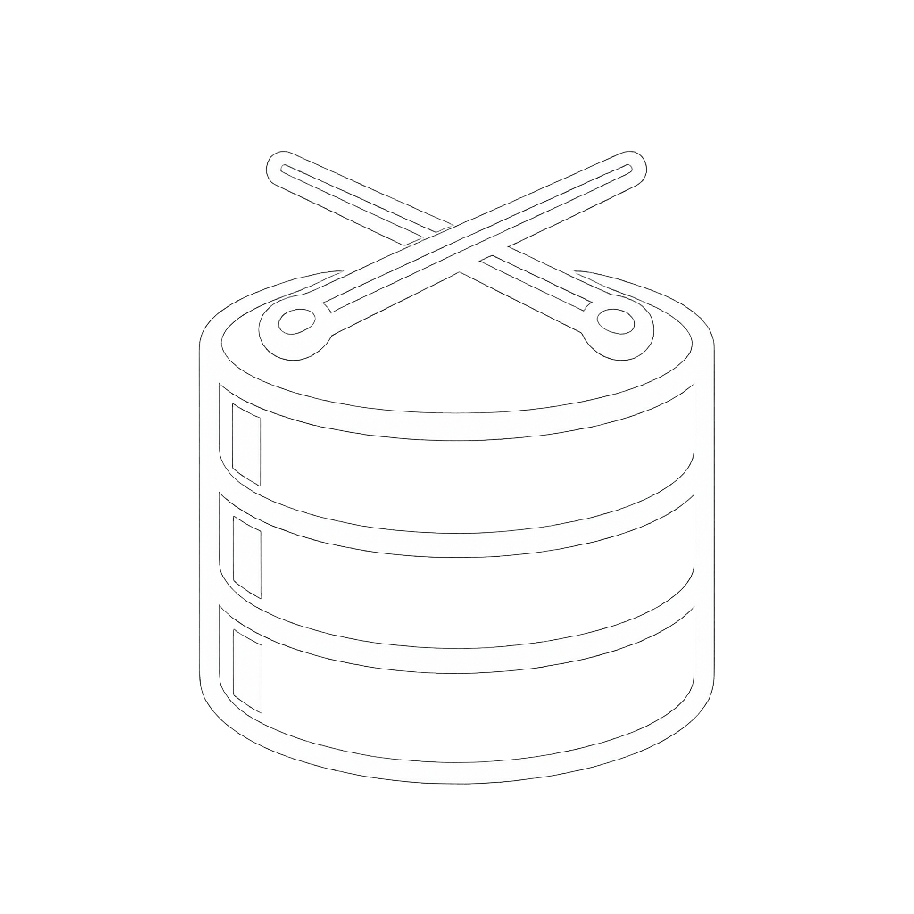
GIT FOR DATABASES
Your code. Your environment. Your data.
Prepared for JPMorgan Chase | Developer Experience & Productivity
WHY DATADATDAT FOR JPMC
JPMC CHALLENGES
DATADATDAT SOLUTION
OUTCOMES FOR JPMC
■ 20+ developers share a single dev database — outages and restores hit the entire team.
■ Database rehydrations and restore-from-backup are slow and operationally disruptive.
■ Load-bearing shared DBs make developers risk-averse.
■ Current workspaces do not host containers locally but expectation is that will change in the future.
■ Data workflow is misaligned with the app code workflow, eroding quality and velocity.
■ Git semantics for databases: clone, push, pull, commit, checkout, branch.
■ Each developer provided an isolated, fully-functional database from a known commit.
■ Delta-only versioning of the data file and container metadata — commits are fast and lightweight.
■ Same workflow whether containers run outside or inside the workspace — future-proof.
■ Database state versioned alongside code — aligned cognitive model with app development.
■ Outages localized to one developer — never to the whole team.
■ Database restoration collapse from hours to seconds via a single d3 checkout.
■ Database rehydration now happens asynchronously increasing productivity and eliminating downtime.
■ Developers move faster, with confidence to make DB changes.
■ Investment carries forward as JPMC's workspace strategy evolves.
■ Higher code quality, faster delivery, measurably stronger dev engagement.
IMPLEMENTATION
d3 executable on workstation
Docker / Kubernetes runtime
Datadatdat Remote Server (commit store)
30+ DATABASES SUPPORTED
PostgreSQL · MySQL · MariaDB · SQL Server · Oracle · MongoDB · DynamoDB · CockroachDB · TiDB · Cassandra · ClickHouse · Couchbase · CouchDB · Redis · Valkey · Dragonfly · Elasticsearch · OpenSearch · Neo4j · ScyllaDB · SurrealDB · TigerGraph · Qdrant · Chroma · Weaviate · Typesense · Meilisearch · InfluxDB · QuestDB · NATS · StarRocks

