Slide 1
MAIN PROJECT – 2ND REVIEW | MCA 2026
GeoPoverty AI: An Explainable Multimodal AI System for Area-Level Deprivation Estimation Using Satellite Imagery
Integrating Sentinel-2, VIIRS Nightlights, GHSL, Terrain, Climate, and Land-Cover Telemetry with Spatial ML and TreeSHAP
CANDIDATE NAME
Dithesh Ashlesh Kumar
Master of Computer Applications
UNIVERSITY SEAT NO.
4JK25MC036
Batch 2024–2026
PROJECT GUIDE
Mr. Sunith Kumar T
Department of Computer Applications
EVALUATION DATE
November 2026
Main Project 2nd Review Stage
Notes:
Respected Chairperson, esteemed members of the departmental review panel, and my guide Mr. Sunith Kumar T, good morning.
I am Dithesh Ashlesh Kumar, USN 4JK25MC036. Today, I present the 2nd Review of my MCA Main Project: 'GeoPoverty AI: An Explainable Multimodal AI System for Area-Level Deprivation Estimation Using Satellite Imagery'.
Traditional ground socioeconomic surveys (such as the Census or NFHS) are conducted only every 5 to 10 years, costing hundreds of crores and experiencing severe latency. GeoPoverty AI addresses this gap by utilizing free, high-revisit satellite remote sensing telemetry to estimate district-level socioeconomic deprivation across India continuously.
In this 2nd Review presentation, I will strictly adhere to the departmental guidelines covering:
1. Software Design Specification (SDS): System architecture, 9-table schema, and sequence workflows.
2. Methodology: NFHS-5 ground truth index, 10 Google Earth Engine features, and our spatial leakage-free validation framework.
3. Performance Metrics: Leave-One-State-Out (LOSO) benchmarks across 564 districts, ablation studies, and qualitative decision-support features.

Slide 2
SOFTWARE DESIGN SPECIFICATION (SDS) | ARCHITECTURE & MODULARITY
6-Tier Modular Architecture & System Decomposition
2 / 12
Data & Preprocessing Tiers
• Tier 1: Multi-Source Remote Sensing: Ingests Sentinel-2, VIIRS, GHSL, SRTM DEM/Slope, CHIRPS Rainfall, MODIS LST, WorldCover v200, and Oxford/MAP 2015 travel time.
• Ground Truth Benchmarking: Ingests National Family Health Survey (NFHS-5) 5-dimensional socioeconomic survey indicators across 564 matched districts.
• Tier 2: Pipeline Feature Fusion: Combines 10 satellite & geospatial indicators into a unified district vector anchored to 2019-11-01 to 2021-04-30 (plus 2015 travel-time baseline).
• Leakage-Free Preprocessing: Pipeline-contained training-fold median imputation and 3.0×IQR outlier filtering to ensure zero cross-fold snooping.
Modeling & Explainability Tiers
• Tier 3: Spatial ML Inference: Deploys XGBoost (Best Model), Gradient Boosting, Random Forest, and Ridge regression models trained with spatial CV.
• Spatial Generalization Engine: Employs Leave-One-State-Out (LOSO) 31-fold cross-validation to assess generalization on entirely unseen states.
• Tier 4: Game-Theoretic XAI: Implements TreeSHAP (SHapley Additive exPlanations) for global feature rankings and local district waterfall attributions.
• Spatial Clustering (DBSCAN): Haversine metric density clustering (150 km radius) to discover continuous geographic deprivation hot zones.
Application & Presentation Tiers
• Tier 5: Backend & REST APIs: Lightweight Flask 3.0.3 microframework managing REST endpoints (/api/districts, /api/predict, /api/simulate).
• Database & Caching: SQLite 3 relational engine (sqlite3 / schema.sql) for fast retrieval of district metrics and precomputed out-of-state scores.
• Tier 6: Web Presentation: Interactive Leaflet.js choropleth GIS interface with real-time district drilldowns, Chart.js XAI plots, and scenario simulators.
• Decoupling & Modularity: Clean separation of concerns: client-side UI communicates exclusively via JSON contracts; backend pipelines run headless.
Notes:
Moving to the Software Design Specification: Slide 2 illustrates our 6-Tier Modular Architecture.
To ensure industrial-grade software engineering, we enforced strict separation of concerns, high cohesion, and low coupling across the layers:
- Tier 1: Ingests raw multi-sensor telemetry (Sentinel-2, VIIRS nightlights, and GHSL human settlement rasters), anchored strictly to the NFHS-5 survey period (Nov 2019 to Apr 2021).
- Tier 2: Preprocessing and Feature Fusion encapsulated inside Scikit-learn pipelines. All imputation and IQR outlier boundaries are computed solely on training partitions.
- Tier 3: Predictive Modeling & Spatial Inference, hosting frozen models validated via Leave-One-State-Out partitioning.
- Tier 4: Explainability & Analytics, hosting TreeSHAP for exact game-theoretic attributions and Haversine DBSCAN for trans-boundary cluster detection.
- Tier 5: Application Backend powered by Flask 3.0.3 and SQLite 3 relational storage.
- Tier 6: Client Presentation using Leaflet.js, Bootstrap 5, and Chart.js.
The UI communicates with the backend exclusively through defined REST JSON interfaces, enabling headless ML execution or independent UI redesign without breaking model pipelines.

Slide 3
SOFTWARE DESIGN SPECIFICATION (SDS) | COMPONENT & DATA DESIGN
Relational Schema Modeling & Subsystem Interfaces
3 / 12
Table Name | Primary Key | Foreign Key | Purpose & Logical Scope
areas | area_id | None | 564 Indian districts, states, coordinates, GAUL boundary data
ground_truth | gt_id | area_id | NFHS-5 composite deprivation target and 5 raw indicator metrics
geospatial_features | feature_id | area_id | 10 Earth Engine features (VIIRS, NDVI, GHSL, SRTM, CHIRPS, LST, WorldCover, MAP)
satellite_data | sat_id | area_id | Raster metadata, acquisition windows, cloud coverage fractions
predictions | prediction_id | area_id | Out-of-state predicted deprivation score, tertile categories
explanations | explain_id | prediction_id | SHAP base values, per-feature local attributions, feature ranks
model_results | result_id | None | LOSO benchmark metrics (R2, MAE, RMSE, Spearman rho, Top-20%)
users / audit_logs | user_id / id | users.user_id | RBAC roles, authentication credentials, and system audit logs
Component Architecture & Integrity
• District Relational Pivot: The 'areas' table acts as the unified primary anchor (area_id), guaranteeing 1:1 alignment between remote sensing telemetry and survey truth.
• State-Contained Boundary Match: GAUL 2015 geometries reconciled with NFHS-5 2019-21 districts using strict state-contained fuzzy matching (564 districts across 31 states with 0 cross-state leakage).
• Dual Operational Modes: Features 'real' mode (validated empirical records) and 'demo' mode (synthetic sandbox with data_mode='demo' flag for zero-side-effect testing).
• PredictionService Component: Singleton inference engine loading frozen serialized models ('best_model.pkl') with strictly enforced input schemas.
• ExplainabilityService Component: On-demand and pre-cached SHAP TreeExplainer delivering exact local feature attributions within 15 ms per district.
Notes:
Slide 3 details our component design and relational data model.
Our database schema is organized into 9 normalized tables within SQLite 3:
- The 'areas' table serves as the primary relational pivot via 'area_id', maintaining official boundaries, canonical names, and centroid coordinates for 564 districts.
- 'ground_truth' stores the official NFHS-5 survey metrics and our composite index.
- 'geospatial_features' holds the 10 satellite and geospatial indicators.
- 'predictions' and 'explanations' record our out-of-state model predictions, tertile classifications (Low, Medium, High), and SHAP attribution vectors.
- 'users' and 'audit_logs' enforce Role-Based Access Control (Admin, Researcher, Public).
A critical architectural feature is our state-contained boundary matching: because FAO GAUL 2015 boundaries predate some district splits in NFHS-5 (2019-21), we enforced strict in-state entity resolution (with Telangana/Andhra bifurcation as the only cross-state exception). This yielded 564 matched districts across 31 states with zero false cross-state matches.
Furthermore, the system supports dual operating modes: Real-World Mode for verified empirical analytics, and Demo Mode for sandboxed testing.

Slide 4
SOFTWARE DESIGN SPECIFICATION (SDS) | BEHAVIORAL WORKFLOWS
System Interaction & Sequence Workflows
4 / 12
1. Client Request
User / Policymaker
• User browses Leaflet map and clicks target district or adjusts feature sliders in Policy Simulator.
• Asynchronous HTTP fetch request dispatched to Flask API endpoint (/api/predict or /api/districts).
• Session validation and request payload validation against configured schema.
2. Backend Routing
Flask Application Tier
• Controller validates inputs, checks session permissions, and queries SQLite database.
• Extracts canonical district telemetry or receives live slider overrides.
• Packages aligned feature vector matching feature_columns.json order.
3. Pipeline Execution
ML & XAI Engine
• Loads frozen Scikit-learn Pipeline (best_model.pkl).
• Executes training-fold median imputation and 3.0×IQR clipping.
• Generates continuous deprivation score [0, 1] and tertile label (Low/Med/High).
• Executes TreeSHAP to calculate additive feature contributions.
4. Response & Render
Client Presentation
• JSON payload returned: predicted score, 80% empirical prediction interval, and SHAP vectors.
• Leaflet map dynamically color-codes district polygon.
• Chart.js generates waterfall attribution plot.
• Optional: One-click PDF policy dossier generation.
System Activity Flow (Swimlane Summary)
• Exploration Activity: Map Click → Retrieve Area Coordinates → Fetch Out-of-State Prediction → Load SHAP Breakdown.
• What-If Simulation: Parameter Slider Adjustment → Forward Inference Pipeline → Differential Score Computation → Impact Delta.
User Roles & Access Control Workflows
• Policy Maker & Researcher: Full access to choropleth GIS, district deep-dives, SHAP waterfall plots, and PDF dossier exports.
• Public & Admin Roles: Public: view-only high-level deprivation maps; Admin: model retraining trigger, audit log inspection, user management.
Notes:
Slide 4 illustrates our interaction sequence and activity workflows.
When a user interacts with the application—whether clicking a district polygon on the Leaflet map or testing hypothetical scenarios in our Policy Simulator:
1. The client dispatches an asynchronous HTTP request to Flask endpoints such as /api/predict or /api/districts/<id>.
2. The controller validates incoming payloads against feature_columns.json, checks authorization, and queries the database.
3. The request is routed to our singleton PredictionService. The feature vector passes through our frozen Scikit-learn pipeline, executing IQR clipping and median imputation. The XGBoost model outputs the predicted deprivation score [0.0 to 1.0] and tertile category.
4. Concurrently, the ExplainabilityService generates additive TreeSHAP values.
5. A structured JSON payload is returned containing the score, empirical 80% prediction interval ([-0.1179, +0.1271] from LOSO residuals), and feature attributions. The UI asynchronously renders choropleth shading, Chart.js waterfall graphs, or triggers automated PDF dossier compilation.
This modular workflow ensures low response latency (<50 ms for live forward inference) while maintaining full traceability.

Slide 5
EXPLANATION OF MODEL / METHODOLOGY | DATA INGESTION & GROUND TRUTH
Multimodal Telemetry & NFHS-5 Deprivation Target
5 / 12
Multimodal Earth Observation Telemetry
• Sentinel-2 MSI Surface Reflectance: Multispectral optical imagery at 30m native resolution. Cloud-masked using Scene Classification Layer (SCL 4-7); extracts District Mean NDVI = (NIR - Red) / (NIR + Red).
• NOAA/NASA VIIRS DNB: Day/Night Band monthly composites at 500m resolution. Measures nocturnal luminosity (nW·cm⁻²·sr⁻¹), proxying electrification, commercial density, and infrastructure.
• JRC GHSL (GHS-BUILT-S & POP): Global Human Settlement Layer at 100m (epoch 2020) for built-up surface percentage and spatial population density (people/km²).
• Terrain, Climate & Access (6 Extra): NASA SRTM 30m elevation & slope, CHIRPS annualized rainfall, MODIS daytime LST (°C), ESA WorldCover v200 cropland %, and Oxford/MAP 2015 travel time.
• Temporal Synchronization & Caveat: Time-varying telemetry anchored to 2019-11-01 – 2021-04-30; Oxford/MAP 2015 travel time is a static 2015 baseline (deprecated in GEE).
NFHS-5 Ground Truth Deprivation Index
• 5 Core Deprivation Dimensions: Formulated from official district factsheets of National Family Health Survey (NFHS-5, 2019–21) conducted by MoHFW / IIPS:
• 1. Sanitation Deficit: Percentage of households without access to improved sanitation facilities.
• 2. Energy Poverty: Percentage of households lacking access to electricity.
• 3. Cooking Fuel Deprivation: Percentage of households not using clean cooking fuel (LPG/biogas).
• 4. Child Stunting: Prevalence of stunting (height-for-age < -2 SD) in children under 5.
• 5. Maternal Anaemia: Prevalence of anaemia among pregnant women aged 15–49 (< 11.0 g/dl).
• Composite Index Formulation: Each raw indicator is min-max normalized across surveyed districts; composite score is the unweighted arithmetic mean: Deprivation = (1/5) Σ I_k^norm ∈ [0, 1].
• Sensitivity Validation: Principal Component Analysis (PCA) reveals PC1 explains 49% variance and maintains Spearman rank correlation ρ = 0.996 with equal-weight index.
Notes:
Moving to Section 2: Model and Methodology on Slide 5.
Here we explain our data ingestion and ground truth formulation:
Ground Truth Target: We constructed a continuous deprivation score from official factsheets of the National Family Health Survey (NFHS-5, 2019-21), conducted by MoHFW and IIPS. We selected 5 indicators capturing multi-dimensional living standards:
1. Household sanitation deficit
2. Lack of electricity access
3. Lack of clean cooking fuel
4. Child stunting prevalence (< -2 SD height-for-age)
5. Maternal anaemia prevalence (< 11.0 g/dl)
Each indicator is min-max normalized, and the overall deprivation score is their unweighted arithmetic mean in [0, 1].
To validate this index against weighting bias, we performed PCA across all surveyed districts: PC1 explains 49% of total variance and has a 0.996 Spearman rank correlation with our equal-weight score. Leaving out any single indicator maintains rank correlations between 0.932 and 0.988, proving the composite is exceptionally stable.
Remote Sensing & Geospatial Inputs: We combine 4 core satellite layers (Sentinel-2 NDVI, VIIRS nightlights, GHSL built-up & population) with 6 adopted physical/climate features (SRTM elevation & slope, CHIRPS rainfall, MODIS LST, WorldCover cropland, and Oxford/MAP 2015 travel time). Time-varying signals are synchronized to the survey window (Nov 2019 to Apr 2021).

Slide 6
EXPLANATION OF MODEL / METHODOLOGY | FEATURE PIPELINE & SELECTION
Algorithmic Pipeline & Feature Engineering Design
6 / 12
4
Core Satellite Features
Zero multicollinearity
564
Evaluated Districts
31 Indian States / UTs
3.0×IQR
Outlier Clipping
Fold-isolated thresholds
0.996
Ground Truth Stability
PCA PC1 rank correlation
Scikit-Learn Pipeline Architecture
• End-to-End Pipeline Packaging: All data transformations, imputation, clipping, and estimators encapsulated in sklearn.pipeline.Pipeline to prevent data snooping.
• Training-Fold Median Imputation: Missing values imputed strictly using median statistics calculated on the training partition of each CV fold.
• Fold-Contained Outlier Clipping: Interquartile range [Q1 - 3×IQR, Q3 + 3×IQR] calculated exclusively on training partitions; validation districts clipped passively.
• Deterministic Feature Order: 10 features ordered via models/feature_columns.json (NTL, NDVI, built-up, pop + elevation, slope, rainfall, LST, cropland, travel time).
• Uncertainty Estimation: Empirical prediction intervals from LOSO residuals: 80% [-0.118, +0.127] and 90% [-0.145, +0.153] around predicted score.
Scientific Feature Selection & Adoption Rationale
• Pre-Registered 6-Feature Adoption: Adding terrain, climate, cropland, and travel time passed all 3 RF LOSO gates (+0.0857 R², +0.0559 repeated CV, 65% states improved), lifting XGBoost to R² = 0.4884.
• Ablation of Deep Vision (VGG-16): Exploratory CNN deep visual features (VGG-16) produced poor standalone R² (0.0702) and degraded tabular models (0.3273 -> 0.2879); intentionally excluded.
• Ablation of Legacy OSM Columns: Untraceable OpenStreetMap columns exhibited extreme collinearity (|r| ≈ 0.96) and ΔR² ≈ 0.003; excluded in favor of reproducible Earth Engine travel time.
• Transparent Vintage Caveat: Final 10-feature set uses reproducible public Earth Engine datasets across all 564 districts (noting MAP travel time reflects a static 2015 baseline).
Notes:
Slide 6 covers our algorithmic pipeline architecture and feature selection rationale.
Our feature pipeline is encapsulated entirely inside Scikit-learn Pipeline objects.
To prevent any data leakage:
- Outlier filtering applies a 3.0×IQR threshold computed exclusively on the training fold.
- Imputation uses training-fold medians only.
- All 10 features follow the strict ordering in models/feature_columns.json.
Now, an important technical decision we made: in early exploratory work, we evaluated VGG-16 embeddings and untraceable legacy OSM distances, and excluded both (VGG-16 degraded R² from 0.3273 to 0.2879; legacy OSM columns had |r| ≈ 0.96 collinearity).
Instead, we pre-registered a rigorous LOSO adoption test for six reproducible Earth Engine features (SRTM elevation & slope, CHIRPS rainfall, MODIS daytime LST, WorldCover cropland, and Oxford/MAP 2015 travel time).
All three adoption gates passed—raising RandomForest LOSO R² from 0.3360 to 0.4217 across 65% of states and lifting retrained XGBoost to R² = 0.4884. We explicitly note that the MAP travel-time layer is a static 2015 baseline.

Slide 7
EXPLANATION OF MODEL / METHODOLOGY | SPATIAL VALIDATION ARCHITECTURE
Spatial Leakage Mitigation: Tobler's First Law & LOSO
7 / 12
The Spatial Autocorrelation Hazard
• Tobler's First Law of Geography: 'Everything is related to everything else, but near things are more related than distant things.' Adjacent districts share climate, topography, infrastructure, and state policies.
• The Flaw of Standard Random CV: Randomly assigning districts to train/test folds places neighboring districts across both splits. The model memorizes regional patterns, producing artificially inflated metrics.
• Quantifying the Inflation (+35.3%): Standard Random 5-Fold CV on XGBoost yields an artificially high R² of 0.6606 and MAE of 0.0610. This +0.1722 gap is spurious spatial leakage, NOT genuine generalization.
• Published Literature Failure: Many published poverty mapping studies report inflated metrics due to random splits; GeoPoverty AI enforces strict spatial partitioning to guarantee peer-reviewed integrity.
Rigorous Spatial Validation Architecture
• Primary: Leave-One-State-Out (LOSO): 31 Iterations: In each fold, all districts belonging to an entire administrative state are held out. The model is trained on the other 30 states and evaluated on the unseen state.
• Genuine Generalization Test: Simulates real-world deployment where the model predicts deprivation for un-surveyed regions or future census boundaries without local ground-truth hints.
• Displayed Scores Integrity: Every district score displayed in the GeoPoverty AI web application is an out-of-state prediction from this honest LOSO process (XGBoost R² = 0.4884, MAE = 0.0752).
• Secondary: Repeated GroupKFold: 5-fold cross-validation grouped by state_name, repeated 5 times with distinct random seeds (XGBoost R² = 0.3888 ± 0.1048).
• Leakage-Free Guarantee: Guarantees zero geographic, feature, or target leakage across all evaluation benchmarks.
Notes:
Slide 7 addresses one of the most critical methodological contributions of our work: Spatial Leakage Prevention.
In geospatial machine learning, standard random train/test splits are deeply flawed due to Tobler's First Law of Geography: 'Near things are more related than distant things'. Neighboring districts share similar climate, topography, infrastructure, and administrative schemes.
If district A is in the training set and neighboring district B is in the test set, the model memorizes local geography rather than learning generalizable socioeconomic signatures.
When we ran standard random 5-fold cross-validation, XGBoost produced an R² of 0.6606. However, this is an illusion of accuracy—an artificial +35.3% (+0.1722) boost over true LOSO (0.4884) due to spatial leakage.
To establish genuine generalization, we engineered a rigorous Leave-One-State-Out (LOSO) cross-validation framework across 31 administrative states:
- In each of the 31 iterations, all districts in an entire state are held out.
- The model trains on 30 states and predicts on the held-out state, simulating a real-world scenario where remote sensing is deployed over un-surveyed regions.
Every single district prediction in our system is an out-of-state estimate from this honest LOSO scheme.

Slide 8
EXPLANATION OF MODEL / METHODOLOGY | IMPLEMENTATION STATUS
Framework Implementation & Core Modules Built to Date
8 / 12
Module 1: Ingestion & Matching
preprocessing/name_keys.py
• Fuzzy state-contained district matcher linking GAUL 2015 polygons to NFHS-5 survey.
• 564 districts matched across 31 states with zero cross-state entity errors.
• Built-in temporal alignment to 2019-2021 survey.
Module 2: ML Inference Pipeline
training/pipelines.py
• Trained & serialized XGBoost (Best), GBDT, Random Forest, and Ridge regressors.
• Pipeline-contained IQR clipping (3.0×IQR) and training-fold median imputation.
• Outputs continuous score [0, 1] & tertile category.
Module 3: Game-Theoretic XAI
explainability/shap_explain.py
• TreeSHAP integration computing exact Shapley feature attributions.
• Local waterfall plots explaining which indicators drove predictions up or down.
• Precomputed district caching in SQLite for instant retrieval.
Module 4: Spatial DBSCAN Engine
backend/services/hotspot_service.py
• Haversine metric density-based spatial clustering (150 km radius, min=3 districts).
• Identifies contiguous regional poverty hot zones across state borders.
• Interactive cluster visualization on Leaflet map.
Module 5: Decision Support Web App
backend/app.py & api/routes.py
• Flask 3.0.3 REST backend with SQLite 3 relational database (sqlite3 / schema.sql).
• Session-based RBAC authentication and full audit logging.
• Endpoints for live predictions and district lookups.
Module 6: GIS UI & Policy Simulator
frontend/ (HTML5 / Leaflet)
• Interactive choropleth map with search, state filtering, and legend.
• What-If Policy Intervention Simulator testing infrastructure adjustments.
• One-click automated PDF policy dossier generation.
Notes:
Slide 8 summarizes our framework implementation and the 6 core software modules built to date:
1. Data Harmonization Engine: Robust string-normalization and state-contained matching linking 564 districts.
2. Spatial ML Inference Pipeline: Scikit-learn pipelines with serialized model artifacts (best_model.pkl).
3. Game-Theoretic Explainability Engine: TreeSHAP implementation calculating exact local Shapley values precomputed in SQLite.
4. Spatial DBSCAN Analytics Engine: Density-based clustering using Haversine distance with a 150 km search radius, successfully finding contiguous poverty pockets regardless of administrative borders.
5. Decision-Support Backend: Flask 3.0.3, SQLite 3 relational database, RBAC authentication, and audit logs.
6. GIS Client & Policy Simulator: Leaflet.js choropleth visualization, interactive What-If scenario simulations, and automated ReportLab PDF dossier generation.
All 6 core modules are implemented, tested, and integrated into our functional prototype.

Slide 9
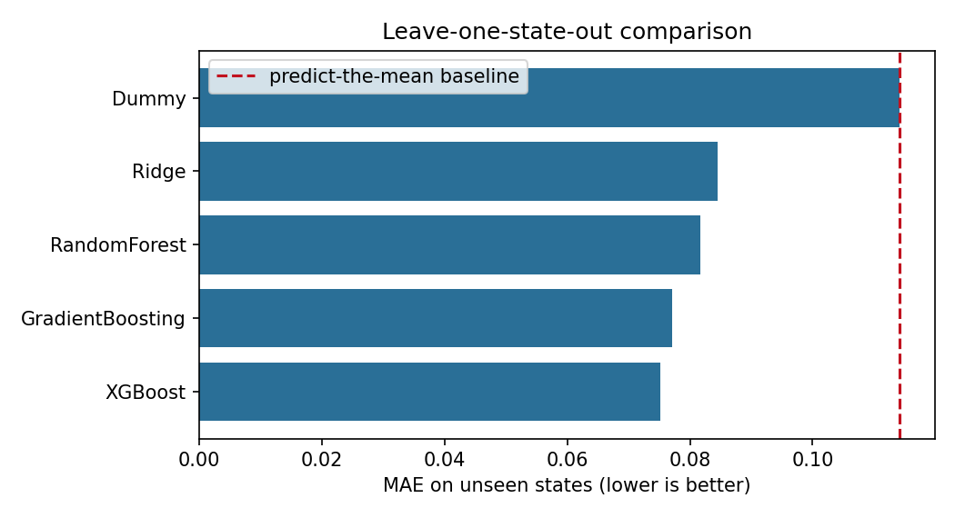
PERFORMANCE METRICS & EVALUATION | BENCHMARK COMPARISON
Quantitative Model Evaluation & Benchmark Results
9 / 12
Model | R² | MAE | RMSE | Spearman ρ | Cat. Acc | Top-20% Rec.
Dummy (Mean) | -0.0565 | 0.1142 | 0.1371 | -0.6972 | 31.9% | 0.9%
Ridge | 0.3742 | 0.0846 | 0.1056 | 0.6372 | 57.5% | 51.3%
RandomForest | 0.4217 | 0.0817 | 0.1015 | 0.6716 | 58.0% | 45.1%
GradientBoosting | 0.4665 | 0.0771 | 0.0975 | 0.6973 | 60.8% | 47.8%
XGBoost ★ | 0.4884 | 0.0752 | 0.0954 | 0.7150 | 61.2% | 47.8%
Model Selection & Key Findings
• XGBoost Outperforms All: Selected as primary 10-feature model: achieves highest R² (0.4884), lowest MAE (0.0752), and lowest RMSE (0.0954) on strict out-of-state holdout.
• 34.2% Error Reduction: Outperforms Dummy baseline by -34.2% MAE (0.0752 vs 0.1142), confirming strong predictive signal from 10 Earth Engine features.
• High Rank Correlation (ρ = 0.7150): Demonstrates strong monotonic ranking ability and 61.2% 3-class accuracy for prioritizing high-need districts.
• Top-20% Recall (47.8%): Successfully identifies nearly half of India's most acutely deprived fifth from physical and climate telemetry without survey covariates.
• Boosting Captures Interactions: Adding climate & terrain helped XGBoost overtake RandomForest (0.4884 vs 0.4217; Ridge 0.3742).
Notes:
Slide 9 presents our primary quantitative evaluation: the 10-feature Leave-One-State-Out (LOSO) benchmark across 564 districts in 31 states.
As shown in the table and chart:
1. The Dummy Regressor (predicting the training mean of other states) yields an R² of -0.0565 and MAE of 0.1142.
2. Ridge Regression achieves an R² of 0.3742, showing clear linear signal.
3. RandomForest reaches R² = 0.4217 (up from 0.3360 on 4 features) and GradientBoosting reaches 0.4665.
4. XGBoost Regressor clearly emerges as the champion model:
- Out-of-state R² of 0.4884
- MAE of 0.0752 (a 34.2% reduction in error vs. baseline)
- RMSE of 0.0954
- Spearman rank correlation of 0.7150
- 3-class Categorical Accuracy of 61.2%
- Top-20% Deprivation Recall of 47.8%
Adding climate, terrain, cropland, and travel-time features allowed regularized boosting to capture non-linear regional thresholds without overfitting.

Slide 10
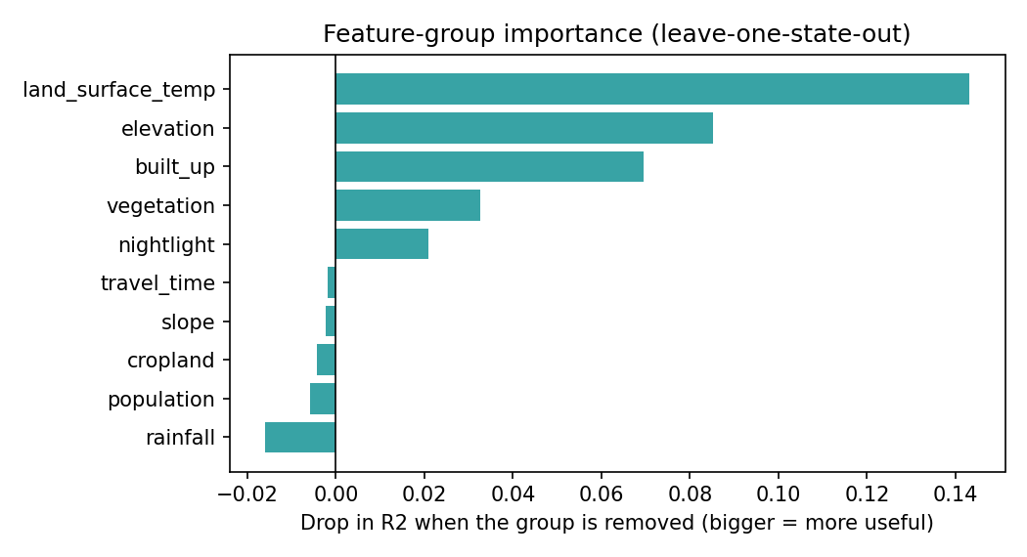
PERFORMANCE METRICS & EVALUATION | ABLATION & SPATIAL INTEGRITY
Feature Ablation Study & Spatial Leakage Analysis
10 / 12
Feature Configuration | Features | R² | MAE | RMSE | Spearman ρ | Top-20% Rec.
All 10 Features (Full) | 10 | 0.4884 | 0.0752 | 0.0954 | 0.7150 | 47.8%
Without Land Temp (LST) | 9 | 0.3452 | 0.0869 | 0.1080 | 0.5987 | 47.8%
Without Elevation (SRTM) | 9 | 0.4031 | 0.0810 | 0.1031 | 0.6523 | 47.8%
Without Built-Up (GHSL) | 9 | 0.4189 | 0.0804 | 0.1017 | 0.6634 | 47.8%
Without Vegetation (NDVI) | 9 | 0.4557 | 0.0779 | 0.0984 | 0.6998 | 50.4%
Without Nightlight (VIIRS) | 9 | 0.4674 | 0.0762 | 0.0974 | 0.7001 | 45.1%
Ablation Insights & Honest Caveats
• Daytime LST is #1 Driver: Omitting MODIS daytime LST drops XGBoost R² sharply from 0.4884 to 0.3452 (-0.1432), followed by Elevation (0.4031) and Built-Up (0.4189).
• Neutral Single-Drop Caveat: Removing rainfall, population, cropland, slope, or MAP travel time individually yields R² 0.4903–0.5044, though the 10-feature set passed our pre-registered gate.
• Spatial Leakage Empirical Proof: Random 5-Fold CV yields R² = 0.6606 vs LOSO R² = 0.4884 (+35.3% artificial boost), validating state-held-out evaluation.
• Residual Error Geography: Highest MAE occurs in Meghalaya (0.1632), Tripura (0.1306), Andhra Pradesh (0.1255), Mizoram (0.1253), and Jharkhand (0.1197).
Notes:
Slide 10 presents our systematic feature ablation study and spatial error breakdown on the 10-feature XGBoost pipeline.
By training models while selectively omitting one feature group at a time under Leave-One-State-Out evaluation:
- Omitting MODIS daytime land surface temperature (lst_day_c) causes R² to drop from 0.4884 to 0.3452 (-0.1432), making it our strongest single signal across Indian agro-climatic zones.
- Omitting SRTM elevation drops R² to 0.4031 (-0.0853), and dropping built-up share reduces R² to 0.4189.
- Dropping NDVI and nighttime lights reduces R² to 0.4557 and 0.4674 respectively.
- We also state honestly that five features (rainfall, population density, cropland, slope, and static 2015 travel time) show neutral-to-slightly negative single-drop effect under XGBoost (0.4903 to 0.5044) even though the combined 10-feature set passed our pre-registered RandomForest adoption gate.
On the right, highest residual errors remain concentrated in Meghalaya, Tripura, Andhra Pradesh, Mizoram, and Jharkhand due to complex terrain, canopy cover, mining belts, and state-level welfare differences.

Slide 11
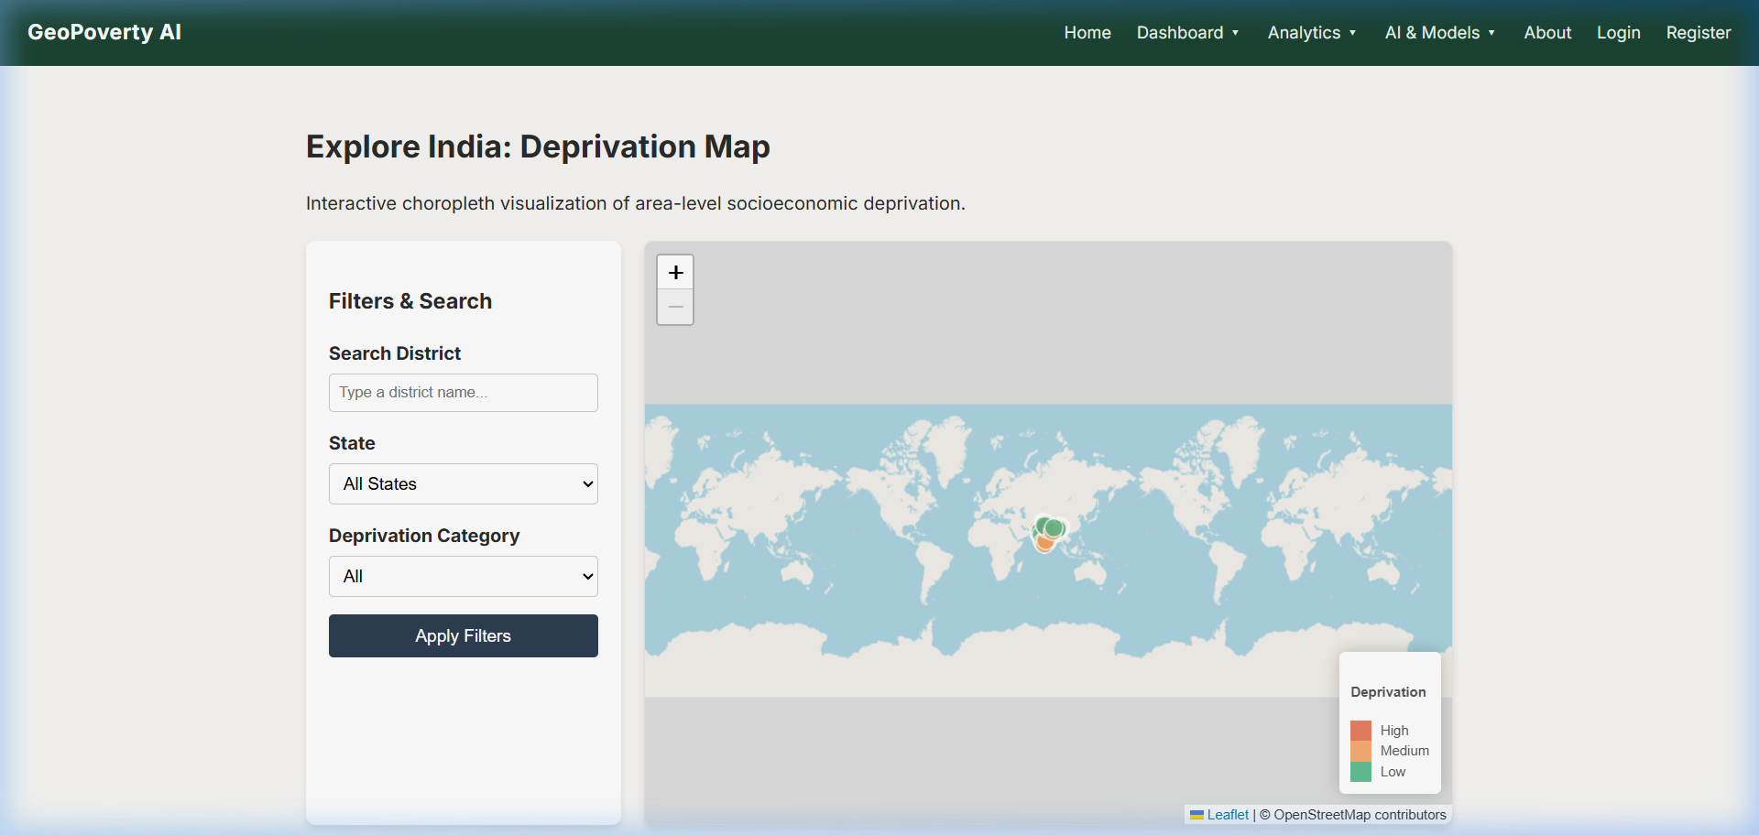
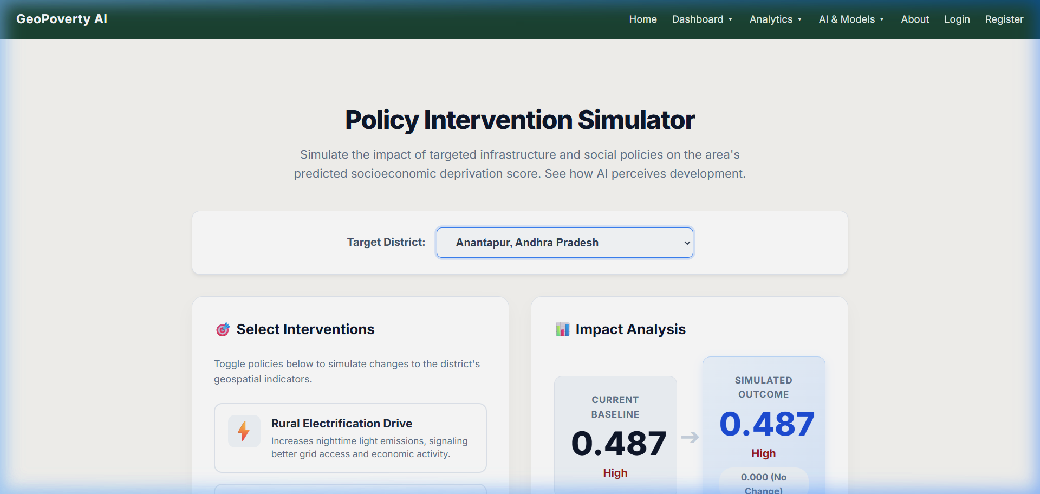
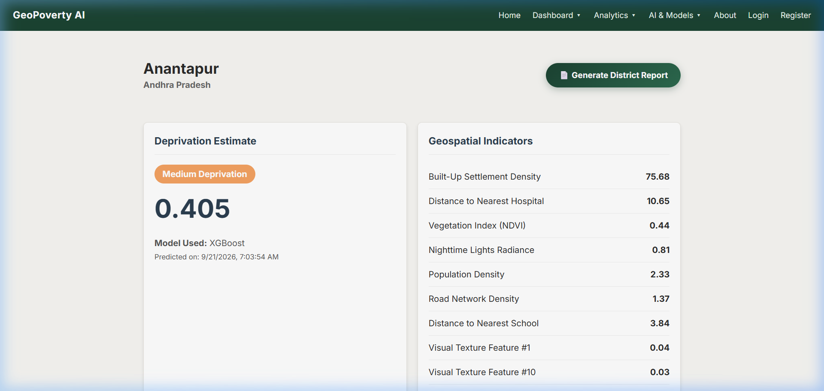
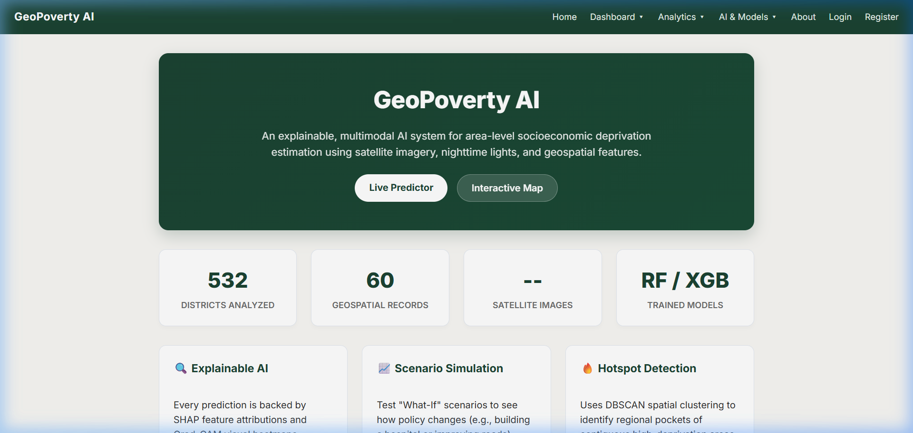
PERFORMANCE METRICS & EVALUATION | QUALITATIVE VALIDATION
Qualitative Validation: XAI, Policy Simulator & GIS UI
11 / 12
Interactive Choropleth GIS
• Choropleth map of 564 districts color-coded by tertile.
• Real-time state and category filtering.
• Hover metadata displaying exact predicted scores and uncertainty bounds.
What-If Policy Simulator
• Simulates infrastructure interventions (e.g. rural electrification).
• Computes forward inference delta in real time.
• Aids targeted developmental fund allocations without live surveys.
TreeSHAP Local Attributions
• Additive feature explanations for every individual district.
• Explains why a district was rated High or Low deprivation.
• Validates domain socioeconomic intuition with transparent AI.
Spatial Clusters & Executive Dossier
• Haversine DBSCAN clusters contiguous regional deprivation pockets.
• Discovers trans-boundary deprivation corridors.
• Automated server-side PDF dossier export for field deployment.
Notes:
Slide 11 highlights our qualitative evaluation and decision-support capabilities:
1. Interactive Choropleth Map: Displays 564 districts classified into Low, Medium, and High deprivation tertiles, enabling state-level filtering, spatial queries, and dynamic hover overlays showing empirical 80% prediction intervals.
2. What-If Policy Intervention Simulator: Allows policymakers to adjust parameters (such as simulating a rural electrification drive or urban settlement expansion) and observe forward model predictions and score changes in real-time.
3. TreeSHAP Local Attributions: Provides transparent explanations. For instance, in East Godavari or Anantapur, SHAP shows exactly how high vegetation index and low nighttime luminosity push deprivation scores up or down, corroborating known economic geography.
4. Hotspot Detection & PDF Reporting: Haversine DBSCAN isolates continuous regional clusters (e.g. the tribal belt in Central India) across administrative state borders, and one-click PDF dossiers provide field officers with publication-ready reports.

Slide 12
SUMMARY & ROADMAP | 2ND REVIEW DELIVERABLES
Project Milestones, Deliverables & Roadmap for Final Review
Completed Work & 2nd Review Deliverables
✓ Complete SDS Documentation: Architectural decomposition, 9-table relational database schema, and detailed UML workflows fully formalized.
✓ Leakage-Free Spatial ML Engine: Leave-One-State-Out (LOSO) 31-fold cross-validation pipeline trained on 10 Earth Engine features (XGBoost R² = 0.4884, MAE = 0.0752).
✓ XAI & Spatial Clustering Engines: TreeSHAP additive attributions and 150 km Haversine DBSCAN hotspot detection fully operational.
✓ Full-Stack Decision Support System: Flask 3.0.3 backend, Leaflet interactive choropleth GIS, Policy Simulator, and automated PDF dossier export active.
✓ Scientifically Audited Dataset: 564 Indian districts matched with zero cross-state errors; sensitivity-verified equal-weighted NFHS-5 ground truth.
Planned Enhancements for Final Review
→ Sub-District Spatial Disaggregation: Investigate downscaling model predictions to tehsil/block level using 10m Sentinel-2 bands and high-resolution building footprints.
→ Dynamic Earth Engine Tile Server: Integrate direct Google Earth Engine API tile serving to stream live false-color infrared and nightlight raster overlays directly onto the Leaflet map.
→ Multi-Year Longitudinal Drift Analysis: Evaluate model temporal transferability across successive survey waves to track deprivation dynamics over time.
→ Cloud Deployment & Containerization: Docker containerization and deployment to an institutional server with NGINX reverse proxy and automated backup schedules.
→ Comprehensive Final Project Dissertation: Drafting complete project report and publishing empirical findings for academic review.
Thank You! Questions and Feedback from the Panel are Welcome.
Notes:
In conclusion: for this 2nd Review milestone, we have accomplished all targeted deliverables:
- We completed the detailed Software Design Specification (SDS).
- We solved spatial entity reconciliation across 564 districts in 31 states.
- We formulated and sensitivity-validated the continuous NFHS-5 deprivation index.
- We proved the necessity of spatial cross-validation, demonstrating how random K-Fold inflates XGBoost R² by +35.3%, and established an honest 10-feature Leave-One-State-Out benchmark (XGBoost R² = 0.4884, MAE = 0.0752, Top-20% recall = 47.8%).
- We integrated TreeSHAP explainability, Haversine DBSCAN spatial clustering, and an interactive GIS decision-support portal.
For the Final Review phase, our roadmap includes sub-district spatial disaggregation, dynamic Earth Engine raster tile streaming, longitudinal drift analysis, and completing the comprehensive MCA dissertation.
Thank you for your valuable time and attention. I am now open to questions, feedback, and suggestions from the esteemed panel.

