Slide 1
RESTAURANT INSPIRED RECIPE APP
By Diti Oza

Slide 2
Introduction
Designing user-centered interfaces for restaurant inspired recipe application, which involves:
Restaurant style recipes
Trending recipes
Well-known chefs recipes
Creating new recipes

Slide 3
Objective:-
The goal of UI/UX design for a restaurant inspired recipe app is to create an engaging, intuitive, and effective digital platform that allows various restaurants and chefs to provide their recipes to all the newbie chefs out there.
It also provides a chance for the new chefs to create their own recipes and recreate various recipes out there.

Slide 4
Project Overview
This app is designed to allow food enthusiasts and chefs to explore different types of recipe across the world. They can learn their favourite recipe from their favourite chef or favourite restaurant. It also encourages chefs to create their own recipes.

Slide 5
Problem Statement
There are many food enthusiasts and newbie chefs who want to recreate the recipe in their favourite restaurant style but could not find one. There are many chef’s special dishes that don’t have proper recipe on the internet and people can’t connect with them.

Slide 6
Solution Statement
Snapchef is an app that eliminates the guesswork from cooking your favorite dishes at home, by unifying restaurant inspired recipes created by the app and its users.

Slide 7
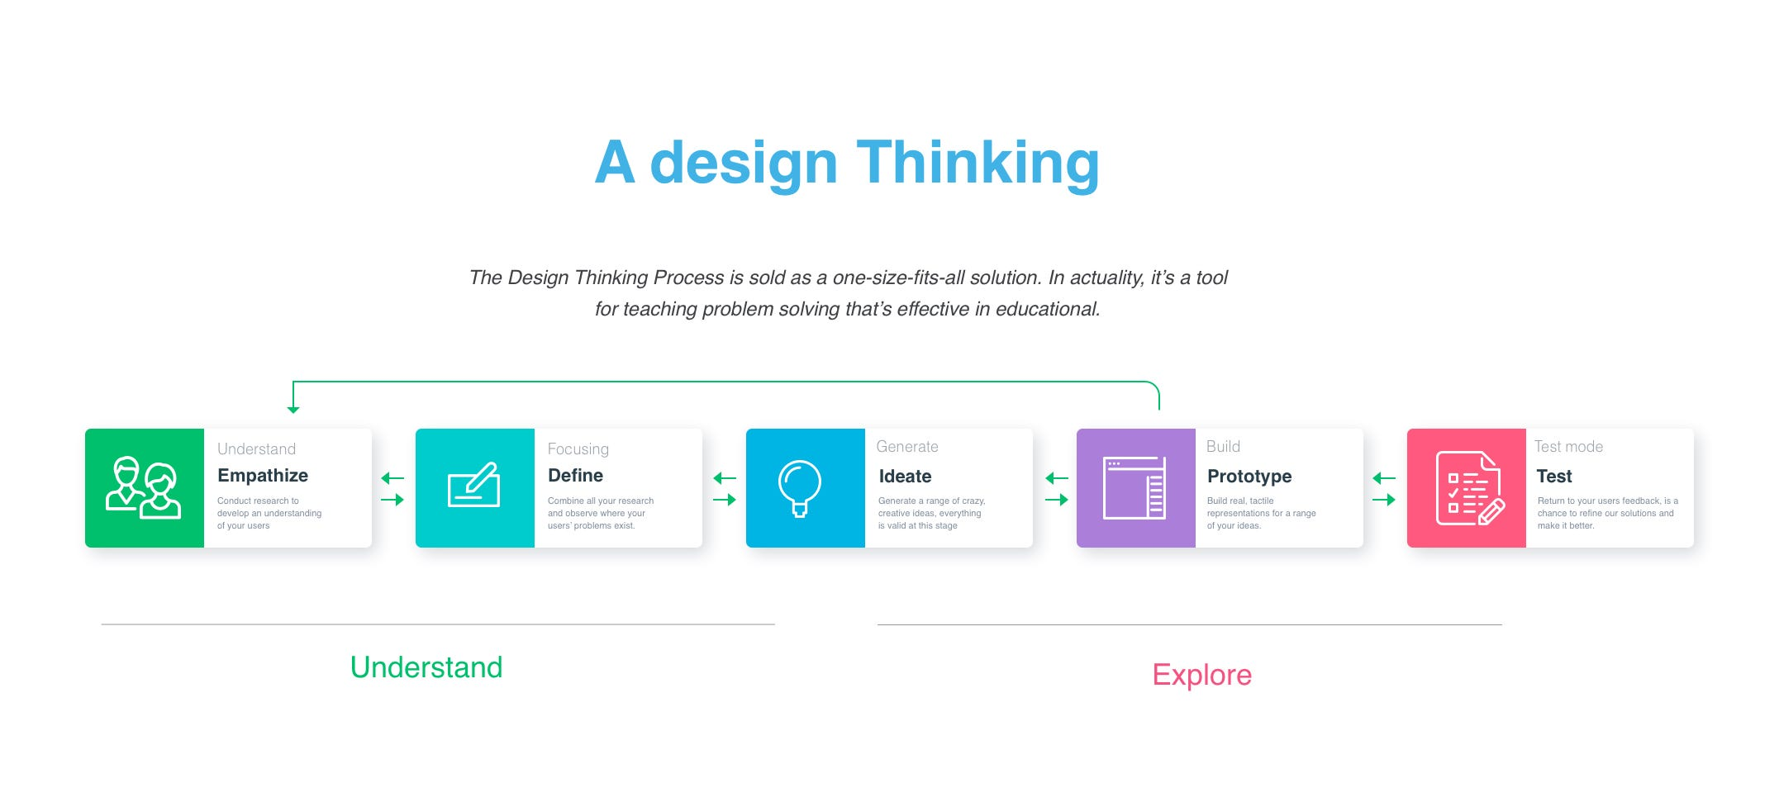
Design Thinking Process

Slide 8
Empathize Phase
USER RESEARCH
User research was conducted to understand user’s behavior, helping us to discover the true needs, pain points and motivation. Quantitative and Qualitative research methods were used to conduct user research.
There are two types of Researches
Quantitative Research
Qualitative Research

Slide 9
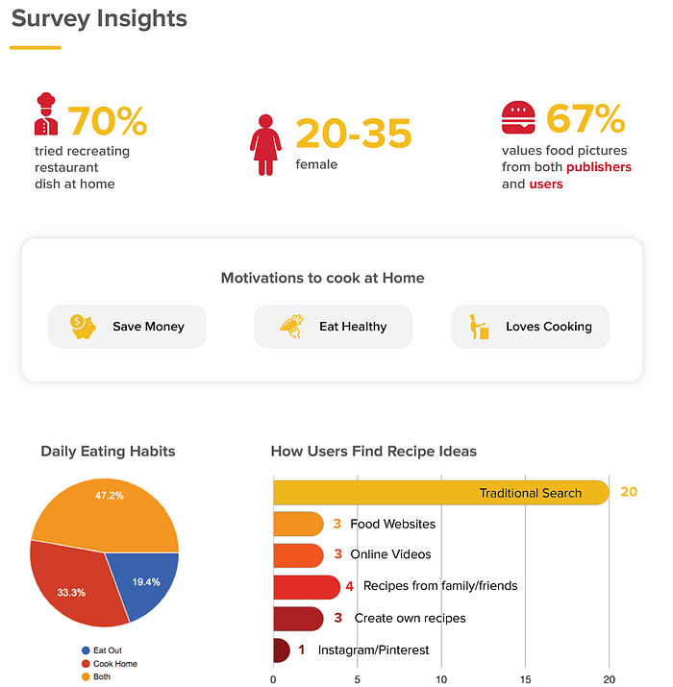
Quantitative Research
From data collection of 34 users, here are some insights received.

Slide 10
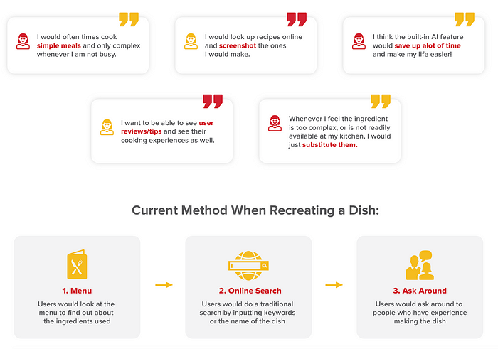
Qualitative Research
By user interviews, we get the following data:

Slide 11
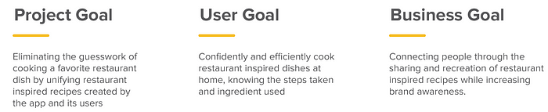
Defining the Goals
UX is a mixture of User Needs, Project Feasibility and Business Viability.

Slide 12
Define
Empathy Map
Empathy map is a great way to gain a deeper understanding of the user's thoughts, feeling and needs, which can inform the design and development of the app........

Slide 13
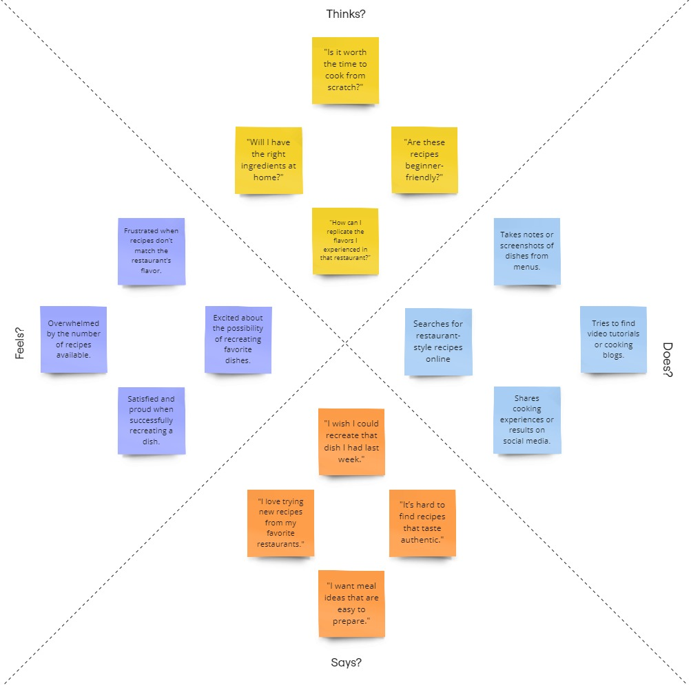
Empathy Map

Slide 14
Ideate
Information Architecture
Information Architecture is the art and science of organizing, structuring and labeling content to enhance user understanding and navigation on the app.

Slide 15
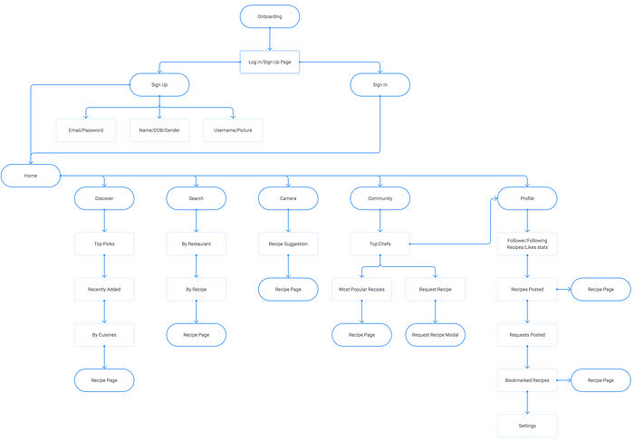
User-Flow Diagram

Slide 16
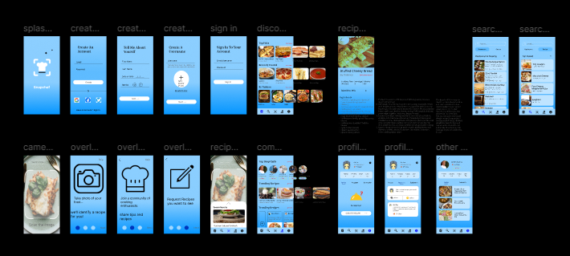
Implementation

Slide 17
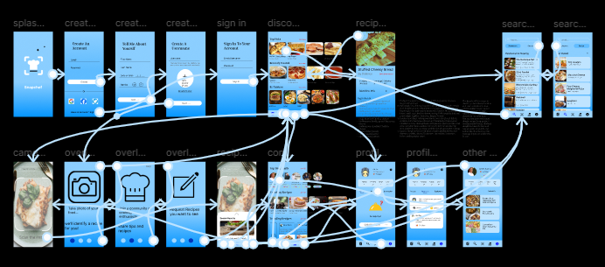
Prototype

Slide 18
Conclusion
The restaurant-inspired recipe app is designed to bridge the gap between dining out and home cooking, allowing users to recreate their favorite restaurant dishes with ease and confidence.
This app not only aims to simplify the cooking process but also seeks to inspire users to explore their culinary creativity, making home cooking as enjoyable and rewarding as dining out.
By continuously gathering user feedback and iterating on features, we can ensure the app remains relevant and beloved by its users.

