Slide 1
802.1x Bypass Drop-Pi
Rob Ditmer
Doug Kent

Slide 2
Rob Ditmer
About Us
Red Team

Slide 3
Doug Kent
About Us
No one cares
Security Engineer

Slide 4
Drop-Pi
What are we Talking About
The Drop-Pi is a suite of software developed on a Raspberry Pi to facilitate the automatic bypassing of 802.1x/NAC implementations (pre 802.1x-2010 standards).
Establish discrete remote access into target networks. Designed with physical penetration testing in mind, the Drop-Pi can establish remote access inside a target network within a matter of seconds after being plugged in.
Built with common and easily sourced hardware which allows for easy and quick provisioning of multiple Drop-Pi devices.
When it's not feasible to utilize a target network for egress traffic, the Drop-Pi can easily be configured to employ a wireless connection or mobile hotspot to facilitate access in and out of the network.

Slide 5
Drop-Pi : Our Demolab Focus
What are we talking about
This DemoLab will only focus on the 802.1x NAC bypass capabilities of the Drop-Pi
Give an overview of the code used to bypass 802.1x NAC
Live demo of the Drop-Pi in use
Doug will be handing out candy, most likely

Slide 6
Lets Have a Talk - 802.1x
What is this thing
802.1X is a network authentication protocol that opens ports for network access when an organization authenticates a user's identity and authorizes them for access to the network.
The user's identity is determined based on their credentials or certificate, which is confirmed by the RADIUS server.
The RADIUS server is able to do this by communicating with the organization's directory, for example over the LDAP or SAML protocol.

Slide 7
Lets Have a Talk - More than just 802.1x
What is this thing
NAC solutions use more than just the 802.1x protocol to authenticate clients
Endpoint applications which scan clients and compare against approved baselines before allowing network access
Will still use 802.1x to authenticate
Poor man’s NAC - port security (Is it really NAC?)

Slide 8
Limitations
What is this Thing
The Drop-Pi can get past everything discussed so far, except when the underlying connection utilizes:
  Media Access Control Security (MACsec) - Used in 802.1x-2010 and newer standards.
  IPSec from the client to the switch or other controller.

Slide 9
Why These Limitations
What is this Thing
The Drop-Pi constructs a transparent bridge between the client and the switch, assuming the identity of the client. This allows the Drop-Pi to inject its own traffic over the bridge and gain access to the secured network.
Encrypting and placing integrity checking on the connection between the client and the switch prevents the Drop-Pi from creating that transparent bridge and injecting traffic.

Slide 10
Drop-Pi workflow
Lets Get Into It - Finally
Cable is plugged into on-board NIC
Ifplugd catches link heartbeat. Calls script dispatcher
Dispatcher
USB NIC Detected
GoGoNacBypass()
EAPOLMagic() & StealThyCreds()
Bring NIC up on client side only
Get very first packet from client machine
Kick off remote access
If USB NIC is not present, act as normally device
Run GoGoNacBypass()
Get MAC address of client
If EPOL packet, try running hostapd
Determine if NAC is enabled
InitialSetupEBtable()

Slide 11
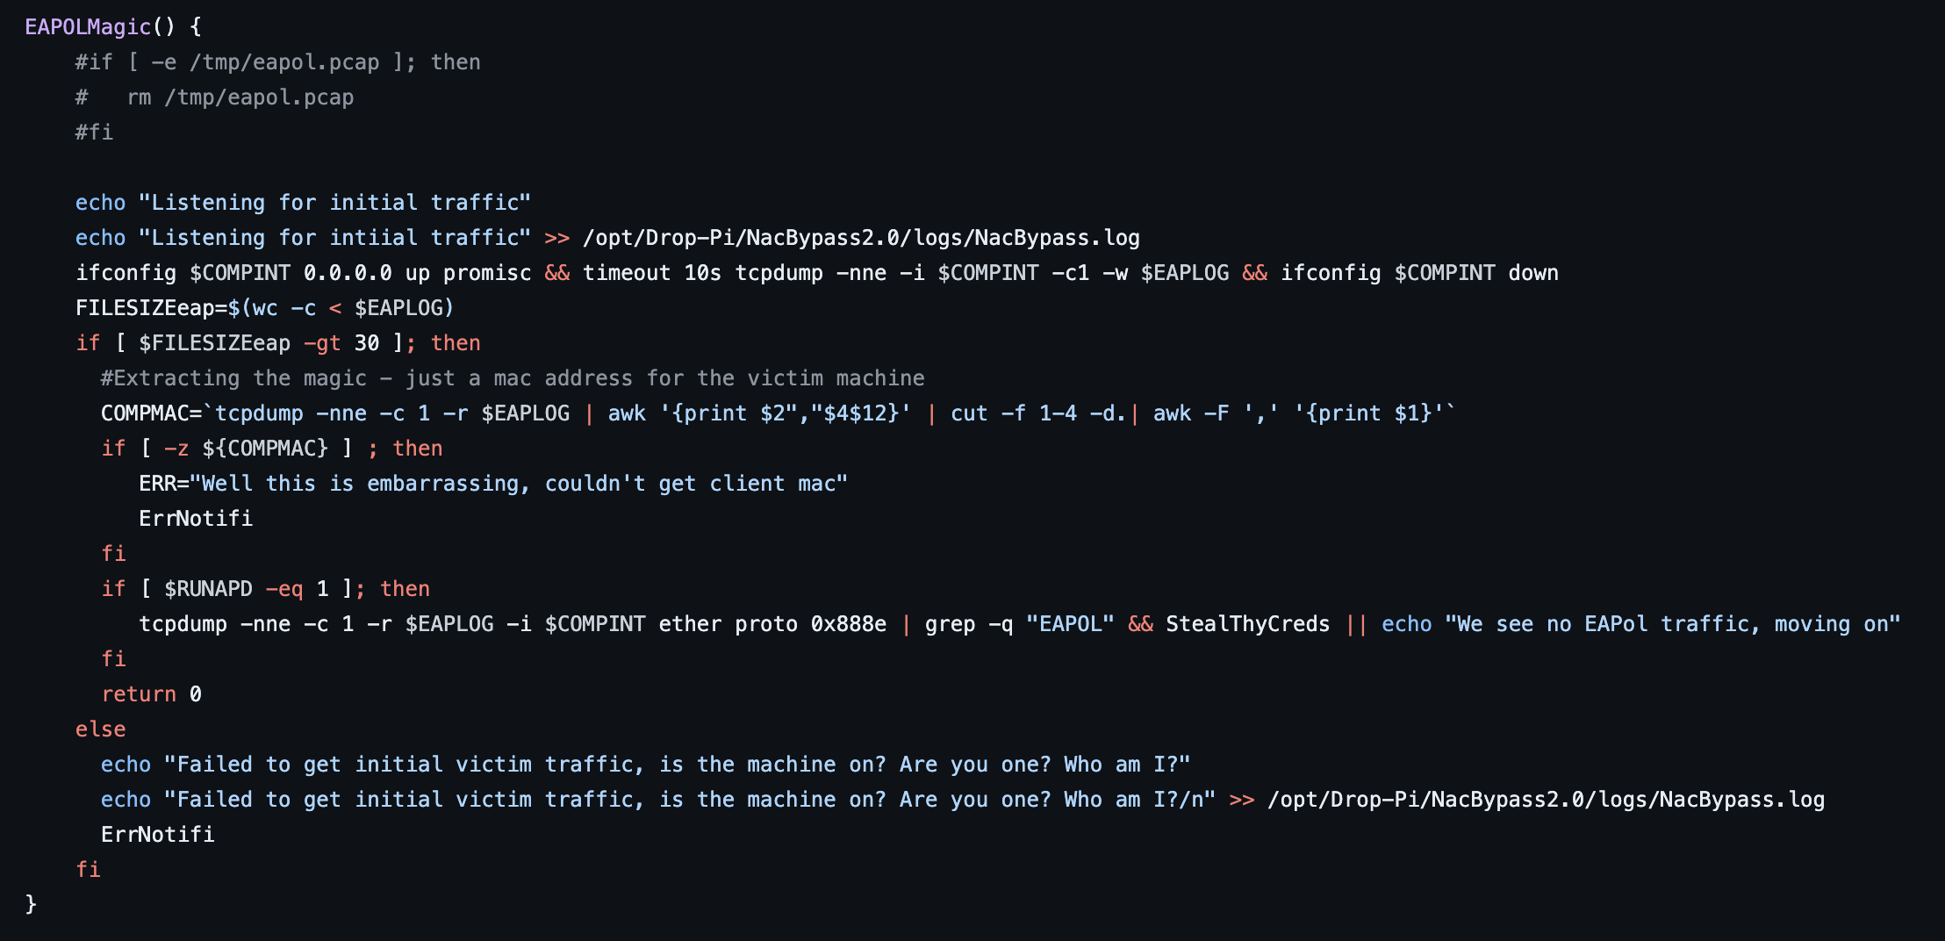
Look at That CODE

Slide 12
Drop-Pi workflow
Lets Get Into It - Finally
GoGoNacBypass()
InitialSetupEBtable()
DHCPSecretSquirrel()
Create bridge between USB and on-board NIC
Use ebtables to rewrite with client MAC
Enable EAP forwarding
Reset connection on client machine
Bring up switch side interface
Listen to network traffic for DHCP packet
Randomize MAC addresses on all interfaces
Bring up the bridge
Extract gateway IP, client IP, and DNS server from DHCP packet
If we cannot get gateway MAC from packet capture, fall back on using arping
Get gateway MAC from packet capture.
> ebtables (Ethernet Bridge tables) is the Ethernet bridge frame table administration command. It is the OSI layer 2 (Data Link Layer, Ethernet) equivalent to iptables.

Slide 13
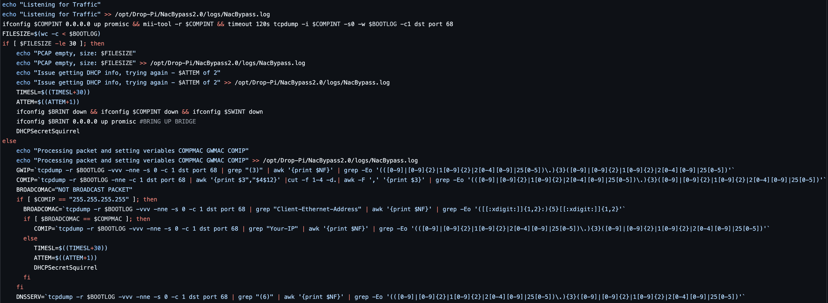
Look at That CODE
DHCPSecretSquirrel()

Slide 14
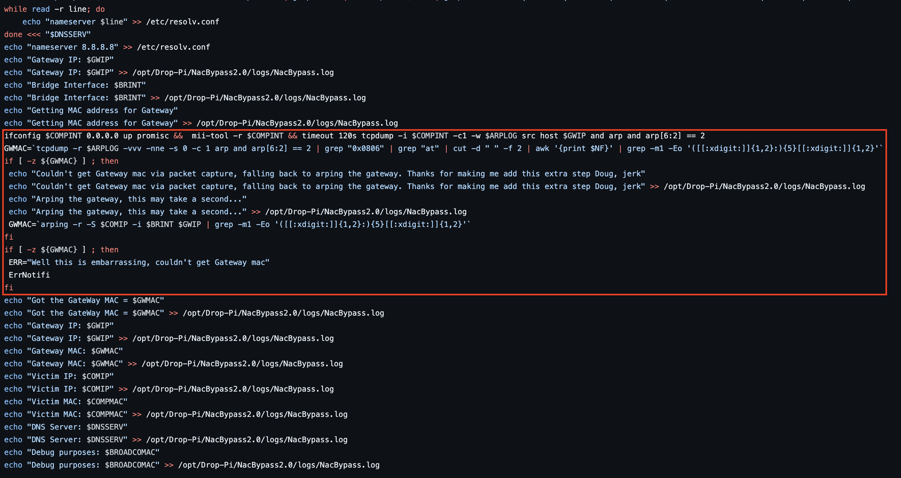
Look at That CODE, Gross
DHCPSecretSquirrel() cont.

Slide 15
Drop-Pi workflow
Lets Get Into It - Finally
GoGoNacBypass()
Setup iptables to rewrite any traffic leaving the RaspPI with the client IP and NAT with designated port range
Create default route with bridge interface and gateway MAC
Initiate remote connection: rev shell, rev ssh over https tunnel, carrier pigeon, smoke signals
Run any auxiliary commands - WAN setup, mobile connection

Slide 16
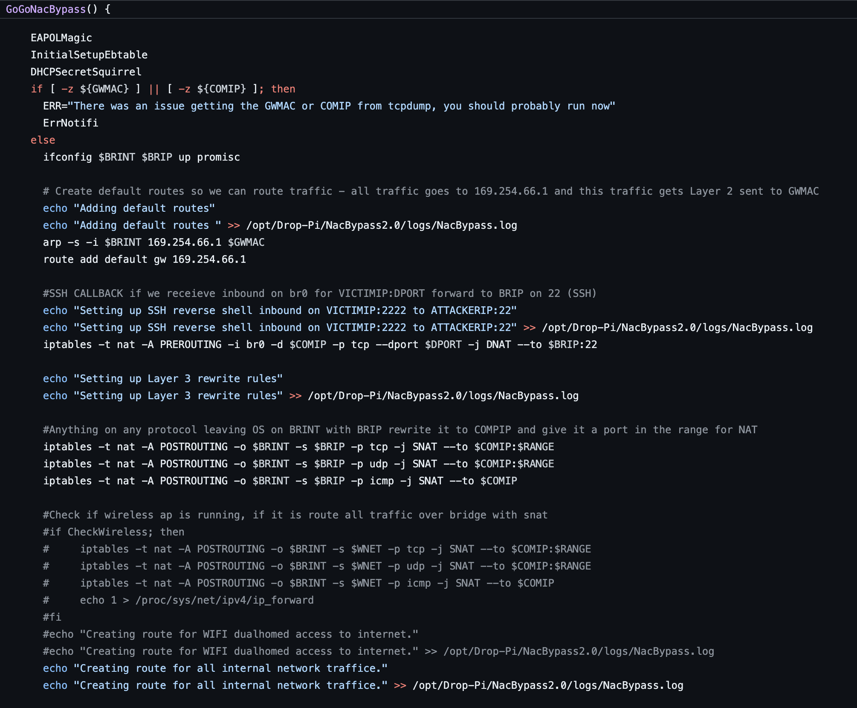
Look at That CODE

Slide 17
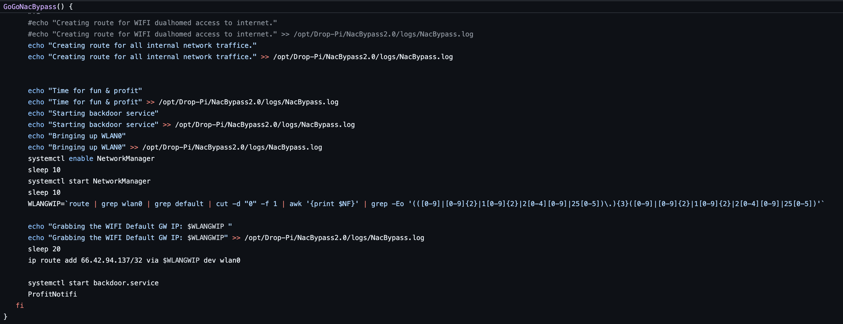
Look at That CODE

Slide 18
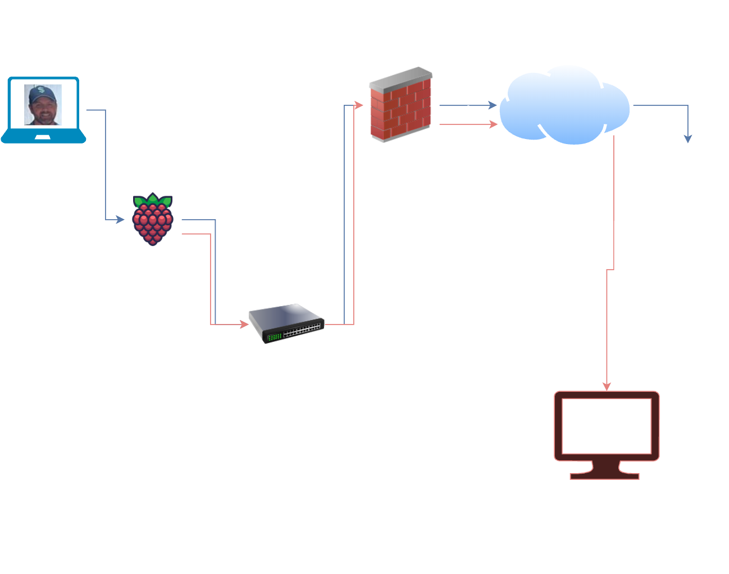
Demo Lab - Network Layout

Slide 19
Time for a Demo
Demo TIME
Turn your attention to the demo
Why are you still reading this
Seriously, watch the demo

Slide 20
This is the end
Questions?

Slide 21
Repo Things
This is actually The End
Code Repo
  https://github.com/ditmer/Drop-Pi
  https://github.com/ditmer/cryptmypi-drop-pi
Personal Github
  https://github.com/ab0l3th
  https://github.com/ditmer

Slide 22
The End

