Slide 1


controls
indicator
aggregation
output
per_capita
series
input
regions
state
in/output
continent
sub-title
store
serverside
regions
clientside
bbox
tab
map
comparsion
country
reset
regions: countries & continents

Slide 2
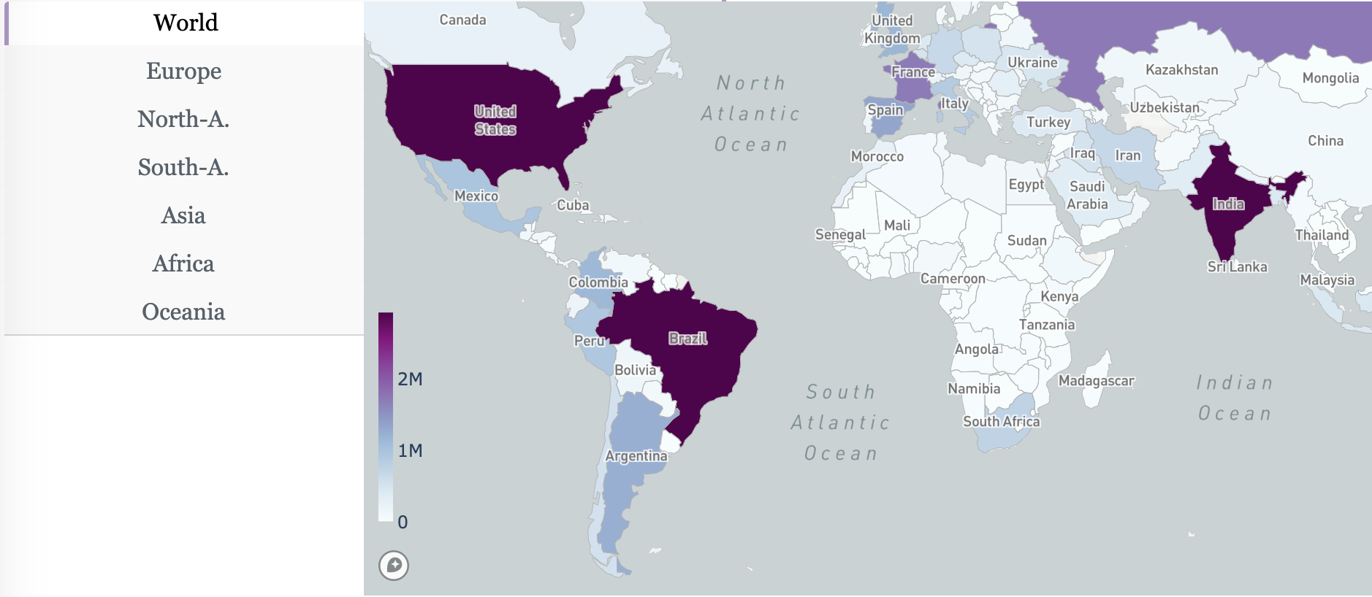
Map module
2342342 cases in Europe on 2020-01-10
add Europe to comparsion

Slide 3
client side
server side
bbox
{...,
‘indicator‘:‘cases‘,
‘map‘:{
‘France‘:{‘iso3‘,‘FRA‘,'value‘:2034},
‘Germany‘:{‘iso3‘,‘DEU‘,'value‘:1355},
...}
region
state
{...,
‘regions‘:{
‘selected‘:[‘Europe‘, ‘France‘],
‘active‘: ‘Europe‘}
...}
Server

Slide 4
State
{...,
‘indicator‘:‘cases‘,
‘map‘: {
‘France‘:{‘iso3‘,‘FRA‘,'value‘:2034},
‘Germany‘:{‘iso3‘,‘DEU‘,'value‘:1355}
},
‘regions‘:{
‘selected‘:[‘Europe‘, ‘France‘],
‘active‘: ‘Europe‘}
...}

Slide 5
MVC (model –view – control ler)
uses
controller
manipulates
user
model
sees
view
update

Slide 6
select data
DATA
region(s)
indicator
time (latest, all)
PULLDOWN: indicator
MAP: country
TAP: continent

Slide 7
present data
compare timeseries
show spatial patterns at time t

