Slide 1
controls
indicator
indicator
indicator
output
tab
map
series
sub-title
input
reset
bbox
(continent)
in/output
country
regions
logic/mem.
continent
regions
regions
information

Slide 2
select data
DATA
region(s)
indicator
time (latest, all)
PULLDOWN: indicator
MAP: country
TAP: continent

Slide 3
present data
compare timeseries
show spatial patterns at time t

Slide 4
controls
indicator
indicator
indicator
output
tab
series
sub-title
map
input
reset
bbox
(continent)
in/output
country
regions
memory
continent
regions
regions
serverside
clientside

Slide 5
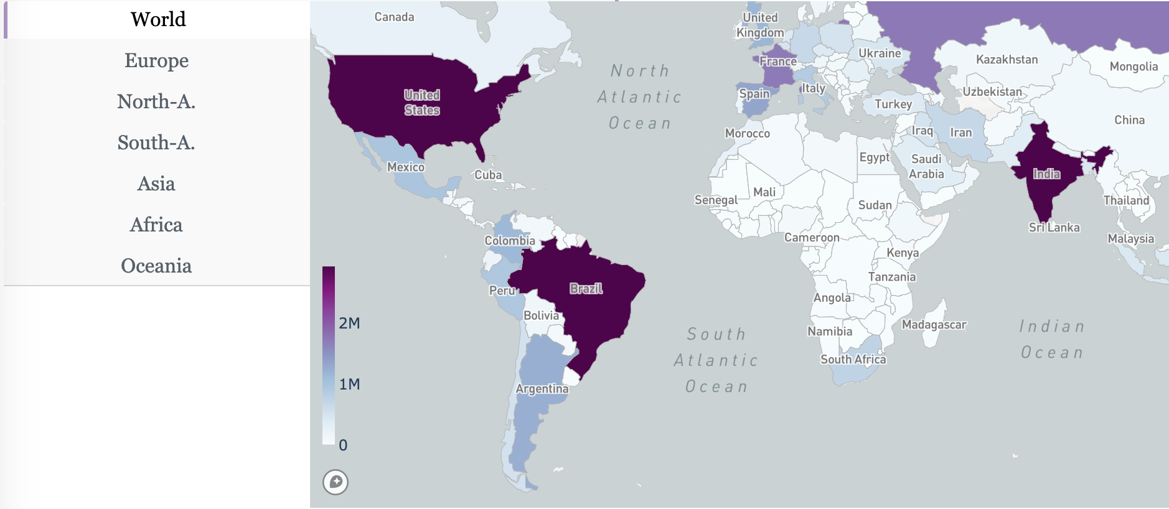
Map module

Slide 6
client side
server side
bbox
{...,
‘indicator‘:‘cases‘,
‘map‘:{
‘France‘:{‘iso3‘,‘FRA‘,'value‘:2034},
‘Germany‘:{‘iso3‘,‘DEU‘,'value‘:1355},
...}
region
state
{...,
‘regions‘:{
‘selected‘:[‘Europe‘, ‘France‘],
‘active‘: ‘Europe‘}
...}
Server

Slide 7
MVC (model –view – control ler)
uses
controller
manipulates
user
model
sees
view
update

