Slide 1
02.02.2022 CoP Meeting

Slide 2
When the team discusses this aspect of the model, they literally speak phrases such as
“Nurses administer flu vaccines to patients in standard doses.”

Slide 3
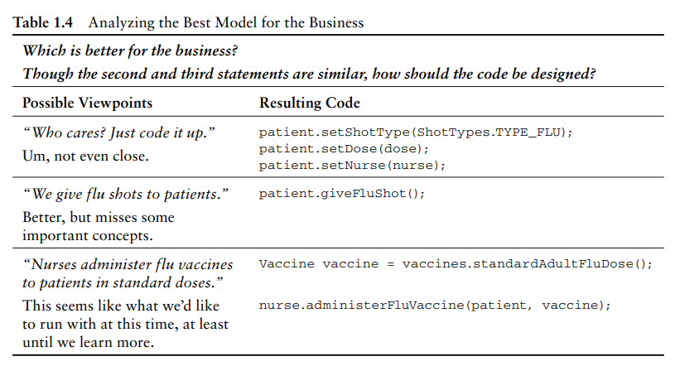

Slide 4
Let‘s have a look into the code!

Slide 5
What did this code just do?
It saves a Customer no matter whether it is new or preexisting.
It saves a Customer no matter whether the last name changed
Or the person moved to a new home.
It saves a Customer no matter whether the person got a new home phone number or discontinued home phone service
Or whether he or she got a mobile phone for the first time, or both
It even saves a Customer who switched from using Juno to using Gmail instead
Or who changed jobs and now has a new work e-mail address

Slide 6
End

Slide 7
??.02.2022 CoP Meeting

Slide 8
Definitions:
Two primary pillars of DDD’s strengths: Ubiquitous Language and Bounded Context
Term, phrase, or sentence—the Ubiquitous Language—inside the boundary has a specific contextual meaning
A Bounded Context as a conceptual boundary around a whole application
A team consists of domain experts and developers
There is one Ubiquitous Language per Bounded Context
Process: the begin of DDD
Identify the isolated Bounded Context
Recommendations: you will fail
If you try to apply a single Ubiquitous Language to an entire enterprise, or worse, universally among many enterprises
It can also be a challenge to solicit the necessary involvement from domain experts. No matter how difficult it is, make sure you do

Slide 9
Recommandations: development of the Ubiquitous Language
Draw pictures of the physical and conceptual domain (UML is optional)
“Create a glossary of terms with simple definitions” is optional
A few team members may capture the glossary, so review with the rest of the team
You won’t always, if ever, agree on all the captured linguistics, so be agile and ready to edit heavily
be prepared to abandon the drawings, glossary, and other documentation that will be difficult to keep up-to-date with the spoken Ubiquitous Language and source code as they are rapidly enhanced

Slide 10
Let‘s have a look into the code!

Slide 11
What problems could emerge in the version 1 of the client code?
The client mistakenly changes only the sprintId but not the status
Or the opposite
If in the future another attribute must be set, the client code must be analyzed
The client code in version 2 captures the Ubiquitous Language of the model in context:
Allow each backlog item to be committed to a sprint. It may be committed only if it is already scheduled for release
If it is already committed to a different sprint, it must be uncommitted first.
When the commit completes, notify interested parties.

Slide 12
End

Slide 13
??.02.2022 CoP Meeting

