Slide 1

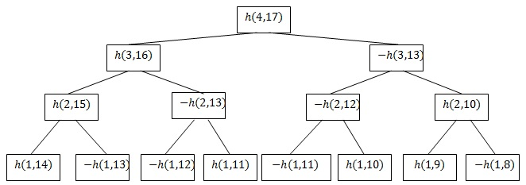
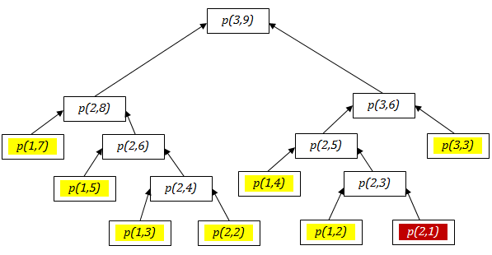
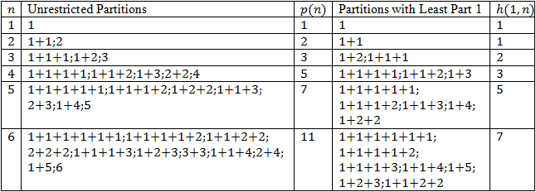
Restricted Partitions as a Number Theory Problem and an NP-Complete Problem
Abdul Hassen, Ph.D.1; Kevin Dittmar 2 1[Department of Mathematics], 2[Department of Computer Science]
abstract
methods
results
The goal of this research is to study restricted partitions through the use of computers and programming. In particular, this paper focuses on counting the number of partitions for a number n where the smallest part of the partition is some number m. This partition counting problem is a member of the set of NP-Complete problems whose solutions are easy to verify but hard to generate. Software written using the C programming language was used to analyze patterns that could be used to simplify calculating the number of unique restricted partitions for a given number. Calculating the number of restricted partitions can be simplified by using a recurrence relation to represent the count of restricted partitions as a sum of the counts of unrestricted partitions that can be calculated from pentagonal numbers. This eliminates one of the two levels of recursion needed to calculate the number of restricted partitions, thus making the calculation more efficient. The methods discussed in this paper make it possible to calculate the number of unique partitions for a number n with a least part of exactly m as long as m is sufficiently small.
We use a binary tree data structure to expand the restricted partition’s recurrence relation and reduce the complexity of counting partitions. Each element in a binary tree can have at most two children. The leaves, or elements at the lowest level of the binary tree represent simple functions whose sum is the number of partitions.
We developed the software using the C programming language due to its efficiency.
We generate caches that contain counts for unrestricted partitions, which were derived from pentagonal numbers. We also generate and cache a list of signs of the function calls at the leaves of the tree. Together, these caches allow us to use an iterative approach that bypasses expensive recursion.
A function exists that can be used to find the difference between the n argument of the first leaf in the decomposition binary tree and the n argument in any other leaf in the decomposition binary tree. This makes it possible for us to avoid using recursion to calculate the h(1,n) terms that make up the leaves of the tree and makes it easier to eliminate terms of identical magnitude with opposite signs.
This decomposition function, the cached sign pattern, and the cached values for unrestricted partitions can be used to iteratively calculate h(m,n), the number of restricted partitions for n where m is the smallest part. Using an iterative method allows us to remove terms that cancel from the calculation, which optimizes the process.
The methods used to research h(m,n) and calculate the size of a set of partitions for a given h(m,n) can also be applied to some other restricted partitions as long as they can be represented with a recurrence relation. For example if f(m,n) denotes the partition of n in which the restriction is in terms of m satisfies
f(m,n) = f(m-a, n-b) + f(m-c, n-d)
where a, b, c, and d are integers, either a or b is positive, and either c or d is positive, then our method applies to computer f(m,n). This is necessary for the recursion to terminate.
background
What are Partitions?
A partition of some number is a sum of positive numbers called parts with the same value as the original number (Example 1 + 4 + 9 is a partition of 14).
It is common to be interested in restricted partitions. Some restrictions include all parts must be distinct, all parts must be odd, and no part can exceed some number m.
Recurrence relations can be used to simplify the process of counting partitions for a given number with or without restrictions.
The partition counting function studied was h(m,n), whose value is the number of partitions for a number n given that the smallest part is exactly m.
Why is it Hard to Count Partitions With a Computer?
Using a computer to count partitions is difficult because it is an NP-Complete problem.
NP-Complete problems have solutions that are easy to verify, but take an exponential amount of time to generate; even medium-sized problems can take years to solve.
Example binary tree showing the decomposition of h(4,17) through the use of its recurrence relation h(m,n) = h(m-1,n-1)-h(m-1,n-m).
+--+ -++- -++- +--+ | -++- +--+ +--+ -++- | -++- +--+ +--+ -++- | +--+ -++- -++- +--+
The signs of the first 64 function calls in a decomposition are shown above from left to right in blocks of 16. + denotes a positive value, and – denotes a negative value. All sign patterns with a length of at least 4 follow the pattern , where the signs of are the inverse of the signs of .
An example of the restricted partition function p(m,n) where n is the number to partition and m is the largest part in the partition. Its recurrence relation is
p(m,n) = p(m-1,n-1) + p(m, n-m).
All yellow leaves add 1 to the partition count, and all red leaves add nothing to the partition count. p(3,9) includes
3+3+3 3+3+2+1 3+3+1+1+1
3+2+2+2 3+2+2+1+1 3+2+1+1+1+1
3+1+1+1+1+1+1
objectives
conclusions
Develop an algorithm for accurately counting the number of partitions h(m,n).
Develop software that implements the algorithm efficiently enough to be used for non-trivial instances of counting partitions.
Extend the findings from the research of h(m,n) to other functions that count restricted partitions with similar recurrence relations.
The number of partitions for h(m,n) where m is the smallest part and n is the number to partition can be calculated for any n if m is small.
A decrement function can be developed that allows the count of a set of restricted partitions to be calculated iteratively rather than recursively, which improves efficiency.
The methods used to calculate h(m,n) can also be used to count a set of restricted partitions as long as the set can be represented with a recurrence relation in a form similar in structure to the form
h(m,n) = h(m-1, n-1) – h(m-1, n-m).
Table of unrestricted partitions whose counts can be generated through the use of pentagonal numbers compared with restricted partitions whose least part is 1. As shown in the table, p(n) = h(1,n+1). This equation allows us to avoid recursively counting partitions, thus improving the efficiency of the calculation.

