Slide 1
Restricted Partitions
An NP-Complete and Number Theory Problem

Slide 2
What Are Partitions?
A partition of some number is a sum of positive numbers called parts with the same value as the original number.
Unrestricted partitions include all combinations.
Example: The partitions of 5 are
5 2+2+1
4+1 2+1+1+1
3+2 1+1+1+1+1
3+1+1

Slide 3
What Are Restricted Partitions?
Restricted partitions require that valid partitions of a number follow certain rules.
These rules could be something like all parts must be odd or all parts must be distinct.
Multiple restrictions can be used.
Example: The partitions of 5 with odd parts are
5
3+1+1
1+1+1+1+1

Slide 4
Why Is This Problem Hard?
Counting the number of partitions is difficult because it is an NP-Complete problem.
“NP” stands for non-deterministic polynomial time (as a general rule, much longer than you want to wait, like many days or years).
An NP problem can be easily verified, but it takes a lot of effort to generate solutions.
“A lot of effort” means that even small problems can take many years of straight computer time to solve.

Slide 5
Proving NP-Completeness
It is easy to make a problem seem harder than it actually is and to make a problem NP-Complete when it really isn’t.
There are two parts to an NP-Complete proof:
Prove that the problem is in the set NP, which means that its solution can be verified in polynomial time (a reasonable amount of time that doesn’t increase exponentially).
The problem can be reduced to another NP-Complete problem.

Slide 6
Basis of NP-Complete Proof
First, is a solution verifiable in polynomial time?
Is 1+2+7+12 a partition of 22?
To solve this, we add up all elements in our solution set {1,2,7,12} to get 22.
This can be done in linear time because it is directly related to the number of elements in the set.
Linear time is polynomial time, so the problem is a member of the set NP.

Slide 7
Basis of NP-Complete Proof
Can we reduce a problem from the known NP-Complete catalog to the Partition problem?
One problem is the Subset Sum problem, which is a relationship that is true if a subset of a given set of numbers adds up to a given n, but is false otherwise.
{-4, 0, 3, 9, 15, 18}; n = 5
{-4,9} is the only subset whose sum is 5.

Slide 8
Basis of NP-Complete Proof
Let us define the set A as available numbers as
We can modify this problem without changing its solution set by adding (-a₁ + 1) to every term in A and adding (-a₁ + 1)x to n where x is the number of elements used to construct a subset sum.
{-4+5, 0+5, 3+5, 9+5, 15+5, 18+5}; n = 5+5x
{1, 5, 8, 14, 20, 23}; n = 5+5x

Slide 9
Basis of NP-Complete Proof
{1, 5, 8, 14, 20, 23}; n = 5+5x
As shown, there are no longer any non-positive numbers in the set.
If we still use the newly modified elements that yielded solution before, x=2, and, therefore, n=15.
Since 1+14=15, the elements we were interested in yield a solution before and after the transformation.
This transformation can be done in linear time, so it fits all of our criteria.

Slide 10
Basis of NP-Complete Proof
We successfully transformed the Subset Sum problem into a Partition problem where all parts are distinct.
To model the Subset Sum problem as an Partition problem with different or no restrictions, we can vary restrictions on Subset Sum set elements.
Unrestricted – allow multiple uses of elements
Evens only – only even elements
All variations of the Subset Sum problem have been proven to be NP-Complete.

Slide 11


Restricted Partition
.
The restricted partition studied was
represents the total number of partitions of the number where the smallest part is exactly .
can be expanded into the difference of two simpler function calls through the use of a recurrence relation.

Slide 12

Restricted Partition
.
The recurrence relation
can be used to decompose the function into a sum of functions with smaller and values.
This is done until the original function is represented as a sum of functions in the form .
This will simplify counting the partitions.

Slide 13
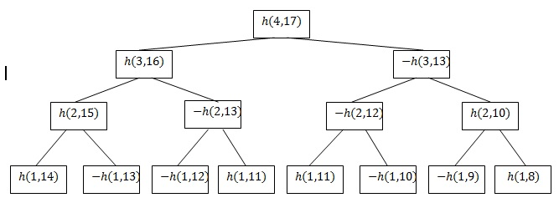

Decomposition Example
The function being decomposed into a sum of the simplest functions possible shown in a binary tree format.

Slide 14
Sign Patterns
The simplified function calls exhibit a pattern that can be used to generalize the calculations.
The signs of the first 64 function calls are shown below from left to right in blocks of 16:
+--+ -++- -++- +--+ | -++- +--+ +--+ -++- | -++- +--+ +--+ -++- | +--+ -++- -++- +--+
+ represents positive; – represents negative

Slide 15


Sign Patterns
The sign for the k^{th} function call is represented by
This function is defined by nested recursive applications of the sign pattern to a group of function calls whose size is a power of 4.
The pattern is where represents a pattern of signs for 4^{k} function calls where k is a non-negative integer. represents a pattern of signs for 4^{k} function calls where all positive signs in are negative and vice-versa.

Slide 16
Sign Pattern Examples
Where k = 0:
= +
= -
= +--+
Where k = 1
= +--+
= -++-
=+--+-++--++-+--+

Slide 17
Sign Pattern Examples
Where k = 2:
Note that, when grouped in blocks of 16, the pattern for k = 2 is the same as the pattern for k = 0 where the “X” pattern of plusses replaces “+” and the “O” pattern of plusses replaces “-”.
+--+ -++- -++- +--+ | -++- +--+ +--+ -++- | -++- +--+ +--+ -++- | +--+ -++- -++- +--+

Slide 18

Second Argument Patterns
The second argument of decomposed function calls in the form also follow a pattern.
When arranged in blocks of 16 as shown, the terms in the positions of the bold numbers cancel (Example shown for .)
8 of every 16 terms cancel, halving computation time.

Slide 19
Decrement Function
It is possible to generate the second argument for the k^{th} term using only the least part , the number to partition , and k, the index of the term.
The function d(k) returns the total decrement from the original term x(0).
Let
x(k) = x(0) – d(k)
Using d(k), we can find the k^{th} term without using recursion.

Slide 20
Decrement Function
Write k as a linear combination
where [x] is defined as the largest integer that is at most x.
Each summand in the linear combination will be used to find part of the entire d(k).

Slide 21
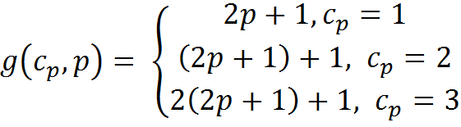
Decrement Function
.
d(k) uses recursion to generate a sum of partial decrements starting from the largest power of 4.
We define g(c_{p} ,p), a function that generates partial decrements, as
where c_{p} is the leading coefficient for k in base 4, and p is the power.

Slide 22



Decrement Function
Using the definitions for k and g(c_{p} ,p), we define d(k) recursively as
An example of d(14) is provided in the next slide.

Slide 23









Decrement Function

Slide 24

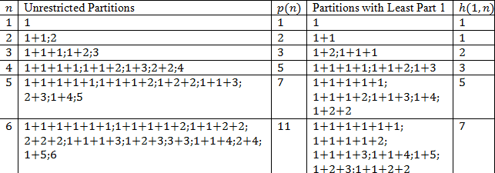
Unrestricted Partitions vs h(1,n)
As shown below, each partition of n with least part of 1 is equivalent to an unrestricted partition of n-1 with a 1 prepended to the sum.

Slide 25
Using this Method for Other Restrictions
With some slight variations, a binary tree can be used to reduce the complexity of counting sets of other restricted partitions.
The general method involves repeatedly using a recurrence relation with a form similar to
to simplify the expression to a sum of easily calculated functions.

Slide 26
p(m,n)
p(m,n) is defined as the number of partitions of n where m is the largest part.
To simplify p(m,n), we can use the recurrence relation
p(m,n) = p(m-1, n-1) + p(m, n-m)
to convert p(m,n) into a sum of terms that are in the form p(1,k), p(k,k), or p(x,k), where k and x are integers and x > k.

Slide 27
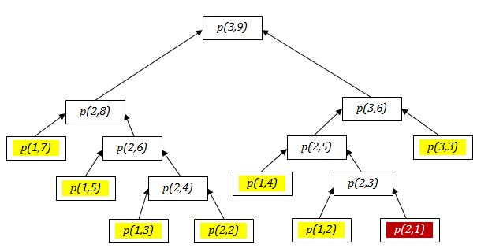
p(m,n)
p(1,k) = 1
p(k,k) = 1
p(x,k) = 0
By using the equations above for each of the colored leaves in the binary tree, the count of partitions p(m,n) can be found, as it is for the example p(3,9).

Slide 28
p’(m,n)
p’(m,n) is defined as the number of partitions of n where the largest part is no greater than m.
To simplify p’(m,n), we can use the recurrence relation
p’(m,n) = p’(m-1, n) + p(m, n)
and the recurrence relation for p(m,n) to convert p(m,n) into a sum of terms that are in the form p(1,k), p(k,k), p(x,k), or p’(0,k), where k and x are integers and x > k.

Slide 29
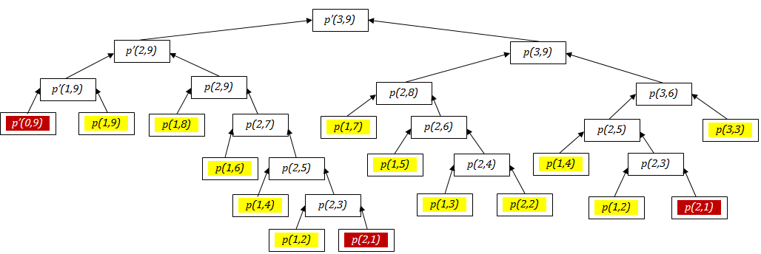
p’(m,n)
p(1,k) = 1; p(k,k) = 1; p(x,k) = 0; p’(0,k)= 0
By using the equations above for each of the colored leaves in the binary tree, the count of partitions p’(m,n) can be found, as it is for the example p’(3,9).

Slide 30
θ(m,n)
θ(m,n) is defined as the number of partitions of n made up of m distinct parts.
θ(m,n) can be simplified using the recurrence relation
θ(m,n)= θ(m,n-m)+ θ(m-1,n-m)
to convert θ(m,n) into a sum of terms in the form θ(1,k) or θ(x,k) where k and x are positive integers and x ≥ k.

Slide 31
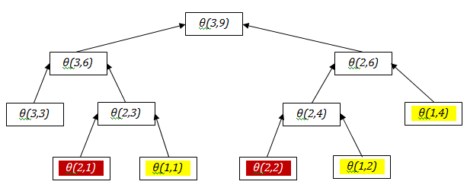
θ(m,n)
θ(1,k) = 1; θ(x,k) = 0
By using the equations above, the yellow leaves in the tree equal 1, and the red leaves equal 0.
The sum of these numbers is θ(m,n), and, in this example, is θ(3,9).

Slide 32
C(m,n)
C(m,n) is defined as the difference in the number of partitions of n with largest part m and an odd number of parts and the number of partitions of n with largest part m and an even number of parts.
C(m,n) can be simplified using the recurrence relation
C(m,n)= C(m-1,n-1)+ C(m-1,n-m)
to convert θ(m,n) into a sum of terms in the form C(1,odd) or θ(1,even).

Slide 33
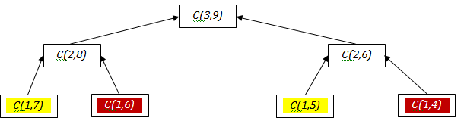
C(m,n)
C(1,odd) = 1; C(1,even) = -1
By using the equations above, the yellow leaves in the tree equal 1, and the red leaves equal -1.
The sum of these numbers is C(m,n)
C(3,9) = 0 because the number of even-part partitions is the same as the number of odd-part partitions.

