Slide 1
Keylogger
CYBER SECURITY
Presented By:
1. ANTONY BENIFERT DITTO A | V V College of Engineering | CSE

Slide 2
OUTLINE
Problem Statement
Proposed System/Solution
System Development Approach
Algorithm & Deployment
Result (Output Image)
Conclusion
Future Scope
References

Slide 3
Problem Statement
The challenge is to monitor and log keystrokes on a computer accurately and efficiently. Not only should the program be able to capture inputs seamlessly, but also it should be user-friendly, easily customizable and maintainable, as well as giving us the ability to start and stop key logging whenever we want.

Slide 4
Proposed Solution
The proposed system is an advanced keystroke monitoring tool created using the Python programming language. It is designed to have a twofold purpose: first, to capture and log every keystroke entered on a keyboard in real-time, providing an accurate record of all keyboard input; and second, to serve as a learning tool for understanding input capturing mechanisms within programming.
At the heart of the proposed solution lies the integration of the 'pynput' library—a powerful library used for monitoring and controlling input devices in Python. With 'pynput', we gain the ability to detect each key press and key release event and record these actions without causing any noticeable lag to the user experience.
The user interface is constructed using 'tkinter', Python's de facto standard GUI (Graphical User Interface) package, to allow users, regardless of their technical proficiency, easy control over the keylogging process. The user-friendly GUI will enable users to start and stop logging at their convenience and safely store the captured data.
The keyloggging script is designed to store keystroke data in two ways for redundancy and ease of parsing:
A plain text file (key_log.txt) where sequential keystrokes are recorded, providing a simplified view of keyboard activity. This can be useful for quick inspection or for cases where a human-readable format is required.
A structured JSON file (key_log.json) where each keystroke event is stored as a separate object, indicating the type of key event (pressed or released) and the key's value. This format is incredibly useful for any in-depth analysis or for feeding the data into further processing pipelines, as JSON is widely used for data exchange and storage.
While logging, the tool is designed to handle any special keys or key combinations, ensuring that every keystroke is accounted for. The output files are programmed to update dynamically, guaranteeing real-time logging efficacy.
Moreover, an essential consideration embedded within the solution is ethical responsibility; transparency regarding the logging process and user consent are of paramount importance. Users are clearly informed of the keylogging activities, and the tool is intended for ethical use only—such as for personal monitoring, system administration, or academic purposes.
Thus, with a robust backend and a straightforward front end, this proposed solution is crafted to deliver an effective, transparent, and user-friendly environment for keystroke logging. The heightened functionality it offers can be utilized in various domains, from software testing to employee productivity tracking, as long as ethical practices and legal compliance are duly observed.

Slide 5
System Approach
We chose Python due to its simplicity and extensive library support. For key logging, we used the 'pynput' library. For the GUI, tkinter was used as it's a lightweight, built-in Python library that can create user-friendly interfaces. Threading was used to ensure the GUI remained responsive throughout the logging process.
Linux/Windows
tkinter

Slide 6
Algorithm & Deployment
Initialization: Upon execution, the system initializes the necessary variables and prepares the output files (`key_log.txt` for text output and `key_log.json` for JSON output) for data logging.
User Interface Activation: The Tkinter library is used to set up a Graphical User Interface (GUI), providing users with 'Start' and 'Stop' controls for the keylogger. The interface also displays status messages to inform the user of the current state of the keylogger.
Listener Setup: A key press listener, provided by the 'pynput' library, is set up to capture all keyboard events. The listener is a separate thread that runs asynchronously from the main program to ensure the GUI remains responsive.
Event Handling: The listener invokes callback functions for two types of events: `on_press` for key press events and `on_release` for key release events. Each time a key is pressed or released, the event is recorded, the flag is updated (if needed), and the output files are generated or updated accordingly.
Data Logging: The keystrokes are logged in real-time into both the text and JSON files. The text file keeps a simple record of the keystrokes as they are typed, while the JSON file maintains structured records of each key event, including the event type (press/held/release) and the key involved.
Process Loop: The system continues to log all keystroke information until the user decides to stop the keylogger using the GUI. At this point, the listener thread is safely terminated.
Safe Termination: Once the stop command is triggered from the GUI, a global flag is set to stop the listener thread, effectively ending the keylogger session. The GUI is then updated to inform the user that logging has ceased.
File Closure: The keylogger ensures that all the data streams to the output files are properly closed, preserving the integrity of the data collected during the session.

Slide 7
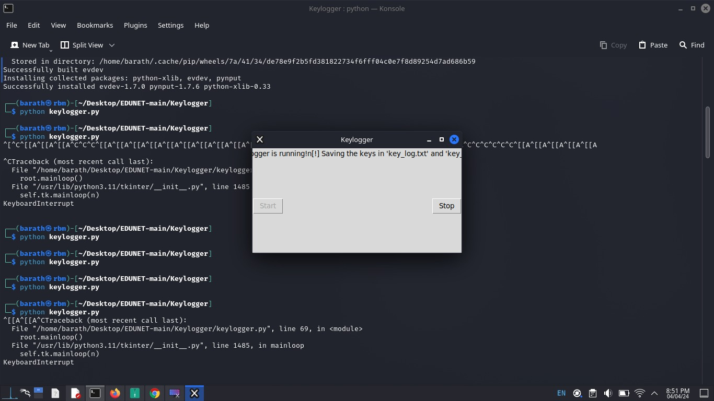
Result

Slide 8
Conclusion
In conclusion, the development of this keystroke monitoring system has successfully demonstrated how a practical application can be designed using Python—leveraging the capabilities of libraries such as 'pynput' for input monitoring and 'tkinter' for user interface creation. This project serves not only as a tool for capturing keyboard input but also as a learning platform to better understand event-driven programming and GUI integration in Python. While the keylogger is powerful in its current form, it is essential to underscore the importance of responsible use, with strict adherence to ethical guidelines and legal regulations. This system, when used with transparency and for legitimate purposes, can provide valuable insights and serve numerous beneficial applications in various domains.

Slide 9
Future scope
The future scope of this keylogger project is promising, with potential enhancements including advanced data encryption for security, machine learning algorithms for pattern detection, customizable filters for specific key event tracking, and cloud integration for remote access and storage. The development of mobile-compatible versions could also greatly expand the tool's versatility. As technology progresses, the adaptability and ethical application of such systems will become increasingly important.

Slide 10
References
- Python Software Foundation. (n.d.). Python Language Reference. https://www.python.org
- "pynput" Documentation. https://pynput.read

Slide 11
THANK YOU

