Slide 1
Steganography
CYBER SECURITY
Presented By:
1. ANTONY BENIFERT DITTO A | V V College of Engineering | CSE

Slide 2
OUTLINE
Problem Statement
Proposed System/Solution
System Development Approach
Algorithm & Deployment
Result (Output Image)
Conclusion
Future Scope
References

Slide 3
Problem Statement
In a world where information security is paramount, the need arises for a simple yet effective method to conceal messages within digital images. This project aims to address the issue by developing a basic steganography tool using Python and OpenCV that allows users to encrypt text messages within an image, thus securing the information from plain sight. This technique enhances privacy and potentially contributes to secure communication in various applications.

Slide 4
Proposed Solution
The process is twofold: encryption and decryption. During encryption, the text message is first converted into its corresponding ASCII values. Then, each character of the message is encoded into the LSBs of the image pixels in a sequential manner, altering the image subtly in a way that is nearly imperceptible to the naked eye.
The process is twofold: encryption and decryption. During encryption, the text message is first converted into its corresponding ASCII values. Then, each character of the message is encoded into the LSBs of the image pixels in a sequential manner, altering the image subtly in a way that is nearly imperceptible to the naked eye.
Our solution includes error handling for cases where the message length exceeds the capacity of the image and ensures that there are no significant alterations to the image that might reveal the presence of an encrypted message. The resultant image, looking seemingly unchanged, can be shared across various platforms, carrying within it the hidden information.
The decryption process reverses the encryption steps by traversing the modified image pixels, reading the LSBs to retrieve the ASCII values, and converting them back to the original characters, reconstructing the hidden message for users with the correct passcode.
A plain text file (key_log.txt) where sequential keystrokes are recorded, providing a simplified view of keyboard activity. This can be useful for quick inspection or for cases where a human-readable format is required.
A structured JSON file (key_log.json) where each keystroke event is stored as a separate object, indicating the type of key event (pressed or released) and the key's value. This format is incredibly useful for any in-depth analysis or for feeding the data into further processing pipelines, as JSON is widely used for data exchange and storage.
The combination of Python's ease of use and OpenCV's robust image-processing capabilities makes this project approachable and executable, even for those with a basic understanding of programming and cryptography. Through this project, we demonstrate a practical application of steganography for secure message transmission in the digital era.

Slide 5
System Approach
Using Python and OpenCV, we read the input image and convert the secret message into ASCII values. Each character of the message is then encoded bit by bit into the pixels of the image by altering the least significant bits. This encoding follows a regular pattern across the pixel array to facilitate easy retrieval.
For enhanced security, a user-defined passcode is used to lock and unlock the message within the image. The alteration to the image is so subtle that it is visually indistinguishable from the original. For decryption, the process is simply reversed, requiring the user to input the matching passcode to extract and reconstruct the original message from the image's pixel data. The system is designed to be user-friendly with input prompts and clear instructions for both encryption and decryption processes.
Linux/Windows
python

Slide 6
Algorithm & Deployment
Encryption Procedure:
Iterate over each character of the message.
For each character, store its ASCII value in the least significant bits of the image's pixel channels (RGB) by replacing the LSBs with the corresponding bits of the ASCII character.
Increment pixel coordinates after each bit insertion maintaining the pattern (e.g., diagonally across the pixels).
Decryption Phase:
Similar to the encoding process but in reverse, read the least significant bits from the pixel channels from the same pattern used during encoding.
Extract the bits and reconstruct each ASCII value.
Convert the ASCII values back into the corresponding characters to form the original message.
Deployment:
Prepare a Python environment, install necessary libraries (opencv-python for OpenCV, and possibly numpy for array manipulations).
Create a Python script that encompasses both the encryption and decryption algorithms with user prompts for inputs.
Design a simple command-line interface that guides the user through the process of encrypting and decrypting messages.

Slide 7
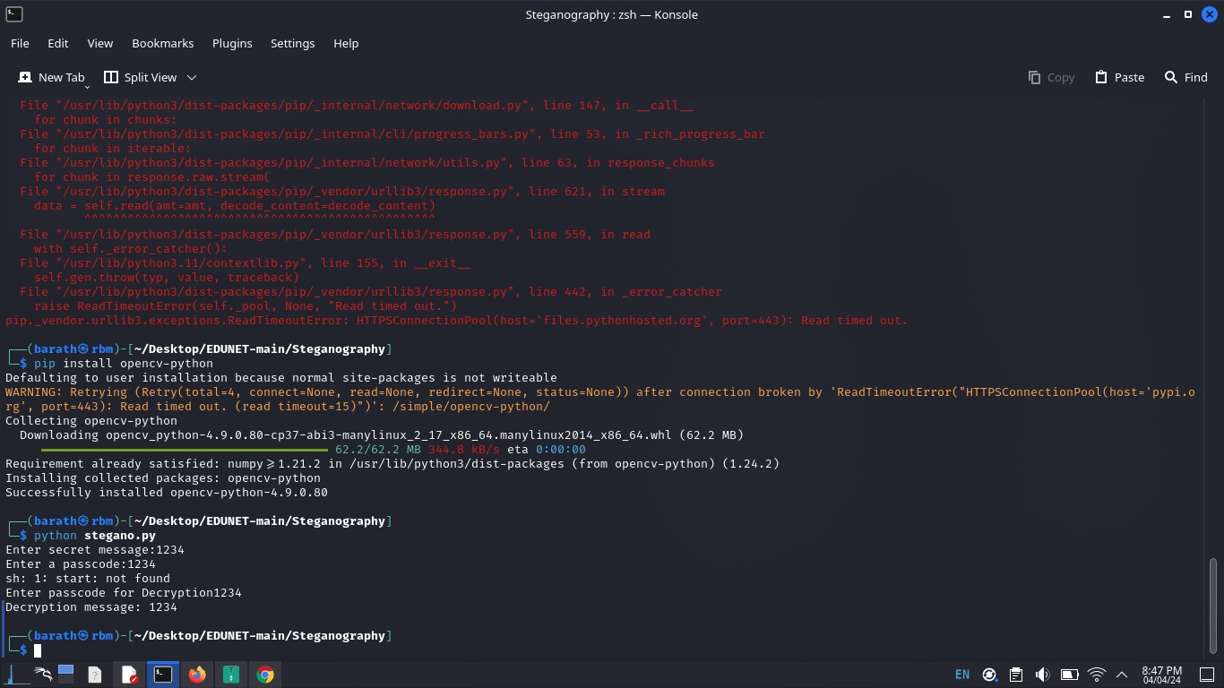
Result

Slide 8
Conclusion
In conclusion, this project successfully demonstrates the use of a simple steganographic method for secure message communication. With Python and OpenCV, we've developed a tool that efficiently embeds a secret message into an image and allows for secure retrieval with a passcode. This approach provides a basic yet effective means of concealing information within a digital medium and can serve as a foundation for more advanced security applications in the future. The project underscores the potential of steganography in enhancing privacy in our increasingly digital world.

Slide 9
Future scope
The future scope of this project holds promising enhancements. We could explore more sophisticated encryption algorithms for increased security, develop a graphical user interface (GUI) for ease of use, and integrate the tool into mobile apps for broader accessibility. Additionally, expanding the tool to work with different file formats and larger datasets could see it being adopted in various fields such as digital rights management, confidential data transmission, and even in educational settings to teach cryptography and information security concepts.

Slide 10
References
- Python Software Foundation. (n.d.). Python Language Reference. https://www.python.org
- "cv2" Documentation. https://docs.opencv.org/4.x/d1/dfb/intro.html

Slide 11
THANK YOU

