Slide 1
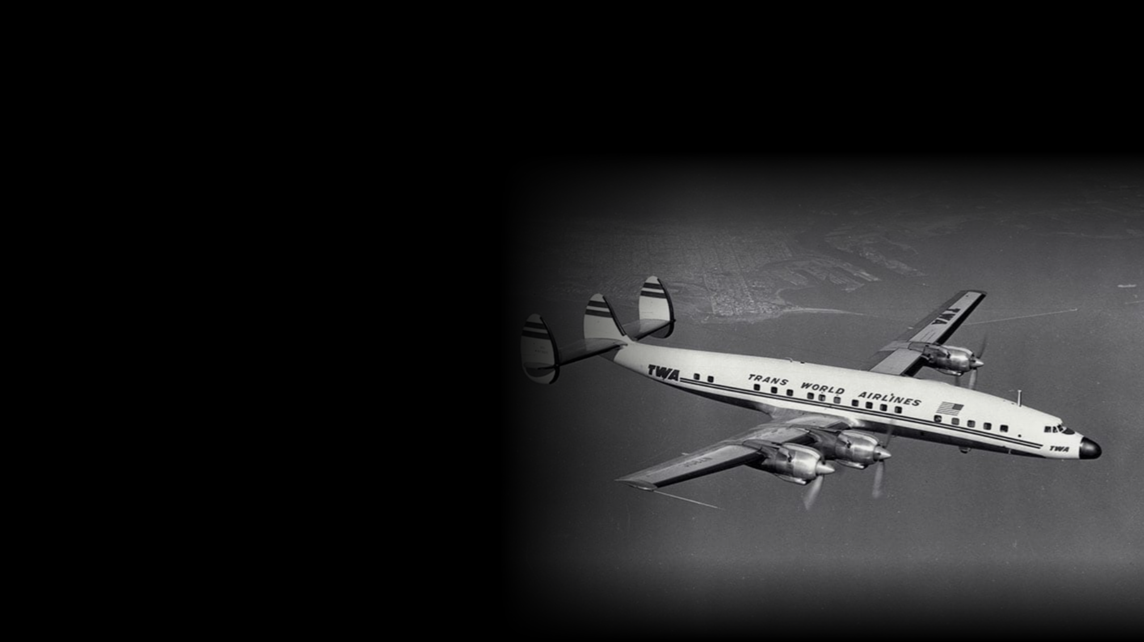
LOCKHEED CONSTELLATION
Making the long journey
something to look forward to
Engineering, business and aviation history
Notes:
Slide 1 | Constellation
Suggested timing: 0:00–0:20
If a long journey were something worth looking forward to in itself, what kind of aircraft would you choose? Today I'd like to introduce the Lockheed Constellation, known to everyone as Connie. We'll start with what passengers feel most directly, time, and then look more closely at the engineering behind it, the business deployment, and the history.
Delivery cue: pause for two seconds at the opening, then reveal Connie.
Diagram point: the value of the aircraft is that it makes a long journey something to look forward to.
Sources (checked 2026-10-05): none on this slide.
Image credit: TWA Super Constellation photo carried over from the original deck; diagrams are editable native slide objects.

Slide 2
Coast to coast: a day and a half, then eight hours
Two eras of TWA service on one time scale
1930
36 hours
Across the United States, with an overnight stop in Kansas City
1953
8 hours
Los Angeles to New York, Super Constellation eastbound nonstop
0
8
16
24
36
hours
A journey of a day and a half shrinks to roughly a working day
Source: TWA Museum. A comparison of route services from different eras, not a speed test of a single aircraft.
Notes:
Slide 2 | Coast to coast: a day and a half, then eight hours
Suggested timing: 0:20–0:52
These two bars represent TWA service in two different eras. In 1930, crossing the United States took thirty-six hours, including an overnight stop in Kansas City. By 1953, the Super Constellation's eastbound nonstop from Los Angeles to New York took just eight hours. Think of it as a journey of a day and a half shrinking to roughly a working day. This is a comparison of route services from different eras; the time saved also reflects nonstop scheduling and operational progress.
Delivery cue: point to the long bar first, then the short one. Both bars share the same zero; don't attribute the whole improvement to aircraft speed.
Diagram point: fitting a long journey inside a single day changes how passengers feel about distance.
Sources (checked 2026-10-05):
https://twamuseum.org/history
Image credit: none; the diagram is an editable native slide object.

Slide 3
Four engines, about 13,600 horsepower together
L-1649A Super Star example, per Lufthansa historical data
ENGINE 1
ENGINE 2
ENGINE 3
ENGINE 4
3,400
3,400
3,400
3,400
13,600
+
+
+
=
hp
hp
hp
hp
hp in total
Eighteen cylinders each; that much power also demands complex maintenance
3,400 × 4 = 13,600 hp. Figures vary by model and engine configuration; not a specification shared across the whole family.
Notes:
Slide 3 | Four engines: how much power together?
Suggested timing: 0:52–1:22
So how does this aircraft family manage long-haul flight? Look at these four circles; each represents one engine. Taking the later Lufthansa Super Star as the example, each Wright R-3350 produced about three thousand four hundred horsepower. Four together make about thirteen thousand six hundred. Each is an eighteen-cylinder, twin-row radial. That much power pushed propeller-airliner performance very high, and it also brought complex maintenance demands.
Delivery cue: point to the four engines one by one, then to the total. The slide specifies the L-1649A; don't apply the figure to every early Connie.
Diagram point: about 3,400 hp each, about 13,600 hp in total.
Sources (checked 2026-10-05):
https://www.lufthansa.com/ba/en/100-years/fleet
https://www.f35.com/en-us/news/features/history/constellation.html
Image credit: none; the diagram is an editable native slide object.

Slide 4

One minute, about eight kilometres
L-1649A Super Star: cruise roughly 480–500 km/h
Each segment is one kilometre of cruise
≈ 8 km
60
seconds
1 km
2 km
3 km
4 km
5 km
6 km
7 km
8 km
Turning speed per hour into a minute you can feel
480 ÷ 60 = 8; about 8–8.3 km/min across the cruise range. Still-air illustration; actual ground speed depends on wind.
Notes:
Slide 4 | One minute, about eight kilometres
Suggested timing: 1:22–1:48
Four hundred and eighty to five hundred kilometres an hour still sounds a bit abstract. Try it another way: in the time it takes you to say about a minute's worth of words, the aircraft has moved roughly eight kilometres through the air. This is a still-air illustration converted from cruise speed. Top speed and cruise speed are two different things, so we won't treat the fastest number as a speed held for the whole flight.
Delivery cue: each segment in the diagram is one kilometre; the speaker only stresses "about eight kilometres a minute".
Diagram point: converting cruise speed into distance per minute makes it tangible.
Sources (checked 2026-10-05):
https://www.lufthansa.com/ba/en/100-years/fleet
Image credit: none; the diagram is an editable native slide object.

Slide 5
One wingspan is longer than the first flight
Two lines at the same scale; the difference is just 3 feet (about 0.91 m)
First flight, 1903
120 ft
Super Constellation, full wingspan
+3 ft
123 ft
The first distance humans ever flew later became roughly the width of one airliner
Wingspan from SCFA HB-RSC data; first-flight distance from the U.S. National Park Service. Wingspan is tip to tip, not a single wing.
Notes:
Slide 5 | One wingspan is longer than the first flight
Suggested timing: 1:48–2:18
Now look at this comparison. The Wright brothers' first successful flight in 1903 covered one hundred and twenty feet. This Super Constellation example has a full wingspan of one hundred and twenty-three feet. Both lines are drawn at the same scale, and they differ by only three feet. The entire distance of humanity's first flight later became roughly the width of one airliner, wingtip to wingtip. That is the scale of aviation's progress in a few decades.
Delivery cue: always say "full wingspan"; the two scale lines differ by only 2.5 percent, so don't exaggerate the gap.
Diagram point: full wingspan of 123 ft, slightly longer than the 120 ft of the 1903 first flight.
Sources (checked 2026-10-05):
https://www.superconstellation.ch/index.php/en/flugzeuge-en/l-1049-hb-rsc-en/technische-daten-en
https://www.nps.gov/places/000/first-flight-landing.htm
Image credit: none; the diagram is an editable native slide object.

Slide 6
Behind the comfort, an engineering system
Pressurization looks after passengers; hydraulic boost helps pilots control the aircraft
PASSENGERS
PILOTS
Pressurization
Hydraulic boost
Cabin
higher pressure
Outside
lower pressure
Pilot input
Hydraulic boost
Control surfaces
The system regulates the pressure differential so the cabin stays comfortable at altitude
Boost amplifies the pilot's control inputs, so a large aircraft stays easy to handle
Flying higher avoids some weather, but it doesn't mean no turbulence
The Boeing 307 was the first pressurized airliner. Arrows are schematic, not a precision system diagram.
Notes:
Slide 6 | Behind the comfort, an engineering system
Suggested timing: 2:18–2:50
Flying far also means sitting comfortably. The pressurization system keeps the high-altitude cabin at a more suitable pressure, and together with a higher cruising altitude it helps avoid some of the weather found lower down. On the other side, hydraulic boost amplifies the pilot's control inputs, making a large aircraft easier to handle. Pressurization does not mean no turbulence, and this was not the first pressurized airliner. Connie's appeal was in integrating these technologies into a long-haul travel experience.
Delivery cue: the left panel is about passengers, the right panel about pilots. The pressure diagram is a schematic, not actual cabin pressure values.
Diagram point: pressurization looks after passengers; hydraulic boost helps pilots control a large aircraft.
Sources (checked 2026-10-05):
https://www.f35.com/en-us/news/features/history/constellation.html
https://www.si.edu/object/lockheed-1049f-55-96-constellation%3Anasm_A19880371000
https://www.sfomuseum.org/exhibitions/queen-skies-legacy-lockheed-constellation
Image credit: none; the diagram is an editable native slide object.

Slide 7
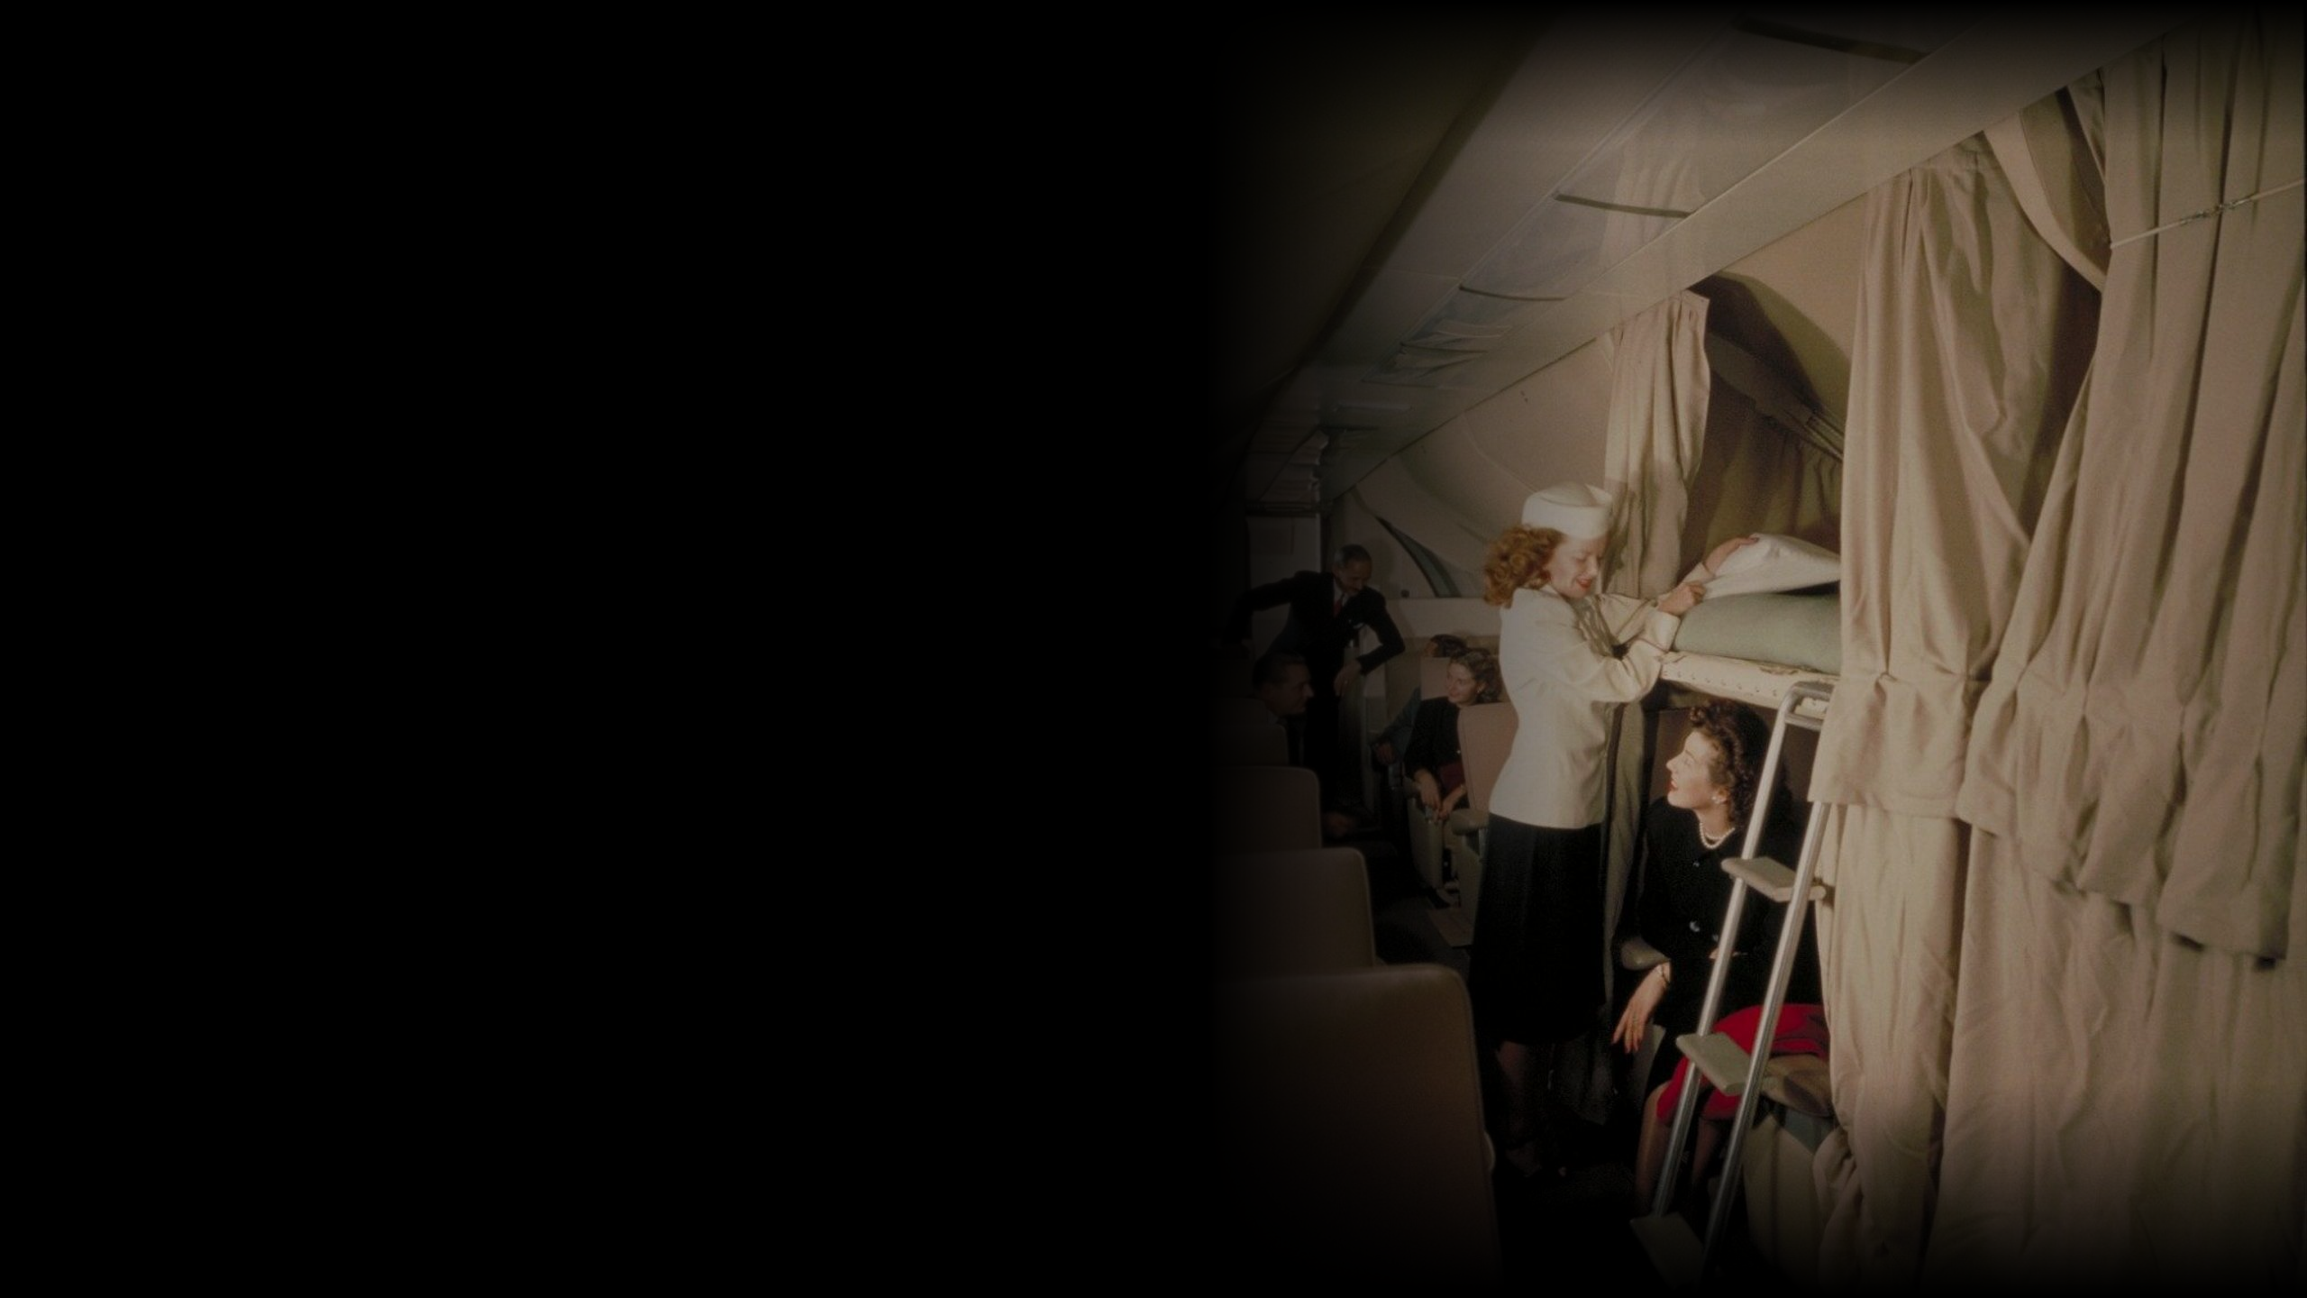




One more thing…
The journey itself is something to look forward to
Hamburg
New York
A transatlantic crossing could last up to 17 hours
Dine
Talk
Rest
Some premium configurations offered a lounge and overnight sleeper berths
Right: M-049 cabin from Lockheed's official history page, not the Lufthansa L-1649A. The sequence does not represent fixed service durations.
Notes:
Slide 7 | One more thing… the journey itself is something to look forward to
Suggested timing: 2:50–3:26
But there's one more thing. The best part of the experience waits until you step into the cabin. Take a Lufthansa Super Star transatlantic trip as an example: the flight could last up to seventeen hours. Some premium configurations offered a lounge and overnight sleeper berths, so you could dine, talk, and then rest. Imagine putting down your book, settling in for a night's sleep, and waking up to a different city. The long hours gain a different use.
Delivery cue: pause two seconds before pointing to the dine-talk-rest sequence. Service varied by airline and configuration; the diagram is a concept of the journey and does not invent meal or sleep durations.
Diagram point: some premium configurations turned a long night flight into time for rest and conversation.
Sources (checked 2026-10-05):
https://www.f35.com/en-us/news/features/history/constellation.html
https://www.lufthansa.com/ba/en/100-years/fleet
https://cdn0.scrvt.com/fcc1c913dc63063c259fa05200249ccd/0b731d3206c7515e/bf1389bccf84/The-history-of-Lufthansa-Technik.pdf
Image credit: https://www.f35.com/content/dam/lockheed-martin/eo/photo/historical-programs/constellation/constellation-interior.jpg.pc-adaptive.full.medium.jpg

Slide 8
35 aircraft for TWA first, then sales to named rivals
Hughes's 1939 supply condition, per Lockheed's historical account
TWA takes delivery first
Other transcontinental airlines
Only after 35 are delivered
Sales permitted only once the condition is met
35-aircraft threshold · each square is one aircraft
What Hughes was buying was time: being first to launch the new service
Illustrates the agreement threshold; it does not claim 35 aircraft were delivered before the war. Applied to other transcontinental airlines, not a permanent worldwide sales ban.
Notes:
Slide 8 | What Hughes was buying was a head start
Suggested timing: 3:26–4:04
Now let's look at the business deployment behind it. In 1939, Howard Hughes asked for secret development and set a key condition. According to Lockheed's historical account, only after TWA had received thirty-five aircraft could Lockheed sell to other U.S. transcontinental airlines. The gate in the diagram represents that delivery threshold. Hughes wanted the new aircraft first, to establish the impression in passengers' minds first. We can call it a first-mover advantage; the clause had specific counterparties and conditions, and it was not a permanent monopoly.
Delivery cue: the 35 squares, one per aircraft, show the agreement threshold, not a claim that 35 were delivered before the war. The restriction applied to other transcontinental airlines.
Diagram point: the priority-delivery condition gave TWA a chance to launch the new product earlier.
Sources (checked 2026-10-05):
https://www.f35.com/en-us/news/features/history/constellation.html
Image credit: none; the diagram is an editable native slide object.

Slide 9
From secret development to postwar airline service
The war, the military takeover and the prototype's first flight came at different times
Wartime · 1942: the military takes over production
1939
1941
1943
1946
Hughes gets involved
U.S. enters the war
C-69 first flight
TWA airline service
Secret development
Military needs take priority
January 9
Transatlantic, from February
The commercial launch timeline was rewritten by the war
Main axis proportional to year. Sources: Lockheed, Smithsonian, TWA Museum.
Notes:
Slide 9 | From secret development to postwar airline service
Suggested timing: 4:04–4:36
But business plans had to face history. From left to right: in 1939, Hughes pushed development forward; in 1941, the United States entered the war; in 1942 the military took over production, and the prototype first flew in 1943 as the C-69. Only in February 1946 did TWA begin transatlantic airline service with the Constellation. The middle stretch of this timeline explains why the product's commercial launch was far more winding than first imagined.
Delivery cue: follow the timeline left to right. The main axis is proportional to year; 1942 is noted within the wartime span.
Diagram point: 1939, 1941, 1943 and 1946 form a path rewritten by the war.
Sources (checked 2026-10-05):
https://www.f35.com/en-us/news/features/history/constellation.html
https://twamuseum.org/history
https://www.si.edu/object/lockheed-1049f-55-96-constellation%3Anasm_A19880371000
Image credit: none; the diagram is an editable native slide object.

Slide 10
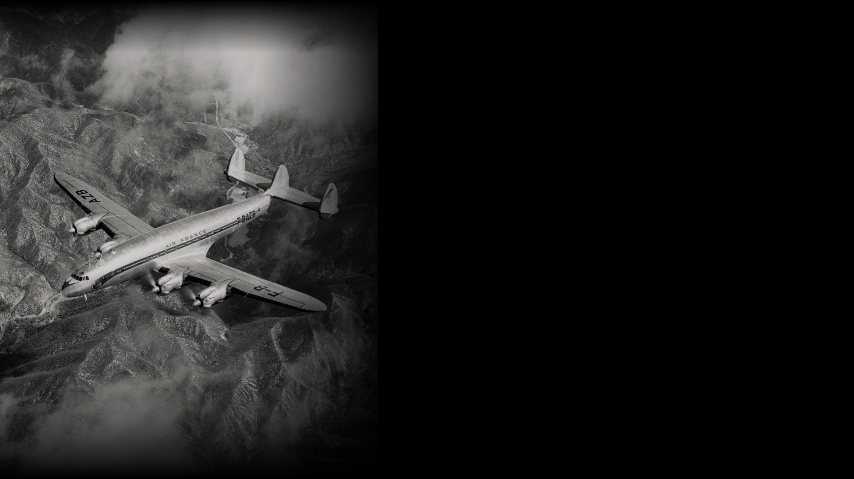
Connie is a family
that kept evolving
Representative models and the year each entered service. Models don't share one specification.
L-049 1946
Postwar airline service
L-1049 1951
Stretched fuselage, more capacity
L-1649A 1957
Starliner: new wing, longer range
Years are when representative models entered service, not first flights. Left: Constellation from Lockheed's history page.
Notes:
Slide 10 | Connie is a family that kept evolving
Suggested timing: 4:36–5:06
So when we talk about the Constellation, we have to be clear about models. The early L-049 entered airline service after the war. The L-1049 Super Constellation, in service from 1951, stretched the fuselage for more passengers and capability. The L-1649A Starliner of 1957 used a new wing to push ultra-long-range flying further. Lufthansa called it the Super Star. The horsepower and speed figures we discussed earlier are each labelled with the example they come from.
Delivery cue: the three nodes are representative models and years entering service, not a complete family tree of every sub-variant.
Diagram point: early airliner, stretched fuselage, longer range: the evolution of different models.
Sources (checked 2026-10-05):
https://www.si.edu/object/lockheed-1049f-55-96-constellation%3Anasm_A19880371000
https://www.lufthansa.com/ba/en/100-years/fleet
Image credit: https://www.f35.com/content/dam/lockheed-martin/eo/photo/historical-programs/constellation/constellation-in-flight-3.jpg.pc-adaptive.full.medium.jpg

Slide 11
856 aircraft: how big is that?
Total production across the family, civil and military
800 + 56
= 856 aircraft
44 of them are Starliners
About 5% of the whole family
A successful family doesn't give every generation the same market window
Each full cell is 10 aircraft; split cells show the exact count. Amber marks the 44 Starliners (44 ÷ 856 ≈ 5.1%). Source: SCFA History L-1049.
Notes:
Slide 11 | 856 aircraft: how big is that?
Suggested timing: 5:06–5:34
The whole family totalled eight hundred and fifty-six aircraft. You don't need to memorise the number; just look at this chart: each cell represents ten aircraft, eight full rows of one hundred, plus fifty-six. That includes both civil and military versions. The Starliner, the last development, had a run of forty-four, about five percent of the whole family. The proportion is a reminder that a successful family doesn't mean every generation gets an equally long market opportunity.
Delivery cue: the final partial cell represents exactly 6 aircraft; the Starliner share is 44 ÷ 856, about 5.1%.
Diagram point: eight groups of one hundred plus fifty-six; the late Starliner is only about 5% of it.
Sources (checked 2026-10-05):
https://www.superconstellation.ch/index.php/en/flugzeuge-en/l-1049-hb-rsc-en/171-geschichte-l-1049-en
Image credit: none; the diagram is an editable native slide object.

Slide 12



One family, several roles in history
Different derivatives of the same design answered different needs
1944
1953
COLD WAR
Orville Wright
Columbine II
EC-121
His last flight was aboard a Constellation
First aircraft to fly under the Air Force One call sign
Airborne radar early warning
Different derivatives of one design, three very different jobs
Air Force One is the call sign used when the president is aboard a U.S. Air Force aircraft, not an aircraft type.
Notes:
Slide 12 | One family, several roles in history
Suggested timing: 5:34–6:06
The family's influence also went beyond airline service. Orville Wright's last flight, in 1944, was aboard a Constellation. In 1953, Eisenhower's Columbine II used the Air Force One call sign. The EC-121 derivative carried radar for airborne early-warning missions. Different configurations answered different needs, writing one design family into several chapters of history.
Delivery cue: the three branches represent roles, not three functions fitted to the same aircraft at once.
Diagram point: passengers, a president and the military used different derivatives of the same family.
Sources (checked 2026-10-05):
https://www.f35.com/en-us/news/features/history/constellation.html
https://www.airmanmagazine.af.mil/Features/Display/Article/2592502/original-air-force-one/
https://www.nationalmuseum.af.mil/Visit/Museum-Exhibits/Fact-Sheets/Display/Article/196058/lockheed-ec-121d-constellation/
Image credit: none; the diagram is an editable native slide object.

Slide 13
The next era arrived quickly
Cruise speed: Lufthansa Super Star against the Boeing 707
1957
Super Star
480–500 km/h
1960
Boeing 707
880–900 km/h
0
300
600
900
km/h
The last Connie's market window met a far faster jet
Shared zero; the solid band shows the cruise range, with a thin line back to zero. Years are when Lufthansa introduced each type, not first flights.
Notes:
Slide 13 | The next era arrived quickly
Suggested timing: 6:06–6:36
But by the end of the 1950s, another era had already arrived. Comparing Lufthansa's historical data: the Super Star cruised at about four hundred and eighty to five hundred kilometres an hour, while the Boeing 707 cruised at eight hundred and eighty to nine hundred. The two bars use the same scale, and the speed roughly doubles. The Super Star joined Lufthansa in 1957; by 1960 Lufthansa had entered the 707 jet age. Technology and passenger expectations kept moving forward, and the classic had to face the next generation.
Delivery cue: the solid bands show cruise ranges; don't pair the extremes to inflate the ratio. This compares speed; don't present it directly as flight times halving.
Diagram point: the jet's speed advantage squeezed the last Connie's market window.
Sources (checked 2026-10-05):
https://www.lufthansa.com/ba/en/100-years/fleet
Image credit: none; the diagram is an editable native slide object.

Slide 14
€150 million: the real cost of preserving a legend
L-1649A Super Star restoration project
€150 million
Total project cost, 2007–2019
2007
2018
2019
2025
Airframe purchased
Return-to-flight plan halted
Shipped back to Germany
Non-airworthy restoration completed
The goal shifted from returning to the sky to preservation and display
Sequence of events, not to scale. €150m includes external donations and sponsorship; it is not the aircraft's market value or total spend through 2025.
Notes:
Slide 14 | €150 million: the real cost of preserving a legend
Suggested timing: 6:36–7:12
Let's come closer to the present. In 2007, a Lufthansa-affiliated organisation bought the airframe and began a programme to preserve the Super Star. In 2018, the return-to-flight project was halted; in 2019 the aircraft was shipped back to Germany. Reports quoting Lufthansa's CEO put the total cost for that period at one hundred and fifty million euros, including external donations and sponsorship. In 2025, Lufthansa announced the completion of a non-airworthy restoration. The figure represents the investment in preserving history, and it also tells how a dream had to adjust its goal.
Delivery cue: €150m covers only the 2007–2019 project cost; don't extend it to a 2025 total, and it is not the aircraft's market valuation.
Diagram point: the restoration investment was huge, but the original goal of returning to the sky was finally changed to display.
Sources (checked 2026-10-05):
https://www.aerotelegraph.com/galerie/gescheiterte-restaurierung-kostete-150-millionen/5c3fy6k
https://newsroom.lufthansagroup.com/en/lufthansa-celebrates-roll-out-of-the-legendary-lockheed-super-star/
Image credit: none; the diagram is an editable native slide object.

Slide 15




What kind of journey would you choose?
Change how long
a journey takes
Enjoy the
journey itself
Remember a
piece of history
Imagine yourself boarding Connie
LOCKHEED CONSTELLATION
Notes:
Slide 15 | What kind of journey would you choose?
Suggested timing: 7:12–7:37
Back to the opening question: what kind of aircraft would you choose? Connie shows us that technology can change how long a journey takes, that design can make the journey something to look forward to, and that an aircraft's story can outlast its commercial life. If we could go back to that era, I'd invite you to board Connie and experience it for yourself. Thank you.
Delivery cue: the three threads converge here. Say thank you only on this slide.
Diagram point: design, experience and history together explain why Connie is worth remembering.
Sources (checked 2026-10-05): none on this slide.
Image credit: none; diagrams are editable native slide objects.

Slide 16
Which example does each figure come from?
Q&A backup, not part of the main talk
L-1649A Super Star
HB-RSC Super Constellation
Lufthansa historical data
SCFA published data
Total power
≈ 13,600 hp
Full wingspan
123 ft
Cruise speed
≈ 480–500 km/h
Power per engine
3,250 hp
Published range
≈ 9,500–10,000 km
Used for
Wingspan slide
Fuel load, engine configuration, payload and operating conditions all affect performance. Published range does not mean every flight can cover the same distance.
Notes:
Q&A backup; not counted in the main talk time.
https://www.lufthansa.com/ba/en/100-years/fleet
https://www.superconstellation.ch/index.php/en/flugzeuge-en/l-1049-hb-rsc-en/technische-daten-en
The speed slide uses the L-1649A; the wingspan slide uses HB-RSC. The two are not treated as the same aircraft.

Slide 17
Four things that are easy to confuse
Q&A backup, not part of the main talk
Pressurization precedent
35-aircraft threshold
The Boeing 307 was pressurized before the Constellation
A contract condition, not the number actually delivered before the war
123 ft
€150 million
The full wingspan, tip to tip, not a single wing
A project cost, not a market value or a return on investment
"First-mover advantage" is a strategic interpretation; an exclusive purchase arrangement should not be described as insider dealing.
Notes:
Q&A backup; not counted in the main talk time.
https://www.sfomuseum.org/exhibitions/queen-skies-legacy-lockheed-constellation
https://www.f35.com/en-us/news/features/history/constellation.html
https://www.superconstellation.ch/index.php/en/flugzeuge-en/l-1049-hb-rsc-en/technische-daten-en
https://www.aerotelegraph.com/galerie/gescheiterte-restaurierung-kostete-150-millionen/5c3fy6k

Slide 18
Sources and how the diagrams are framed
What each figure rests on
Route times, 1946 service
TWA Museum · History
Hughes, the 35-aircraft condition, cabin photo
Lockheed Martin · Constellation history
Super Star and 707 performance
Lufthansa · 100 Years / Fleet
856, 44, 123 ft
SCFA · History L-1049 / Technical data
120 ft first flight
U.S. National Park Service
Air Force One, EC-121
U.S. Air Force / National Museum
Restoration cost and display status
aeroTELEGRAPH (2020) / Lufthansa (2025)
Full URLs, comparison caveats and the per-slide script are in the speaker notes. Checked 2026-10-05.
Notes:
https://www.lufthansa.com/ba/en/100-years/fleet
https://www.f35.com/en-us/news/features/history/constellation.html
https://twamuseum.org/history
https://www.superconstellation.ch/index.php/en/flugzeuge-en/l-1049-hb-rsc-en/technische-daten-en
https://www.superconstellation.ch/index.php/en/flugzeuge-en/l-1049-hb-rsc-en/171-geschichte-l-1049-en
https://www.sfomuseum.org/exhibitions/queen-skies-legacy-lockheed-constellation
https://www.nps.gov/places/000/first-flight-landing.htm
https://www.si.edu/object/lockheed-1049f-55-96-constellation%3Anasm_A19880371000
https://www.airmanmagazine.af.mil/Features/Display/Article/2592502/original-air-force-one/
https://www.nationalmuseum.af.mil/Visit/Museum-Exhibits/Fact-Sheets/Display/Article/196058/lockheed-ec-121d-constellation/
https://newsroom.lufthansagroup.com/en/lufthansa-celebrates-roll-out-of-the-legendary-lockheed-super-star/
https://www.aerotelegraph.com/galerie/gescheiterte-restaurierung-kostete-150-millionen/5c3fy6k
https://cdn0.scrvt.com/fcc1c913dc63063c259fa05200249ccd/0b731d3206c7515e/bf1389bccf84/The-history-of-Lufthansa-Technik.pdf
https://www.f35.com/content/dam/lockheed-martin/eo/photo/historical-programs/constellation/constellation-interior.jpg.pc-adaptive.full.medium.jpg
https://www.f35.com/content/dam/lockheed-martin/eo/photo/historical-programs/constellation/constellation-in-flight-3.jpg.pc-adaptive.full.medium.jpg

