Slide 1
Coursera Capstone
IBM Applied Data Science Capstone
Opening a New Shopping Mall in Kuala Lumpur, Malaysia
By: Divyansh Khare

Slide 2
Business Problem
Location of the shopping mall is one of the most important decisions that will determine whether the mall will be a success or a failure
Objective: To analyse and select the best locations in the city of Kuala Lumpur, Malaysia to open a new shopping mall
This project is timely as the city is currently suffering from oversupply of shopping malls
Business question
In the city of Kuala Lumpur, Malaysia, if a property developer is looking to open a new shopping mall, where would you recommend that they open it?

Slide 3
Data
Data required
List of neighbourhoods in Kuala Lumpur
Latitude and longitude coordinates of the neighbourhoods
Venue data, particularly data related to shopping malls
Sources of data
Wikipedia page for neighbourhoods (https://en.wikipedia.org/wiki/Category:Suburbs_in_Kuala_Lumpur)
Geocoder package for latitude and longitude coordinates
Foursquare API for venue data

Slide 4
Methodology
Web scraping Wikipedia page for neighbourhoods list
Get latitude and longitude coordinates using Geocoder
Use Foursquare API to get venue data
Group data by neighbourhood and taking the mean of the frequency of occurrence of each venue category
Filter venue category by Shopping Mall
Perform clustering on the data by using k-means clustering
Visualize the clusters in a map using Folium

Slide 5
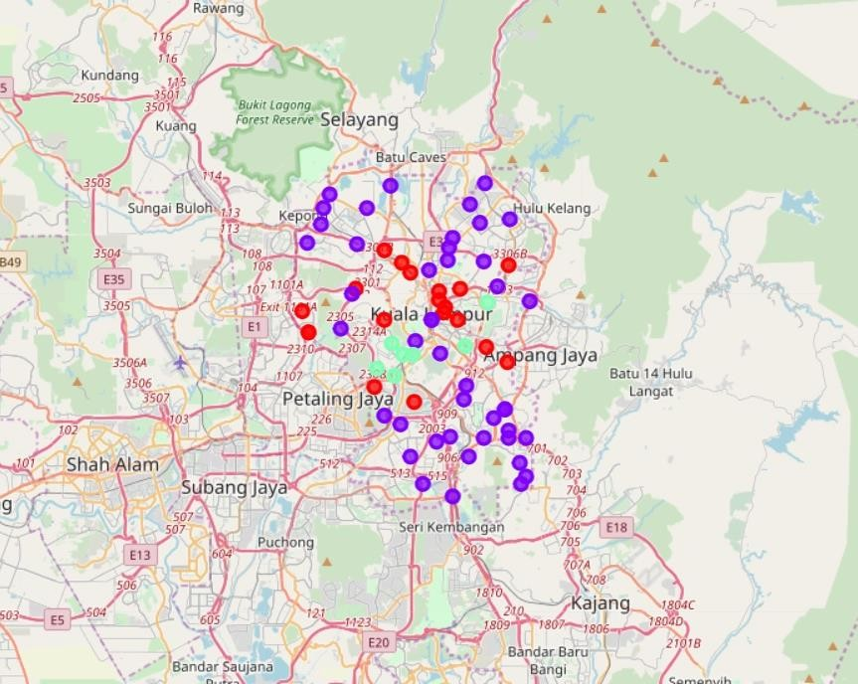
Results
Categorized the neighbourhoods into 3 clusters :
Cluster 0: Neighbourhoods with moderate number of shopping malls
Cluster 1: Neighbourhoods with low number to no existence of shopping malls
Cluster 2: Neighbourhoods with high concentration of shopping malls

