Slide 1

MLSA Internship:
Full Stack Development

Slide 2
Internship Overview
Objective
To gain hands-on experience in full-stack web development.
Skills
Strengthen HTML, CSS, and JavaScript foundations
Projects
Personal Webpage
Simple Calculator Application

Slide 3
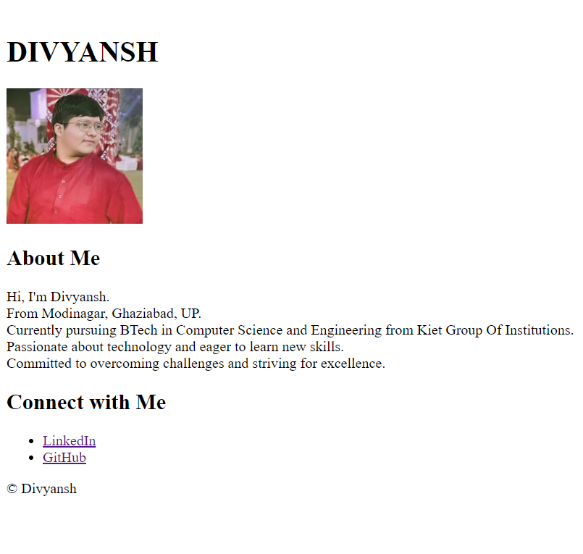
Project 1:
Personal Webpage
Objective
Design simple yet effective personal webpage
Components
Introduction, Bio, and Social media profile Links

Slide 4
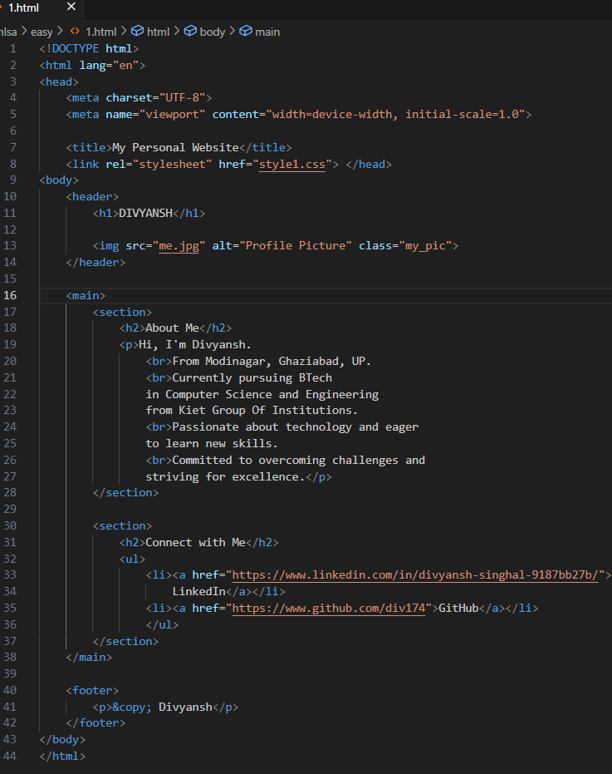
Project 1: Implementation
HTML Structure:
Created a basic HTML structure with sections for 'About Me', and 'Connect with me'.
Used semantic HTML elements like header, nav, main, section, and footer.
CSS Styling:
Applied CSS to style the layout, colors, fonts, and overall appearance.
Used CSS to create a responsive design that adapts to different screen sizes.
Content:
Added relevant personal information, and details.

Slide 5



Project 1:
Key Learnings
HTML Structuring
Semantic elements for better organization
CSS Styling
Enhanced layout techniques and responsive design

Slide 6
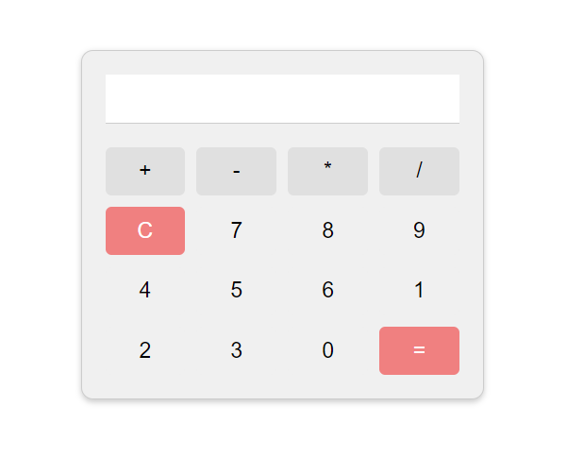
Project 2: Simple Calculator Application
Objective
To create a basic calculator that performs simple arithmetic operations.
Functions
Addition, subtraction, multiplication, and division
Focus
User-friendly interface with real-time calculations

Slide 7
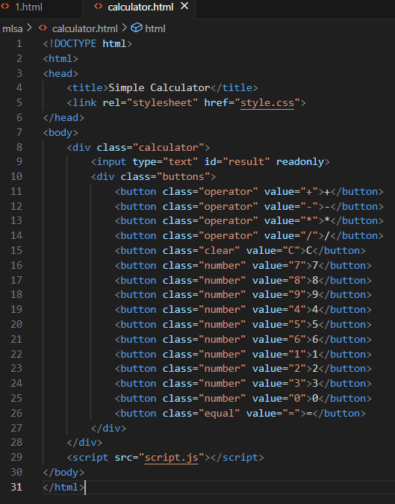
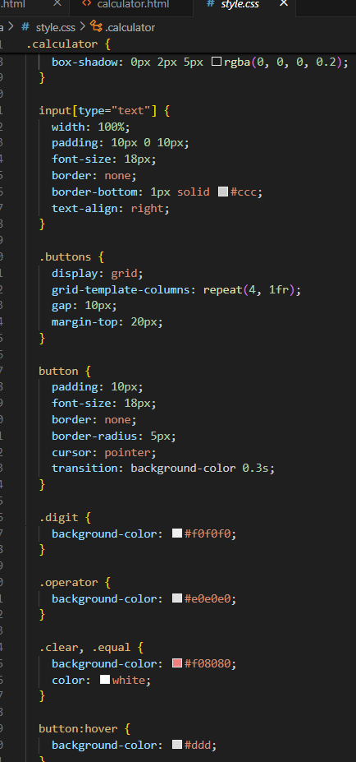
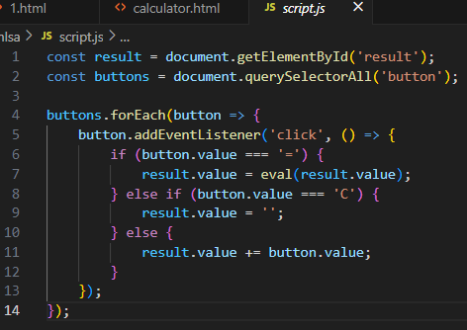
Project 2: Implementation
HTML Structure:
Created a basic HTML structure with an input field and buttons for numbers and operators.
JavaScript Logic:
Implemented JavaScript logic to handle button clicks and perform calculations.
Used the eval() function to evaluate expressions.
CSS Styling:
Applied CSS to style the calculator's appearance, including button colors, font sizes, and layout.

Slide 8

Project 2: Key Learnings
JavaScript Functions
Efficient handling of arithmetic operations
DOM Manipulation
Dynamic input capture and result display
Problem-Solving
Debugging and handling edge cases effectively

Slide 9

Overall Internship Experience
1
Skills
Strengthened HTML, CSS, and JavaScript foundations
2
Confidence
Enhanced ability to create interactive web applications
3
Insights
Gained valuable full-stack development workflow experience

Slide 10

Name- Divyansh
Branch- CSE
Roll No.- 2300290100104

