Slide 1
Design & LOOK-AND-FEEL of LIVE APP

Slide 2
Google like simplicity
Design
clean, uncluttered, minimal
should focus user on the page they are on and the info they get
limited opportunities to wander off (to website etc)
same colors as website and prototype
the dial - same color and look as in prototype

Slide 3
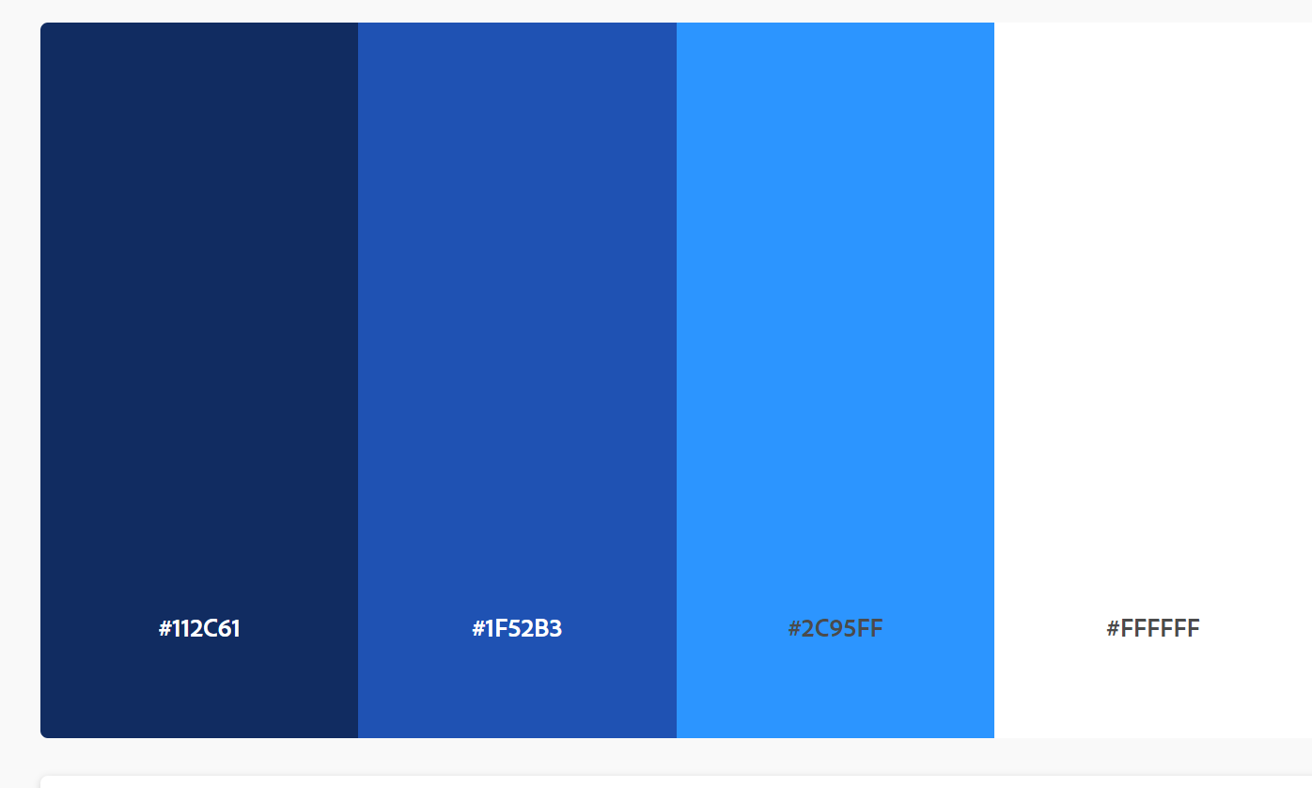
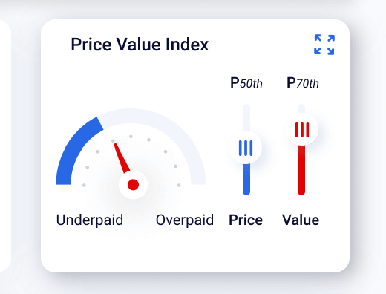
Dial to look like this
Try and stay as close to the prototype
three shades of blue in our brand colors over the arc instead of red-yellow-green look.
Text to say Below – median – Above

Slide 4

YOU ARE WORTH MORE THAN YOU THINK
INFORMS YOU IN REAL-TIME
Carousel Q’s
If you are paid in line with your performance
If your compensation is aligned with the market
How attractive you are to the market and why
How much more you can earn over your career
And which industries and companies to target
How well you are performing in relation to your peers in the market

Slide 5

INFORMS YOU IN REAL-TIME
About C-level opportunities aligned to your career interests
INFORMS YOU IN REAL-TIME
If your compensation is aligned with the market
INFORMS YOU IN REAL-TIME
How attractive you are to the market and why
INFORMS YOU IN REAL-TIME
How much more you can earn over your career
INFORMS YOU IN REAL-TIME
And which industries and companies to target
INFORMS YOU IN REAL-TIME
How well you are performing in relation to your peers in the market

Slide 6
INFORMS YOU IN REAL-TIME
If you are paid in line with your performance
INFORMS YOU IN REAL-TIME
Will connect you in private with companies and jobs that interest you

Slide 7
YOU ARE WORTH MORE THAN YOU THINK
INFORMS YOU IN REAL-TIME
Carousel Q’s
About C-level opportunities aligned to your career interests
Will connect you in private with companies and jobs that interest you

