Slide 1
BITS Pilani presentation
Dr. Nagesh BS

Slide 2
SE ZG501
Software Quality Assurance and Testing
Module 5

Slide 3
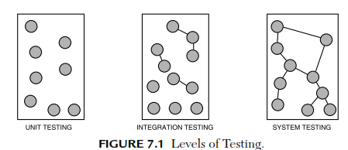
Test levels and types
Three levels of testing:
      1. Unit testing
      2. Integration testing
      3. System testing

Slide 4
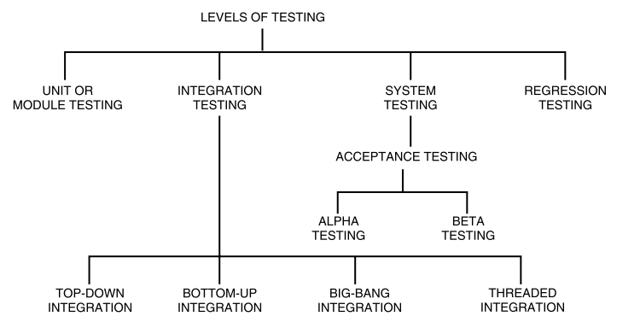

Slide 5
Unit (or module) testing
Unit (or module) testing “is the process of taking a module (an atomic unit) and running it in isolation from the rest of the software product by using prepared test cases and comparing the actual results with the results predicted by the specification and design module.”
It is a white-box testing technique.
Importance of unit testing:
  1. Because modules are being tested individually, testing becomes easier.
  2. It is more exhaustive.
  3. Interface errors are eliminated.

Slide 6
INTEGRATION TESTING
A system is composed of multiple components or modules that comprise hardware and software.
Integration is defined as the set of interactions among components.
Testing the interaction between the modules and interaction with other systems externally is called integration testing.
The architecture and design can give the details of interactions within systems.

Slide 7
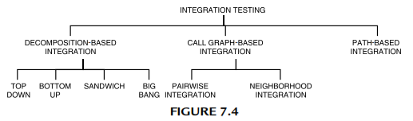
Classification of integration testing

Slide 8
Decomposition-based Integration: functional decomposition of the system to be tested which is represented as a tree or in textual form.
The goal of decomposition-based integration is to test the interfaces among separately tested units.

Slide 9
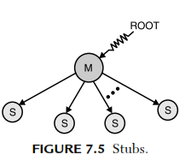
Types Of Decomposition-based Techniques :Top-down Integration Approach
It begins with the main program, i.e., the root of the tree.
Any lower-level unit that is called by the main program appears as a “stub.”
A stub is a piece of throw-away code that emulates a called unit.

Slide 10
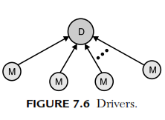
Bottom-up Integration Approach
It is a mirror image to the top-down order with the difference that stubs are replaced by driver modules that emulate units at the next level up in the tree.
start with the leaves of the decomposition tree and test them with specially coded drivers. Less throw-away code exists in drivers than there is in stubs.

Slide 11
Sandwich Integration Approach
It is a combination of top-down and bottom-up integration, bidirectional integration
There will be less stub and driver development effort.
Combination of the top-down and bottom-up integration approaches, it is also called bidirectional integration.
It is performed initially with the use of stubs and drivers.
Focuses on those components which need focus and are new.

Slide 12
Big-bang Integration
Instead of integrating component by component and testing, this approach waits until all the components arrive and one round of integration testing is done. This is known as big-bang integration.
It reduces testing effort and removes duplication in testing for the multi-step component integrations.
Big-bang integration is ideal for a product where the interfaces are stable with fewer number of defects.

Slide 13
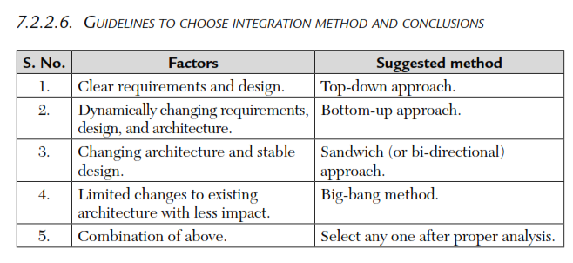

Slide 14
Call Graph-based Integration
Structural testing
Call graph is a directed graph .
Call graph is a directed graph thus, we can use it as a program graph.
    Pairwise Integration
    Neighborhood Integration

Slide 15
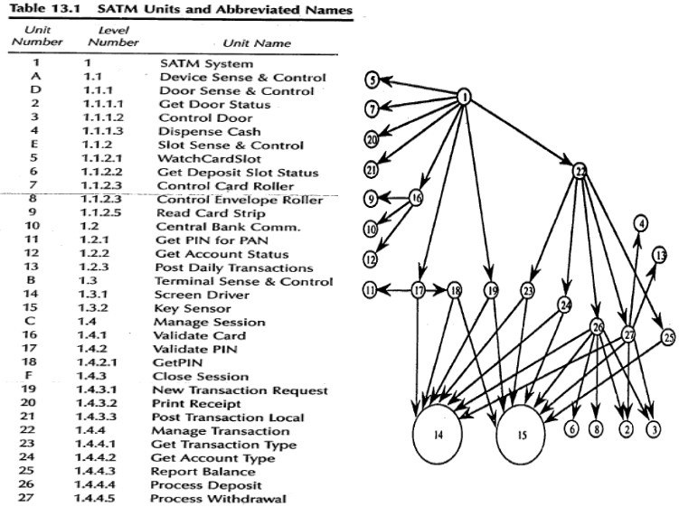

Slide 16
Pairwise Integration
The main idea behind pairwise integration is to eliminate the stub/driver development effort.
Instead of developing stubs and drivers, why not use the actual code?
we restrict a session to only a pair of units in the call graph.
The end result is that we have one integration test session for each edge in the call graph.
This is not much of a reduction in sessions from either topdown or bottom-up but it is a drastic reduction in stub/driver development.

Slide 17
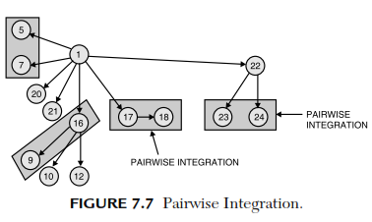

Slide 18
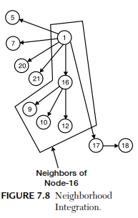
Neighborhood Integration
The neighborhood of a node in a graph is the set of nodes that are one edge away from the given node.

Slide 19
Path-based Integration
The combination of structural and functional testing is
highly desirable at the unit level and it would be nice to have a similar capability for integration and system testing.
“Instead of testing interfaces among separately developed and tested units, we focus on interactions among these units.”
Here, cofunctioning might be a good term.
Interfaces are structural whereas interaction is behavioral.

Slide 20
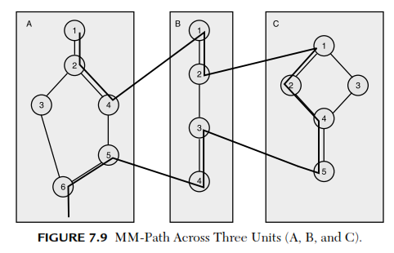
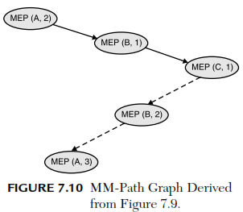

Slide 21
SYSTEM TESTING
The testing that is conducted on the complete integrated products and solutions to evaluate system compliance with specified requirements on functional and non functional aspects is called system testing. It is done after unit, component, and integration testing phases.

Slide 22
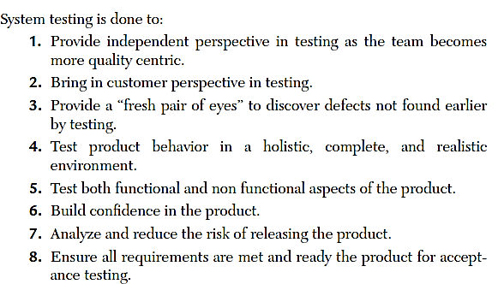

Slide 23
An independent test team normally does system testing.
This independent test team is different from the team that does the component and integration testing.
The system test team generally reports to a manager other than the product-manager to avoid conflicts and to provide freedom to individuals during system testing.
Testing the product with an independent perspective and combining that with the perspective of the customer makes system testing unique, different, and effective.

Slide 24
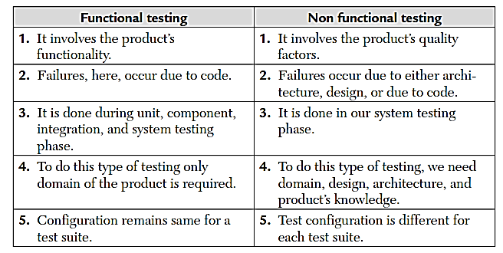

Slide 25
Module 5
Test Execution Process

Slide 26
Test plan
The primary purpose of a test plan is to define the scope, approach, resources, and schedule for testing activities. It provides a systematic approach to ensure that the software meets specified requirements and quality standards.

Slide 27
Key components of a test plan
Objectives,
Scope,
Test Items,
Test Environment,
Testing Strategy,
Test Schedule,
Resource Requirements,
Risk Management
Test Deliverables.

Slide 28
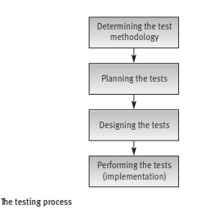
The testing process
Planning, design and performance of testing are carried out throughout the software development process.
These activities are divided in phases, beginning in the design stage and ending when the software is installed at the customer’s site.

Slide 29
Determining the test methodology phase
The main issues that testing methodology has to contend with are:
  The appropriate required software quality standard
  The software testing strategy.
  Determining the appropriate software quality standard
The level of quality standard selected for a project depends mainly on the characteristics of the software’s application.
Example 1: A software package for a hospital patient bed monitor requires the highest software quality standard considering the possibly severe consequences of software failure.

Slide 30
Determining the software testing strategy
The issues that have to be decided include:
  The testing strategy: should a big bang or incremental testing strategy beadopted? If incremental testing is preferable, should testing be performed bottom-up or top-down?
  Which parts of the testing plan should be performed according to the white box testing model?
  Which parts of the testing plan should be performed according to the automated testing model?

Slide 31
Planning the tests
The tests to be planned include:
      Unit tests
      Integration tests
      System tests.
Consider the following issues before initiating a specific test plan:
    What to test?
    Which sources to use for test cases?
    Who is to perform the tests?
    Where to perform the tests?
    When to terminate the tests?

Slide 32
Test planning documentation
The planning stage of the software system tests is commonly documented in a “software test plan” (STP).

Slide 33
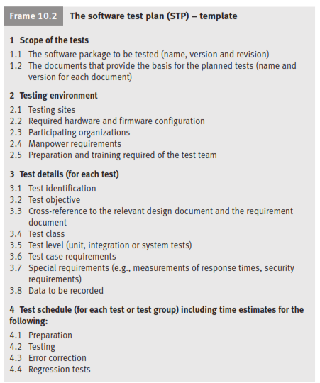

Slide 34
Test design
The products of the test design stage are:
    Detailed design and procedures for each test
    Test case database/file.
The test design is carried out on the basis of the software test plan as documented by STP.
The test procedures and the test case database/file may be documented in a “software test procedure” document and “test case file” document or in a single document called the “software test description” (STD).

Slide 35
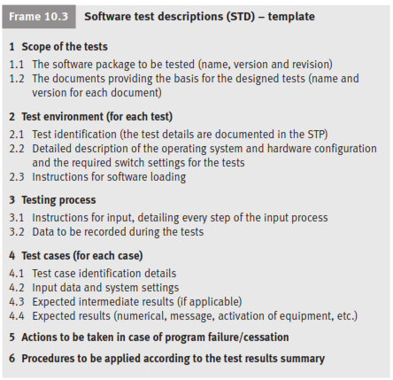

Slide 36
Test implementation
The testing implementation phase activities consist of a series of tests, corrections of detected errors and re-tests (regression tests).
Testing is culminated when the re-test results satisfy the developers.
The tests are carried out by running the test cases according to the test procedures.
Documentation of the test procedures and the test case database/file comprises the “software test description” (STD)
Re-testing (also termed “regression testing”) is conducted to verify that the errors detected in the previous test runs have been properly corrected, and that no new errors have entered as a result of faulty corrections.

Slide 37
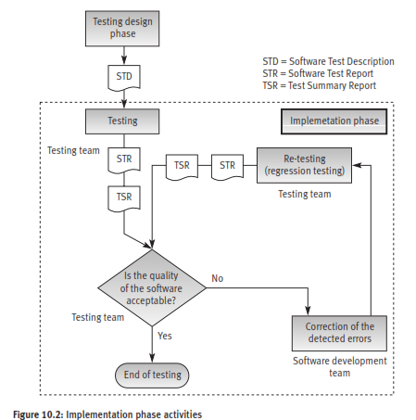

Slide 38
The summary of the set of tests planned for a software package (or software development project) is documented in the “test summary report” (TSR).

Slide 39
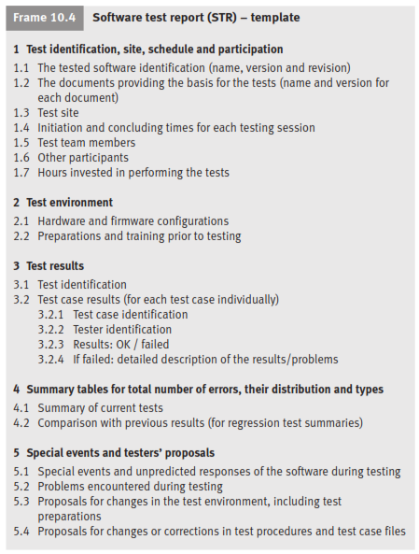

Slide 40
Test case design
Test case data components
A test case is a documented set of the data inputs and operating conditions required to run a test item together with the expected results of the run.
The tester is expected to run the program for the test item according to the test case documentation, and then compare the actual results with the expected results noted in the documents.
If the obtained results completely agree with the expected results, no error is present or at least has been identified. When some or all of the results do not agree with the expected results, a potential error is identified.

Slide 41
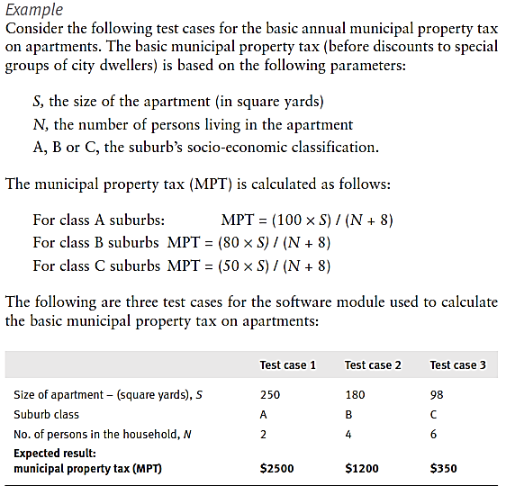

Slide 42
Automated testing
Automated testing represents an additional step in the integration of computerized tools into the process of software development.
These tools have joined computer aided software engineering (CASE) tools in performing a growing share of software analysis and design tasks.

Slide 43
Factors have motivated the development of automated testing tools:
Anticipated cost savings, shortened test duration, heightened thoroughness of the tests performed, improvement of test accuracy, improvement of result reporting as well as statistical processing andsubsequent reporting.

Slide 44
The process of automated testing
Automated software testing requires test planning, test design, test case preparation, test performance, test log and report preparation, re-testing after correction of detected errors (regression tests), and final test log and Report preparation including comparison reports.
The last two activities may be repeated several times.

Slide 45
Types of automated tests
Code auditing : The computerized code auditor checks the compliance of code to specified standards and procedures of coding. The auditor’s report includes a list of the deviations from the standards and a statistical summary of the findings.
Coverage monitoring: Coverage monitors produce reports about the line coverage achieved when implementing a given test case file. The monitor’s output includes the percentage of lines covered by the test cases as well as listings of uncovered lines.
These features make coverage monitoring a vital tool for white-box tests.

Slide 46
Functional tests : Automated functional tests often replace manual black-box correctness tests.
Prior to performance of these tests, the test cases are recorded into the test case database.
The tests are then carried out by executing the test cases through the test program.
The test results documentation includes listings of the errors identified in addition to a variety of summaries and statistics as demanded by the testers’ specifications.

Slide 47
Load tests :The history of software system development contains many sad chapters of systems that succeeded in correctness tests but severely failed – and caused enormous damage – once they were required to operate under standard full load.
The damage in many cases was extremely high because the failure occurred “unexpectedly”, when the systems were supposed to start providing their regular software services.

Slide 48
Test management :Testing involves many participants occupied in actually carrying out the tests and correcting the detected errors.
Testing typically monitors performance of every item on long lists of test case files.
This workload makes timetable follow-up important to management. Computerized test management supports these and other testing management goals.

Slide 49
Advantages of automated tests
Accuracy and completeness of performance.
Accuracy of results log and summary reports.
Comprehensiveness of information.
Few manpower resources required to perform tests.
Shorter duration of testing.
Performance of complete regression tests.
Performance of test classes beyond the scope of manual testing.

Slide 50
Disadvantages of automated testing
High investments required in package purchasing and training.
High package development investment costs.
High manpower requirements for test preparation.
Considerable testing areas left uncovered.

Slide 51
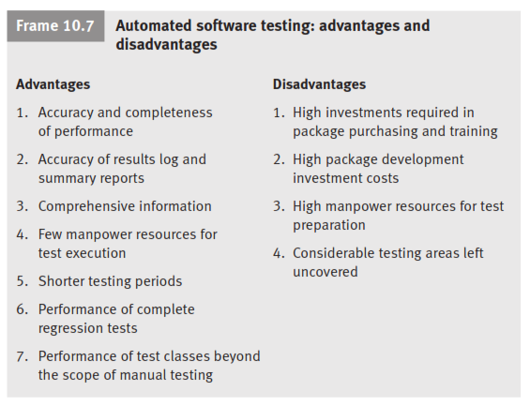

Slide 52
Alpha and beta site testing programs
Alpha site and beta site tests are employed to obtain comments about quality from the package’s potential users.
They are additional commonly used tools to identify software design and code errors in software packages in commercial over-the-counter sale (COTS).

Slide 53
Alpha site tests :“Alpha site tests” are tests of a new software package that are performed at the developer’s site.
Beta site tests : Once an advanced version of the software package is available, the developer offers it free of charge to one or more potential users.
The users install the package in their sites (usually called the “beta sites”), with the understanding that they will inform the developer of all the errors revealed during trials or regular usage.

Slide 54
REGRESSION TESTING TECHNIQUE
Regression testing is used to confirm that fixed bugs have been fixed and that new bugs have not been introduced.
How many cycles of regression testing are required will depend upon the project size. Cycles of regression testing may be performed once per milestone or once per build. Regression tests can be automated.

Slide 55
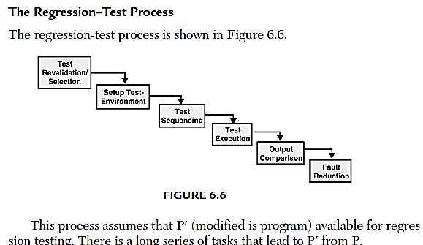

Slide 56
THANK YOU

