Slide 1
BITS Pilani presentation
Dr. Nagesh BS

Slide 2
SE ZG501
Software Quality Assurance and Testing
Lecture No. 1

Slide 3
Software Quality Assurance
SQA Addresses the global challenge of the improvement of software quality.
It seeks to provide an overview of software quality assurance (SQA) practices for customers, managers, auditors, suppliers, and personnel responsible for software projects, development, maintenance, and software services.

Slide 4
In a globally competitive environment, clients and competitors exert a great deal of pressure on organizations.
Clients are increasingly demanding and require, among
other things, software that is of high quality, low cost, delivered quickly, and with impeccable after-sales support.
To meet the demand, quality, and deadlines, the organization must use efficient quality assurance practices for their software activities.

Slide 5
Standards define ways to maximize performance but managers and employees are largely left to themselves to decide how to practically improve the situation.
They face several problems:
  increasing pressure to deliver quality products quickly
  increasing size and complexity of software and of systems
  increasing requirements to meet national, international, and professional standards
  subcontracting and outsourcing
  distributed work teams
  ever changing platforms and technologies.

Slide 6
INTRODUCTION
Software is developed, maintained, and used by people in a wide variety of situations.
Students ,enthusiasts , professionals address quality
problems that arise in the software they are working with
The Guide to the Software Engineering Body of Knowledge (SWEBOK) [SWE 14] constitutes the first international consensus developed on the fundamental knowledge required by all software engineers.

Slide 7
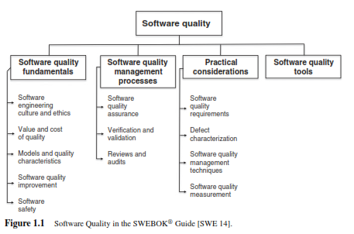

Slide 8
DEFINING SOFTWARE QUALITY
“software,” “software quality,” and “software quality assurance”
Software [ ISO 24765 [ISO 17a] ]
1) All or part of the programs, procedures, rules, and associated documentation of an information processing system.
2) Computer programs, procedures, and possibly associated documentation and data pertaining to the operation of a computer system.

Slide 9
Software found in embedded systems is sometimes called microcode or firmware.
Firmware is present in commercial mass-market products and controls machines and devices used in our daily lives.
Firmware
Combination of a hardware device and computer instructions or computer data that reside as read-only software on the hardware device.

Slide 10
SOFTWARE ERRORS, DEFECTS, AND FAILURES
– The system crashed during production.
– The designer made an error.
– After a review, we found a defect in the test plan.
– I found a bug in a program today.
– The system broke down.
– The client complained about a problem with a calculation in the payment report.
– A failure was reported in the monitoring subsystem.

Slide 11
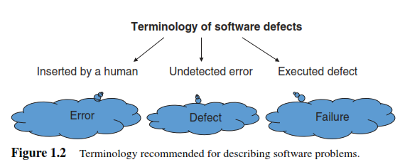

Slide 12
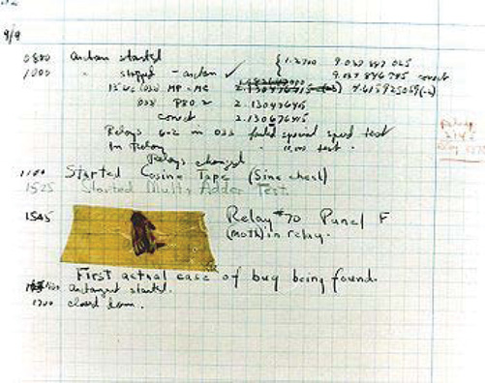

Slide 13
A failure (synonymous with a crash or breakdown) is the execution (or manifestation) of a fault in the operating environment.
A failure is defined as the termination of the ability of a component to fully or partially perform a function that it was designed to carry out.
The origin of a failure lies with a defect hidden, that is,
not detected by tests or reviews, in the system currently in operation.

Slide 14
Defects (synonym of faults) are human errors that were not detected during software development, quality assurance (QA), or testing.
An error can be found in the documentation, the software source code instructions, the logical execution of the code, or anywhere else in the life cycle of the system.

Slide 15
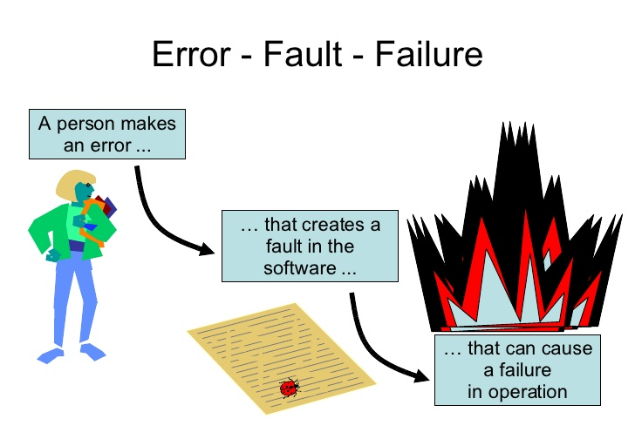

Slide 16
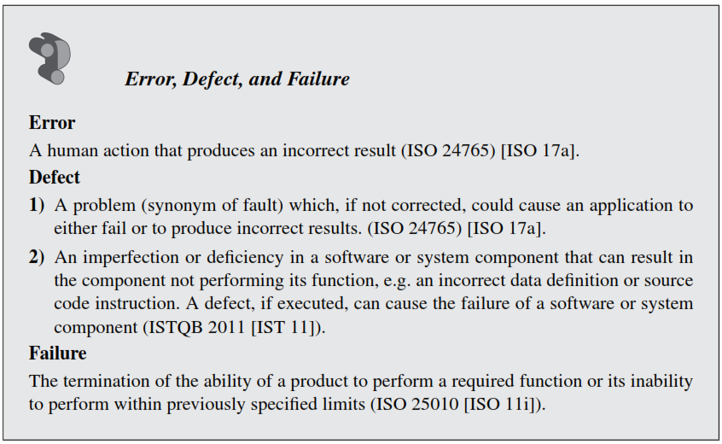

Slide 17
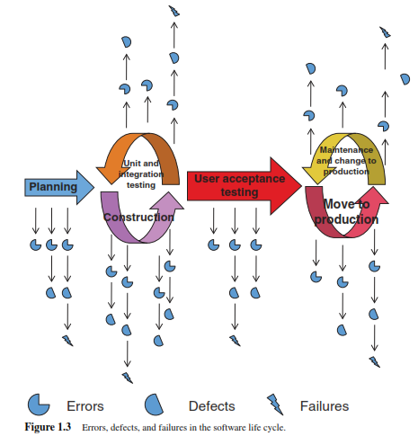

Slide 18
Case 1:
A local pharmacy added a software requirement to its cash register to prevent sales of more than $75 to customers owing more than $200 on their pharmacy credit card.
The programmer did not fully understand the specification and created a sales limit of $500 within the program. This defect never caused a failure since no client could purchase more than $500 worth of items given that the pharmacy credit card had a limit of $400.

Slide 19
Case 2: In 2009, a loyalty program was introduced to the clients of American Signature, a large furniture supplier. The specifications described the following business rules: a customer who makes a monthly purchase that is higher than the average amount of monthly purchases for all customers will be considered a Preferred Customer.
The Preferred Customer will be identified when making a purchase, and will be immediately given a gift or major discount once a month.
The defect introduced into the system (due to a poor understanding of the algorithm to set up for this requirement) involved only taking into account the average amount of current purchases and not the customer’s monthly history. At the time of the software failure, the cash register was identifying far too many Preferred Clients, resulting in a loss for the company.

Slide 20
Development Life Cycle
Software life cycle process that contains the activities of requirements analysis, design, coding, integration, testing, installation, and support for acceptance of software products.

Slide 21
Depending on the business model of your organization, you will have to allow for varying degrees of effort in identifying and correcting defects.
Airbus, Boeing, Bombardier, and Embraer to have
identified and corrected all the defects in the software for their airplanes before we board them!

Slide 22
Research Studies have come to the following
conclusions:
– The scope of most defects is very limited and easy to correct.
– Many defects occur outside of the coding activity (e.g., requirement, architecture activities).
– Poor understanding of the design is a recurrent problem in programming error studies.
– It is a good idea to measure the number and origin of defects in your organization to set targets for improvement.

Slide 23
SQA need to develop a classification of the
causes of software error by category.
1) problems with defining requirements;
2) maintaining effective communication between client and developer;
3) deviations from specifications;
4) architecture and design errors;
5) coding errors (including test code);
6) non-compliance with current processes/procedures;
7) inadequate reviews and tests;
8) documentation errors.

Slide 24
SOFTWARE QUALITY
Conformance to established software requirements; the capability of a software product to satisfy stated and implied needs when used under specified conditions.
The degree to which a software product meets established requirements; however, quality depends upon the degree to which those established requirements accurately represent stakeholder needs, wants, and expectations

Slide 25
SOFTWARE QUALITY ASSURANCE
Software Engineering
The systematic application of scientific and technological knowledge, methods, and experience for the design, implementation, testing, and documentation of software.
Quality Assurance
  1) a planned and systematic pattern of all actions necessary to provide adequate confidence that an item or product conforms to established technical requirements;
  2) a set of activities designed to evaluate the process by which products are developed or manufactured;
  3) the planned and systematic activities implemented within the quality system, and demonstrated as needed, to provide adequate confidence that an entity will fulfil requirements for quality.

Slide 26
Software Quality Assurance
Definition
A set of activities that define and assess the adequacy of software processes to provide evidence that establishes confidence that the software processes are appropriate for and produce software products of suitable quality for their intended purposes.
A key attribute of SQA is the objectivity of the SQA function with respect to the project.
The SQA function may also be organizationally independent of the project; that is, free from technical, managerial, and financial pressures from the project.

Slide 27
SQA Elements
The need to plan the quality aspects of a product or service;
Systematic activities that tell us, throughout the software life cycle, that certain corrections are required;
The quality system is a complete system that must, in the context of quality management, allow for the setting up of a quality policy and continuous improvement;
QA techniques that demonstrate the level of quality reached so as to instill confidence in users; and lastly,
Demonstrate that the quality requirements defined for the project, for the change or by the software department have been met.

Slide 28
BUSINESS MODELS AND THE CHOICE OF
SOFTWARE ENGINEERING PRACTICES
Business Model
A business model describes the rationale of how an organization creates, delivers, and captures value (economic, social, or other forms of value).
The essence of a business model is that it defines the manner by which the business enterprise delivers value to customers, entices customers to pay for value, and converts those payments to profit.

Slide 29
Choice of Software Practices
As expected, people from different business sectors chose software engineering practices that would lower the probability of their worst fears(quality and deadlines).
Since their apprehensions are different, their practices are also different.

Slide 30
SUCCESS FACTORS
Foster Software Quality
1) SQA techniques adapted to the environment.
2) Clear terminology with regards to software problems.
3) An understanding and specific attention to each major category of software error sources.
4) An awareness of the SQA body of knowledge of the SWEBOK as a guide for SQA.

Slide 31
Factors that may Adversely Affect Software Quality
1) A lack of cohesion between SQA techniques and environmental factors in your organization.
2) Confusing terminology used to describe software problems.
3) A lack of understanding or interest for collecting information on software error sources.
4) Poor understanding of software quality fundamentals.
5) Ignorance or non-adherence with published SQA techniques.

Slide 32
Software quality assurance vs. software quality control
Quality control is defined as “a set of activities designed to evaluate the quality of a developed or manufactured product”
The main objective of quality assurance is to minimize the cost of guaranteeing quality by a variety of activities performed throughout the development and manufacturing processes/stages.
These activities prevent the causes of errors, and detect and correct them early in the development process.
Quality assurance activities substantially reduce the rate of products that do not qualify for shipment and, at the same time, reduce the costs of guaranteeing quality in most cases.

Slide 33
The objectives of SQA activities
Software development (process-oriented):
Software maintenance (product-oriented):

Slide 34
Software development (process-oriented):
  1. Assuring an acceptable level of confidence that the software will conform to functional technical requirements.
  2. Assuring an acceptable level of confidence that the software will conform to managerial scheduling and budgetary requirements.
  3. Initiating and managing of activities for the improvement and greater efficiency of software development and SQA activities. This means improving the prospects that the functional and managerial requirements will be achieved while reducing the costs of carrying out the software development and SQA activities.

Slide 35
Software maintenance (product-oriented):
  1. Assuring with an acceptable level of confidence that the software maintenance activities will conform to the functional technical requirements.
  2. Assuring with an acceptable level of confidence that the software maintenance activities will conform to managerial scheduling and budgetary requirements.
  3. Initiating and managing activities to improve and increase the efficiency of software maintenance and SQA activities. This involves improving the prospects of achieving functional and managerial requirements while reducing costs.

Slide 36
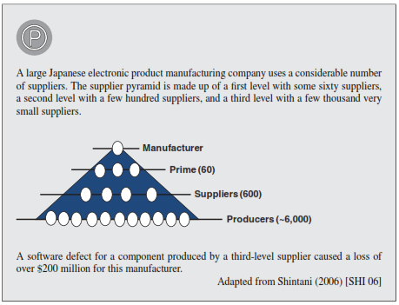
Quality Culture

Slide 37
Setting up a quality culture and software quality assurance (SQA) principles, as stipulated in the standards, could help solve these problems.
Quality, influenced by organization’s senior management
and the organization’s culture, has a cost, has a positive effect on profits, and must be governed by a code of ethics.

Slide 38
COST OF QUALITY
One of the major factors that explains the resistance to implementing quality assurance is the perception of its high cost.
As software engineers, responsible for informing administrators of the risks that a company takes when not fully committed to the quality of its software.
A practical manner of beginning the exercise is to identify the costs of non-quality.
It is easier to identify potential savings by studying the problems caused by software.

Slide 39
Costs of a project
Implementation costs
Prevention costs
Appraisal costs
The costs associated with failures or anomalies.

Slide 40
If all development activities are error free, then 100% of costs could be implementation costs.
Given that we make mistakes, we need to be able to identify them. The costs of detecting errors are appraisal costs (e.g., testing).
Costs due to errors are anomaly costs.
When we want to reduce the cost of anomalies, we invest in training, tools, and methodology. These are prevention costs.

Slide 41
The “cost of quality” is not calculated in the same way in all organizations.
There is a certain amount of ambiguity between the notion of the cost of quality, the cost of non-quality, and the cost of obtaining quality.
Most commonly used model at this time, costs of quality take into account the following five perspectives:
(1) prevention costs, (2) appraisal costs, (3–4) failure costs (internal during development, external on the client’s premises), and (5) costs associated with warranty claims and loss of reputation caused by non-quality.

Slide 42
calculation of the cost of
quality in this model is as follows:
      Quality costs = Prevention costs
      + Appraisal or evaluation costs
      + Internal and external failure costs
      + Warranty claims and loss of reputation costs

Slide 43
Prevention costs: This is defined as the cost incurred by an organization to prevent the occurrence of errors in the various steps of the development or maintenance process.
  For example, the cost of training employees, the cost of maintenance to ensure a stable manufacturing process, and the cost of making improvements.
Appraisal costs: The cost of verifying or evaluating a product or service during the different steps in the development process. Monitoring system costs (their maintenance and management costs).

Slide 44
Internal failure costs: The cost resulting from anomalies before the product or service has been delivered to the client. Loss of earnings due to non-compliance (cost of making changes, waste, additional human activities, and the use of extra products).
External failure costs: The cost incurred by the company when the client discovers defects. Cost of late deliveries, cost of managing disputes with the client, logistical costs for storing the replacement product or for delivery of the product to the client.
Warranty claims and loss of reputation costs: Cost of warranty execution and damage caused to a corporate image as well as the cost of losing clients.

Slide 45
The first objective of the SQA is to convince management that there are proven benefits to SQA activities.
“identifying an error early in the process can save a lot of time, money and effort.”

Slide 46
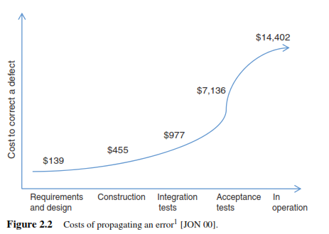

Slide 47
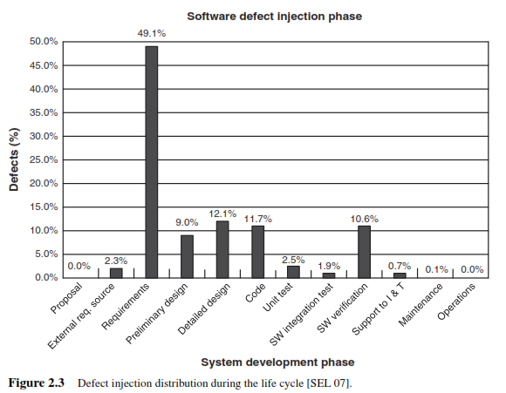

Slide 48
QUALITY CULTURE
Tylor [TYL 10] defined Human Culture as
“that complex whole which includes knowledge, belief, art, morals, law, custom, and any other capabilities and habits acquired by man as a member of society.”
It is culture that guides the behaviors, activities, priorities, and decisions of an individual as well as of an organization.

Slide 49
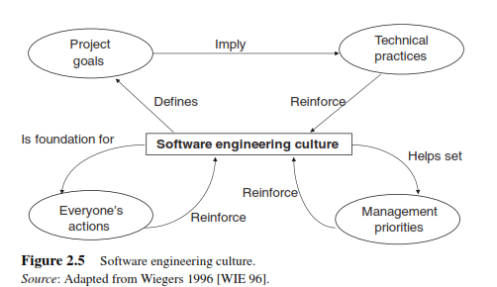
Wiegers (1996) [WIE 96], in his book “Creating a Software Engineering Culture,” illustrates the interaction between the software engineering culture of an organization, its software engineers, and its projects

Slide 50
A healthy culture is made up of the following elements:
The personal commitment of each developer to create quality products by systematically applying effective software engineering practices.
The commitment to the organization by managers at all levels to provide an environment in which software quality is a fundamental factor of success and allows each developer to carry out this goal.
The commitment of all team members to constantly improve the processes they use and to always work on improving the products they create.

Slide 51
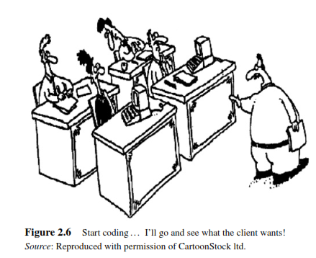

Slide 52
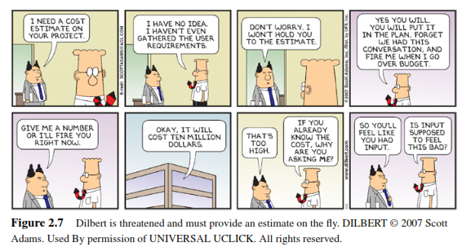

Slide 53
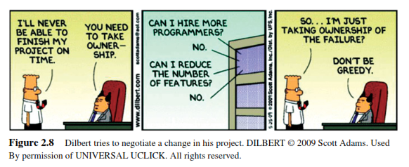

Slide 54
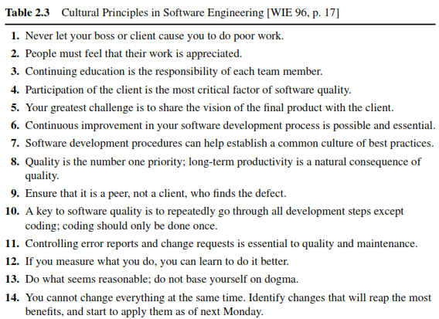
Fourteen principles to follow to develop a culture that fosters quality

Slide 55
THE SOFTWARE ENGINEERING CODE OF ETHICS
The first draft of the software engineering code of ethics was developed in cooperation with the Institute of Electrical and Electronics Engineers (IEEE) Computer Society and the Association for Computing Machinery (ACM)

Slide 56
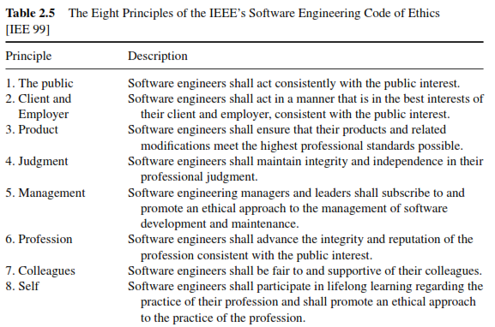

Slide 57
Role of SQA in software development life cycle
The Software Development Life Cycle is split into six main phases.
1. Planning
2. Design
3. Implementation
4. Testing
5. Deployment
6. Maintenance

Slide 58
In the planning phase of a software project, Quality Assurance is responsible for making sure that the project meets all quality requirements, such as scope, budget, timeline, and compliance with standards.
QA can also review user requirements and analyze them to determine if they fit within the scope of the project. This helps ensure that expectations are properly set at the beginning of a project, and that resources are allocated appropriately.

Slide 59
QA is involved in the design phase, they can identify aspects of the design that might cause problems ,while they’re still in-progress. This enables the designer or wireframes creator to make changes on the fly.
The role QA plays in the implementation stage:
  Code Reviews
  System Integration Testing
  User Acceptance Testing

Slide 60
The Role of QA in Testing
QA focuses on various aspects, such as functionality, usability, reliability, performance, and compliance with industry standards. In order to ensure that the requirements of the application are met before it is released to its users.
The Role of QA in Deployment
In deployment stage QA ensures that all the elements of specific Custom software development and its properly implemented, tested, verified, and deployed. This allows the product to be released with confidence and without any issues or bugs.

Slide 61
The Role of QA in Maintenance
  Verifying software updates to confirm they are working properly
  Testing changes to make sure they are as expected
  Identifying potential problems with updates
  Following up with customers to ensure they are satisfied with changes and updates
  Documenting all issues related to releases, so that future versions can be improved upon accordingly.
  By investing in QA during maintenance, companies can be sure their products remain reliable and bug-free for customers for the long haul!

Slide 62
THANK YOU

