Slide 1
Hough Transform CEC 495A David Olson

Slide 2
Presentation Outline
Motivation and Purpose
Hough Transform Process
MATLAB Implementation Example
Research Use for Qbot 2

Slide 3
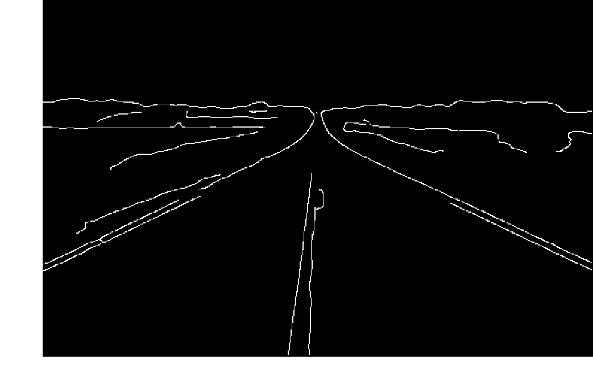

Why use a Hough Transform?

Slide 4
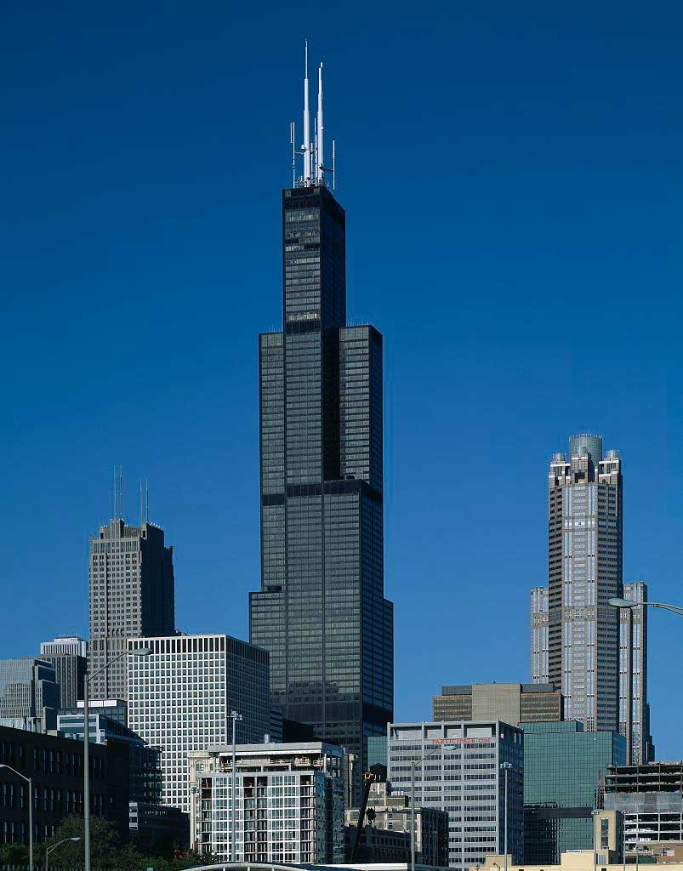
Hough Transform Definition
Hough Transforms is a feature extraction technique which can detect and parameterize shapes within an image. These shapes can be lines, circles, and many others.

Slide 5
Hough Transform Process Overview
Points in “xy” space are transformed into the Hough space given a certain parameterization.
Intersections of lines in the Hough Space occur as more points are brought into the Hough Space.
The location of intersecting lines provide the slope and y-intercept for the “xy” space.

Slide 6
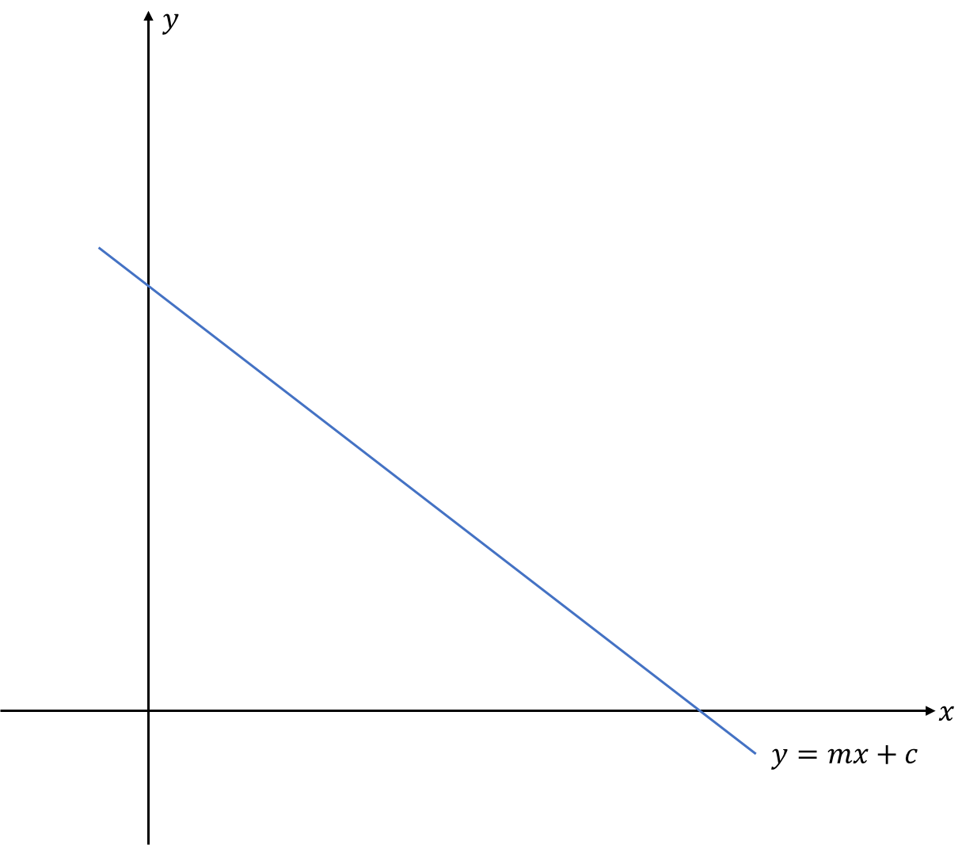
Parameterizing the Hough Transform
Straight lines are normally parameterized with a slope and a y-intercept.
When would this parameterization fail?
What are some alternatives to the slope and y-intercept parameterization?

Slide 7
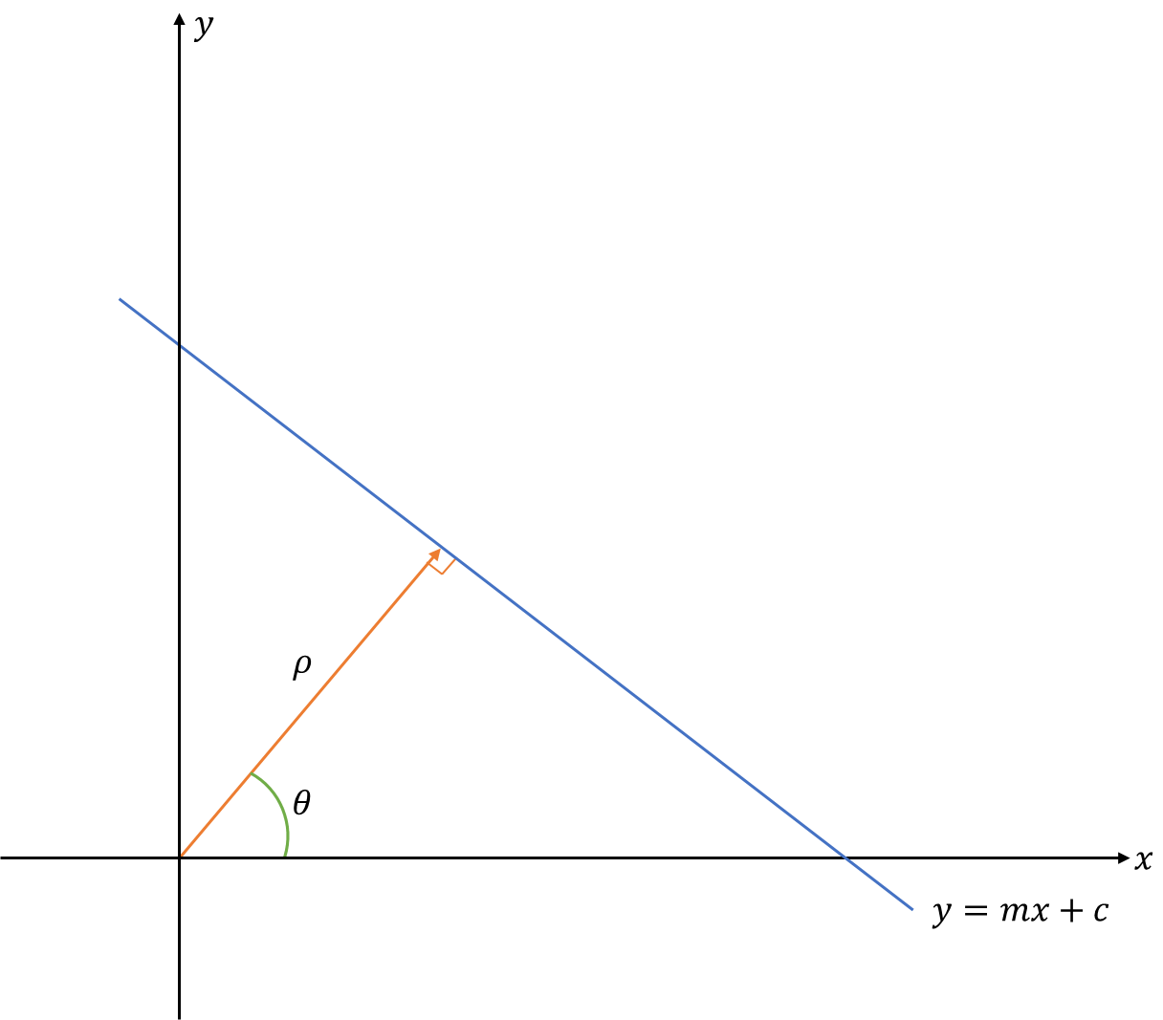
Rho and Theta Parameterization
Rho – Distance of line perpendicular to the line of interest
Theta – Angle from X-axis up to the perpendicular line

Slide 8
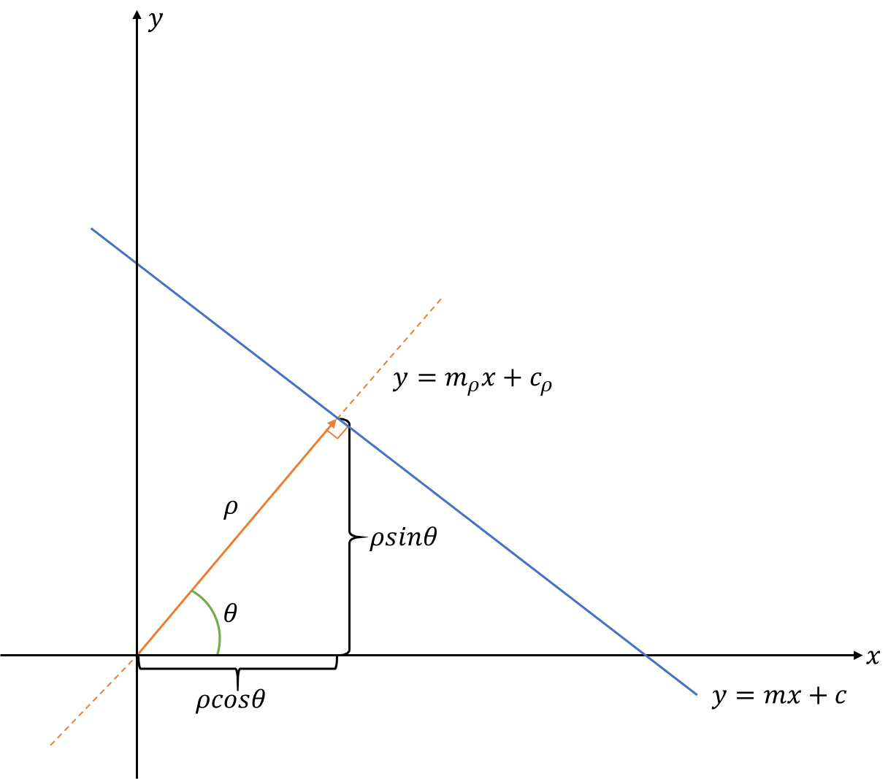


Parameterizing Slope
$$m_{ρ}= \frac{ρsinθ}{ρcosθ}=tanθ$$
$$m=\frac{−1}{m_{ρ}} ∴m=−cotθ$$

Slide 9
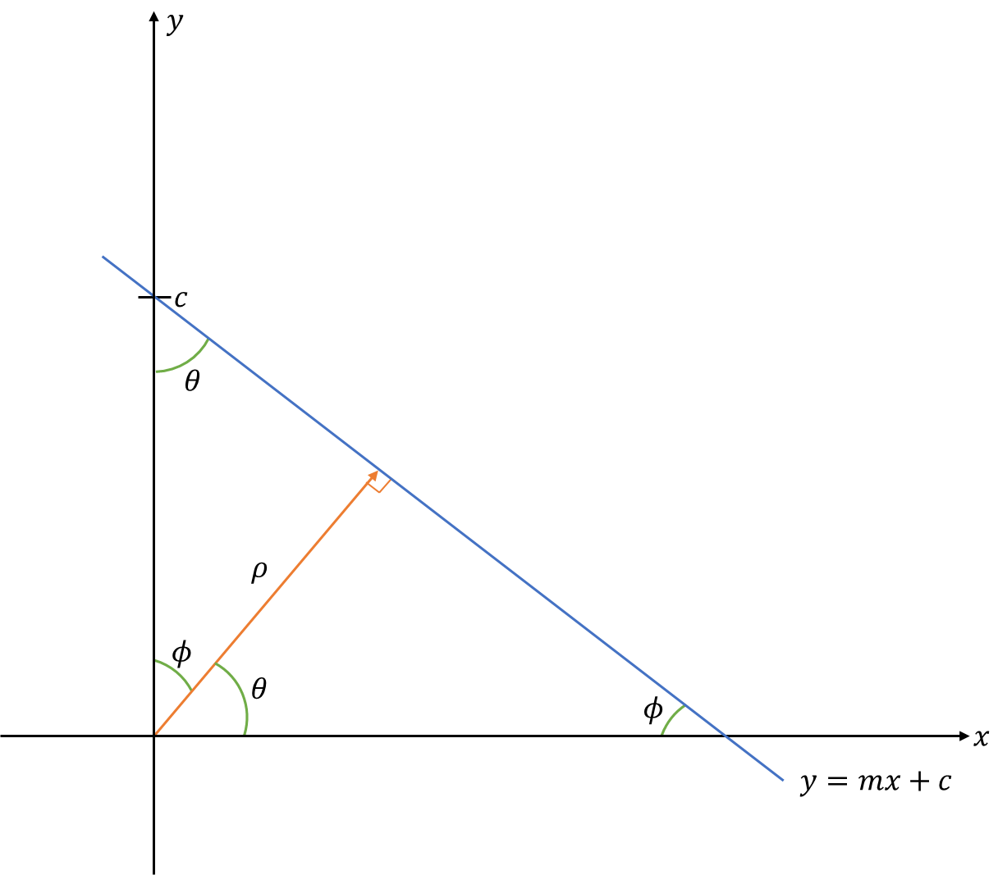


Parameterizing Y-Intercept
$$θ+φ=90°$$
$$ρ=c∙sinθ ∴c= \frac{ρ}{sinθ}$$

Slide 10
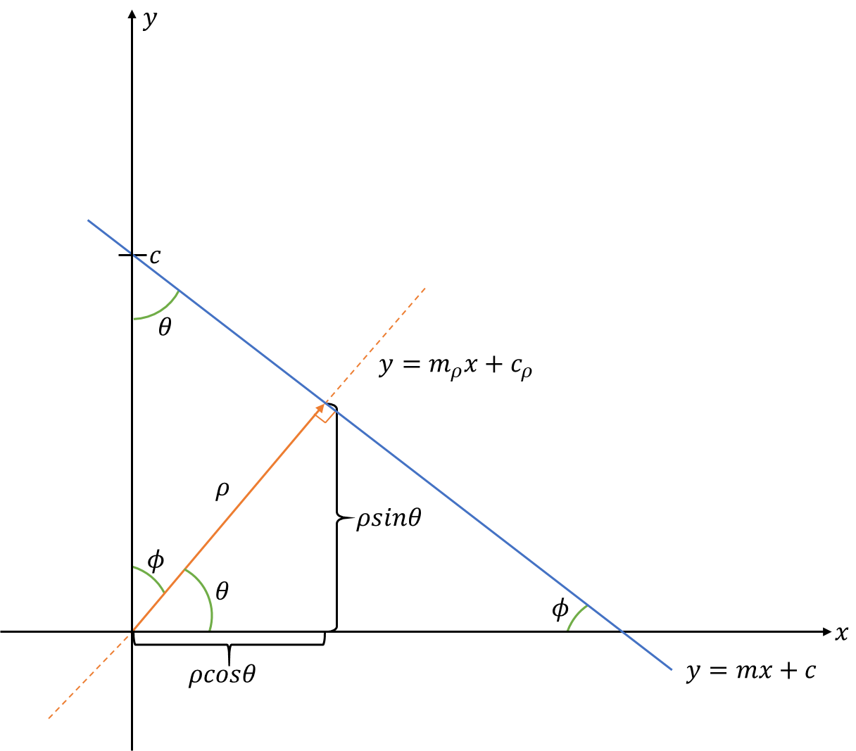




Complete Parameterization
$$y=mx+c$$
$$y=−cotθ∙x+\frac{ρ}{sinθ}$$
$$\frac{ρ}{sinθ}=cotθ∙x+y$$
$$ρ=cosθ x+sinθ y$$

Slide 11




XY Space to Hough Space
$$y$$
$$ρ$$
$$x$$
$$θ$$

Slide 12
MATLAB Example
Go to MATLAB for Example

Slide 13
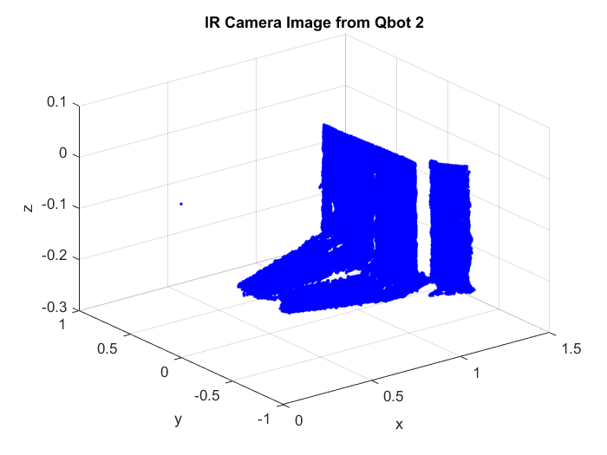
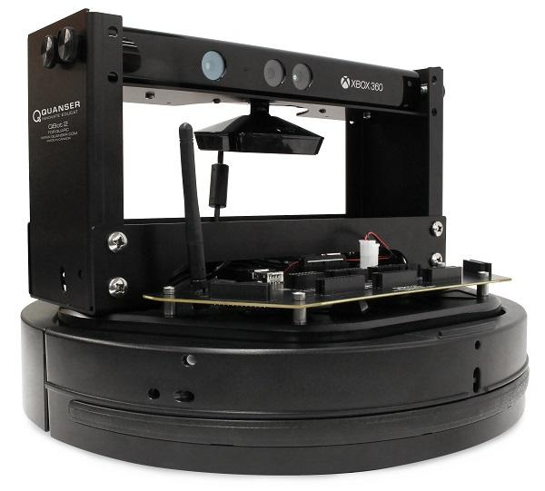
Research Use for Qbot 2

Slide 14
Conclusion
Motivation and Purpose
Hough Transform Process
MATLAB Implementation Example
Research Use for Qbot 2

