Slide 1
Capstone Project - The Battle of Neighborhoods Thai restaurant By Dhiwa Kosittirachart

Slide 2
Introduction
Thai immigrants to Canada are primarily well-educated professionals working as bankers, dentists, doctors, nurses, computer technicians and engineers. Many of them closed businesses such as Thai restaurants or Muay Thai gyms, which has become popular in Canada.
Thai cooking places emphasis on lightly prepared dishes with strong aromatic components and a spicy edge. Thai chef McDang characterises Thai food as demonstrating "intricacy; attention to detail; texture; color; taste; and the use of ingredients with medicinal benefits, as well as good flavor", as well as care being given to the food's appearance, smell and context.
So as part of this project, we will list and visualize all major parts of Toronto that has popular Thai restaurants.

Slide 3
Data
For this project we need the following data :
Toronto,CA data that contains list Boroughs, Neighborhoods along with their latitude and longitude.
Data source : https://en.wikipedia.org/wiki/List_of_postal_codes_of_Canada:_M and get latitude,longitude from https://cocl.us/Geospatial_data'
Description : This data set contains the required information. And we will use this data set to explore various neighborhoods of new york city.
Thai resturants in each neighborhood of Toronto city.
Data source : Fousquare API
Description : By using this api we will get all the venues in each neighborhood. We can filter these venues to get only indian resturants.
GeoSpace data
Data source : Generating GeoJSON File for Toronto FSAs https://medium.com/dataexplorations/generating-geojson-file-for-toronto-fsas-9b478a059f04
Description : By using this geo space data we will get the Toronto Borough boundaries that will help us visualize choropleth map.

Slide 4
Approach
Collect the postal code,borough,neighborhood of Toronto city data from wikipedia
Collect latitude,longitude data from https://cocl.us/Geospatial_data
Using FourSquare API we will find all venues for each neighborhood.
Filter out all venues that are Thai Resturants.
Find rating , tips and like count for each Thai Resturants using FourSquare API.
Using rating for each resturant , we will sort that data.
Visualize the Ranking of neighborhoods using folium library(python)

Slide 5
Defined the problems
As a Thai food business, seeing the picture in business for Thai restaurants, so we would like to find out about the business -Best Places in Toronto city for Thai cuisine -which areas have the potential to market for Thai Restaurant -which is the best place to stay if I like Thai food
Stackholde
- Owner Thai Cuisine. - Some one who want to eat Thai Food.

Slide 6
Analysis
We will import the required libraries for python.
pandas and numpy for handling data.
request module for using FourSquare API.
folium to visualize the results on a map

Slide 7
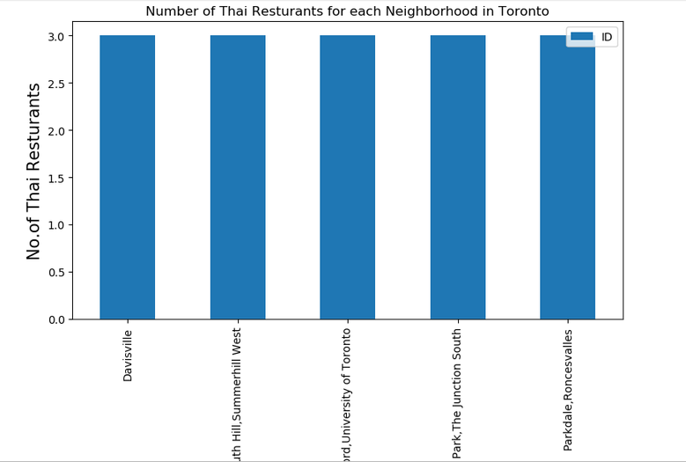
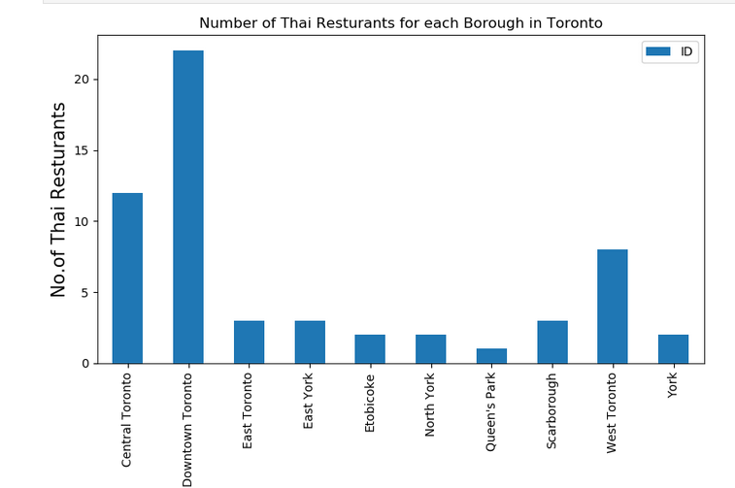
In Toronto have 58 Thai. Restaurants but the most number of Thai restaurantsa is at Down Town and it have similarity number for each borough.

Slide 8
Results form foursquare API
# Resturant with maximum Tips
Borough Downtown Toronto
Neighborhood Adelaide,King,Richmond
ID 529612de11d2ab526191ccc9
Name Pai
Likes 635
Rating 9.3
Tips 193
Postcodd M5H
latitude 43.7067
longitude -79.5941
# Resturant with maximum Rating
Borough Downtown Toronto
Neighborhood Adelaide,King,Richmond
ID 529612de11d2ab526191ccc9
Name Pai
Likes 635
Rating 9.3
Tips 193
Postcodd M5H
latitude 43.7067
longitude -79.5941
# Resturant with maximum Likes
Borough Downtown Toronto
Neighborhood Ryerson,Garden District
ID 4ad4c061f964a52095f720e3
Name Salad King
Likes 489
Rating 8.5
Tips 207
Postcodd M5B
latitude 43.7067
longitude -79.5941
In Downtown Toronto is maximum Tips, Like , rating from foursquare API to show “Pai” is popularity Thai restuarant in Tonronto.

Slide 9
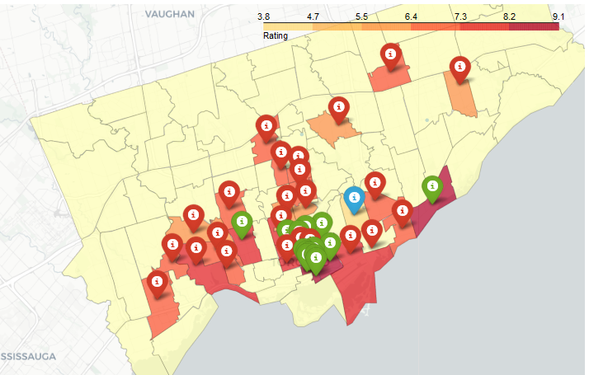
Visualize the Data
Now that we have visualized the Neighborhoods. In green maker show the Restaurants is rating between 8-9 point in Red maker show the Restaurants is Rating Between 0-7 Point
And Others show in blue point

Slide 10
Conclusion
The best place to run the Thai food business is located in the Down Town area in Toronto, as it is considered rating, which means a lot of people who have been eating Thai food, heading Down to Down Town, to go to those Thai cuisine.
Limitations
The ranking is purely on basis of rating of restaurants
The accuracy of data depends purely depends on the data provided by FourSquare

