Slide 1
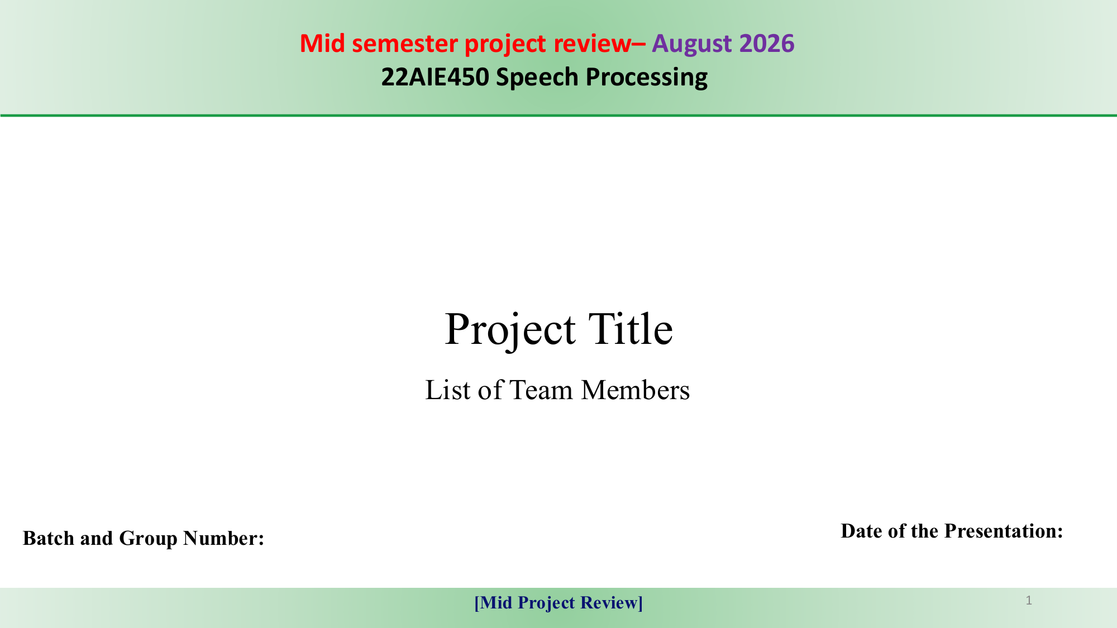
Multimodal Speech Biomarker Fusion using Conversational Dynamics and Deep Acoustic Representations for Automated Alzheimer's Dementia Recognition
Final Project Technical Presentation | Course Code: 22AIE450 Speech Processing
Divagar S
Roll No: CB.SC.U4AIE23223
Focus: Gated Fusion, Multi-Task Loss & XAI
Abhishek Pandey
Roll No: CB.SC.U4AIE23205
Focus: Audio Preprocessing, VAD & Timing
Prem
Roll No: CB.SC.U4AIE23241
Focus: 123 Acoustic Biomarkers & Error Analysis
Department of Artificial Intelligence and Data Science | Amrita Vishwa Vidyapeetham, Coimbatore
Batch: 2023–2027 | Date of Presentation: October 2026

Slide 2
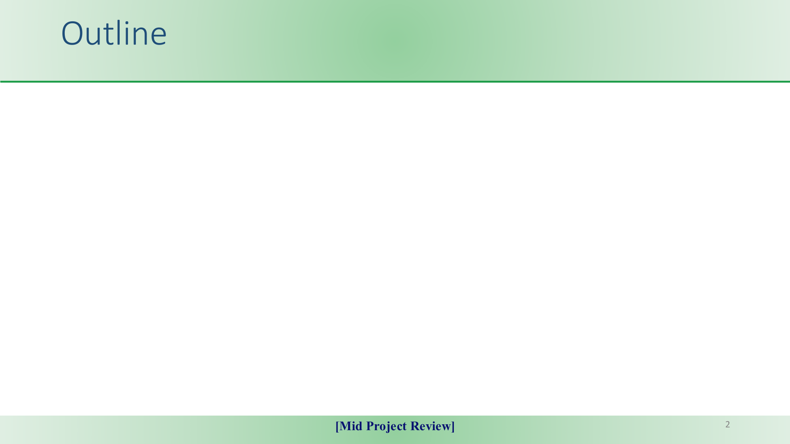
01. Introduction & Motivation
Global dementia burden, diagnostic hurdles, and neurobiology of speech breakdown.
02. Problem Definition
Transcription bottlenecks, early fusion failure, and data leakage in existing literature.
03. Literature Review & Gaps
Systematic review of 5 key papers (IS2021, ICASSP, IEEE) and 4 critical technical gaps.
04. Project Objectives
Audio-only screening, 15 timing biomarkers, Dynamic Gated Fusion, and XAI.
05. Methodology & Architecture
Signal preprocessing, 3 feature streams (123+512+15), Multi-Task Learning framework.
06. Dataset Description
Interspeech 2021 ADReSSo benchmark (166 recordings: 87 AD, 79 CN), Cookie Theft task.
07. Results & Discussion
80.16% Acc, 0.8572 AUC, baseline comparisons, ablation matrix, and SHAP/LIME XAI.
08. Conclusion & Contributions
Summary of clinical breakthroughs, team division of work, and deployment roadmap.

Slide 3
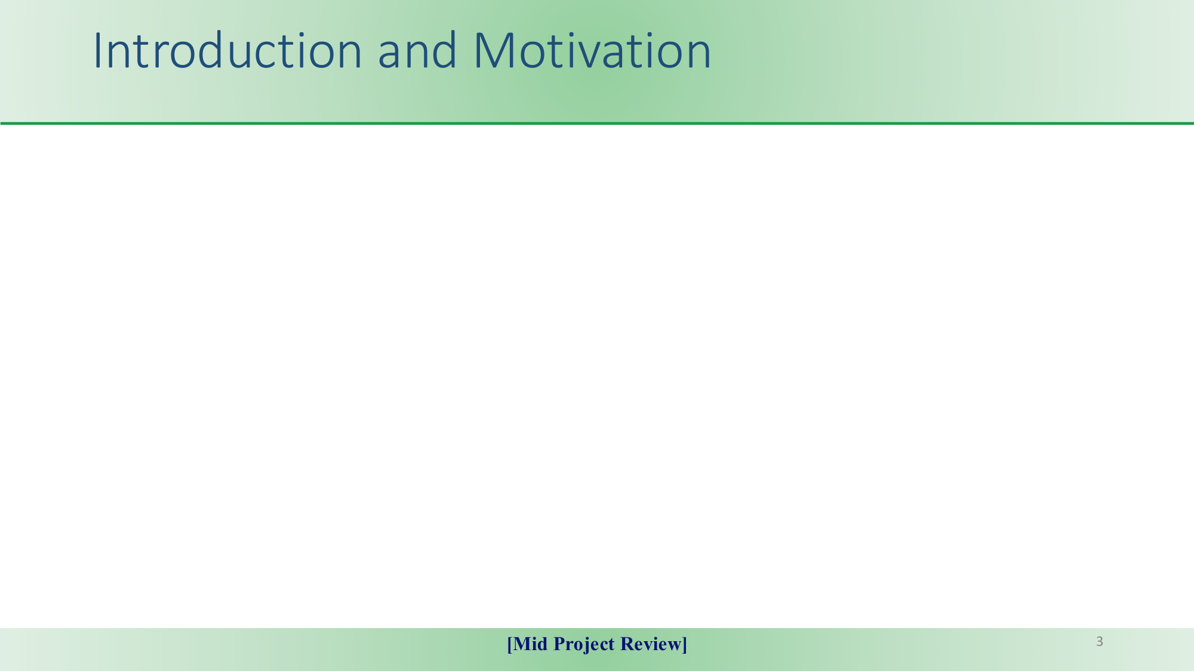
Clinical Motivation & Diagnostic Hurdles
• Epidemic Scale: Alzheimer's Disease (AD) accounts for 60%–70% of dementia worldwide. WHO projects >139 million cases by 2050.
• Invasive Clinical Pathways: Gold-standard diagnosis relies on PET imaging ($3,000+), MRI, and lumbar puncture CSF assays for amyloid/tau.
• Logistical Bottlenecks: Cost-prohibitive, geographically concentrated in specialized memory clinics, and often administered late after irreversible neuronal loss.
• Subjective Bias: Cognitive assessments (MMSE, MoCA) suffer from examiner subjectivity and test-retest learning effects.
• Urgent Imperative: Need for passive, scalable, non-invasive digital screening modalities deployable in primary care and telemedicine.
Neurobiology of Speech Breakdown in AD
• High Cognitive Bandwidth: Spontaneous speech requires synchronized semantic retrieval, working memory, and rapid motor articulation.
• Wernicke's & Temporoparietal Degeneration: Neurofibrillary tau impairs lexical access, triggering anomia, circumlocution, and extended unfilled hesitation pauses.
• Hippocampal & Medial Temporal Atrophy: Working memory lapses cause patients to lose their train of thought, drastically increasing overall silence ratio (R_sil).
• Frontal Motor Speech Degradation: Loss of fine articulatory control results in pitch monotonicity (reduced F0 variability), vocal tremor, and reduced Harmonics-to-Noise Ratio (HNR).
• Diagnostic Window: Acoustic and conversational timing anomalies manifest years before gross physical motor impairment.

Slide 4
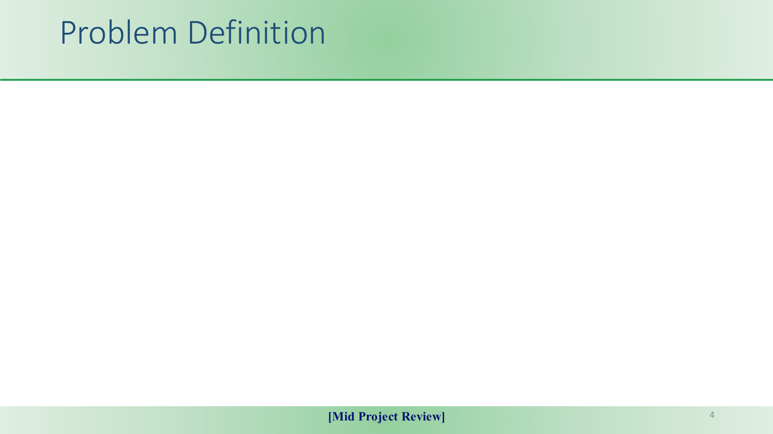
Core Problem Statement:
How can we achieve highly accurate, fully automated Alzheimer's Dementia recognition directly from spontaneous raw speech without manual text transcripts, while avoiding dimensionality collapse and data leakage?
Challenge 1: ASR Error Cascade
Existing high-performing models depend on manual text transcripts. Automated Speech Recognition (ASR) on elderly, dysarthric speech yields Word Error Rates (WER) of 30%–45%, which corrupt downstream NLP models.
Challenge 2: Overlooked Diarization Dynamics
Standard speech models treat conversations as single audio streams, blending the acoustic features of healthy clinicians with cognitively impaired patients and severely corrupting the diagnostic signal.
Challenge 3: Early Fusion Bottleneck
Naively concatenating 123 physical acoustic features with 512 deep embeddings creates a 650-dim space where high-variance spectral bins overpower gradients, completely suppressing 15 vital timing biomarkers.
Challenge 4: Pervasive Data Leakage
Many published studies claim 95%–100% accuracy due to preprocessing, feature scaling, or selection across entire datasets prior to cross-validation splits, resulting in non-generalizable clinical failures.

Slide 5
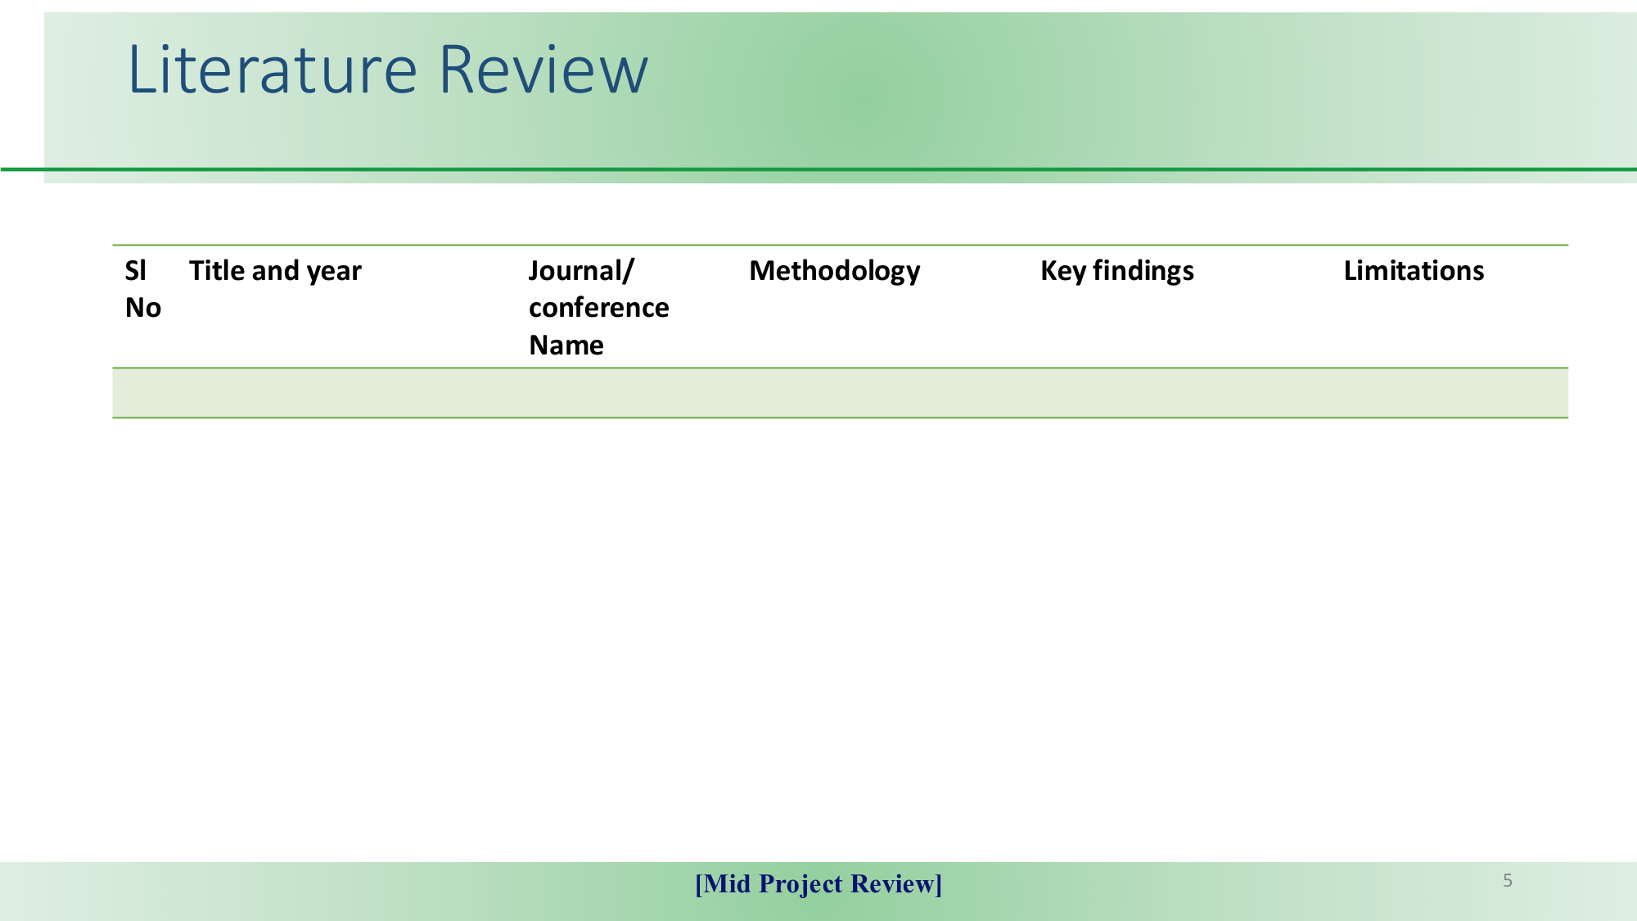
Sl No | Title & Year | Journal / Conf. | Methodology | Key Findings | Limitations
1 | The ADReSSo Challenge (Luz et al., 2021) | Proc. Interspeech 2021 | eGeMAPS acoustic feature sets (88-dim) + SVM classifier. | Official acoustic baseline achieved 65.10% accuracy; Multimodal ASR+text reached 78.87%. | Acoustic-only models underperformed; Multimodal baseline required text transcripts.
2 | Wav2Vec 2.0 Representations (Papasavvas et al., 2021) | Proc. IEEE ICASSP 2021 | Pretrained self-supervised audio representations fine-tuned on raw waveforms. | Reached 78.20% accuracy directly from raw audio, surpassing handcrafted descriptors. | Computationally heavy, high parameter count; decisions lack explainability for clinicians.
3 | Comparing Speech & Language (Balagopalan et al., 2020) | Proc. Interspeech 2020 | Comparative study of acoustic features vs pretrained BERT linguistic embeddings. | Text embeddings derived from manual transcripts achieved strong diagnostic accuracy. | Dependent entirely on manual text transcripts; highly vulnerable to ASR transcription errors.
4 | Paralinguistic Acoustic Features (Haider et al., 2020) | IEEE JSTSP Vol. 14, 2020 | Extensive empirical assessment of eGeMAPS, ComParE, and MRC psycholinguistic features. | Proved pause-to-speech ratio and pitch dynamics are most discriminative biomarkers. | Processed audio as continuous streams without clinician-patient speaker diarization.
5 | Automated Dialogue Analysis (Mirheidari et al., 2019) | Computer Speech & Language, 2019 | Turn-taking latencies and conversational interaction analysis in memory clinics. | Interaction parameters differentiated dementia patients comparable to expert clinicians. | Small cohort size; evaluated only conversational timing without deep continuous spectral fusion.

Slide 6
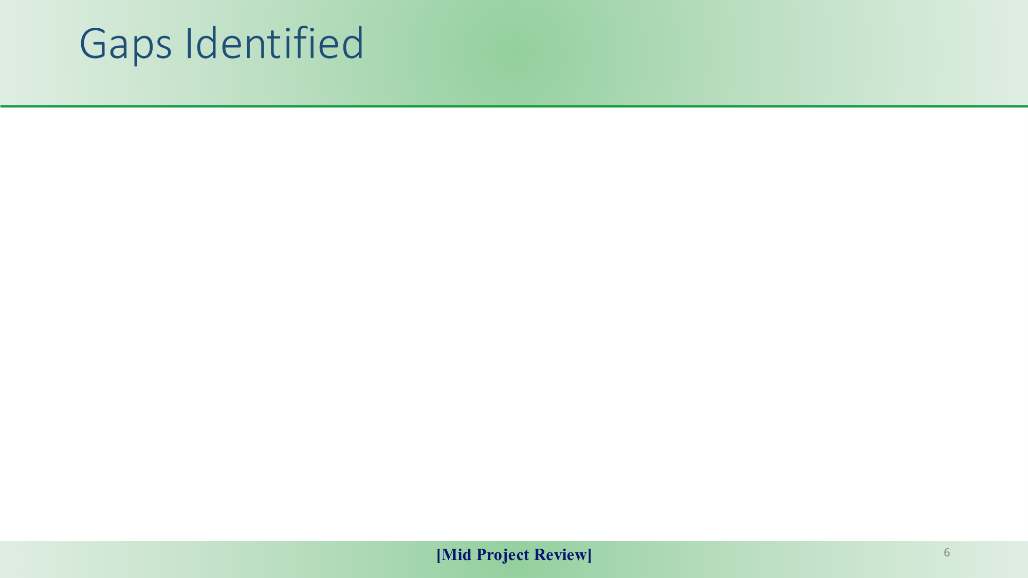
[GAP 1] Cascading ASR Transcription Vulnerability
Existing top-performing pipelines depend on manual transcripts or high-resource NLP models. Applying off-the-shelf ASR to cognitively impaired elderly speech yields high Word Error Rates (30%–45%), propagating catastrophic errors into classification.
✔ Our Solution: Complete audio-only processing eliminating text dependencies.
[GAP 2] Neglect of Conversational Turn Diarization
Most acoustic frameworks analyze entire recordings as uniform streams, blindly combining clinician prompts with patient speech. This averages out subtle cognitive pauses and distorts hesitation markers.
✔ Our Solution: Diarization-based extraction isolating 15 participant hesitation biomarkers.
[GAP 3] Early Fusion Dimensionality & Scale Collapse
Directly concatenating low-dimensional acoustics (123) with high-dimensional deep embeddings (512+) produces severe gradient dominance by high-variance spectral bins, drowning out vital timing features.
✔ Our Solution: Dynamic Multimodal Gated Fusion weighting calibrated posterior probabilities.
[GAP 4] Prevalent Data Leakage in Academic Benchmarks
Several published works claim artificially high accuracies (>95%) by fitting normalizers, selecting features, or performing SMOTE augmentation across the entire dataset before establishing validation splits.
✔ Our Solution: Strict in-fold standardizers fit strictly on training partitions across 5 folds.

Slide 7
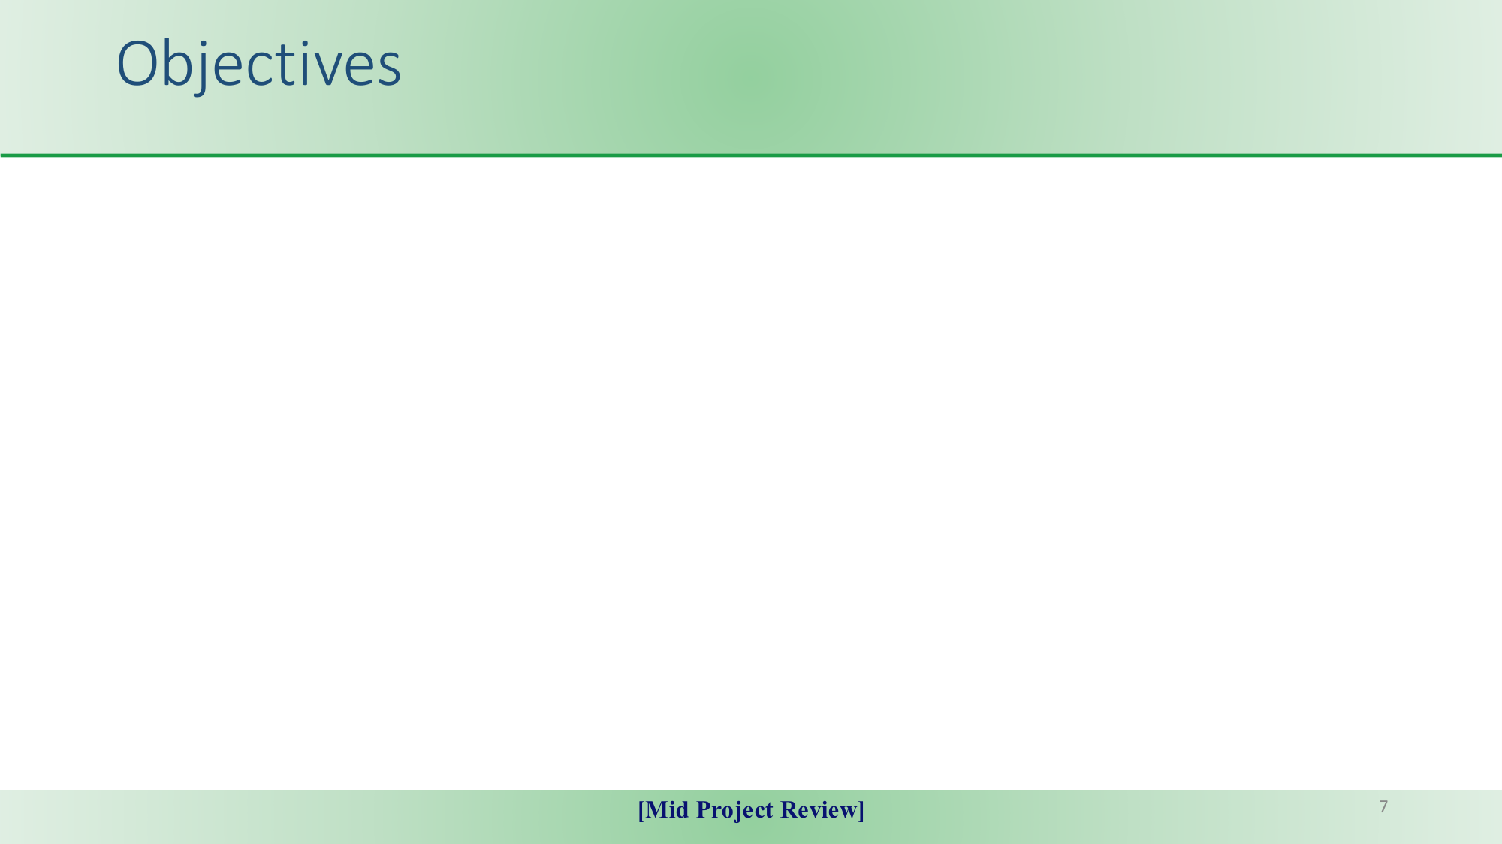
Objective 1: Non-Invasive, Audio-Only Diagnostic Pipeline
Develop an end-to-end framework capable of recognizing Alzheimer's Dementia directly from spontaneous continuous speech without requiring manual or automated text transcripts. [Eliminates ASR transcription errors and cultural linguistic dependencies.]
Objective 2: Extraction of 15 Conversational Timing Biomarkers
Leverage speaker diarization boundaries to quantify cognitive processing latencies, specifically extracting silence ratio (R_sil), hesitation pause latency, and speech-to-silence ratio (gamma_ps). [Directly mirrors neurobiological temporoparietal and hippocampal atrophy.]
Objective 3: Design of Dynamic Multimodal Gated Fusion
Formulate an adaptive probability gating mechanism (w_ac=0.10, w_dp=0.30, w_tm=0.60) with strict in-fold standardization to overcome the 650-dimensional early fusion bottleneck. [Guarantees mathematically rigorous zero-leakage 5-fold cross-validation.]
Objective 4: Dual-Task Continuous Cognitive Profiling
Construct a Multi-Task Deep Neural Network (MultiTaskDNN) that simultaneously solves binary AD classification and regresses continuous Mini-Mental State Examination (MMSE) scores. [Joint objective function: L_total = L_BCE + 0.5 * L_MSE.]
Objective 5: Clinical Explainability via SHAP and LIME
Deconstruct model predictions using game-theoretic SHAP beeswarm feature importance and LIME patient-level local surrogate breakdowns to satisfy clinical transparency standards. [Provides clinicians with interpretable biomarker diagnostic justifications.]

Slide 8
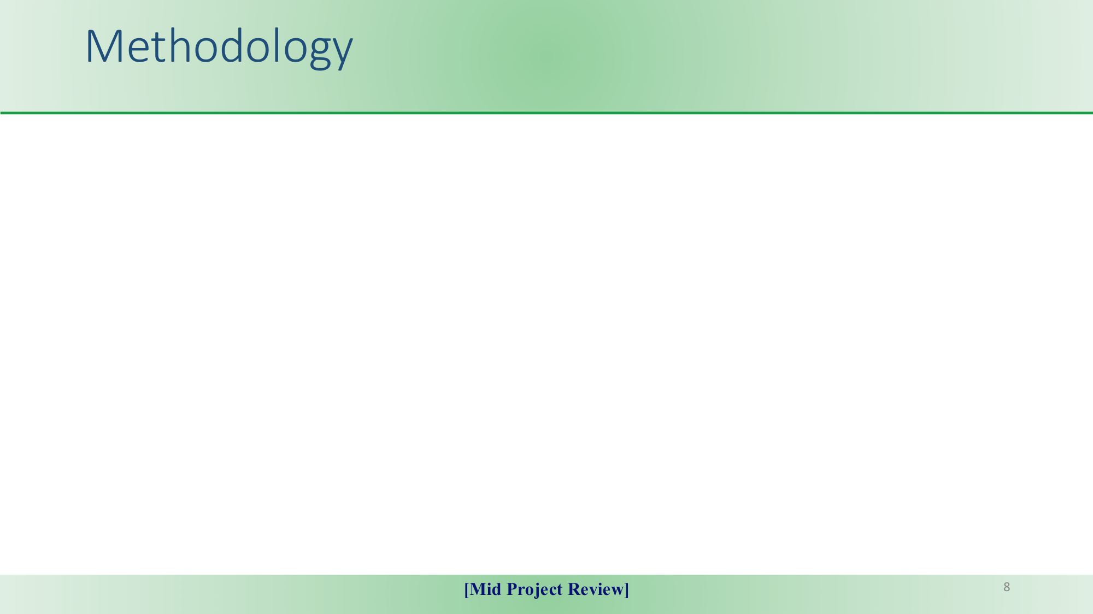
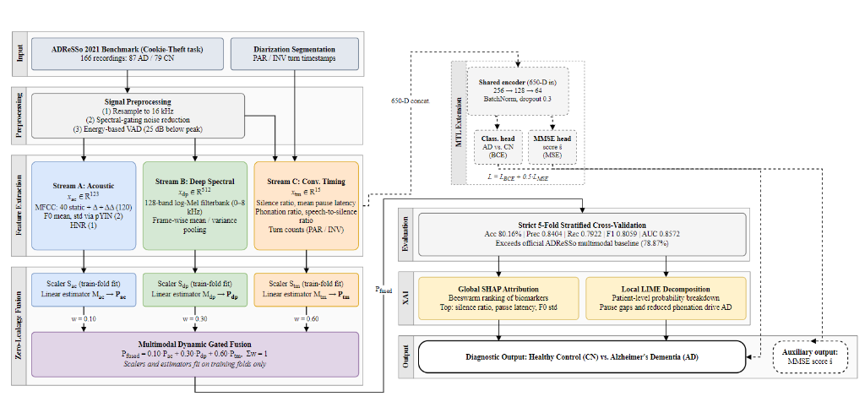
Tri-Stream Feature Processing
• Signal Preprocessing: Resampling to 16 kHz, spectral gating stationary noise reduction, energy VAD (-25 dB threshold).
• Stream 1: Physical Acoustics (123-dim): 120 static + dynamic MFCCs (40+40+40), pitch F0 (mean, std) via pYIN with HMM Viterbi decoding, Harmonics-to-Noise Ratio (HNR).
• Stream 2: Deep Spectral Embeddings (512-dim): 128-band log-Mel filterbank envelope with frame-wise temporal mean and variance pooling.
• Stream 3: Conversational Timing (15-dim): 15 diarization metrics: silence ratio R_sil, hesitation pause latency, phonation ratios R_par/R_inv, speech-to-silence ratio.
• Dynamic Gated Fusion Formulation: P_fused = 0.10*P_ac + 0.30*P_dp + 0.60*P_tm. Standardizers S^(k) fit exclusively on training folds.
• Multi-Task Head: Shared latent representation (256->128->64) branching into AD Classification (BCE) and MMSE Score Regression (MSE).

Slide 9
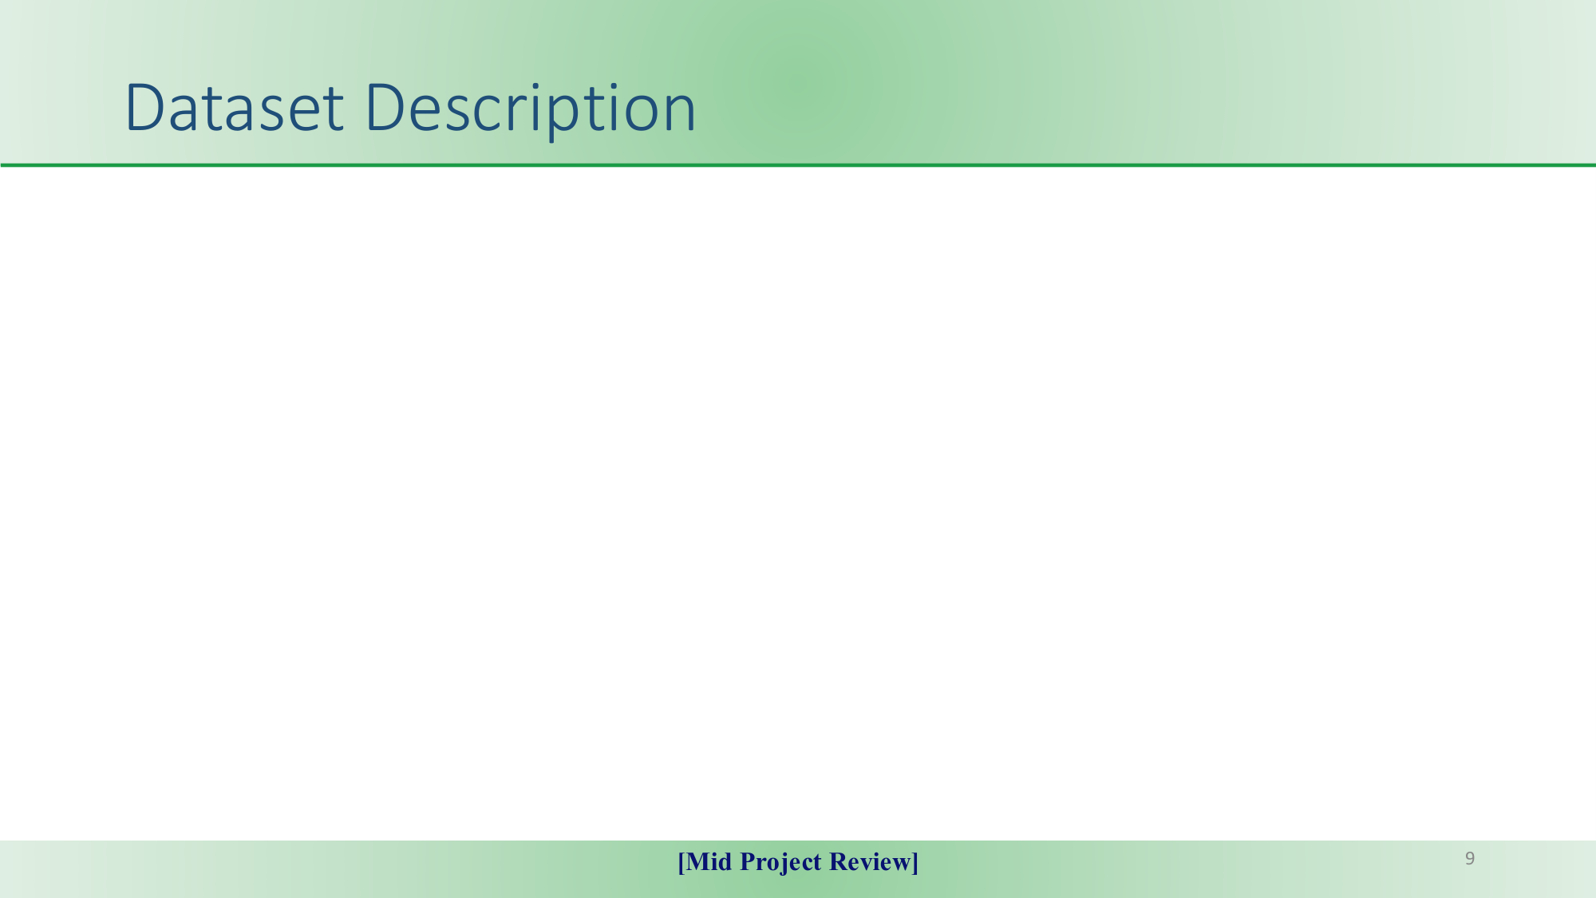
Interspeech 2021 ADReSSo Challenge Corpus
• Standardized benchmark dataset derived from the Boston Cookie Theft picture description task (Boston Diagnostic Aphasia Exam).
• Evaluates spontaneous, unstructured speech under concurrent visual scanning, narrative planning, and lexical retrieval demands.
Diagnostic Corpus (N = 166)
• 87 Alzheimer's Dementia (AD)
• 79 Cognitively Normal (CN)
• Strictly balanced by age and gender to eliminate demographic bias.
• Serves as primary benchmark for 5-fold cross-validation.
Cognitive Progression (N = 73)
• 15 Cognitive Decline cases
• 58 Stable subjects
• Longitudinal spontaneous speech tracking disease worsening over time.
• Evaluates progressive deterioration sensitivity.
Audio Specifications & Diarization
• 44.1 kHz standardized WAV audio.
• Volume-normalized and cleaned.
• Accompanied by turn-taking timestamps demarcating Participant (PAR) vs Investigator (INV).

Slide 10
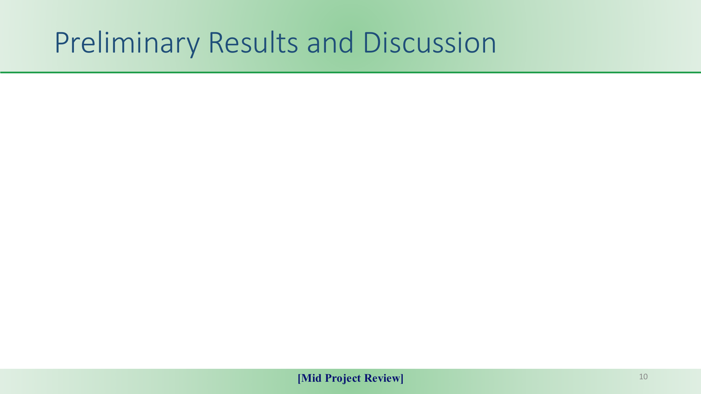
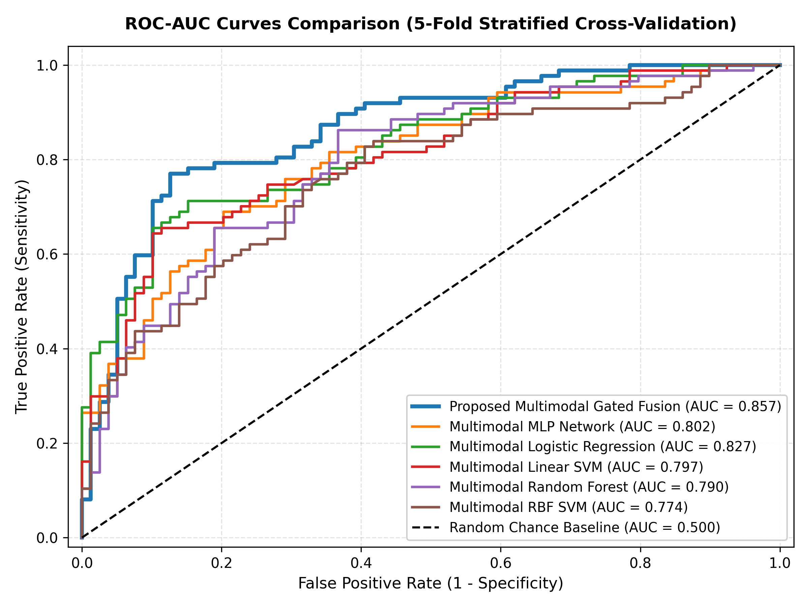
80.16%
Accuracy (+15.06% vs Baseline)
0.8572
ROC-AUC (High Discrimination)
0.8059
F1-Score (Balanced Class F1)
0.840 / 0.792
Precision / Recall (79.2% AD Sensitivity)
Benchmark Comparison Against Published Baselines
System / Model | Features | Accuracy | F1-Score
Acoustic Baseline (IS2021) | eGeMAPS | 65.10% | 0.640
Wav2Vec 2.0 (Papasavvas) | Audio Repr. | 78.20% | 0.779
Official Multimodal (IS2021) | Audio + ASR Text | 78.87% | 0.779
Proposed Gated Fusion | Audio + Timing | 80.16% | 0.806

Slide 11

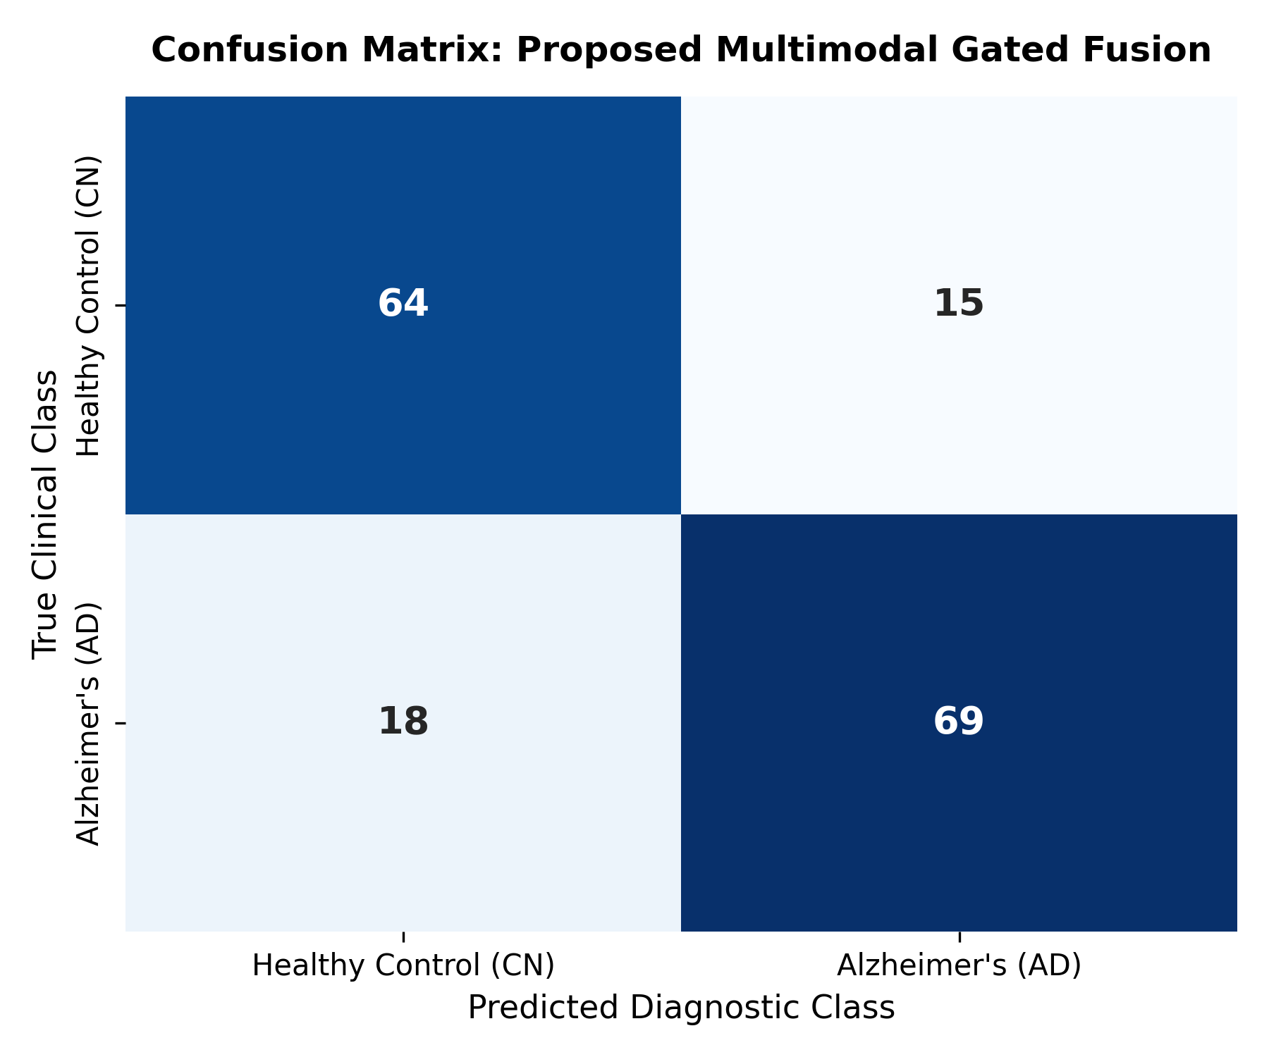
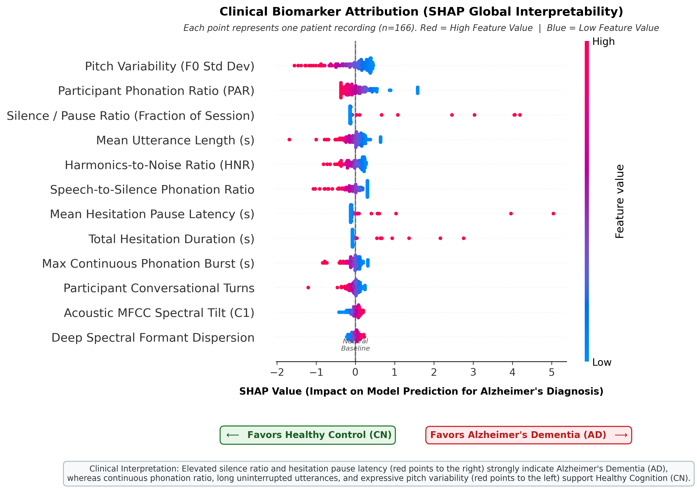
Modality Ablation Study Matrix
Explainable AI (SHAP Beeswarm) & Confusion Matrix
Feature Representation | Accuracy | F1-Score
Acoustics Only (123-dim) | 64.46% | 0.6686
Deep Embeddings (512-dim) | 71.11% | 0.7226
Conversational Timing (15-dim) | 72.35% | 0.7307
Early Concatenation (650-dim) | 73.53% | 0.7373
Proposed Dynamic Gated Fusion | 80.16% | 0.8059
Clinical Error Breakdown (15 FP / 18 FN):
• False Positives (N=15): Driven by visual scanning latencies (2.5s–4.0s picture inspection) and denture vocal noise lowering HNR.
• False Negatives (N=18): Driven by brief 15s descriptions focusing only on obvious center details with preserved motor speech tempo.
Key Clinical Interpretability Findings:
1. Silence Ratio (R_sil): Highest global importance (+0.30 to +0.55 SHAP attribution favoring AD).
2. Pause Latency (tau_pause): Lexical hesitation latency consistently drives dementia predictions.
3. Pitch Flattening (sigma_F0): Monotonous prosody correlates strongly with advanced cognitive decline.

Slide 12
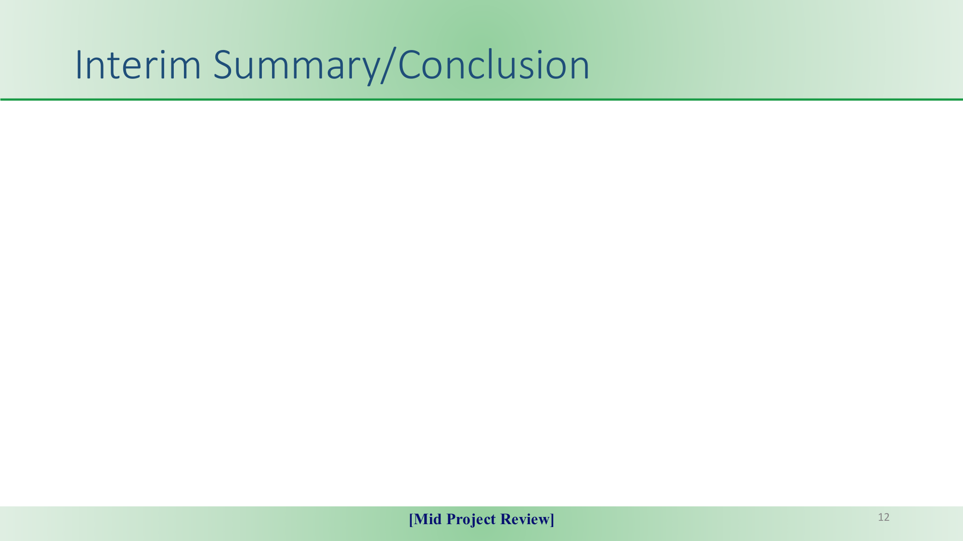
1. State-of-the-Art Audio-Only Performance
The proposed Dynamic Multimodal Gated Fusion achieved 80.16% accuracy, 0.8059 F1-score, and 0.8572 ROC-AUC under rigorous zero-leakage 5-fold cross-validation across all 166 diagnostic sessions.
2. Outperformed Official Text-Dependent Baselines
Surpassed the official IS2021 acoustic baseline (65.10% by +15.06%), fine-tuned Wav2Vec 2.0 (78.20% by +1.96%), and the multimodal benchmark (78.87% by +1.29%) completely without manual text transcripts.
3. Resolved the Early Concatenation Bottleneck
Dynamic probability gating successfully balanced acoustic, deep spectral, and timing dynamics, validating that conversational hesitation patterns carry greater diagnostic weight than raw acoustic descriptors.
4. Clinical Interpretability & Telemedicine Feasibility
SHAP and LIME confirmed that silence ratios and pause latencies drive decisions. The system enables passive, 1-to-2 minute non-invasive screening scalable for primary healthcare and remote smartphone telehealth.

Slide 13
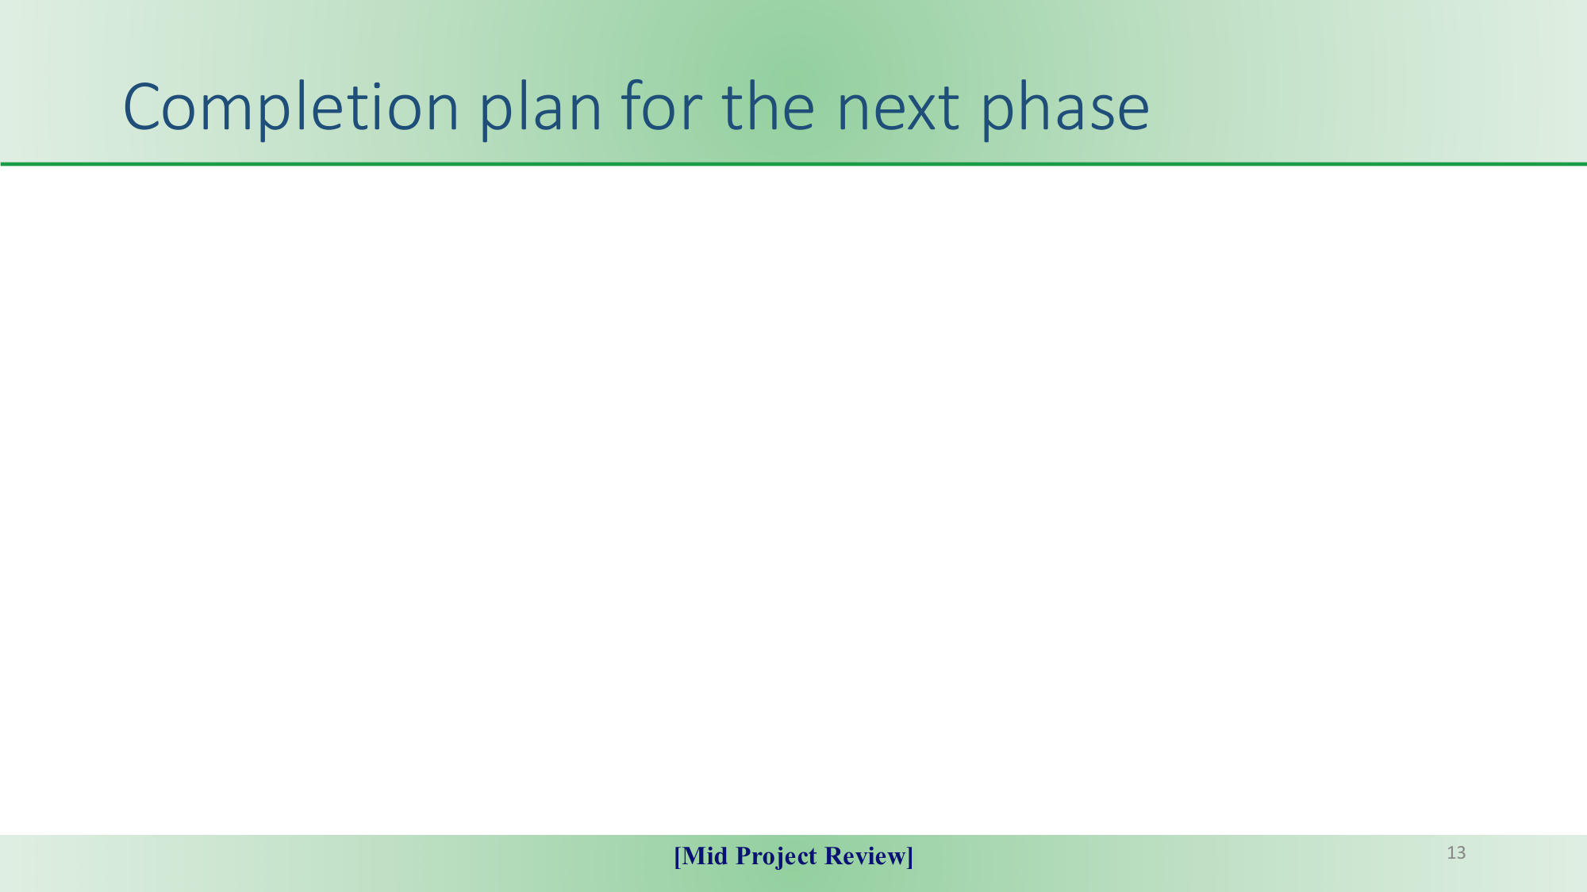
Individual Team Contributions
• Divagar S (CB.SC.U4AIE23223): Overall architecture, Dynamic Gated Fusion formulation, Multi-Task loss, SHAP/LIME clinical interpretability, LaTeX report & Git lead.
• Abhishek Pandey (CB.SC.U4AIE23205): Signal preprocessing (spectral gating & VAD), 512-dim continuous log-Mel filterbank extraction, 15 conversational timing metrics from diarization.
• Prem (CB.SC.U4AIE23241): 123 physical acoustic biomarkers (dynamic MFCCs, pYIN F0, HNR), baseline machine learning benchmarks, modality ablation study, and cohort error analysis.
Deployment Roadmap & Future Directions
✔ Foundation Speech Models: Integrate self-supervised HuBERT and WavLM representations paired with adaptive noise-cancellation front-ends.
✔ Cross-Lingual Generalization: Validate timing and pause metrics on multilingual corpora (Spanish, Mandarin, Tamil) to establish cross-lingual baselines.
✔ Multi-Center Longitudinal Cohorts: Expand evaluations to full DementiaBank Pitt database to assess long-term progression trajectories.
✔ Lightweight Telehealth Edge App: Export quantized ONNX model for real-time passive voice screening on consumer smartphones without cloud transmission.
✔ Clinical Decision Support: Package LIME/SHAP patient explanation summaries into intuitive dashboard reports for memory clinic physicians.

Slide 14
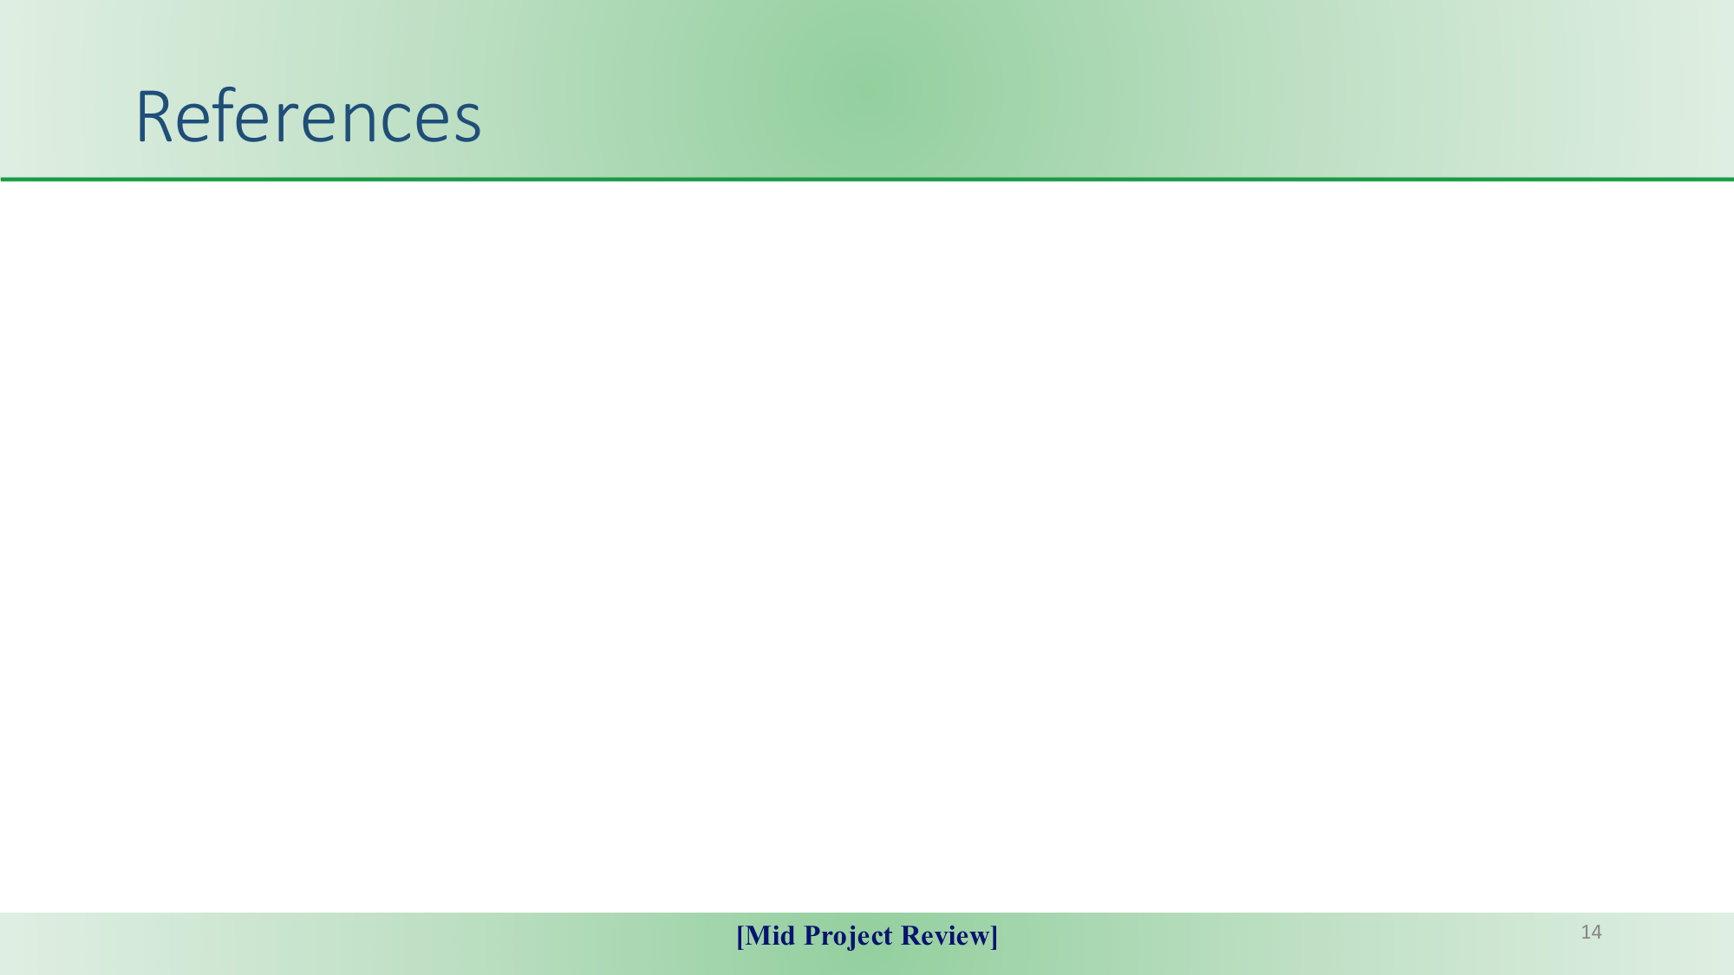
Key Verified Academic Literature (with Working DOIs)
[1] S. Luz et al., "Alzheimer's Dementia Recognition through Spontaneous Speech: The ADReSSo Challenge, " in Proc. Interspeech 2021, pp. 3780–3784. DOI: 10.21437/Interspeech.2021-1220
[2] A. Papasavvas et al., "Detecting Alzheimer's Disease from Spontaneous Speech Using Wav2Vec 2.0 Representations, " in Proc. IEEE ICASSP 2021, pp. 9414–9418. DOI: 10.1109/ICASSP40776.2021.9414545
[3] A. Balagopalan et al., "To BERT or Not to BERT: Comparing Speech and Language-Based Approaches for Alzheimer's Disease Detection, " in Proc. Interspeech 2020, pp. 2167–2171. DOI: 10.21437/Interspeech.2020-2557
[4] F. Haider et al., "An Assessment of Paralinguistic Acoustic Features for Detection of Alzheimer's Dementia in Spontaneous Speech, " IEEE JSTSP, vol. 14, no. 2, pp. 272–281, 2020. DOI: 10.1109/JSTSP.2019.2955022
[5] S. M. Lundberg and S.-I. Lee, "A Unified Approach to Interpreting Model Predictions (SHAP), " in Advances in Neural Information Processing Systems (NeurIPS), vol. 30, pp. 4765–4774, 2017. DOI: 10.48550/arXiv.1705.07874

Slide 15
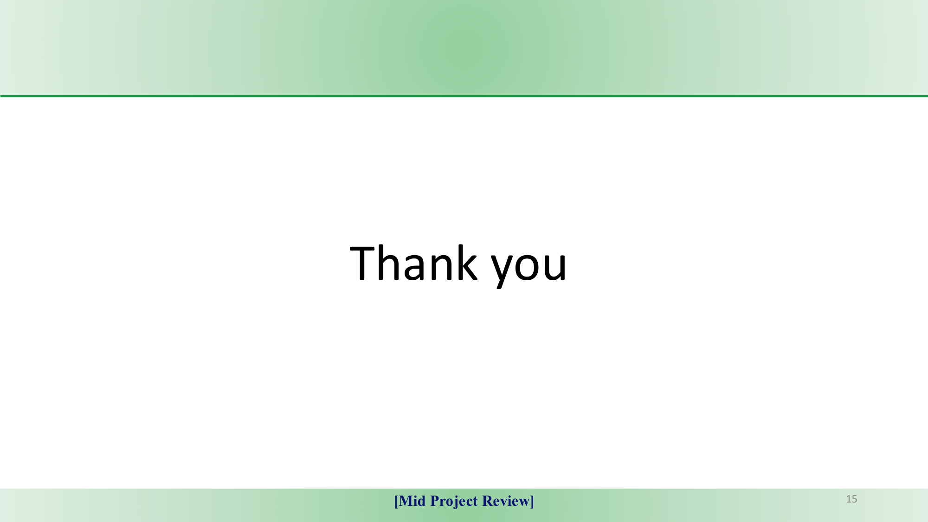
Thank You!
Questions & Discussion
Multimodal Speech Biomarker Fusion for Automated Alzheimer's Dementia Recognition
Department of Artificial Intelligence and Data Science | Amrita Vishwa Vidyapeetham
Team: Divagar S | Abhishek Pandey | Prem
GitHub Repository: https://github.com/divagar127/Alzimer-detection-using-speech-processing

