Slide 1

Digital portfolio
Student Name :S.Divagar
Register No And NmId:astvu20520525u18009
Department :B. Sc. Computer science
College :Indo-american college, cheyyar.
University :Thiruvalluvar university

Slide 2
Project Title :
Digital portfolio Website

Slide 3
Agenda:
1.Problem Statement
2.Project Overview
3.End Users
4.Tools and Technologies
5.Portfolio design and Layout
6.Features and Functionality
7.Results and Screenshots
8.Conclusion
9.Github Link

Slide 4
Problem statement :
In today’s digital world, individuals need a professional
online presence to showcase their skills, achievements,
and projects. Traditional resumes are often limited in
presenting creativity and interactivity.

Slide 5
Project overview :
This project is a personal portfolio website designed to showcase an
individual’s skills, background, and projects in a professional and
interactive way. The website is structured into four main sections —
Home, About, Projects, and Contact — to provide visitors with a
complete understanding of the developer’s profile.

Slide 6
End users:
●Recuiters
●Professor’s
●Clients
●Network people
●The owner of the portfolio
(used to organize thier achievement properly)

Slide 7
Tools And Techniques:
1. HTML5 – For structuring the content of the website.
2. CSS3 – For styling, layout, responsive design, and animations.
3. JavaScript – For interactivity (navbar highlighting, fade-in
effects, smooth scrolling).
4. Text Editor / IDE – (e.g., VS Code, Sublime Text, or Notepad++) for
writing code.
5. Web Browser – (e.g., Chrome, Edge, Firefox) for testing and
running the website.

Slide 8
Potfolio Design And layout :
Section includes home ,about ,project and contact
Home menu contains information about me
About menu containsmy photo and my personal information
Project my portfolio contains2 Project
(digital portfolio and service based
application)
Contact it includes name ,email and
message it wasBuilt using Javascript for dynamic Website.

Slide 9
Features And Functionality :
1. Fixed Navigation Bar – Easy movement between sections.
2. Responsive Design – Works well on mobile, tablet, and desktop.
3. Fade-in Animations – Sections appear smoothly while scrolling.
4. Projects Showcase – Big images with hover effects.
5. Contact Form – Users can send messages directly.

Slide 10
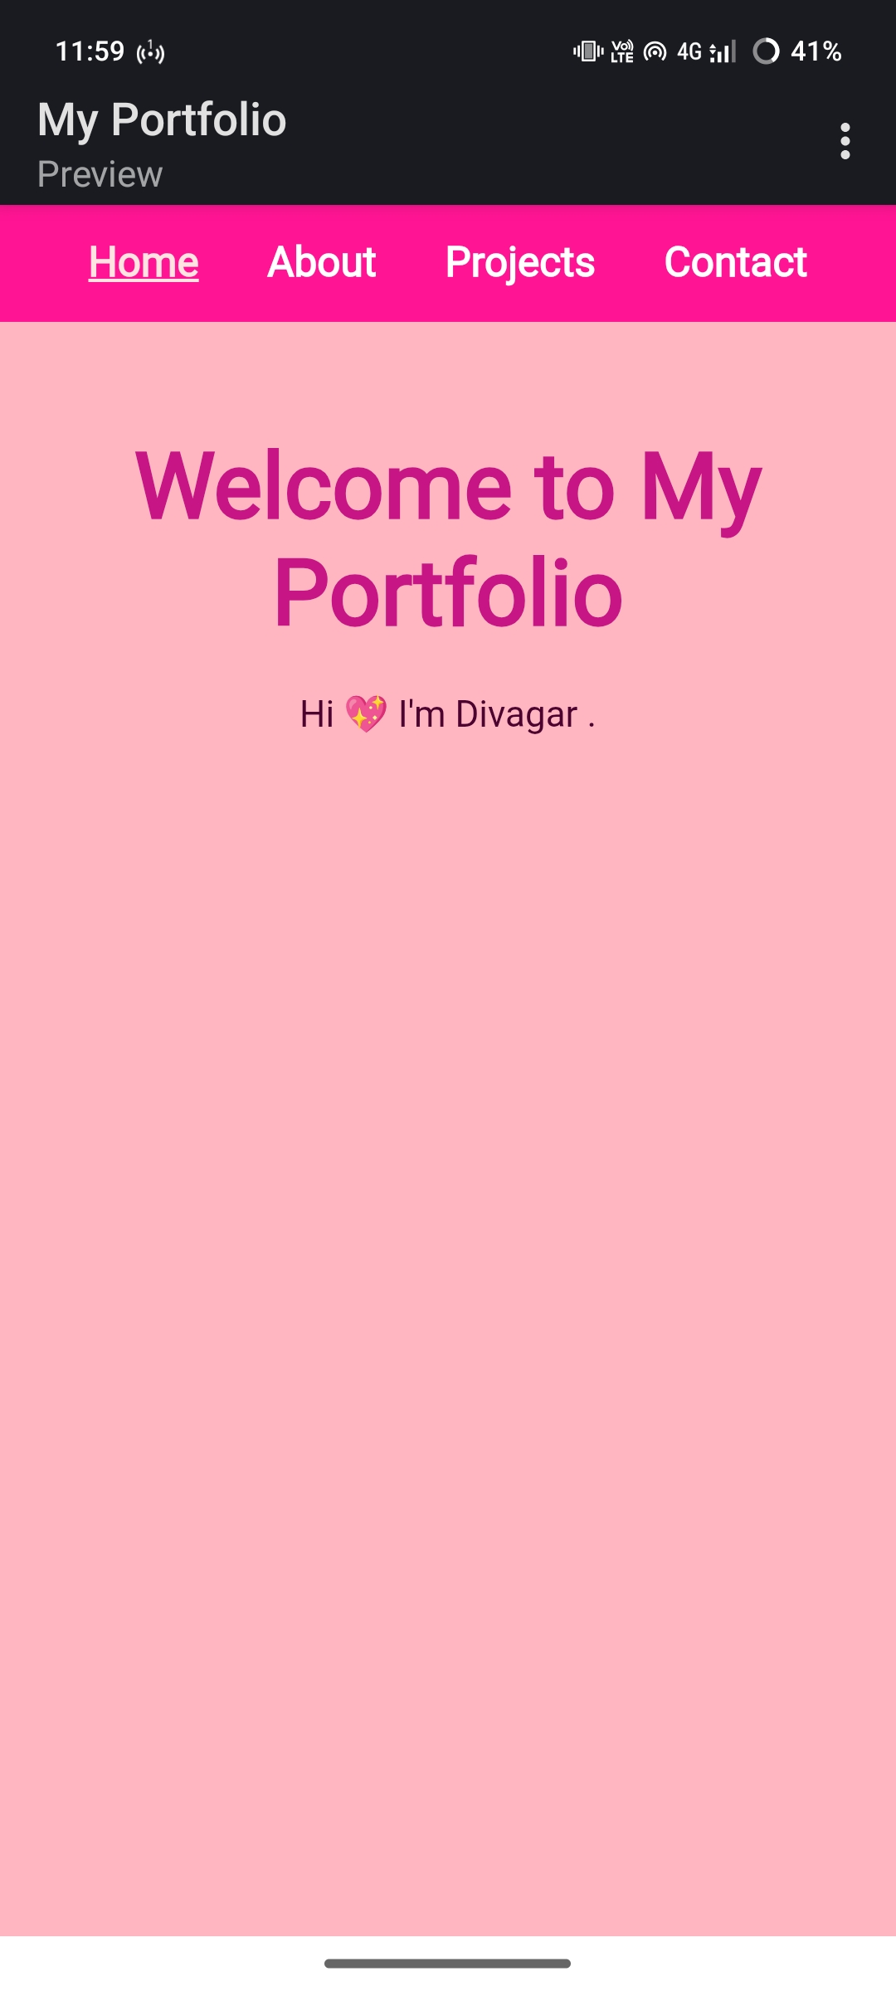
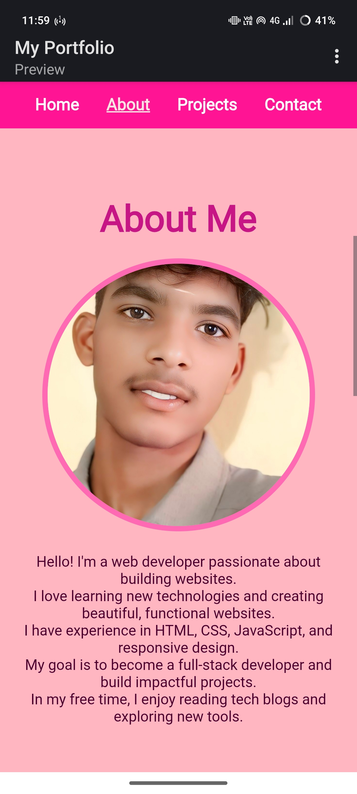
Results And Screenshot :

Slide 11
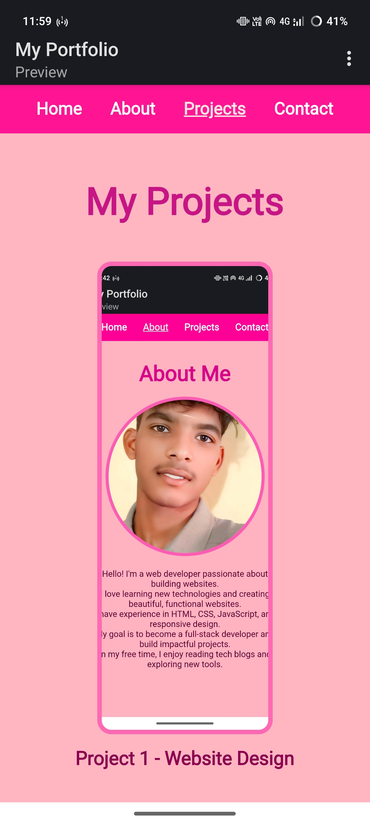
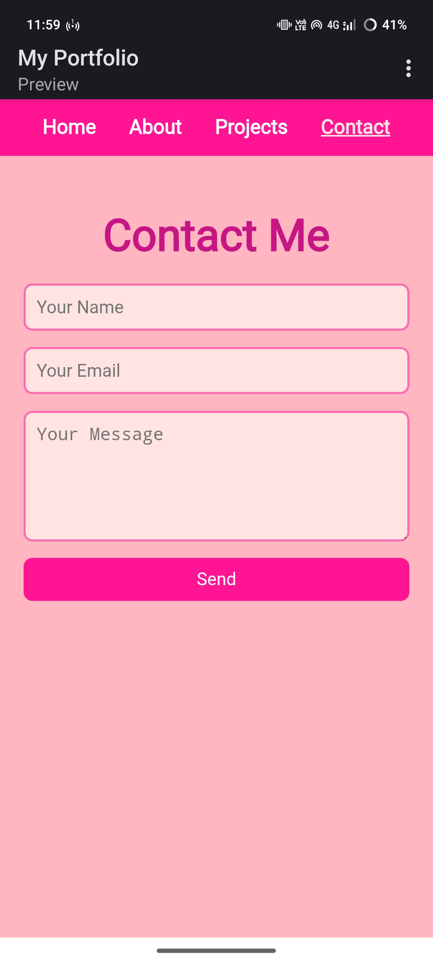
Results And Screenshot :

Slide 12
Conclusion :
Built using HTML,CSS and Javascript.
Clean and userfriendly design.
Responsive layout(Workson mobile phone and desktops)
Organized section (home,about,projects and contact).
Acts as an online resume/portfolio.
Showcases academicPlus technical achie.

