Slide 1

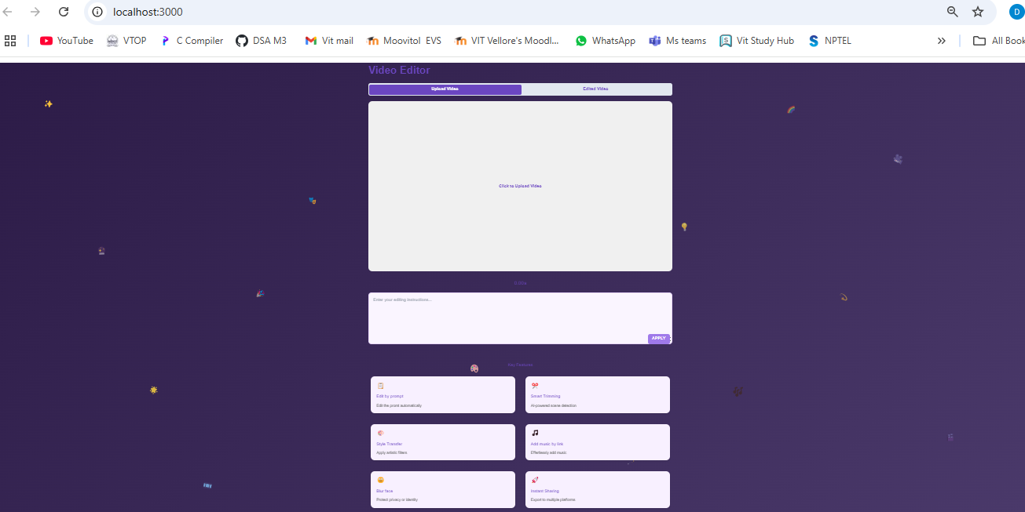
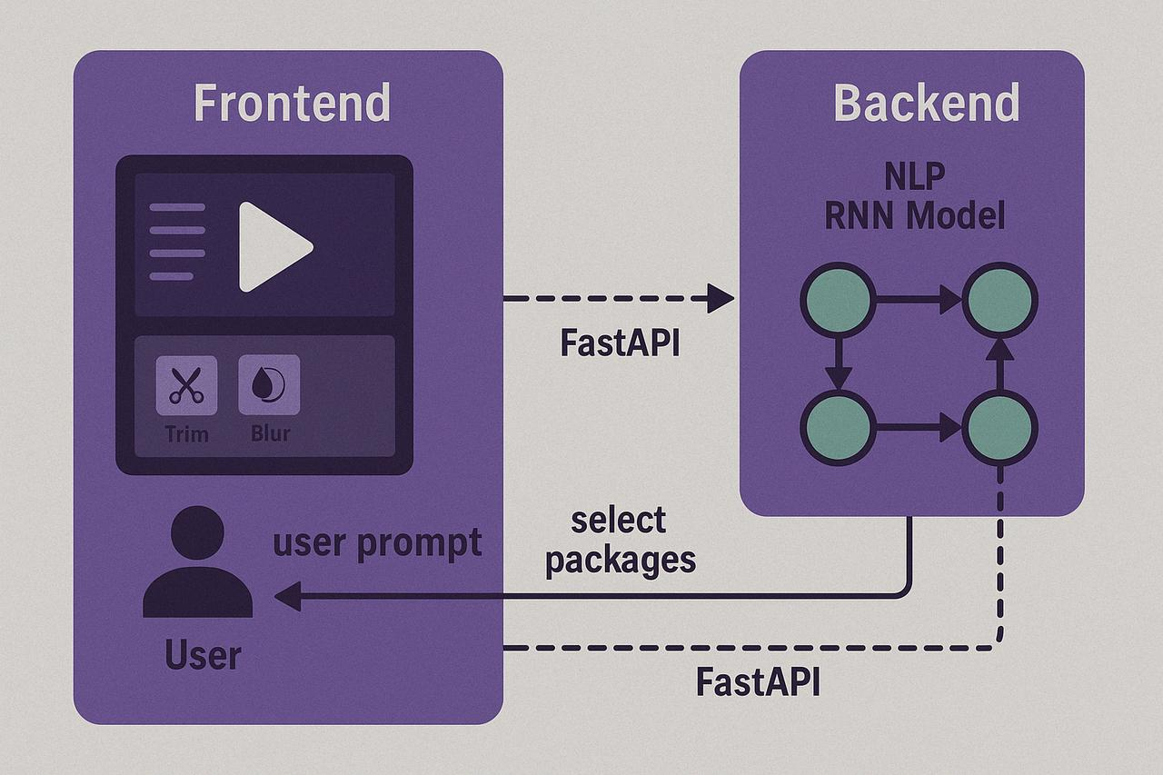
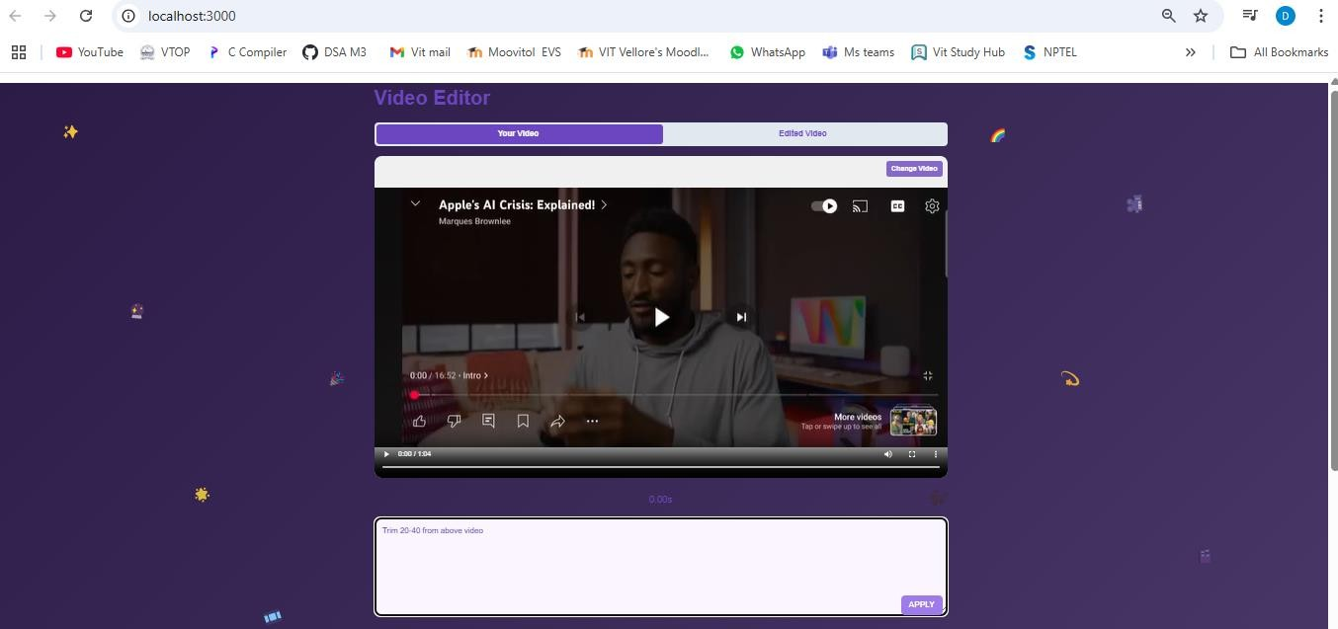
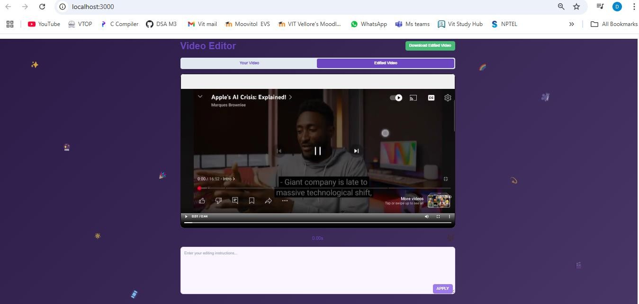
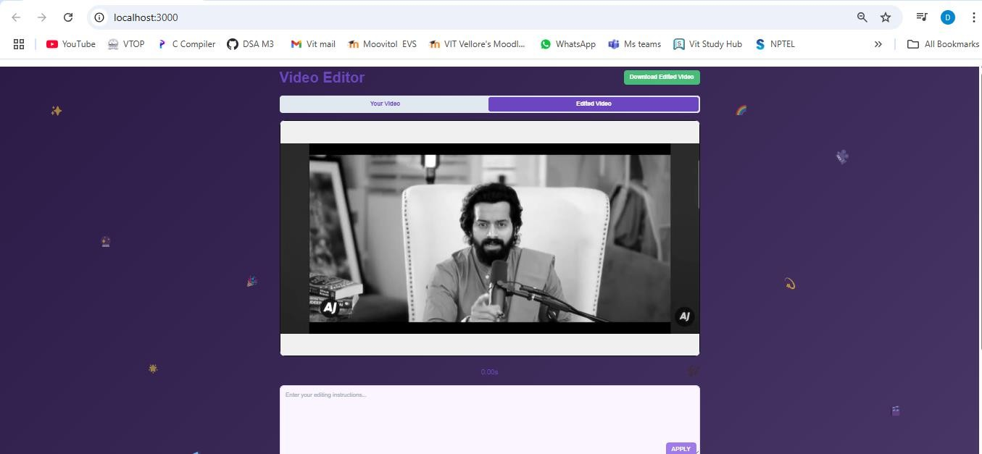
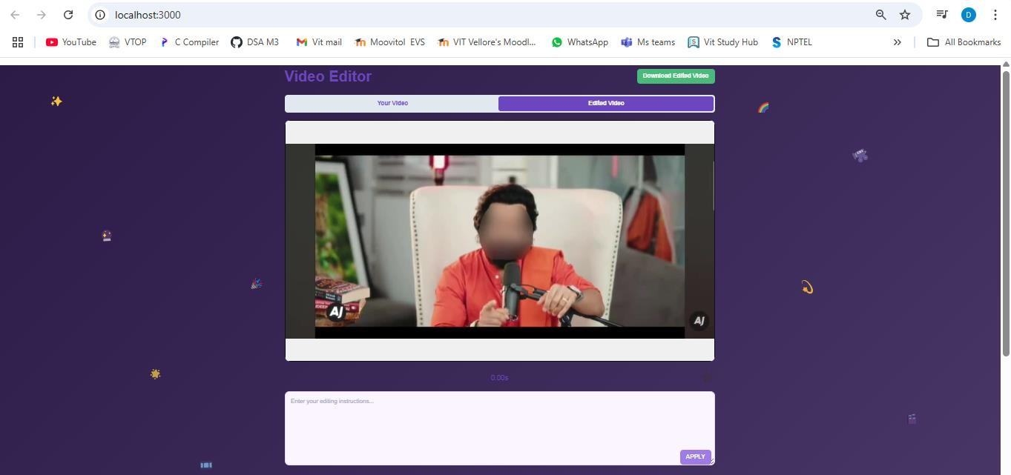
VIDEO EDITING USING ARTIFICIAL INTELLIGENCE
Divakar Reddy G |Gurushrekar M | Dr. Karthik k| School of Computer Science and Engineering
Introduction
Results
In today’s digital era, video content has become one of the most powerful forms of communication, widely used across platforms for entertainment, education, marketing, and social interaction.AI is transforming video editing by automating complex tasks and enhancing creativity. This reduces manual effort and speeds up the production process.
Index Page
H
By using above snapshot by clicking ‘Click to upload video’ we can give any video to index page.
1.Smart Trimming – By providing a specific input, such as trimming the video from 20 to 30 seconds, the system processes the request and outputs the trimmed segment accordingly.
2.Style Transfer - By providing an input such as 'apply black and white filter to the video,' the system processes the request and applies the black and white effect to the entire video accordingly.
3. Add Music By Link - By providing an input, such as a music link, the system processes the request and adds the corresponding audio as background music to the video.
4. Blur Face - By providing an input such as 'blur the face in the video,' the system processes the request and automatically detects and blurs all visible faces in the video.
Motivation
The motivation behind using AI in video editing is to simplify and speed up the editing process while maintaining high quality. Traditional editing can be time-consuming and skill-intensive, whereas AI tools offer automation, precision, and ease of use.
Scope of the Project
The project aims to explore how Artificial Intelligence can automate and enhance video editing tasks. It focuses on features like automatic scene detection and smart transitions. It targets reducing manual work involved in editing while maintaining high-quality output. The tool is designed to be user-friendly, catering to both beginners and professionals. The project will test the model’s ability to adapt to different types of video content. There is also potential to integrate the tool with social media platforms for quick publishing. Overall, the project seeks to make video editing more accessible, intelligent, and time-efficient.
Methodology
The input video is first analyzed using AI to detect scenes, objects, and actions. Based on this analysis, the system generates smart editing suggestions like trimming or transitions. These suggestions are applied automatically to enhance the video with minimal user input. The final output is a professionally edited video ready for viewing or sharing.
Block diagram
• Natural Language Input
Users describe edits in plain English. Example: “Trim the first 5 seconds and blur the face.”
•NLP-Driven Intelligence
An RNN-based model processes the prompt and selects the right editing operations such as trim, blur or enhance.
•Real-Time Backend Processing:
Powered by FastAPI, user prompts are sent from the frontend to backend instantly for seamless performance.
•Auto-Detection Features
AI detects faces, scenes, motion, and lighting conditions for precision-level edits without manual input.
•User-Centric Interface
A clean, intuitive UI allows users to preview, approve, or fine-tune edits — all in one place.
• Future Scope
Plan for integration of generative AI to create missing scenes or effects.
Conclusion
AI-powered video editing revolutionizes traditional workflows by automating complex tasks. It enhances efficiency, accuracy, and creativity while minimizing manual intervention. Through models like NLP and RNN, user prompts are intelligently interpreted. This allows for smart selection of editing tools like trimming, blurring, and transitions. Overall, AI offers scalable, user-friendly solutions that redefine digital content creation.
References
[1]. Wang, T. et al. (2021). “Learning Retargetable Video Representations for Efficient Video Editing.” ICCV.
[2]. S. Kashyap (2024). "AI-Driven Content Creation Tools for Video Editors," International Journal of Digital Media, vol. 12, no. 1, pp. 23-40.

