Slide 1
Video editing using ai
By(BCSE498J)
Name :G. Divakar Reddy(21BCE3417) ,
M. Gurushrekar(21BCE3738)
Under the Guidance of
Dr. Karthik. K

Slide 2
Introduction
Video editing is the process of cutting, arranging, and improving video clips to make them look better and tell a story. Normally, this takes a lot of time and effort. But now, with the help of Artificial Intelligence (AI), video editing has become much easier and faster.
In this project, we use AI to automatically edit videos. AI can help with many tasks like cutting out unwanted parts , improving video quality, adding background noise, and even suggesting the best scenes. This saves a lot of time and helps even beginners create professional-looking videos.
Our goal is to show how AI can make video editing smarter, faster, and more efficient.

Slide 3
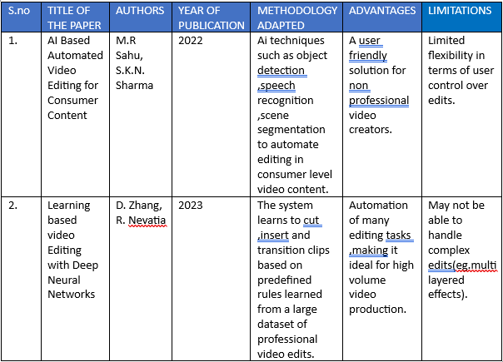
LITERATURE SURVEY

Slide 4
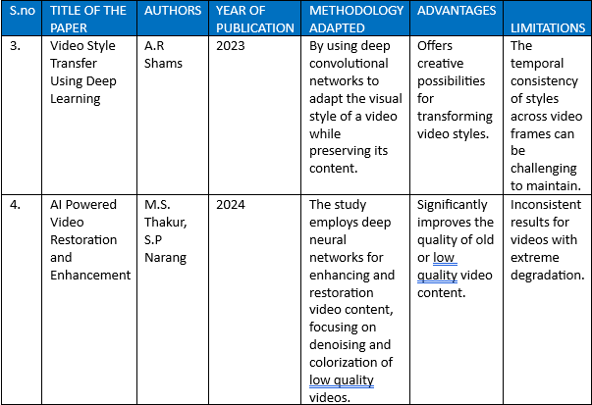

Slide 5
PROBLEM FORMULATION
Traditional video editing is a time-consuming task that involves several manual steps such as selecting the best scenes, trimming unwanted clips, adjusting audio, and adding visual effects. These tasks can be challenging and overwhelming, especially for users who lack professional editing skills. As video content continues to grow in popularity across platforms like YouTube, Instagram, and TikTok, there is a need for a faster and more user-friendly solution.
Scene Detection: One major task in video editing is identifying and separating different scenes. AI can automatically detect scene changes based on visual and audio cues, making it easier to organize and edit video segments.
Highlight Selection: Instead of going through the entire video manually, AI can analyze content to find and extract the most important or interesting parts. This is especially useful for creating summaries, trailers, or highlight reels.
Video Quality Improvement: Low-resolution or poorly lit videos can be improved using AI tools that enhance video resolution, adjust brightness, and improve overall visual quality.

Slide 6
Problem Statement with respect to Software Development Goals
The "Video Editing Using AI" project matches well with important goals in software development, such as automation, better user experience, and using new technology.
First, it helps with automation of repetitive tasks. In software development, one main goal is to save time by letting the software do boring or repeated jobs. This project uses AI to automatically detect scenes, adding background noise and improve video quality. This saves a lot of time and reduces manual work.
Next, it supports improving user experience (UX). Good software should be easy to use. With AI, video editing tools become simpler and more helpful, especially for people who are new to editing. This makes the software more accessible and efficient for everyone.
It also encourages innovation by using AI. Today, software developers try to use the latest technologies. This project combines AI with video editing, adding smart features that traditional editors may not have. It brings new ideas and creativity to the software.
Another goal it meets is scalability and efficiency. AI-based editors can handle a lot of videos at once. This means the software can be used by individuals or big companies and still work well, which is important for growth.

Slide 7
MODULE DESIGN
The system will be structured with both a frontend and a backend to provide a smooth and efficient video editing experience.
For the frontend (user interface), the application will use React.js for web-based apps. The frontend will focus on creating an easy-to-navigate editing dashboard, where users can preview their videos and access various editing options, such as trimming, adding effects, and adjusting colors.
The backend (processing and storage) will rely on Python for the AI models that perform video analysis and editing tasks.
An NLP model using RNNs can understand text prompts like "trim the video" and trigger automated video editing tasks. It uses Python libraries like MoviePy for video editing and Pydub for audio manipulation. The system processes the commands and produces the edited video with the requested effects and adjustments.

Slide 8
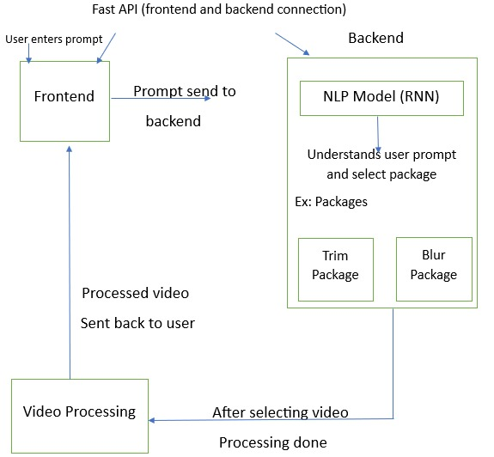
SYSTEM ARCHITECTURE

Slide 9
RESEARCH GAPS
AI in video editing is progressing, but there are still some challenges that need to be addressed. One big issue is that AI struggles to understand the context or meaning behind the events in a video. Another problem is the quality of automated edits. Although AI can handle tasks like cutting scenes or adding transitions, it doesn’t yet match the creativity and professionalism of human editors. Additionally, AI needs to improve at adapting its editing style to suit different types of videos whether they are fast-paced or slow and cinematic. When it comes to creativity, AI is not yet good at making artistic choices, like picking the right music or conveying the right mood. Audio editing is another area where AI struggles, especially when it comes to cleaning up sound or synchronizing audio with video. Real-time video editing, such as during live streams, also presents challenges because AI needs to make decisions quickly. Finally, while AI tools assist editors, they don't truly collaborate with them in a creative way. Improving AI's ability to interact with human editors could lead to a more seamless and creative editing process.

Slide 10
SOFTWARE SPECIFICATIONS
The libraries you mentioned MoviePy, Pygame, Librosa, Pillow (PIL), and OpenCV (cv2)—are essential tools for audio and video manipulation in Python. MoviePy is a versatile video editing library that allows you to cut, concatenate, resize, add effects, and manipulate both video and audio. Pygame, primarily used for game development, also supports video playback, sound mixing, and media manipulation for interactive applications. Librosa is a specialized library for audio analysis and manipulation, perfect for tasks like pitch shifting, tempo changes, and spectral analysis. Pillow (formerly PIL) focuses on image processing and can be used to manipulate video frames, apply filters, resize, crop, and convert image formats. Lastly, OpenCV is a powerful computer vision library, ideal for video analysis, real-time frame manipulation and video capture, making it widely used in video processing. Together, these libraries provide a comprehensive toolkit for multimedia manipulation in Python.

Slide 11
HARDWARE SPECIFICATIONS
For a video editing project using AI, having the right hardware is crucial to handle the demanding tasks involved. A fast processor (CPU), such as an Intel i5 or AMD Ryzen 7, is essential for managing both video editing and AI computations efficiently. A graphics card (GPU) like the Intel Iris Xe is necessary to speed up rendering and boost AI performance, especially for tasks like real-time video processing. RAM (Memory) is also important, as video editing with high-resolution files can be very memory-intensive. A minimum of 8GB of RAM is recommended, with 32GB being ideal for smooth performance. For storage, a solid-state drive (SSD) with at least 512GB is recommended to store video files and software, and adding an extra 1TB of storage will help with larger video files and AI models. A high-resolution display (1080p ) is vital for clear video details during editing, and a larger screen or dual-monitor setup can help improve workflow efficiency. Lastly, since video editing and AI tasks can generate a lot of heat, a cooling system is necessary to prevent the system from overheating during extended use.

Slide 12

RESULTS

Slide 13
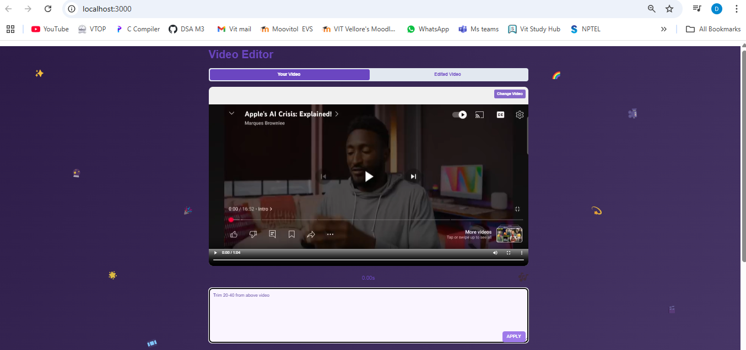
Smart Trimming – By providing a specific input, such as trimming the video from 20 to 30, the system processes the request and outputs the trimmed segment accordingly.

Slide 14
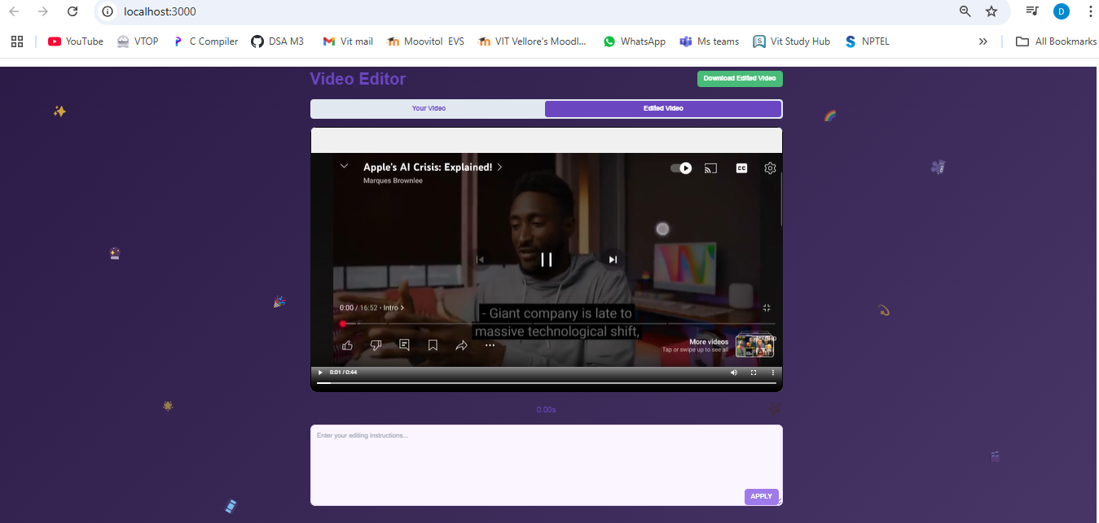
OUTPUT VIDEO

Slide 15
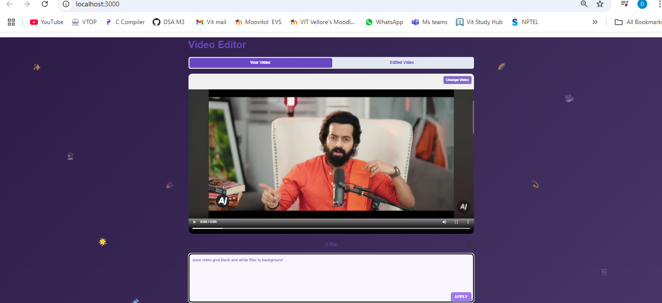
INPUT VIDEO - By providing an input such as 'apply black and white filter to the video,' the system processes the request and applies the black and white effect to the entire video accordingly.

Slide 16
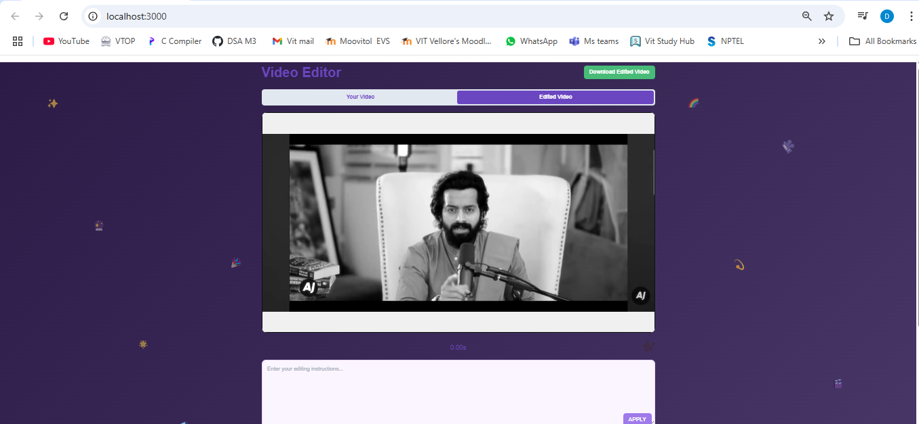
OUTPUT VIDEO

Slide 17
CONCLUSION
In this project, we explored how Artificial Intelligence can be used to make video editing faster, smarter, and more user-friendly. Traditional video editing takes a lot of time and effort, but with the help of AI, many tasks like scene detection and video quality improvement can be automated.
The proposed AI-based system helps both beginners and professionals by simplifying the editing process and producing high-quality results with less manual work. It saves time, reduces the need for advanced skills, and supports the creation of engaging content for education, entertainment, and business.
Overall, this project shows how AI can transform video editing into a more efficient and accessible process, supporting creativity and innovation in the digital world.

Slide 18
Contribution of individual team members
M. Gurushrekar (21BCE3738) – Frontend
G. Divakar Reddy (21BCE3417) - Backend

Slide 19
Impact of the project on society and environment
This project has a positive impact on society by making video editing easier and more accessible. With AI handling most of the work, even people who don’t have editing skills can create quality videos. This is helpful for students, teachers, content creators, small business owners, and influencers, as it allows them to share their ideas more effectively.
In terms of employment and creativity, AI-powered video editing saves time and effort, allowing creators to focus more on being creative and telling their stories. It also opens up new job opportunities in fields like AI, software development, content creation, and digital marketing.
Regarding the environment, AI tools, especially those that run in the cloud, are more energy-efficient compared to traditional editing setups, which require heavy hardware and long hours of work. By automating tasks and reducing the need for re-editing, the system helps save energy and resources, which benefits the environment.

Slide 20

Thank you

